Slide 1
Sentiment Analysis
Web and Social Network Analysis - 07

Slide 2
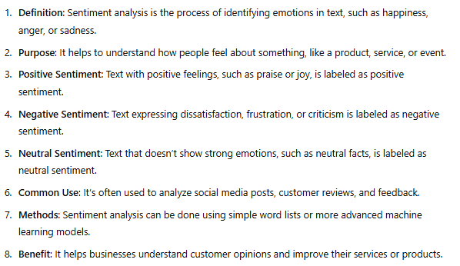
Sentiment analysis

Slide 3
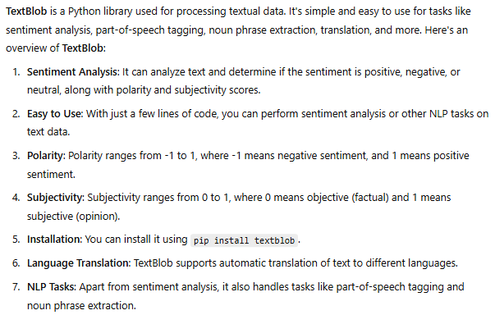
TextBlob

Slide 4
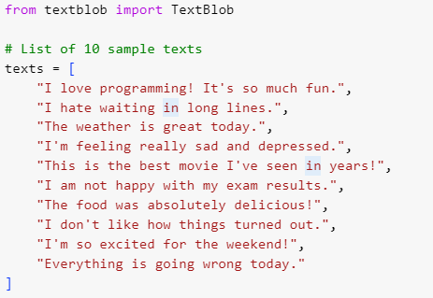


Slide 5
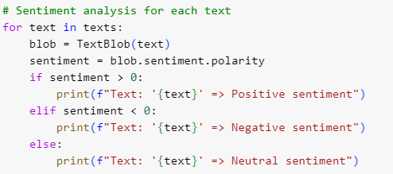


Slide 6

