Slide 1
Web And Social Network Analysis
Unit - 3

Slide 2
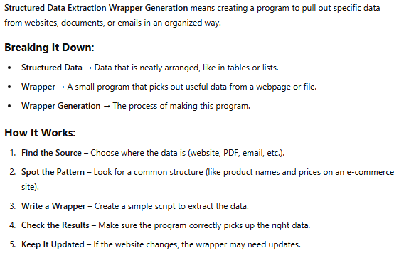

Structured Data Extraction Wrapper Generation

Slide 3
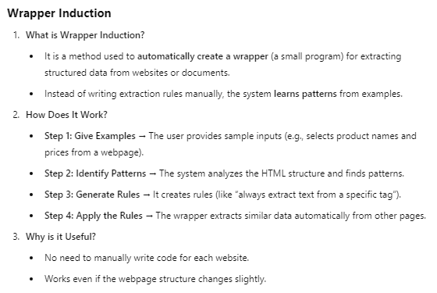
Wrapper Induction

Slide 4
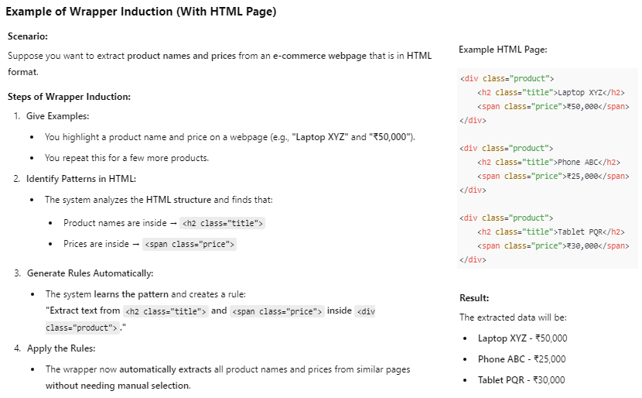

Slide 5
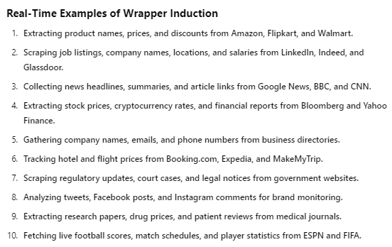

Slide 6
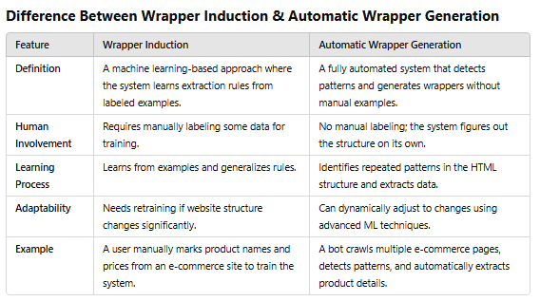

Automatic Wrapper Generation

Slide 7
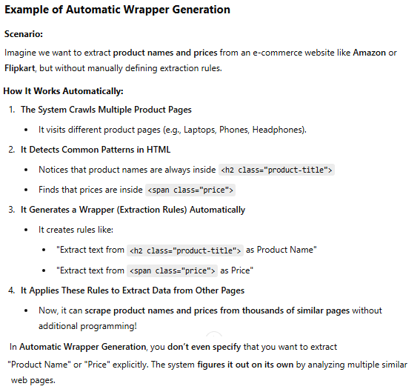
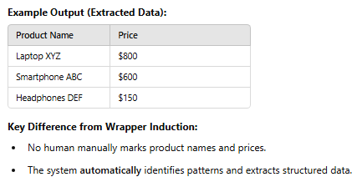

Slide 8
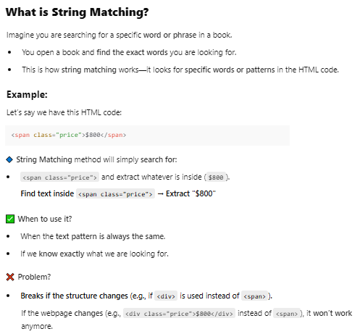
String Matching & Tree Matching

Slide 9
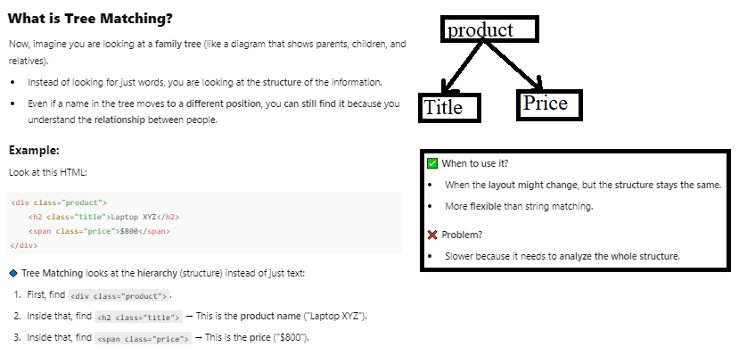

Slide 10
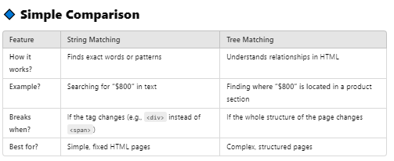


Slide 11
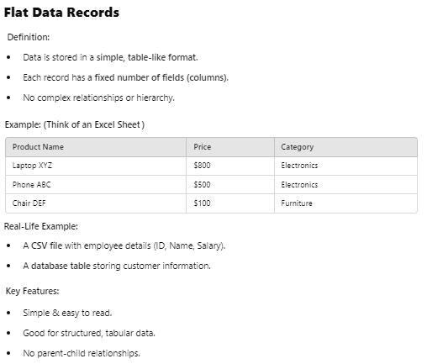
Flat Data Records & Nested Data Records

Slide 12
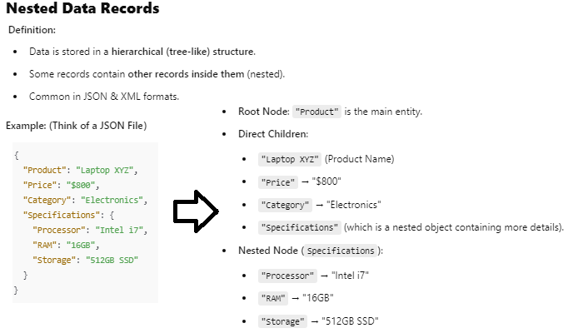
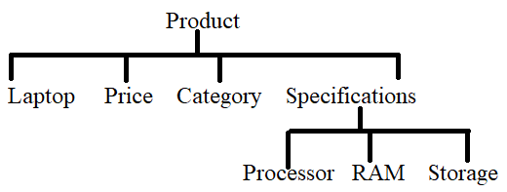

Slide 13
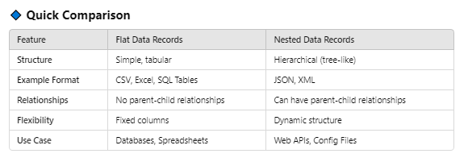


Slide 14
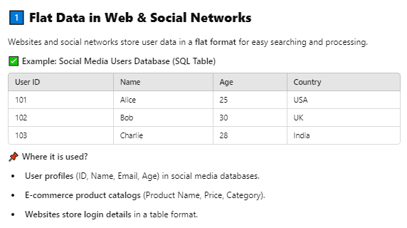

Slide 15
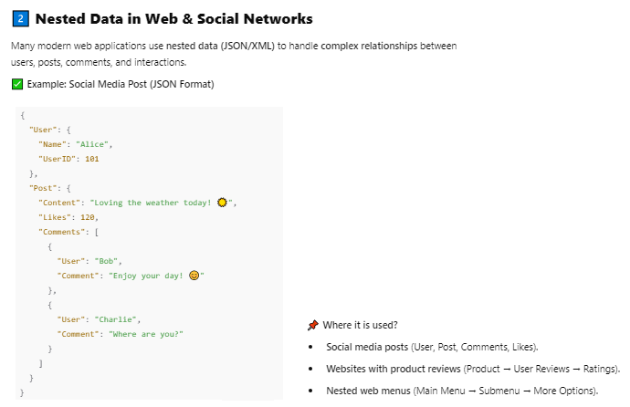

Slide 16



Slide 17
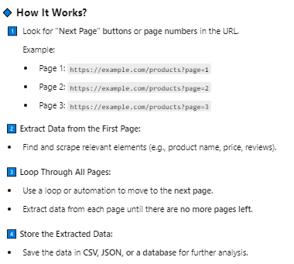
Extraction Based on Multiple Pages
When data is spread across multiple web pages, we need a method to extract information from all pages efficiently. This is commonly used in web scraping when data is paginated (spread over different pages).

Slide 18
