Slide 1
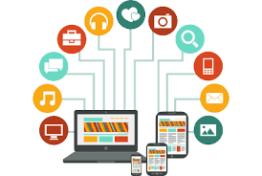

B. Tech Project
ReachMe
By
Pratiksha Suryawanshi | B.Tech CSE – 1 | Roll No 58
Rutuja Damkondwar | B.Tech CSE – 1 | Roll No 14
Under the guidance of
Dr. A. M. Rajurkar
Head of Department
Computer Science and Engineering
MGM’s College of Engineering, Nanded

Slide 2

Agenda
Introduction
Problem Statement
Solution
Key Features
Flow of an App
Technology Stack

Slide 3

Problem Statement
Because of the pandemic, classes shifted to online mode. There is a communication gap between students, teachers, and also classmates. Everyone has to use on average 3-4 apps to stay connected. This wastes a lot of time and also creates a distraction.
Current Problems:
Doubts remain unsolved
Difficult for teachers to connect to every student personally
School's or college's motivational atmosphere is missing
Students don't have an idea about what their peers are doing

Slide 4

Solution
A Social Media Web App that will provide a platform to ease the communication between students, teachers, and mentors by connecting them through a single app.
USPs of App :
Easy doubt asking
Easy for teachers to respond individual student
Helps to maintain the motivational school/college environment

Slide 5
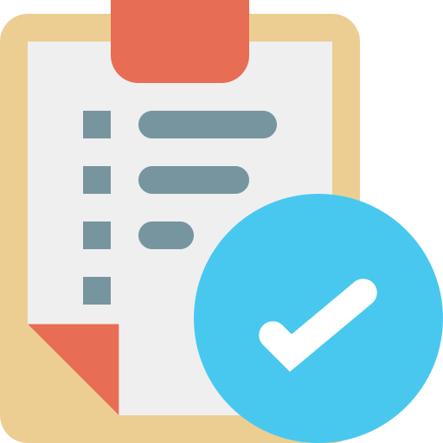



Key Features
Posts
User can post doubts, notices, progress info
Explore
Can see other’s posts, like, and also can comment the solution or suggestion
Search
Can search for particular user’s profile by his/her name
Real Time Notifications
User gets notifications of likes, comments, followers, etc

Slide 6
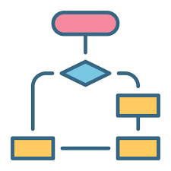





Flow of an App
01
02
03
04
05
Register/Login
Create Profile
Follow your classmates or students
Post your doubts
Get a quick reply from your classmates, teachers or seniors/alumni

Slide 7





Technology Stack
HTML 5 , CSS 3, JS, ES7+
ReactJS 16, React Native, Redux 7.2
ExpressJS, NodeJS
MongoDB

Slide 8

USP :
It will work as an Institutional Quora
Connecting students, teachers, non-teaching staff and alumna through a single app

