Slide 1
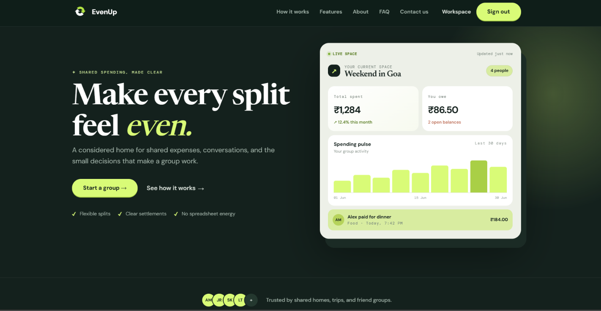
EvenUp
A Smart Shared Expense & Bill-Splitting System
PRESENTED BY:
Pratiksha Rajesh Gaikwad
Roll No. 66010
TY.B.Sc. Computer Science

Slide 2
Why EvenUp?
WHO PAID?
Different members pay for different items.
WAS IT SETTLED?
Chat-based payments may lack a durable record.
WHO OWES?
Not every expense involves everyone.
Manual notes → repeated calculations → confusion
EVENUP'S RESPONSE
A shared, persistent record connecting people, expenses, shares, balances and settlements.
HOW MUCH?
Manual calculations become difficult.

Slide 3
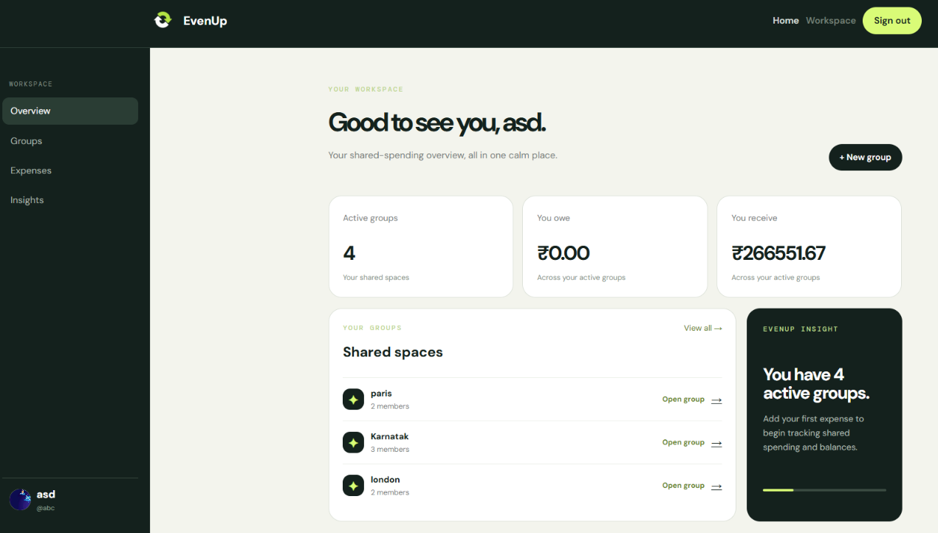
Our Solution:
One platform to record, split, calculate and settle shared expenses.
• User registration & login
• Group creation & members
• Equal / selected-member splitting
• Automatic balances & settlement suggestions
• Expense history & filters
• Insights, messages & reporting

Slide 4
Technology Stack
FRONTEND
HTML • Jinja Templates
• CSS • JavaScript
BACKEND
Python
• Flask
DATABASE
MySQL • mysql-connector-python
AUTHENTICATION
Werkzeug password hashing
•Optional Google OAuth
MODELLING
UML diagrams
ARCHITECTURE
Layered Flask monolith
Browser → Flask + Jinja → MySQL
WHY THIS STACK?
Relational data + server-rendered workflows + suitable academic-scale deployment.

Slide 5
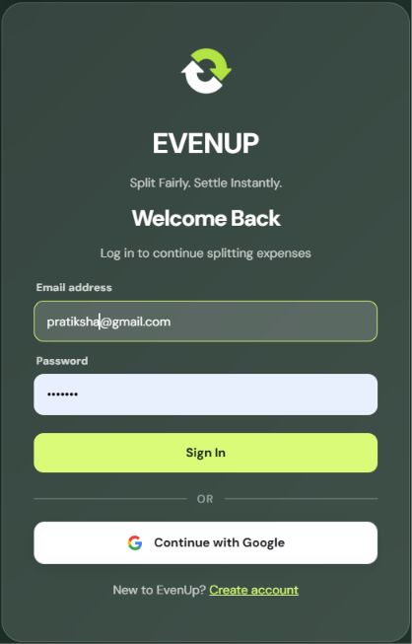
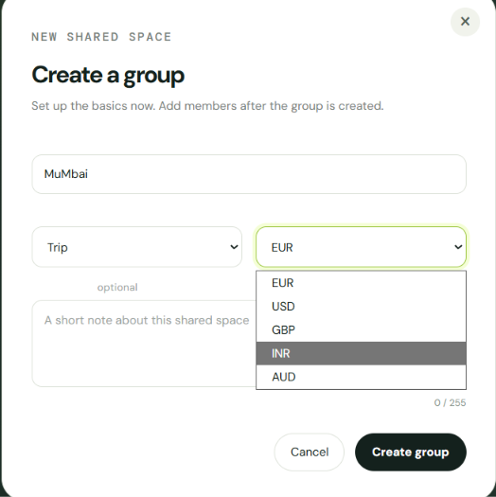
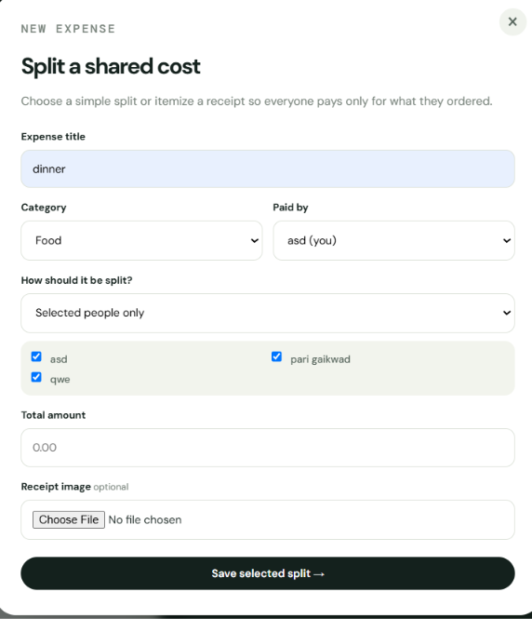
How EvenUp Works
1. Login
2. Create Group
3. Add Members
4. Add Expense
5. Split
6. Calculate
7. Settle

Slide 6
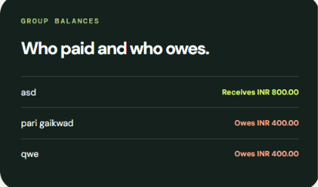
Core Logic : Expense to Settlement
Example: ₹1,200 dinner shared by asd,pari &que
Member | Paid | Share | Balance
asd | ₹1,200 | ₹400 | +₹800
Pari que | ₹0 ₹0 | ₹400 ₹400 | −₹400 −₹400
BALANCE LOGIC
Positive balance → should receive | Negative balance → should pay
SETTLEMENT SUGGESTION
Bob → Alice : ₹600

Slide 7
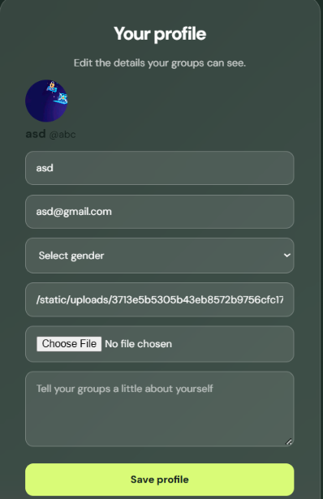
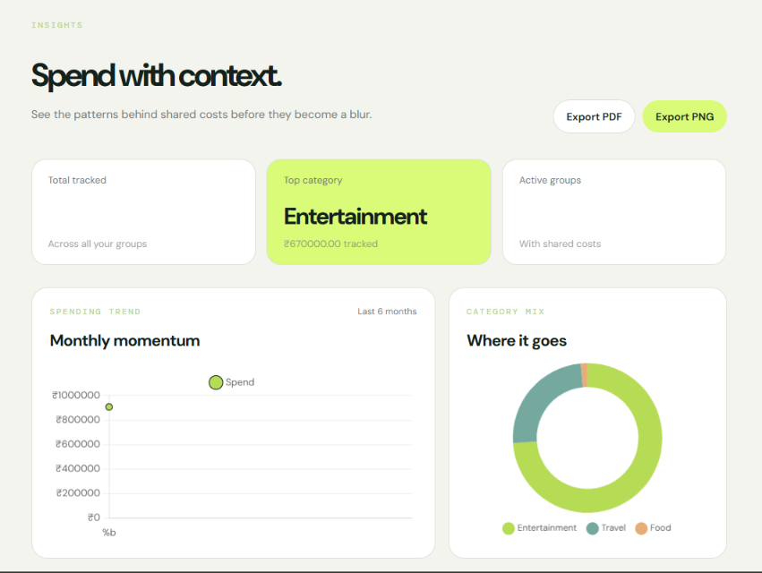
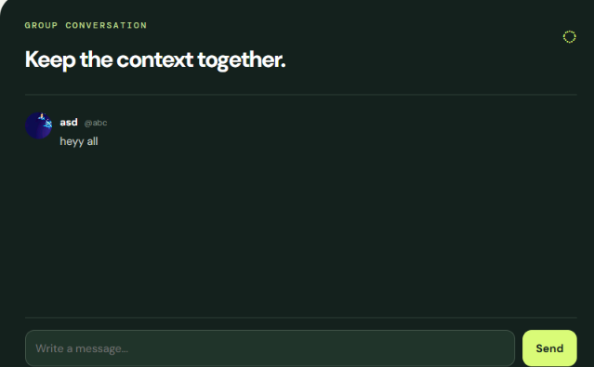
Product Walkthrough -Key Features
THE WEBSITE GOES BEYOND BILL SPLITTING
• Searchable expense history
• Spending insights and trends
• Group communication
• Profile management
• Reporting/export controls

Slide 8
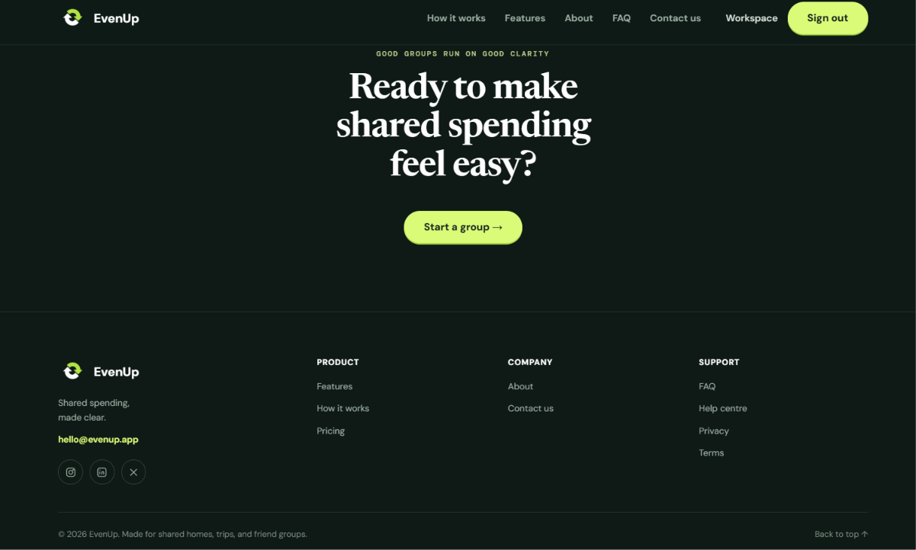
Conclusion & Future Scope
WHAT WE ACHIEVED
✓ Shared expense management
✓ Equal & selected-member splitting
✓ Automatic balances & settlements
✓ Expense history & insights
✓ Group communication & reporting
FUTURE SCOPE
• Multi-currency support
• Receipt attachments
• Notifications & reminders
• Payment gateway integration
• Role-based permissions
• Mobile application
“Split expenses. Clear balances. Better coordination.”

