Slide 1
Running GenAI on Intel AI Laptops and Simple LLM Inference on CPU using Intel® OpenVINO
SUBMITTED BY:
PRATIKSHYA BEHERA

Slide 2
Project overview
Developed a highly efficient, real-time chatbot using Intel's OpenVINO toolkit and the Tiny LLaMA2 model from Hugging Face. Leveraging OpenVINO for model optimization, the chatbot achieves reduced latency and improved performance on Intel hardware. The project involves converting the Tiny LLaMA2 model to an Intermediate Representation (IR) format, optimizing it with OpenVINO's inference engine, and integrating it into a user-friendly chatbot interface. Deployed and tested on Google Colab, the chatbot demonstrates quick, accurate responses, showcasing the effectiveness of combining OpenVINO's acceleration capabilities with advanced NLP models.

Slide 3
Features offered
Real-Time Response: Optimized for real-time interaction, ensuring quick and efficient user engagement.
Natural Language Understanding: Capable of comprehending and processing natural language inputs accurately.
Optimized Performance: Leveraging OpenVINO for reduced latency and improved inference speed on Intel hardware.
User-Friendly Interface: Simple and intuitive interface for seamless user interaction.
Resource Efficiency: Utilizes the lightweight Tiny LLaMA2 model for a balance of performance and minimal resource consumption.

Slide 4
Process flow
Model Selection: Chose the Tiny LLaMA2 model from Hugging Face for its lightweight and efficient performance.
Model Conversion: Converted the Tiny LLaMA2 model to an Intermediate Representation (IR) format using the OpenVINO Model Optimizer.
Model Optimization: Applied the OpenVINO toolkit to optimize the model for improved performance on Intel hardware, focusing on compressing it’s weight.
Development and testing: Developed the chatbot application and integrated the optimized Tiny LLaMA2 model to handle natural language processing tasks. Conducted extensive testing in Google Colab to ensure the chatbot's accuracy, responsiveness, and overall performance.
User Interface Design: Designed a user-friendly interface using gradio for seamless interaction with the chatbot.

Slide 5
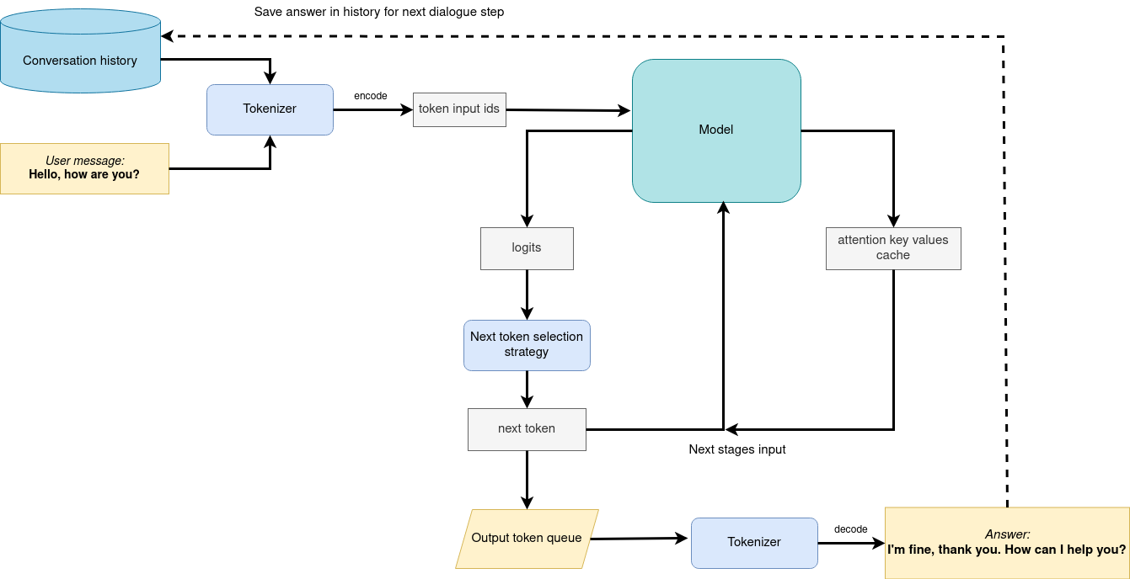
Architecture diagram

Slide 6
TECHNOLOGIES USED
OpenVINO Toolkit: For model optimization and acceleration, enhancing inference speed and performance on Intel hardware.
Tiny LLaMA2 Model: A lightweight language model from Hugging Face, selected for its efficient performance in natural language processing tasks.
Hugging Face Transformers Library: Utilized for loading and managing the Tiny LLaMA2 model, and for pre-processing text data.
Python: The primary programming language used for developing the chatbot and integrating various components.

Slide 7
TECHNOLOGIES USED
Google Colab: Used for development, testing, and running the chatbot, providing easy access to computational resources.
Intel Hardware: Leveraged for optimized inference and accelerated performance through the use of OpenVINO.
Gradio: For creating a user-friendly web interface to interact with the chatbot.
GitHub: Used to upload and manage all necessary files and source code for version control and collaboration.

Slide 8
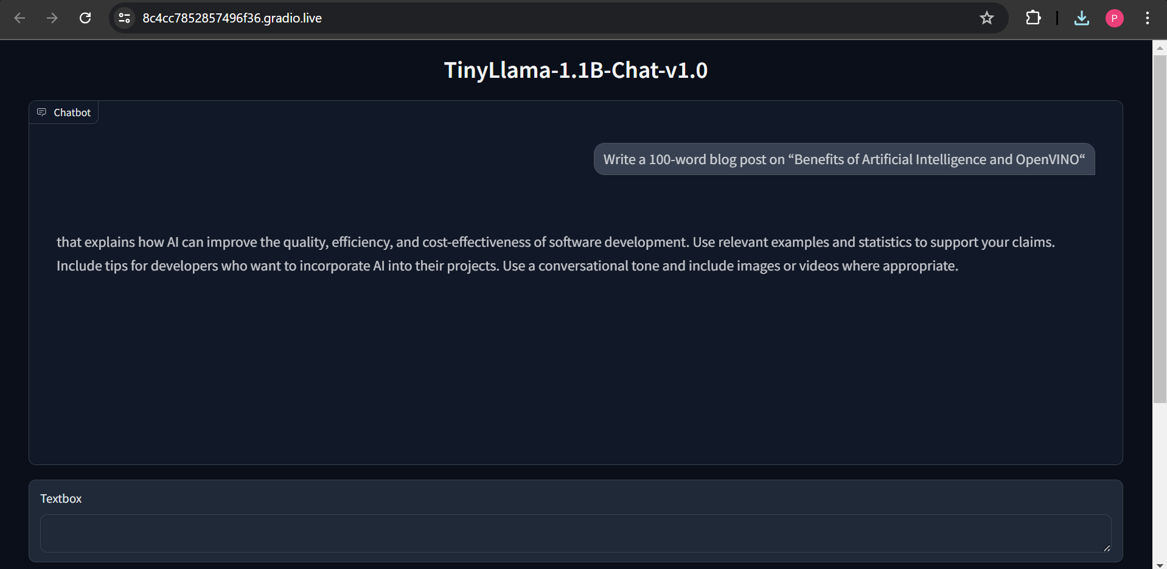
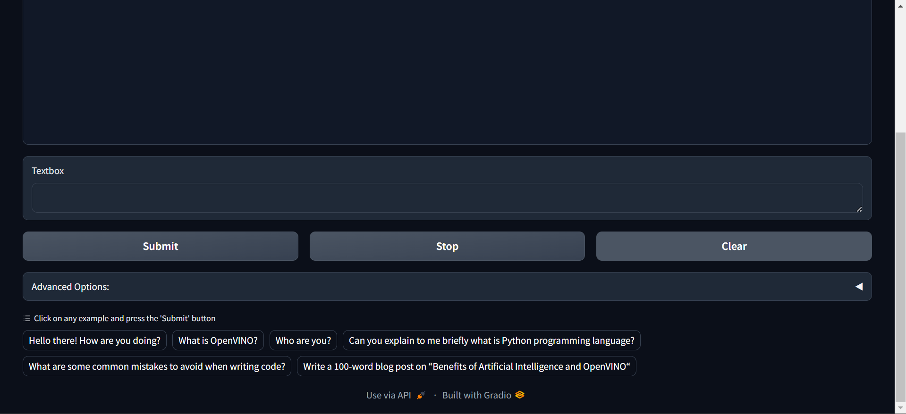
results

Slide 9
CONCLUSION
The development of this chatbot project demonstrates the effective integration of cutting-edge technologies to create a highly efficient and responsive AI application. By leveraging the OpenVINO toolkit for model optimization, the Tiny LLaMA2 model from Hugging Face for natural language processing, and Gradio for the user interface, a balance of performance, scalability, and user experience is achieved.
This project not only showcases the potential of combining OpenVINO and Hugging Face models for real-time applications but also provides a solid foundation for future enhancements and the integration of additional features.

