Slide 1
Automobile Insurance Complaint Dashboard & Business Insights
Client Project: CDACL-001 | Team ID: PTID-CDA-FEB-25-356
Presented by: Suryawanshi Pratik

Slide 2
Aim of the Project
The main objective of this project is to analyze automobile insurance complaint data across multiple companies, understand trends, identify customer pain points, and provide actionable insights to improve service quality and reduce future complaints.

Slide 3
Tools & Technologies Used
Data Source: Automobile Insurance Complaints Dataset
Tools: Power BI, Excel
Techniques: Aggregation, Ratio Analysis, Year-wise Trends, Company Comparisons

Slide 4
What I Did
Cleaned and pre-processed the dataset using Excel
Built interactive Power BI dashboard
Visualized complaint trends and premium data
Compiled summary and insights

Slide 5
Dashboard Overview
Visuals Included:
1. Total Complaints – 23K
2. Upheld – 2.6K | Not Upheld – 13K | Fact- Based – 7K
3. Year-wise and Company-wise complaint distribution
4. Premium and Complaint Ratios

Slide 6
Key Insights
Most Complaints: GEICO General (3K), Allstate (2.6K)
-Least in top 5: GEICO Indemnity (1.4K)
Only 11.4% of complaints upheld
2011 and 2014 saw highest complaint volumes
Premiums rose yearly, but complaints didn't reduce proportionally

Slide 7
Business Inputs to Improve
1. Strengthen Complaint Resolution
2. Monitor High-Complaint Companies
3. Improve Transparency
4. Investigate High-Complaint Years
5. Benchmark Against Low-Complaint Companies
6. Adopt AI/CRM tools

Slide 8
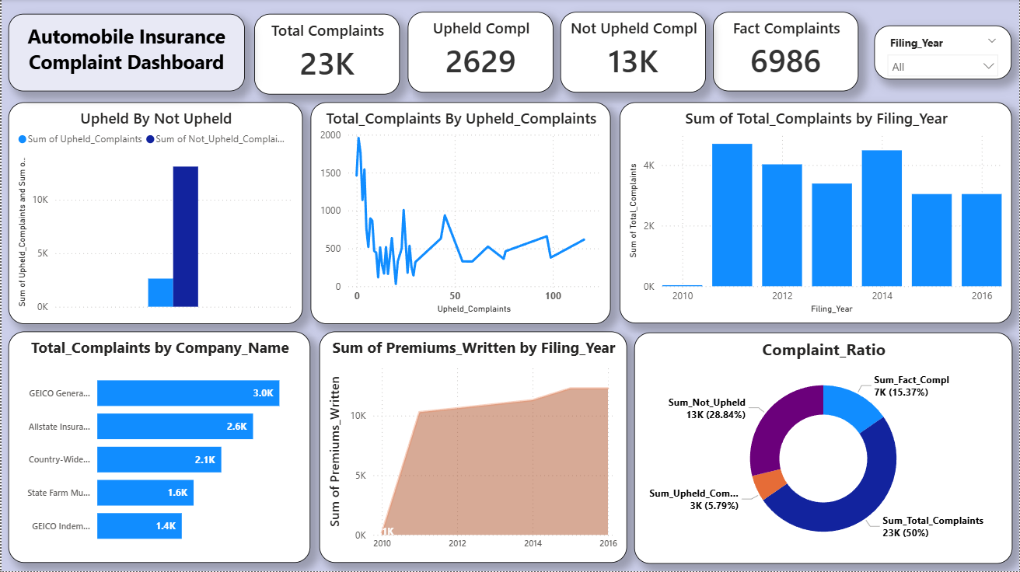
Dashboard

Slide 9
Results
Delivered end-to-end solution from raw data to insights
Built executive-level dashboard
Enabled company-wise performance comparison

Slide 10
Conclusion
The dashboard empowers stakeholders to improve complaint handling, customer satisfaction, and strategic planning. These insights offer a competitive advantage and long-term service quality improvement.

Slide 11
Thank You
Let’s Build Better Services Together!

