Slide 1













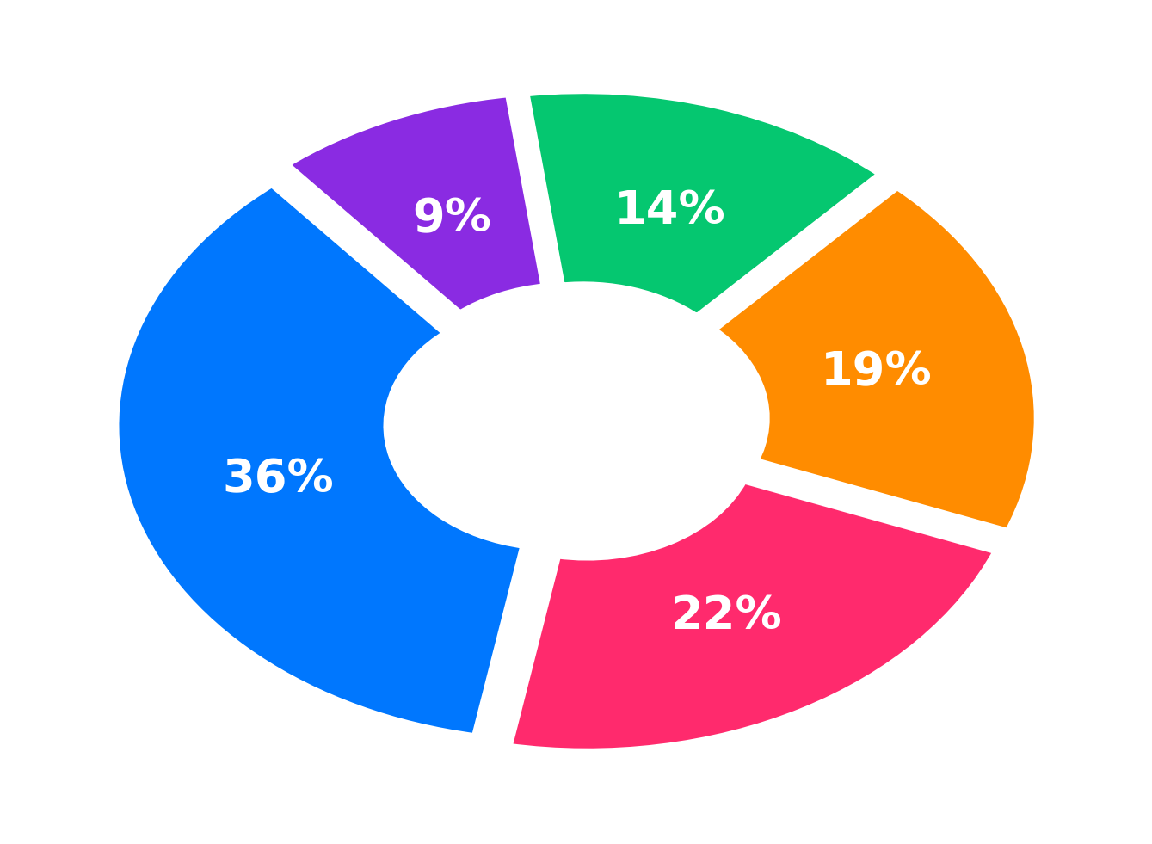








सर्वकर्मक्षमः
FEASIBILITY AND VIABILITY
Financials
Feasibility
Viability
Commission
0% – 5% Fee
Escrow held
Co-op Store
Tool Margin
20-30% Trade cut
B2B AMC
Society Pacts
Fixed contracts
Govt Grants
Welfare Pool
Sahakar funds
Full-Stack PWA + FastAPI built on Next.js 14 & Python. Bypasses 30% App Store cuts; lightweight and offline-cached for low-end ₹6,000 devices.
India's home services market to hit $35B by 2030; over 90%+ unorganized technicians ready for digital formalization.
Zero-cost public infra via OpenStreetMap / OSRM & UIDAI Offline e-KYC/Secure QR, eliminating commercial Google Maps and KYC API billing.
25%–35% higher take-home pay via 0%–5% commission guarantees organic viral retention with ₹0 Customer Acquisition Cost (CAC).
Others: Compliance (9%) ₹35K - ₹40K
Bylaws | Grievance | Audit | Legal
In-process statistical AI engine delivers 30-day demand forecasts locally with zero external GPU or LLM token costs.
Direct National Policy Alignment with Code on Social Security 2020 and Ministry of Cooperation's 'Sahakar Se Samriddhi' framework.
Tech & Security (22%) ₹70K - ₹80K
PWA app | Security audits | Testing
Co-op Onboarding (36%) ₹1.2L - ₹1.4L
Field onboarding | Skill Testing | KYC
Provider Abstraction Architecture allows seamless plug-and-play migration between zero-cost demo mocks and live production gateways.
Self-sustaining Social Security Vaults: automated 1% micro-deductions fund worker health, pension, and insurance with zero fiscal debt.
Verification & SMS (14%) ₹45K - ₹55K
UIDAI QR | 2Factor SMS | SSL APIs
Cloud & DB (19%) ₹60K - ₹75K
Supabase | Render | Redis | CDN
Challenges and Mitigation
Semi-literacy & digital divide among gig workers
Trilingual Voice AI (Hindi, Marathi, English) + 1-click icon dispatch and SMS fallback cuts onboarding friction by 60%.
Doorstep trust & customer safety concerns
100% DigiLocker / Aadhaar KYC + mandatory doorstep 4-digit arrival OTP handshake ensures zero unauthorized visits.
Platform sustainability on low 0%–5% cut
Co-op tool store wholesale margins (20–30% trade discount) and society AMC contracts cross-subsidize digital platform overhead.
Weak rural / Tier-3 internet connectivity
Offline-first PWA caching + lightweight Haversine radius search requires <50KB payload, delivering 2x faster performance on 2G/3G.

