Slide 1
Module:3 chapter:1
Extracting Relations from Text From Word Sequences to Dependency Paths

Slide 2
3.1 Introduction
Extracting semantic relationships between entities mentioned in text documents is an important task in natural language processing.
In this chapter, we present two recent approaches to relation extraction that diﬀer in terms of the kind of linguistic information they use:

Slide 3
In the ﬁrst method, each potential relation is represented implicitly as a vector of features, where each feature corresponds to a word sequence an- chored at the two entities forming the relationship.
In the second approach, the representation is centered on the short- est dependency path between the two entities in the dependency graph of the sentence.

Slide 4
3.2 Subsequence Kernels for Relation Extraction
A sentence matches the rule if and only if it satisﬁes the word constraints in the given order and respects the respective word gaps.
A new method ELCS (Extraction using Longest Common Subsequences) that automatically learns such rules.
ELCS’ rule representation is similar to that in [7, 8], except that it currently does not use POS tags, but allows disjunctions of words.

Slide 5
3.2.1 Capturing Relation Patterns with a String Kernel
It generally does this using one of the following three patterns:
[FB] Fore–Between: words before and between the two entity mentions are simultaneously used to express the relationship. Examples: ‘interaction of <P1> with <P2>‘, ‘activation of <P1> by <P2>‘.
[B] Between: only words between the two entities are essential for asserting the relationship. Examples: ‘<P1> interacts with <P2>‘, ‘<P1> is activated by <P2>‘.
[BA] Between–After: words between and after the two entity mentions are simultaneously used to express the relationship. Examples: ‘<P1> – <P2> complex‘, ‘<P1> and <P2> interact‘.

Slide 6
A Generalized Subsequence Kernel
Let Σ1, Σ2, ..., Σk be some disjoint feature spaces. Following the example in Section 3, Σ1 could be the set of words, Σ2 the set of POS tags, etc.
Let Σ× = Σ1 × Σ2 × ... × Σk be the set of all possible feature vectors, where a feature vector would be associated with each position in a sentence.
Given two feature vectors x, y ∈ Σ×, let c(x, y) denote the number of common features between x and y.

Slide 7
Let Σ∪ = Σ1 ∪ Σ2 ∪ ... ∪ Σk be the set of all possible features. We say that the sequence u ∈ Σ ∗ ∪ is a (sparse) subsequence of s if there is a sequence of |u| indices i such that uk ∈ sik , for all k = 1, |u|. Equivalently, we write u ≺ s[i] as a shorthand for the component-wise ‘∈‘ relationship between u and s[i].

Slide 8
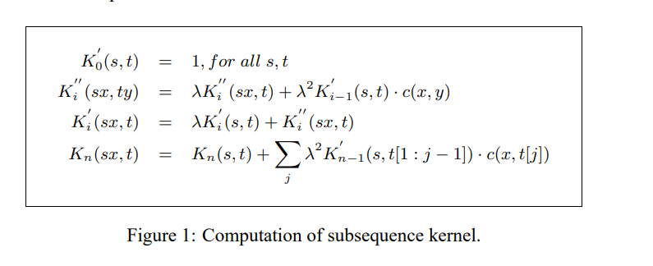

Slide 9
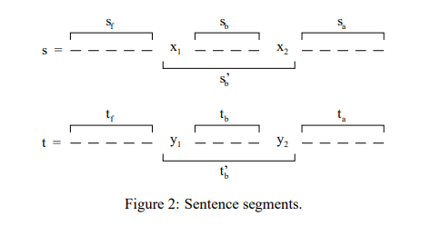
Computing the Relation Kernel:
we show the segments that will be used for computing the relation kernel between two example sentences s and t. In sentence s for instance, x1 and x2 are the two entities, sf is the sentence segment before x1, sb is the segment between x1 and x2, and sa is the sentence segment after x2.
we also include the auxiliary segment s ′ b = x1sbx2, whose span is computed as l(s ′ b ) = l(sb) + 2 (in all length computations, we consider x1 and x2 as contributing one unit only)

Slide 10
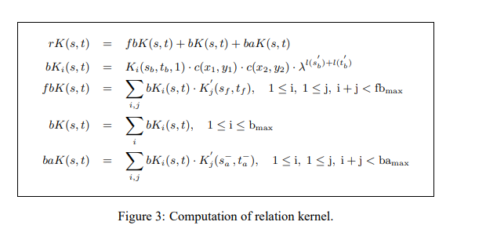

Slide 11
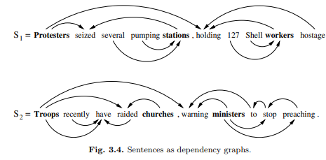
3.3 A Dependency-Path Kernel for Relation Extraction

Slide 12
Word-word dependencies are typically categorized in two classes as follows:
• [Local Dependencies] These correspond to local predicate-argument (or headmodifier) constructions such as ‘troops → raided’, or ‘pumping → stations’.
• [Non-local Dependencies] Long-distance dependencies arise due to various linguistic constructions such as coordination, extraction, raising and control. In Figure 3.4, among non-local dependencies are ‘troops → warning’, or ‘ministers → preaching’.

Slide 13
3.3.1 The Shortest Path Hypothesis
If e1 and e2 are two entities mentioned in the same sentence such that they are observed to be in a relationship R, then the contribution of the sentence dependency graph to establishing the relationship R(e1, e2) is almost exclusively concentrated in the shortest path between e1 and e2 in the undirected version of the dependency graph.

Slide 14
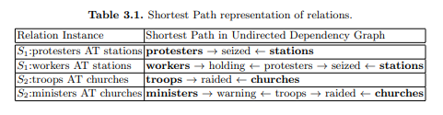

Slide 15
3.3.2 Learning with Dependency Paths
The set of features can then be defined as a Cartesian product over words and word classes, as illustrated in Figure for the dependency path between ‘protesters’ and ‘station’ in sentence S1.
In this representation, sparse or contiguous subsequences of nodes along the lexicalized dependency path (i.e., path fragments) are included as features simply by replacing the rest of the nodes with their corresponding generalizations

Slide 16
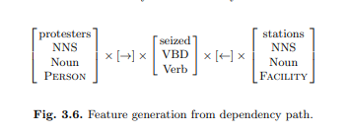
Examples of features generated by Figure 3.6 are “protesters → seized ← stations,”
“Noun → Verb ← Noun,” “Person → seized ← Facility,” or “Person → Verb ← Facility.”

Slide 17
3.4 Experimental Evaluation
The dependency graph that is input to the shortest path dependency kernel is obtained from two different parsers:
• The CCG parser introduced in 2 outputs a list of factor-argument dependencies, from which head-modifier dependencies are obtained using a straight forward procedure
• Head-modifier dependencies can be easily extracted from the full parse output of Collins’ CFG parser in which every non-terminal node is annotated with head information.

Slide 18
3.4.1 Interaction Extraction from AIMed
The following systems are evaluated on the task of retrieving protein interactions from AIMed (assuming gold standard proteins):
• [Manual]: We report the performance of the rule-based system of [7, 8].
• [ELCS]: We report the 10-fold cross-validated results from [9] as a Precision Recall (PR) graph.
• [SSK]: The sub sequence kernel is trained and tested on the same splits as ELCS. In order to have a fair comparison with the other two systems, which use only lexical information, we do not use any word classes here.

Slide 19
[SPK]: This is the shortest path dependency kernel, using the head-modifier dependencies extracted by Collins’ syntactic parser. The kernel is trained and tested on the same 10 splits as ELCS and SSK.

Slide 20
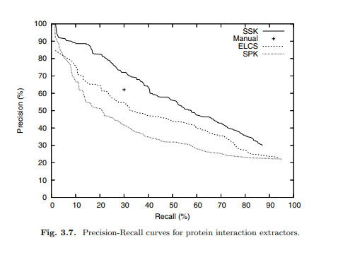
Figure , show that the subsequence kernel outperforms the other three systems, with a substantial gain

Slide 21
3.4.2 Relation Extraction from ACE:
There are five types of entities – Person, Organization, Facility, Location, and Geo-Political Entity – which can participate in five general, top-level relations: Role, Part, Located, Near, and Social.
In total, there are 7,646 intra-sentential relations, of which 6,156 are in the training data and 1,490 in the test data.

Slide 22
Two different scenarios:
– [S1] This is the classic setting: one multi-class SVM is learned to discriminate among the five top-level classes, plus one more class for the no-relation cases.
– [S2] One binary SVM is trained for relation detection, meaning that all positive relation instances are combined into one class.

Slide 23
The shortest-path dependency kernel (SPK) is trained under both scenarios.
To avoid numerical problems, the dependency paths are constrained to pass through at most 10 words (as observed in the training data) by setting the kernel to 0 for longer paths.

Slide 24
Chapter 2
Mining Diagnostic Text Reports by Learning to Annotate Knowledge Roles

Slide 25
4.1 Introduction
Several tasks approached by using text mining techniques, like text categorization, document clustering, or information retrieval, operate on the document level, making use of the so-called bag-of-words model.
The nature of the text mining task as well as the quantity and quality of available text data are other issues that need to be considered.
we present an approach to extracting knowledge from text documents containing diagnostic problem solving situations in a technical domain (i.e., electrical engineering)

Slide 26
Several processing steps were required to achieve the goal of case annotation. In particular, we had to
(a) transform the documents into an XML format,
(b) extract paragraphs belonging to cases,
(c) perform part-of-speech tagging,
(d) perform syntactical parsing,
(e) transform the results into XML representation for
manual annotation,
(f) construct features for the learning algorithm, and
(g) implement an active learning strategy.

Slide 27
4.2 Domain Knowledge and Knowledge Roles
4.2.1 Domain Knowledge: Our domain of interest is predictive maintenance in the field of power engineering, more specifically, the maintenance of insulation systems of high-voltage rotating electrical machines.
In the domain of predictive maintenance, two parties are involved: the service provider (the company that has the know-how to perform diagnostic procedures and recommend predictive maintenance actions) and the customer (the operator of the machine).

Slide 28
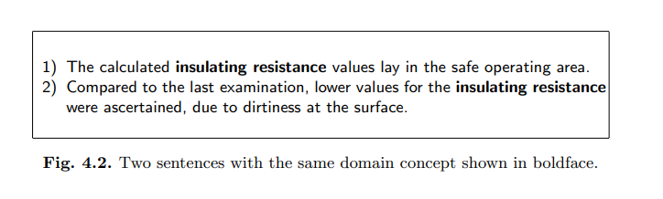
4.2.2 Domain Concepts
In some text mining applications, such as text categorization or information retrieval, the goal is often to discover terms specific to the domain that could be used as indices for organizing or retrieving information.
Example:

Slide 29
4.2.3 Knowledge Roles Knowledge: roles are a concept introduced in CommonKADS , a knowledge engineering methodology for implementing knowledge-based systems. More specifically, knowledge roles are abstract names that refer to the role a domain concept plays when reasoning about a knowledge task.
for example, diagnosis, assessment, monitoring, or planning. Although these tasks are found in many domains, their description in CommonKADS is domain-independent..

Slide 30
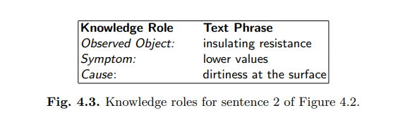
one might write a query as below:
[low | small | high | large] && [value] && [insulating resistance]
for retrieving symptoms Or one can search for:
[due to] | [caused by] | [as a result of] ...

Slide 31
4.3 Frame Semantics and Semantic Role Labeling
4.3.1 Frame Semantics: a frame is a “script-like conceptual structure that describes a particular type of situation, object, or event and the participants involved in it”.
The structure of a frame contains lexical units (pairs of a word with its meaning), frame elements (semantic roles played by different syntactic dependents), as well as annotated sentences for all lexical units that evoke the frame

Slide 32
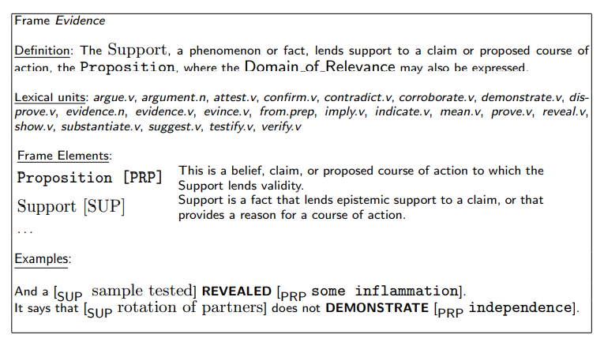
An example of a frame with its related components is shown in Figure

Slide 33
4.3.2 Semantic Role Labeling:
In this work, after acknowledging the success of information extraction systems that try to fill in domain specific frame-and-slot templates the need for semantic frames that can capture the meaning of text independently of the domain was expressed.
SRL systems usually divide sentences word-by-word or phrase-by-phrase and for each of these instances calculate many features creating a feature vector.

Slide 34
The feature vectors are then fed to supervised classifiers, such as support vector machines, maximum entropy, or memory-based learners.
While adapting such classifiers to perform better on this task could bring some improvement, better results can be achieved by constructing informative features for learning.

Slide 35
4.3.3 Frames and Roles for Annotating Cases
When knowledge related to a knowledge task (like diagnosis) is represented by natural language, it is reasonable to expect that some knowledge roles will map to some semantic roles.
A knowledge task like diagnosis or monitoring is not equivalent to a semantic frame. The former are more complex and abstract, and can usually be divided into several components, which in turn can be regarded equivalent to semantic frames.

Slide 36
4.3.4 Information Extraction: Information extraction (IE), often regarded as a restricted form of natural language understanding, predates research in text mining, although today, IE is seen as one of the techniques contributing to text mining.
Actually, the purpose of IE is very similar to what we are trying to achieve with role annotation

Slide 37
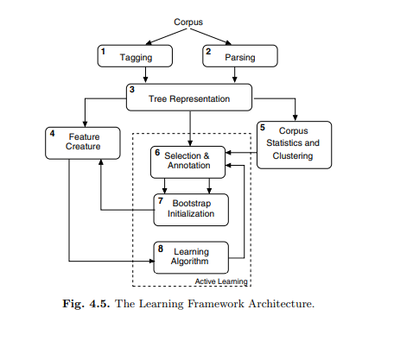
4.4 Learning to Annotate Cases with Knowledge Roles

Slide 38
4.4.1 Document Preparation
It was mentioned that our documents are official diagnostic reports hierarchically structured in several sections and subsections, written by using MSR Word. Actually, extracting text from such documents, while preserving the content structure, is a difficult task. In completing it we were fortunate twice.
First, with MSR Office 2003 the XML based format WordML was introduced that permits storing MSR Word documents directly in XML.
Second, the documents were originally created using a MSR Word document template, so that the majority of them had the same structure.

Slide 39
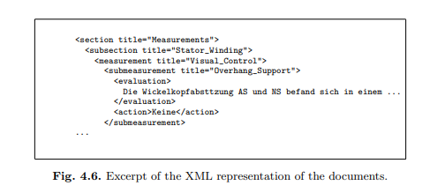
We wrote a program that reads the XML document tree and for each section with a specified label (from the document template) it extracts the pure text and stores it in a new XML document, as the excerpt in Figure shows

Slide 40
4.4.2 Tagging:
The part-of-speech (POS) tagger (TreeTagger4) that we used is a probabilistic tagger with parameter files for tagging several languages: German, English, French, or Italian.
our primary interest in using the tagger was not the POS tagging itself
The tag set used for tagging German is slightly different from that of English

Slide 41
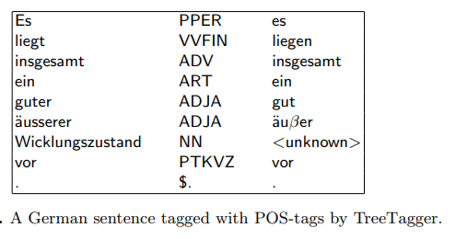

Slide 42
4.4.3 Parsing:
Syntactical parsing is one of the most important steps in the learning framework.
Since we are interested in getting qualitative parsing results, we experimented with three different parsers:
1.Stanford parser
2.BitPar parser
3.Sleepy parser

Slide 43
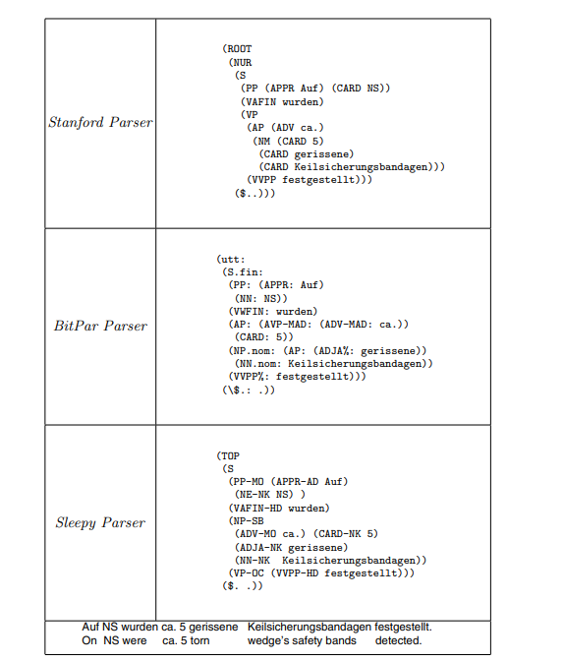

Slide 44
4.4.4 Tree Representation
The tree is composed of terminals (leaf nodes) and non-terminals (internal nodes), all of them known as constituents of the tree.
For export purposes as well as for performing exploration or annotation of the corpus, the tree data structures are stored in XML format, according to a schema defined in the TigerSearch10 tool.

Slide 45
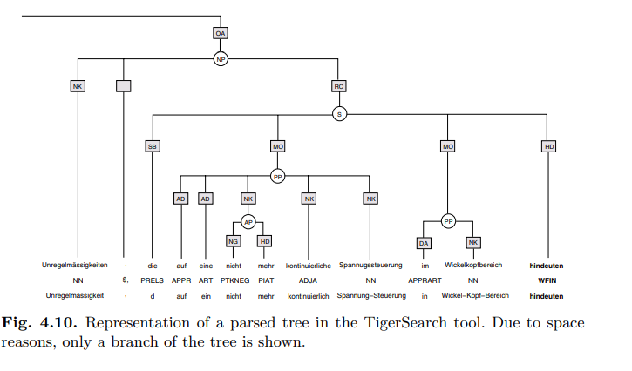

Slide 46
4.4.5 Feature Creation
Features are created from the parse tree of a sentence.
A feature vector is created for every constituent of the tree, containing some features unique to the constituent, some features common to all constituents of the sentence, and some others calculated with respect to the target constituent (the predicate verb).

Slide 47
4.4.6 Annotation:
To perform the manual annotation, we used the Salsa annotation tool (publicly available).
The Salsa annotation tool reads the XML representation of a parse tree and displays it as shown in Figure
The user has the opportunity to add frames and roles as well as to attach them to a desired target verb

Slide 48
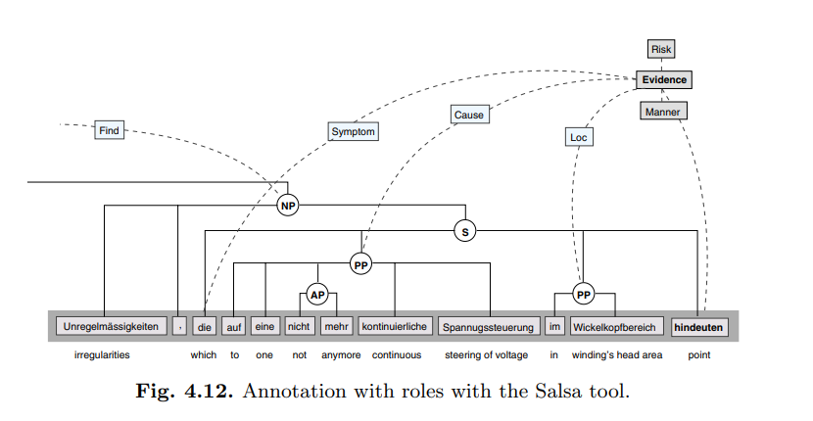

Slide 49
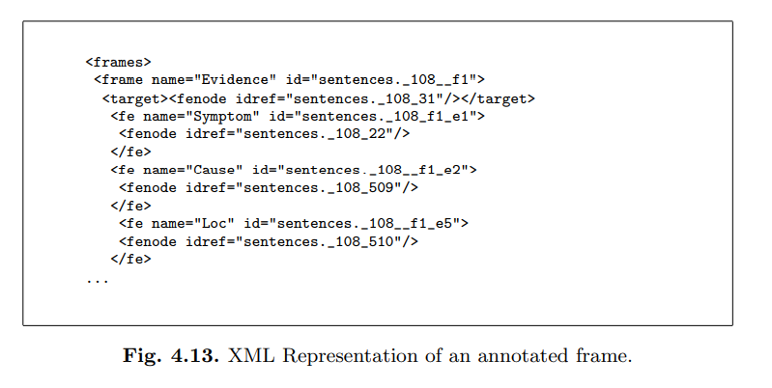

Slide 50
4.4.7 Active Learning:
a) Divide the corpus in clusters of sentences with the same target verb. If a cluster has fewer sentences than a given threshold, group sentences with verbs evoking the same frame into the same cluster.
b) Within each cluster, group the sentences (or clauses) with the same parse subtree together.
c) Select sentences from the largest groups of the largest clusters and present them to the user for annotation.
d) Bootstrap initialization: apply the labels assigned by the user to groups of sentences with the same parse sub-tree.

Slide 51
e) Train all the classifiers of the committee on the labeled instances; apply each trained classifier to the unlabeled sentences.
f) Get a pool of instances where the classifiers of the committee disagree and present to the user the instances belonging to sentences from the next largest clusters not yet manually labeled.
g) Repeat steps d)–f) a few times until a desired accuracy of classification is achieved

Slide 52
4.5 Evaluations:
To evaluate this active learning approach on the task of annotating text with knowledge roles, we performed a series of experiments that are described in the following.
Based on the XML structure of the documents, we created sub corpora with text belonging to different types of diagnostic tests.
Verbs were grouped with one of the frames: Observation, Evidence, Activity, and Change. Other verbs that did not belong to any of these frames were not considered for role labeling.

Slide 53
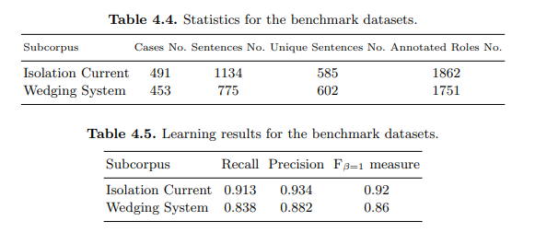
4.5.1 Learning Performance on the Benchmark Datasets
We annotated two different sub corpora and then manually controlled them, to create benchmark datasets for evaluation. Some statistics for the manually annotated sub corpora are summarized in Table

Slide 54
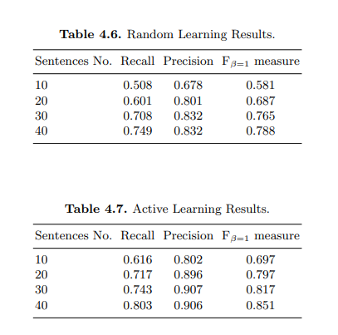
4.5.2 Active Learning versus Uniform Random Selection
In order to evaluate the advantages of active learning, we compared it to the uniform random selection of sentences for manual annotations.

Slide 55
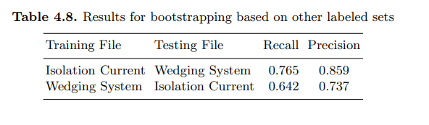
4.5.3 Bootstrapping Based on Other Sets
During the annotation of the two benchmark datasets, we noticed that the two sub corpora, although different in nature
(set 1: Isolation Current contains evaluations of numerical measurements performed on the three phases of the machine, set 2: Wedging System describes visual inspections on the wedging components of the machine)

Slide 56
Module :3
Chapter:3
A Case Study in Natural Language Based Web Search

Slide 57
5.1 Introduction
Information retrieval on the Web today makes little use of Natural Language Processing (NLP) techniques.
The perceived value of improved understanding is greatly outweighed by the practical difficulty of storing complex linguistic annotations in a scalable indexing and search framework.
Examples are syntactic categories (parts of speech), syntactical roles (such as subject, objects, verbs, prepositional constraints, modifiers, etc.) and semantic categories (such as people, places, monetary amounts, etc.).

Slide 58
5.2 InFact System Overview
InFact models text as a complex multivariate object using a unique combination of deep parsing, linguistic normalization and efficient storage. The storage schema addresses the fundamental difficulty of reducing information contained in parse trees into generalized data structures that can be queried dynamically.

Slide 59
5.2.1 Indexing:
InFact’s Indexing Service performs in order:
1) document processing :The first step in document processing is format conversion, which we handle through our native format converters, or optionally via search export conversion software from StellantTM (www.stellent.com), which can convert 370 different input file types.

Slide 60
2) clause processing: The indexing service takes the output of the sentence splitter and feeds it to a deep linguistic parser.
A sentence may consist of multiple clauses. Unlike traditional models that store only term frequency distributions, InFact performs clause level indexing and captures syntactic category and roles for each term, and grammatical constructs, relationships, and inter-clause links that enable it to understand events.
3) linguistic normalization:We apply normalization rules at the syntactic, semantic, or even pragmatic level

Slide 61
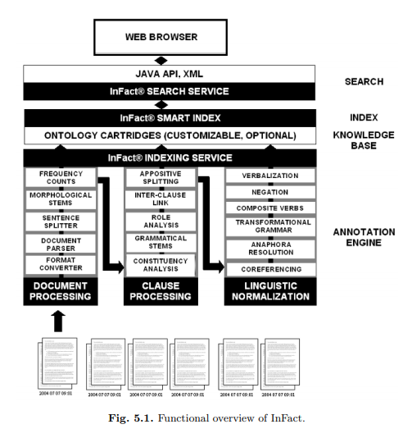

Slide 62
5.2.2 Storage:
In a dependency tree, every word in the sentence is a modifier of exactly one other word (called its head), except the head word of the sentence, which does not have a head. We use a list of tuples to specify a dependency tree with the following format:
(Label Modifier Root POS Head-label Role
Antecedent [Attributes])

Slide 63
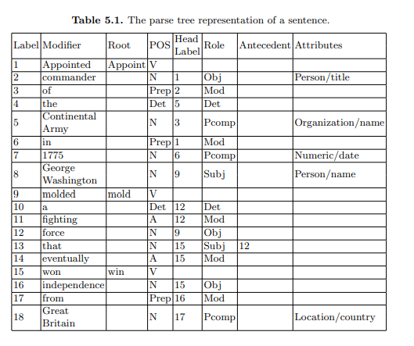

Slide 64
InFact stores the normalized triplets into dedicated index structures that
• are optimized for efficient keyword search
• are optimized for efficient cross-document retrieval of arbitrary classes of relationships or events (see examples in the next section)
• store document metadata and additional ancillary linguistic variables for filtering of search results by metadata constraints (e.g., author, date range), or by linguistic attributes (e.g., retrieve negated actions, search subject modifier field in addition to primary subject in a relationship search)
• (optionally) superimposes annotations and taxonomical dependencies from a custom ontology or knowledge base.

Slide 65
5.2.3 Search:
InFact represents the basic relationship between two entities with an expression of the kind:
Subject Entity > Action > Object Entity, The arrows in the query refer to the directionality of the action, which could be either uni-directional (as above) or bi-directional. For example,
Entity 1 <> Action <> Entity 2

Slide 66
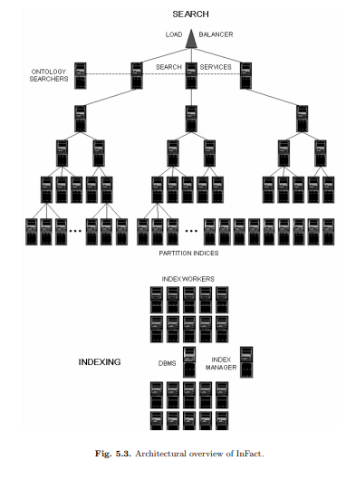
5.3 Architecture and Deployment

Slide 67
5.4 The GlobalSecurity.org Experience
5.4.1 Site Background: GlobalSecurity.org is the most comprehensive and authoritative online destination for those in need of both reliable background information and breaking news.
The director of GlobalSecurity.org, John Pike, regularly provides commentary and analysis on space and security issues to PBS, CNN, MSNBC, Fox, ABC, CBS, NBC, BBC, NPR, and numerous print and online publications.
In powering this site, InFact serves the information search needs of a well-established user community of 100,000, consisting of news reporters, concerned citizens, subject matter experts, senior leaders, and junior staff and interns.

Slide 68
5.4.2 Operational Considerations
When preparing the GlobalSecurity.org deployment, one of our prime concerns was the response time of the system.
We split the GlobalSecurity.org data across two index chunks, each containing roughly 14 GB of data in each partition index.
Another area of concern was the distribution of query types. Our system has significantly varying average response time and throughput (measured in queries/ minute) depending on the type of queries being executed.

Slide 69
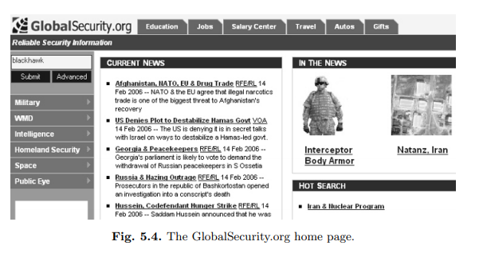

Slide 70
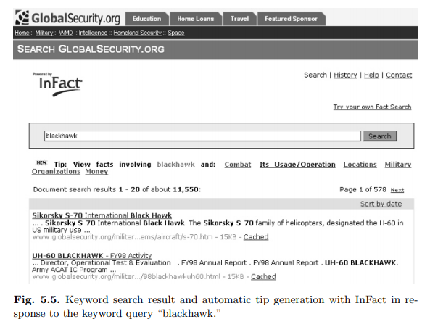
After automatically generating millions of query files, we heavily loaded the system with the queries to simulate heavy traffic using JMeter, a multi-threaded client web user simulation application from the Apache Jakarta organization. Based on these simulations, we deployed with only four nodes.

Slide 71
5.4.3 Usability Considerations:
In deploying InFact on the GlobalSecurity.org site, our goal was to serve the information needs of a wide community of users, the majority of which are accustomed to straightforward keyword search.
The relationships are returned in a table display where each row is an event, and columns identify the three basic semantic roles of source (or subject), action (or verb), and target (or object).

Slide 72
5.4.4 Analysis of Query Logs
log data reflect four ways users submit a natural language query to InFact:
1) They click on the Hot Search link
2) They click on a keyword tip
3) They click on an example in the Query Generator or Help page
4) They attempt to type an explicit relationship or fact search using the IQL syntax

