Slide 1

Addtocart
Front-End Batch
Name: Pratim Sharma
Under The Guidance:
Miss Jayasuruthy L

Slide 2
Introduction
This is Fully Responsive App.
In which user have option to add the item and also delete.
You can increment and as well as decrement the item.
When you select the item than item quantity will be reflected.

Slide 3
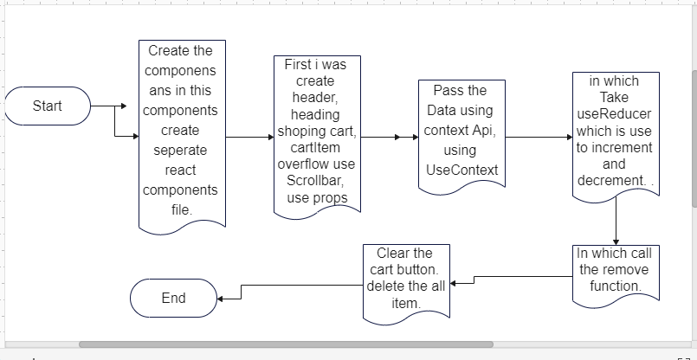

Slide 4
