Slide 1
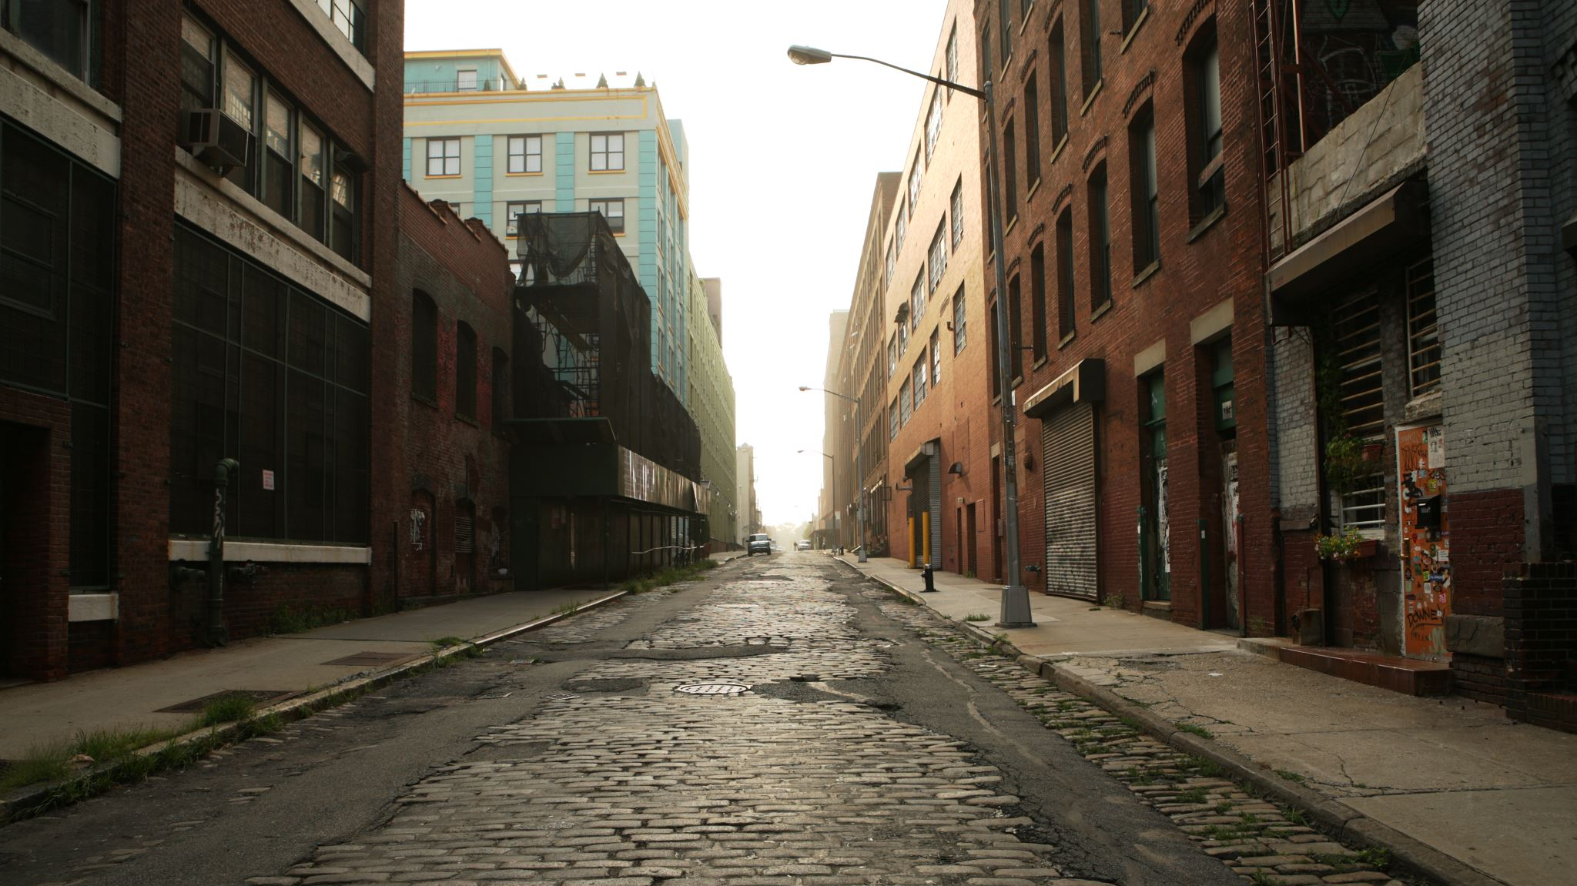
Baltimore Crime Analysis
https://github.com/robo-codes/Projects/blob/main/Section_4_Group_5_Project.ipynb
Group Number : 05
Section Number : 004

Slide 2




The Team
Ruturaj Solanki
Chris Chhotai
Dhruv Raval
Pratinav Jinwal

Slide 3
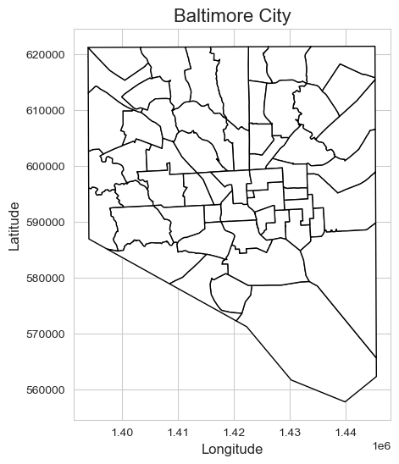
Motivation
“Baltimore city” has experienced an extremely high rate of crime in past recent years. In 2021 Baltimore city experienced the highest homicide rates in the USA, which concerns the residents and the local authorities who are trying to address this issue.
As an analyst who are interested in studying crime patterns and their trends, “Baltimore city” reflects the most interesting case study. Moreover, from this analysis we can gain awareness about the factors that contribute to high crime rates like poverty, drug abuse, social inequality and many more. Furthermore, from this study it can help identifying patterns and trends which inform policy decisions and interventions aimed at reduction crime.

Slide 4
Problem Statement
Baltimore city has been experiencing high crime rates despite of the countries law and order made by USA, however the percentage of crime remains the same. Furthermore, in certain areas the crime problem is very severe and in some or the other way it affects certain demographic group. We need to identify the root cause of crimes, should develop strategies to stop crime and promote public safety.
There is a need to establish positive community partnerships that promote trust between communities. This will require efforts to engage with leaders and build strong relationship between residents.

Slide 5
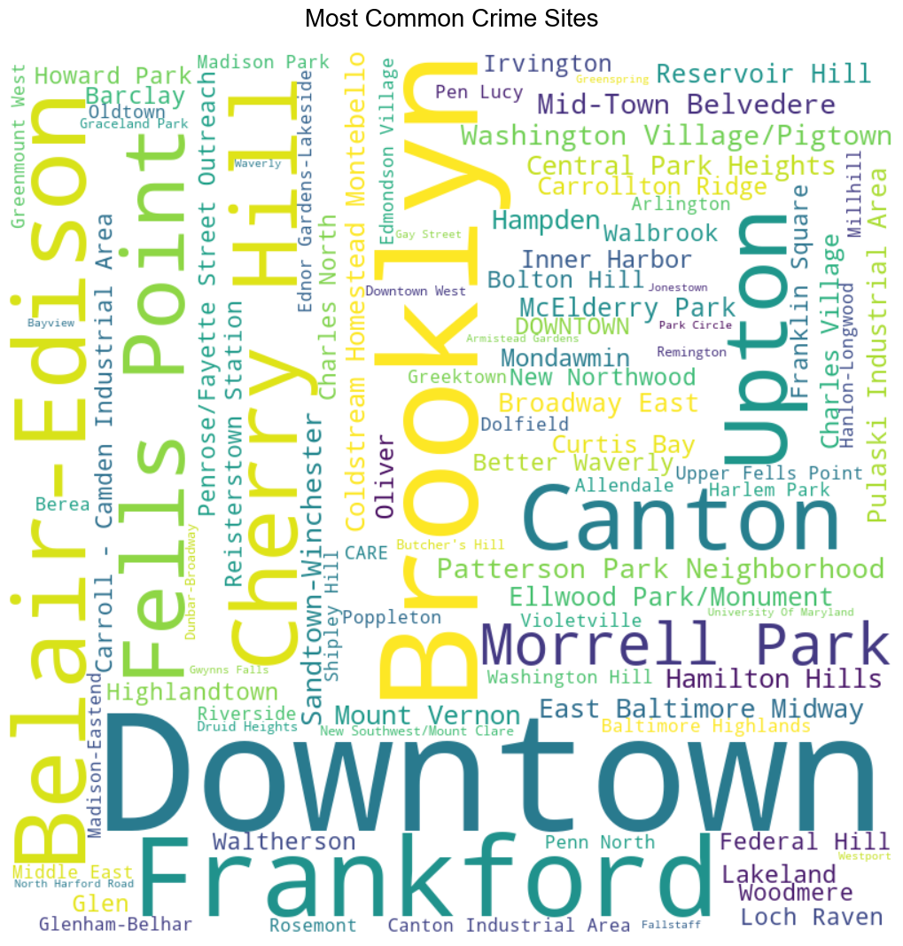
Project Proposal
This dataset contains information on all documented crimes in the city for the year 2022, including the date, time, place, and nature of each incident. Baltimore City's high crime rate is still a problem, although the city has been making efforts to reduce it with several initiatives. This project presents an examination of the city's 2022 crime statistics to better comprehend the status of crime there presently and to highlight prospective development areas. Therefore, we will try to determine which areas of the city are most impacted by each type of crime and to identify the most prevalent crime types for the year 2022.

Slide 6
Data set description
This dataset depicts the location and details of major (Part 1) crime against people that occurs in the City of Baltimore, including homicide, shooting, robbery, violent assault, etc. Each week, data is updated.
This dataset depicts the location and details of major (Part 1) crime against people that occurs in the City of Baltimore, including homicide, shooting, robbery, violent assault, etc. Each week, data is updated.
The dataset contains 40543 instances and 23 attributes including crime location, weapon, and description about the crime in Baltimore city.

Slide 7
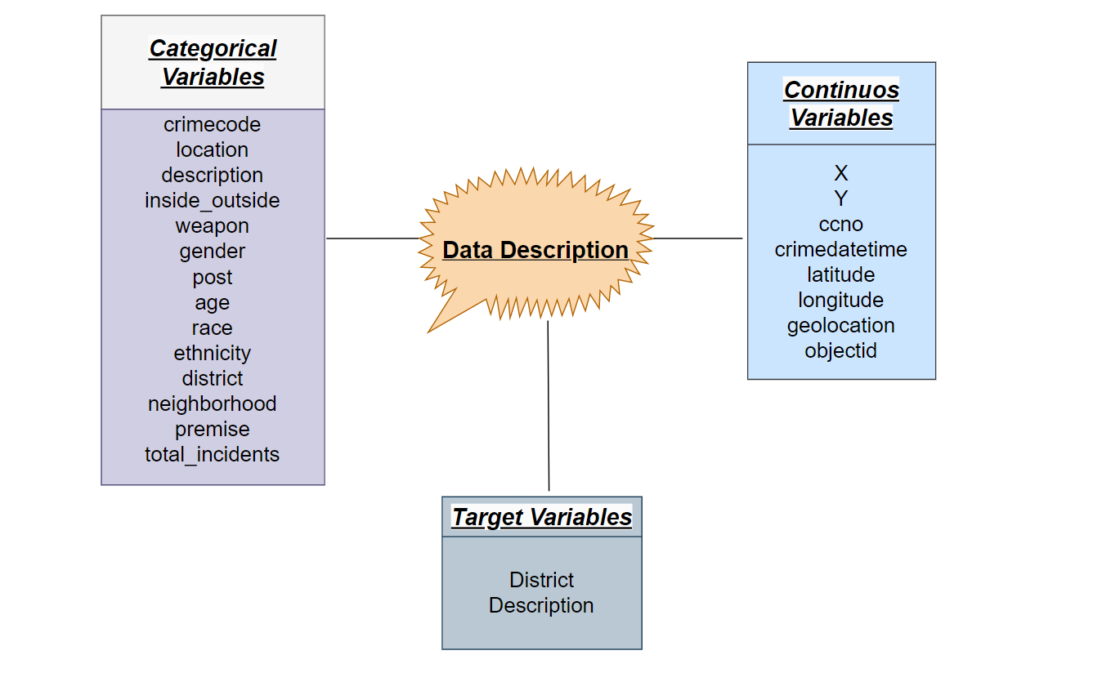
Data Description

Slide 8
Analysis Questions
Which district/neighborhood had the greatest number of crime scenes?
What type of crime has been committed the most?
Are there weapons involved in the crime? If so what kind of?
Are there any groups committing more crimes?

Slide 9

Data Cleaning and Transformation

Slide 10
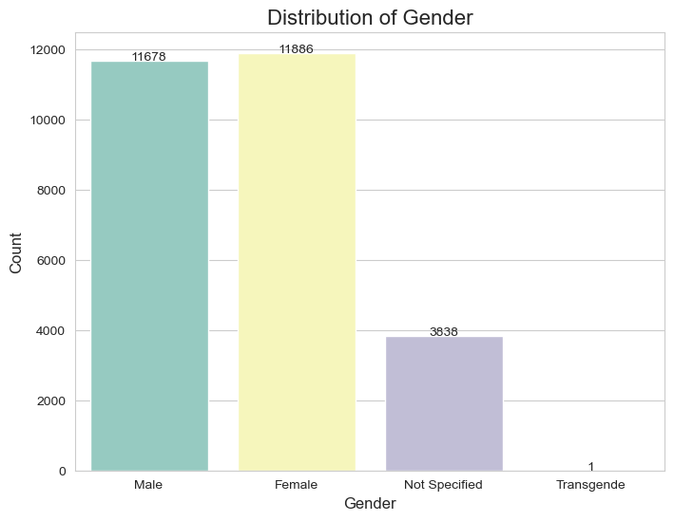
Data Cleaning
To start with, as we have seen so far the coordinates (latitude and longitude) are not so useful for us to draw any conclusion out of it. Also, the columns X, Y, latitude, longitude, geolocation and a new one created by us geometry this all have the coordinate values. Thus, we will drop this columns.
Secondly, the ccno and objectid has almost every values as unique and which does not provide us with any context related to data.On the other hand, for total_incidents have just one value which is 1, and shape column is NaN. Thus, both columns will be dropped.
Moreover, the ethnicity has to many missing values and does not add more context to our data so it can be dropped.
Lastly, there are many cloumns providing lacation informations, the location column has to many uniques values for a catagorical variable while as we know post column is derived using neighborhoods it can be dropped as well.

Slide 11
Data Transformation
Data Transformation
Here we will divide the date and time for better usage for analysis.
First, we will convert the crimedatetime to Date and Time column and then the from the Date column we will select just the Month's values as we have only 2022 years data and days are too many for a catagorical variable.
Thus, after transforming the Date we will end up with just the month name.
Transforming the Time:
After splitting the date and time we will further split time into 4 parts of the day: Morning, Afternoon, Evening, and Night.
Lastly we will delete the uneccessory columns which are crimedatetime, Date, Time, and Month.

Slide 12
Data Analysis

Slide 13
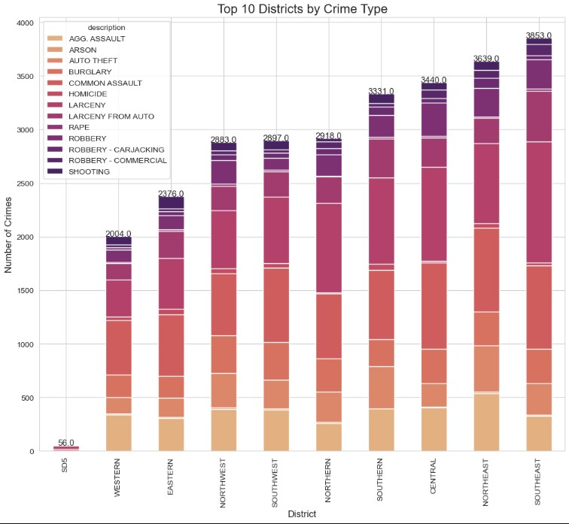
Q1: Which district/neighborhood had the most number of crime scenes?

Slide 14
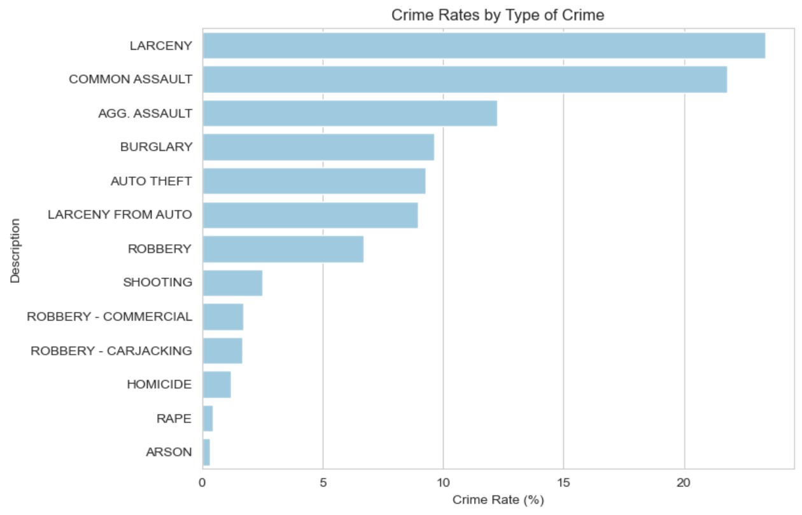
Q2: What type of crime has been committed the most?

Slide 15
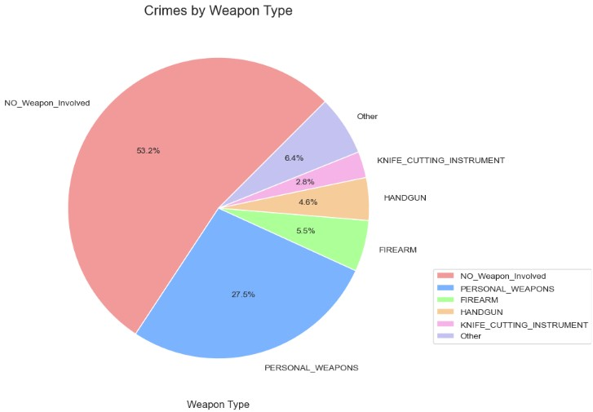
Q3 Are there weapons involved in the crime? If so what kind of?

Slide 16
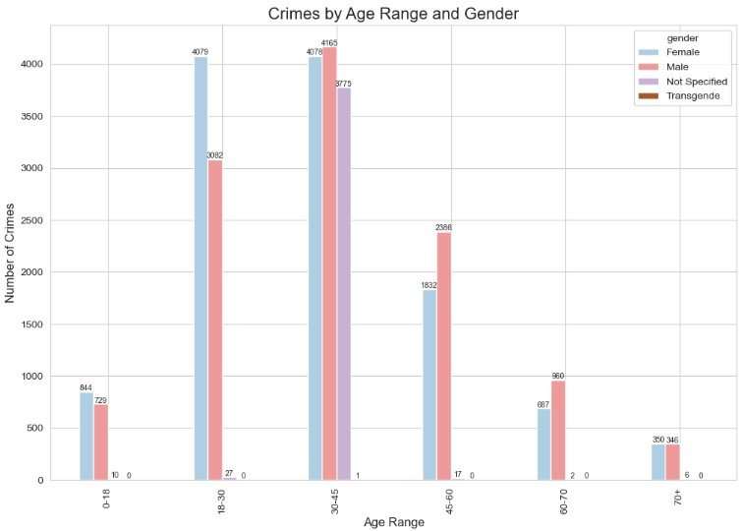
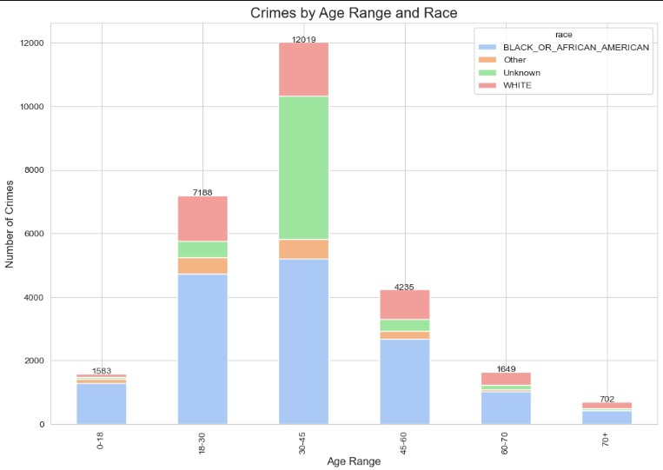
Q4: Are there any groups committing more crimes?

Slide 17
References
https://www.geeksforgeeks.org/data-visualization-with-python/
https://towardsdatascience.com/complete-guide-to-data-visualization-with-python-2dd74df12b5e
https://www.slideshare.net/aniketmaithani/data-visualizations-using-python
https://realpython.com/pandas-plot-python/
https://www.machinelearningplus.com/plots/top-50-matplotlib-visualizations-the-master-plots-python/
https://www.digitalvidya.com/blog/python-visualization/
https://www.kaggle.com/code/benhamner/python-data-visualizations

Slide 18

Thank You

