Slide 1
Structure in C
Presented by:
Mission Khadka
Nitya Shrestha
Prajwal Dahal
Pratik Dhimal
Pratisha Bista

Slide 2
Content Outline
Structure Definition
Difference between Array and Structure
Structure Declaration
Array of Structure
Structures within Structures
Structure and Function

Slide 3
Structure
Definition: A structure is a collection of heterogeneous (i.e., of various sorts) data elements that are grouped together and referred to by the same name (single name reference).
It is a user-defined data type.

Slide 4
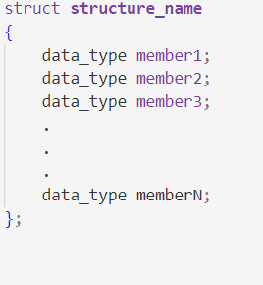
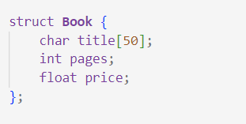
Syntax
Start by using the struct keyword followed by the structure name, and inside curly braces, list its members along with their data types. Finally, end with a semicolon (;).

Slide 5
Difference between array and structure
-An array is a collection of elements of the same type, stored in a consecutive block of memory. Arrays are homogeneous. Arrays are derived datatype. An array does not have a specific keyword.
-A structure is a collection of elements of different types, grouped together under a single name. Structures are heterogeneous.Structures are user defined datatype. Structure is defined using struct keyword.

Slide 6
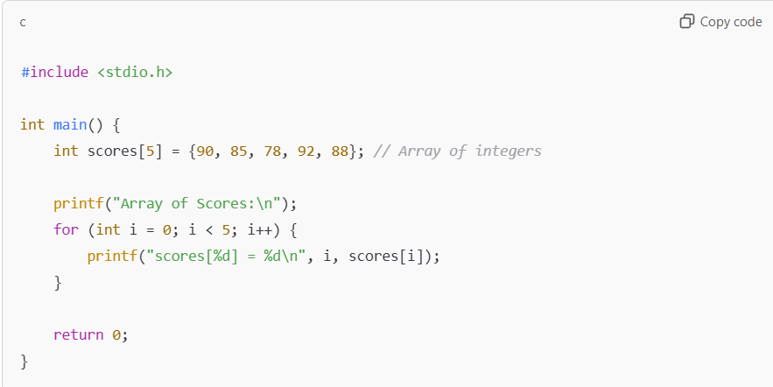
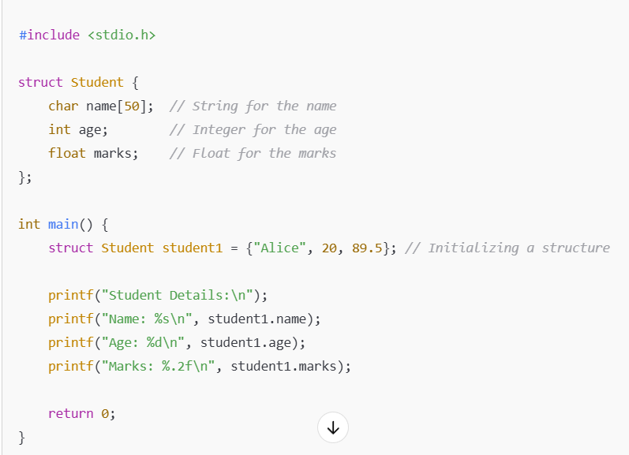
Examples of Array and Structure
Elements are accessed using indices to
In Array.
Each member is accessed using dot(.)
Operator in structure.

Slide 7
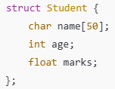
Declaration of Structure
We declare a structure to simplify the programming by grouping related data and making it easier to manage and maintain.Structures not only make the program more readable but also provide a Flexible way to represent and handle real-world data.

Slide 8
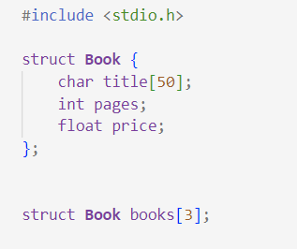
Array of Structure
In C, an array of structures is a collection of many structure variables, each of which contains information on a different entity.

Slide 9
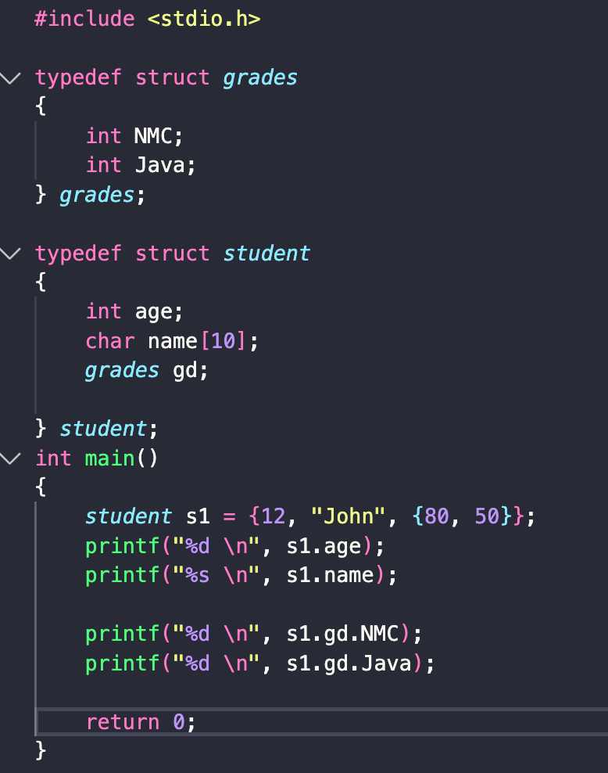
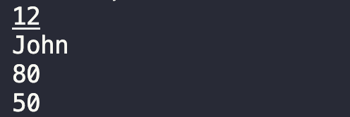
Structure of structure
In C we can have a structure nested inside another structure. For example:
Output

Slide 10
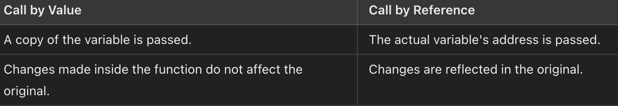
Function and structure
Similar to passing other data types to a function, we can also pass structure as parameter.
Call by Value
Call by reference

Slide 11
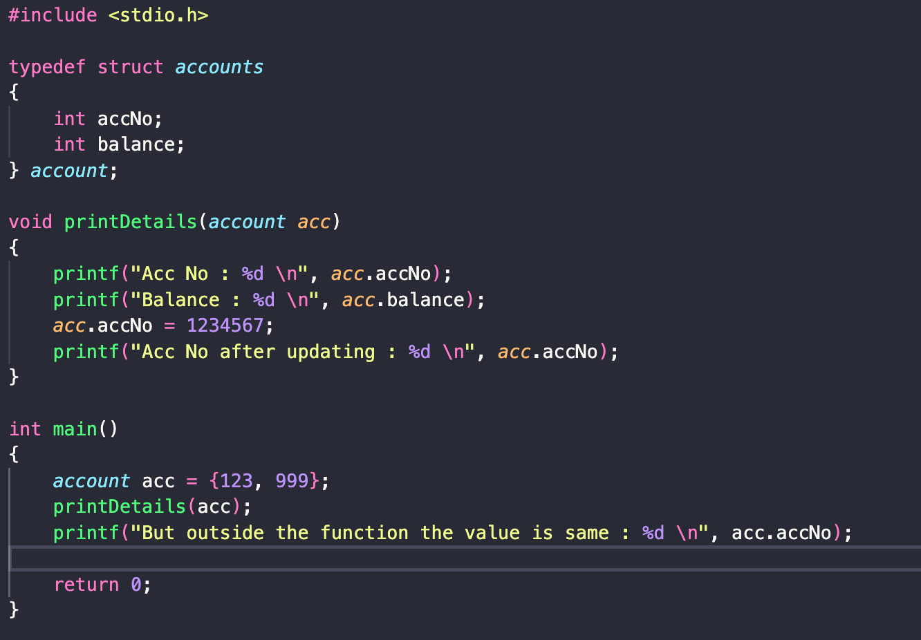
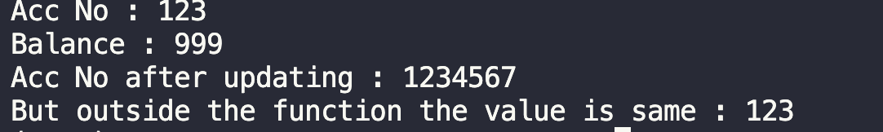
Call by value
Only a copy of the structure is passed in the function and any changes is limited only within the function.
Output

Slide 12
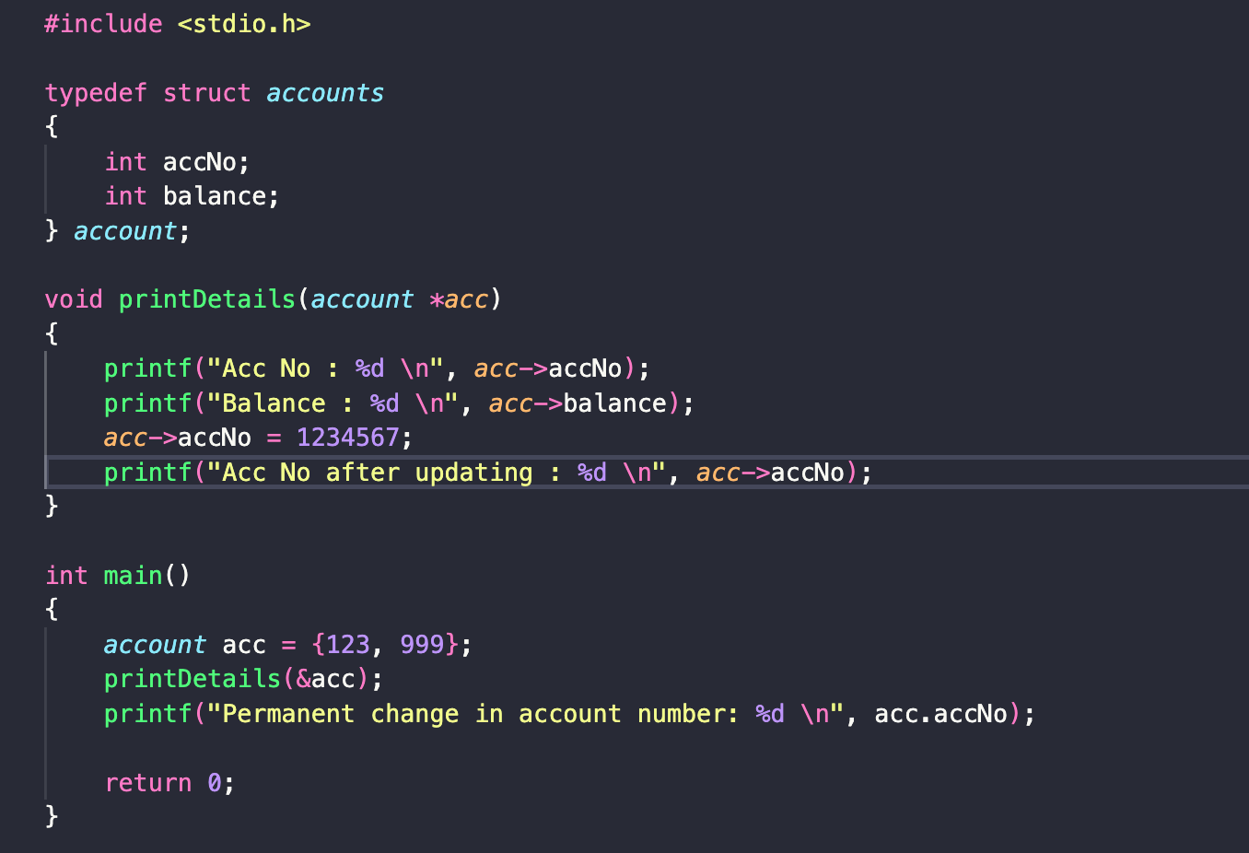
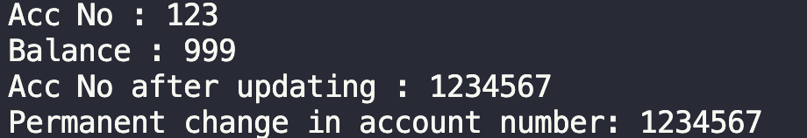
Call by reference
The actual memory address of the structure is passed and any changes is permanent for the original structure.
Output

Slide 13
THE END

