Slide 1
Multi-objective Community Detection

Slide 2
What is Community?
Refers to a group of nodes or individuals that are densely connected with each other, but sparsely connected with nodes outside the group.
Examples :
- Groups of people with shared interests
- Groups of proteins that work together to perform specific
biological functions.
What is Community Detection?
A method used to partition a network into subsets of nodes
The process of identifying groups or communities of nodes in a network

Slide 3
Community and Cluster
A community can be defined as a group of entities closer to each other in comparison to other entities of the dataset.
A community is formed by individuals such that those within a group interact with each other more frequently than with those outside the group.
Clustering is the process of grouping a set of similar items together in structures known as clusters.
A social network is depicted by a social network graph G consisting of n number of nodes denoting n individuals or the participants in the network.
The connection between node i and node j is represented by the edge eij of the graph.
Directed and Undirected graph

Slide 4
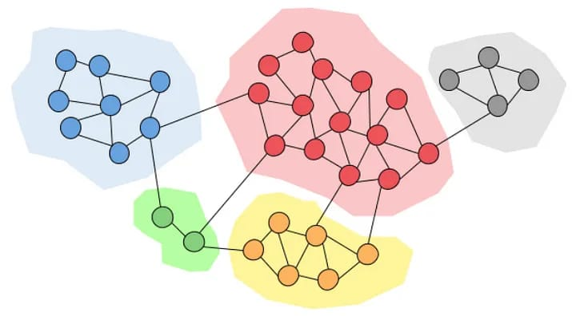
NP-hard problem : Community detection is often considered an NP-hard problem because it involves searching for an optimal partition of a network into communities, which is a combinatorial problem that can grow exponentially with the size of the network. This means that as the number of nodes in the network increases, the time required to find the optimal solution can quickly become infeasible, even for modern computers.

Slide 5
Applications of Community Detection
Social network analysis - groups of people having shared interest
Biological network analysis - group of proteins that work together to perform specific biological functions.
Recommendation systems - group users with similar interests or preferences, and recommend products or services
Marketing - identify groups of customers with similar behavior or preferences, and develop targeted marketing campaigns to increase customer engagement and satisfaction.
Transportation and logistics - identify clusters of interconnected cities or regions,
Cybersecurity - identify clusters of computers or devices that are connected to each other which can help in detecting and preventing cyber attacks.

Slide 6
Evaluating Criteria
Modularity:
Measure of the quality of community structure in a network.
Measures the extent to which the nodes in a network are more densely connected within groups than between groups.
Higher modularity values indicate better community structure.
Negative modularity values indicate that the network is less modular than that expected by chance.
Normalized mutual information (NMI):
Measure the amount of information shared by two partitions of a network, normalized by the amount of information contained in each partition separately.
Higher NMI value indicates that the community partition obtained by a community detection algorithm is more similar to the ground truth partition (if available)

Slide 7
Conductance:
Measures the quality of a community by comparing the number of edges between a community and the rest of the network to the total number of edges in the community.
Lower conductance values indicate better community structure.
Problem Statement
In this project we will try to evaluate all the communities in a graph using multi-
objective Particle – Swarm Optimization , the objectives being modularity NMI
and conductance

Slide 8
Why multi-objective ?
Single objective algorithm mostly used
Inefficient for complex networks
As community structure often depends on more than one objective.
Choosing more than one objective is beneficial

Slide 9
Why Optimization Algorithms ?
Optimization algorithms are used in community detection for several reasons:
Improve accuracy: removes noise
Handle large networks: reduce the computational burden by finding efficient solutions that are close to the optimal solution.
PSO – A metaheuristic algorithm
Metaheuristic is a class of optimization algorithms that are used to solve difficult optimization problems for which exact algorithms may be impractical or infeasible. These problems often involve large search spaces. Metaheuristic algorithms are iterative and use a combination of stochastic and deterministic methods to explore the search space and find good solutions.

Slide 10
Defination :
In PSO, the behaviour of a flock of birds is used as a metaphor to optimize a problem. In this metaphor, a swarm of particles represents a flock of birds. Each particle corresponds to a bird, which moves through the search space to find the best position to obtain food. Initially, each bird moves randomly throughout the search space. However, it adjusts its direction based on two things: the position of the best food it has ever found so far (personal best) and the position of the best food found by the flock (global best)

Slide 11
Optimization Algorithm
PSO (Particle Swarm Optimization) :
Randomly initializing a population of particles in the search space by using Locus based adjacency representation.
Particle is evaluated based on its fitness.
The modularity, conductance and NMI of the particle is calculated.
Initialize the personal best of the particle with the particle itself.
Finding not dominated set of solutions i.e. pareto optimal set
From the pareto set, find the particle with the highest NMI and set it as the global best.
To move each particle toward the best positions, genetic operators such as crossover and mutation are used.
- personal best update
- global best update
Obtain pareto set, and then assign the particle with highest NMI from this set
as gbest

Slide 12
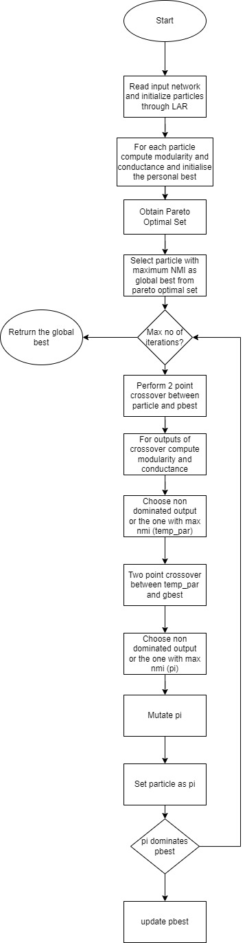
Control – Flow graph

Slide 13
Datasets Used
Zachary's karate club: social network of friendships between 34 members of a karate club at a US university in the 1970s. Please cite W. W. Zachary, An information flow model for conflict and fission in small groups, Journal of Anthropological Research 33, 452-473 (1977).
Dolphin social network: an undirected social network of frequent associations between 62 dolphins in a community living off Doubtful Sound, New Zealand. Please cite D. Lusseau, K. Schneider, O. J. Boisseau, P. Haase, E. Slooten, and S. M. Dawson, Behavioral Ecology and Sociobiology 54, 396-405 (2003). Thanks to David Lusseau for permission to post these data on this web site.

Slide 14
Datasets:
Name | Nodes | Edges | Type | Relationship
The bottlenose dolphin community of Doubtful Sound | 62 | 159 | Undirected | An undirected social network of frequent associations between 62 dolphins in a community living off Doubtful Sound, New Zealand.
Zachary’s Karate Club Dataset | 34 | 78 | Directed | Social network of friendships between 34 members of a karate club at a US university in the 1970s.

Slide 15
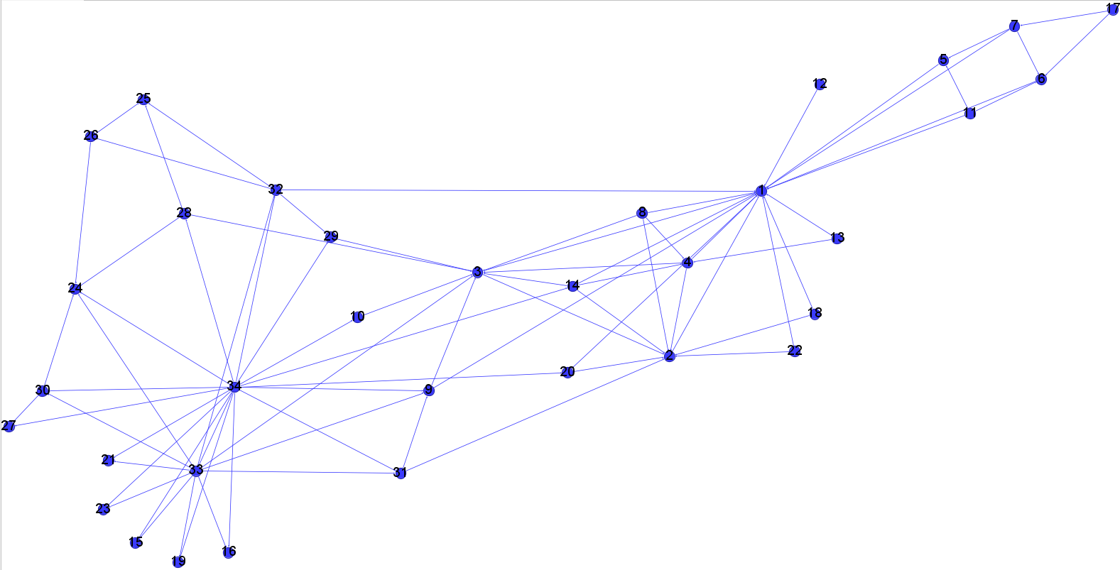
Karate – club dataset

Slide 16
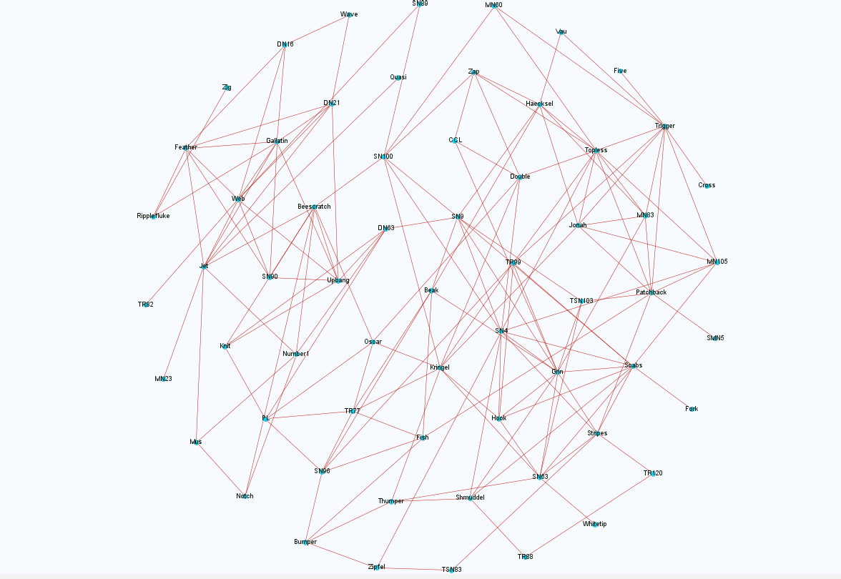
Dolphins - dataset

Slide 17
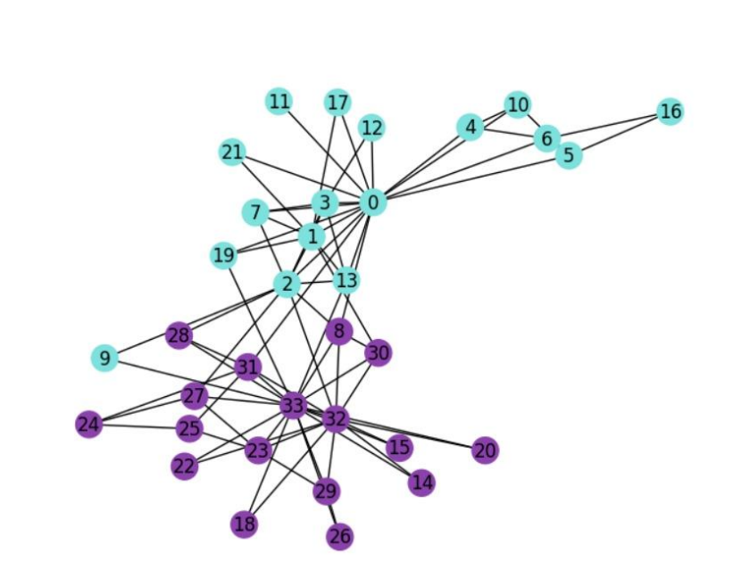
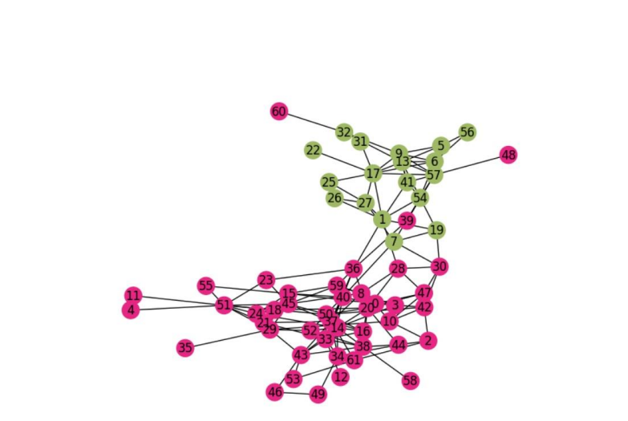
Result
Communities :Karate – club
Communities : Dolphins

Slide 18
Datset | NMI
Karate - club | 83.72%
Dolphins | 80.82%
Why this difference ?
Datasets can have varying levels of complexity, structure, and inherent variability.
The distribution of data points within a dataset can impact the performance of a clustering algorithm.
- well – separated – higher NMI
- overlap – lower NMI

