Slide 1
Pancreatic Cancer Prognosis using Clinical and Radiomic Data
UE24CS352A Machine Learning - Mini-Project (Problem #6)
Team: Pratik Patil(PES2UG24CS372), Ruhika Kolla(PES2UG24CS908)

Slide 2
Problem & Motivation
Pancreatic cancer is usually found late; prognosis guides treatment for borderline/locally advanced cases
Goal: predict patient survival risk from clinical, radiomic (MRI) and combined features
Key question: does radiomics add prognostic value beyond clinical data?
Reference: A. Jamalian, Stanford CS229 (2020)

Slide 3
Dataset
Original: 80 patients, 900 QIFP radiomic features + clinical data (Stanford, under NDA - not public)
Our data: synthetic cohort with the same structure (80 patients, 12 clinical, 900 radiomic features)
Right-censored survival: 57 events, median 336 days
Hidden Cox-style hazard gives the models real signal
Results show the pipeline works, not clinical findings

Slide 4
Approach
1
2
3
4
Naive Bayes
SMOTE
Cox PH + L2
Evaluate
pick high/low-risk day threshold
augment high-risk minority
clinical / radiomic / combined
10-fold C-index, KM, log-rank
Improvement: SMOTE, scaling and feature filtering are fitted inside each training fold, so no leakage into held-out data.

Slide 5
Implementation
Python: lifelines, imbalanced-learn, scikit-learn, matplotlib
src/generate_data.py - synthetic cohort
src/pipeline.py - NB search, SMOTE, Cox, CV, KM, log-rank
src/demo.py - scores a patient (live demo)
Radiomic filter: drop features with 95% CI width on log(HR) > 1
Penalizer 0.1, l1_ratio 0 (L2 only); L1 did not converge in the paper

Slide 6
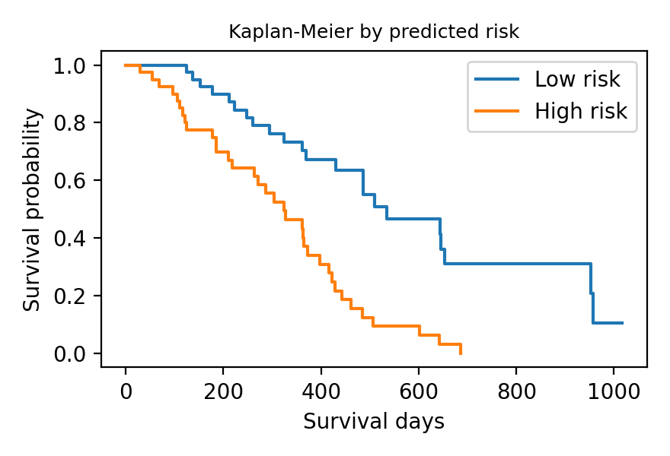
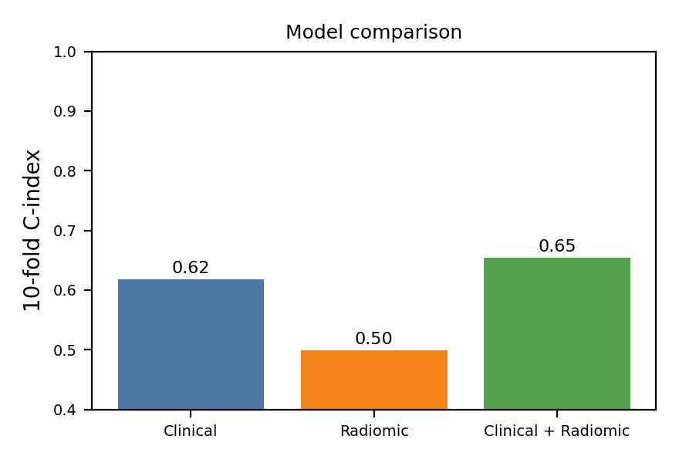
Results
Model | Features | 10-fold C-index
Clinical | 12 | 0.618 +/- 0.133
Radiomic | 150 | 0.499 +/- 0.165
Clinical + Radiomic | 162 | 0.654 +/- 0.142
Best NB threshold: 270 d
Log-rank: 18.9
(in-sample)

Slide 7
Conclusions & Future Work
Pipeline works end to end: NB threshold, SMOTE, Cox, risk groups
Clinical + radiomic (0.65) beat clinical alone (0.62), same direction as the paper
Radiomic-only is near chance: 150 correlated features vs ~70 training patients
Limits: synthetic data, tiny sample, large fold variance
Next: real data, PCA/stronger regularisation, DeepSurv / DeepHit

