Slide 1

STOCK MARKET ANALYSIS AND PREDICTION
Team members:
Prathamesh Limaye
Prathamesh Verlekar
Saurabh Satra
Yash Pandya

Slide 2
INTRODUCTION
Financial Markets are highly volatile and generate huge amounts of data daily.
Stock prices are predicted to determine the future value of companies’ stock or other financial instruments that are marketed on financial exchanges.
It is the most popular financial market instrument and its value changes quickly.
However, the stock market is influenced by many factors such as political events, economic conditions and Traders’ expectation.

Slide 3
OBJECTIVE
Over the years, Stock market prediction has always caught the attention of many analysts and researchers.
Predicting stock prices is a difficult problem in itself because of the number of variables which are involved. Therefore, investors and researchers have been interested in developing and testing models of stock price behavior.
The objective of the proposed project is to study, analyze and improve the supervised machine learning algorithms to accurately predict the future closing value of a given stock across a given period in the future.

Slide 4
DESCRIPTION OF DATA SET
The Dataset Titled “Huge Stock Market Dataset” contains full historical data daily price and volume data for all US-based stocks and ETFs (Exchange Traded Funds) trading on the NYSE (The New York Stock Exchange), NASDAQ (National Association of Securities Dealers Automated Quotations) and NYSE MKT.
The dataset provided on Kaggle is around 1.53 GB.
The data is presented in CSV (Comma Separated Values) Format and has features such as Date, Opening Value, High Value, Low Value, Closing Value, Volume of Stocks and OpenInt Stock Values for over 1000 Companies in the United States of America.
Data Set Link: https://www.kaggle.com/borismarjanovic/price-volume-data-for-all-us-stocks-etfs#aadr.us.txt

Slide 5

LIBRARIES USED:
1) NumPy
2) Pandas
3) Sklearn
4) Matplotlib

Slide 6
1. NumPy
NumPy is the fundamental package for scientific computing with Python
NumPy can be used as an efficient multi-dimensional container of generic data. Arbitrary data-types can be defined. This allows NumPy to seamlessly and speedily integrate with a wide variety of databases
In our project we have used NumPy for data cleaning and to compute mean.

Slide 7
2. Pandas
pandas is an open source, BSD-licensed library providing high-performance, easy-to-use data structures and data analysis tools for the Python programming language
It is built on the NumPy package and its key data structure is called the DataFrame. DataFrames allow you to store and manipulate tabular data in rows of observations and columns of variables
In our project we have implemented pandas to import a csv file as a dataframe

Slide 8
3. Sklearn
Scikit-learn is largely written in Python, and uses NumPy extensively for high-performance linear algebra and array operations.
In our project we have used Sklearn and it is used for model training

Slide 9
4. Matplotlib
Matplotlib is a plotting library for the Python programming language and its numerical mathematics extension NumPy. It provides an object-oriented API for embedding plots into applications using general-purpose GUI toolkits.

Slide 10
ALGORITHMS USED
We have made use of the following algorithms in our project:
1) Linear Regression
2) AutoRegression
3) ARIMA
4) RNN

Slide 11
1. Linear Regression
Linear Regression is a machine learning algorithm based on supervised learning.
Linear regression performs the task to predict a dependent variable value (y) based on a given independent variable (x).
So, this regression technique finds out a linear relationship between x (input) and y(output). Hence, the name is Linear Regression.
While doing linear regression our objective is to fit a line through the distribution which is nearest to most of the points. Hence reducing the distance (error term) of data points from the fitted line.

Slide 12
STEPS FOR LINEAR REGRESSION:
We imported the packages and classes we needed for Linear Regression
Provided the data we needed and created visualization for understanding data
Created a regression model and fitted it with existing data.
Checked the results of model fitting to know whether the model is satisfactory or not.
Calculated the Train and Test set by R2 – score.

Slide 13
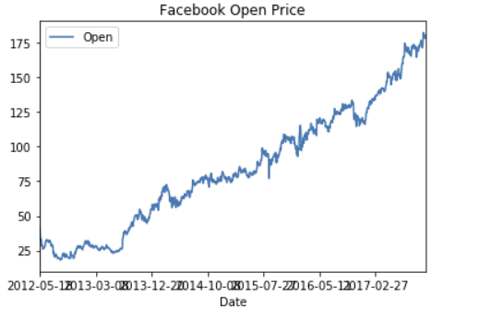
Company : Facebook
Stock prediction using Linear Regression:

Slide 14
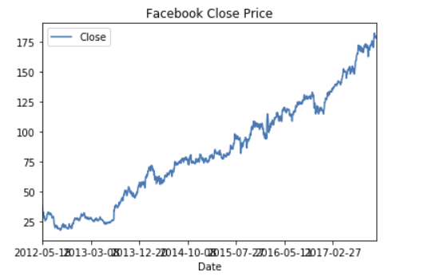
Company : Facebook
Stock prediction using Linear Regression:

Slide 15
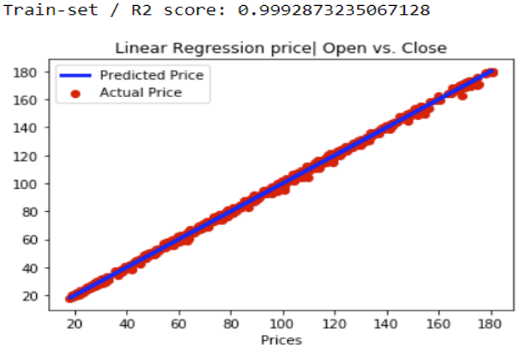
Company : Facebook
Stock prediction using Linear Regression:

Slide 16
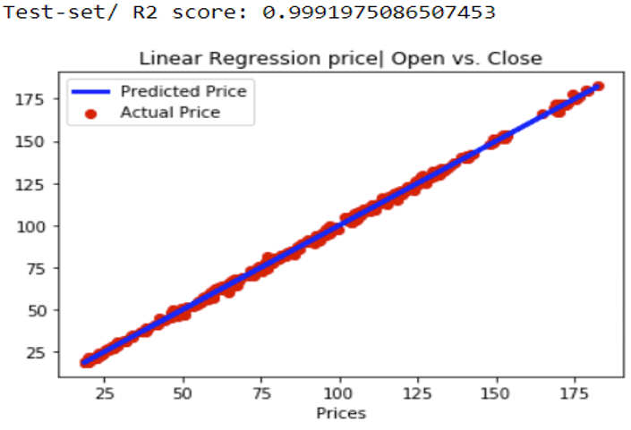
Company : Facebook
Stock prediction using Linear Regression:

Slide 17
2.Auto-Regression
Autoregression is a time series model that uses observations from previous time steps as input to a regression equation to predict the value at the next time step.
It is a very simple idea that can result in accurate forecasts on a range of time series problems.

Slide 18
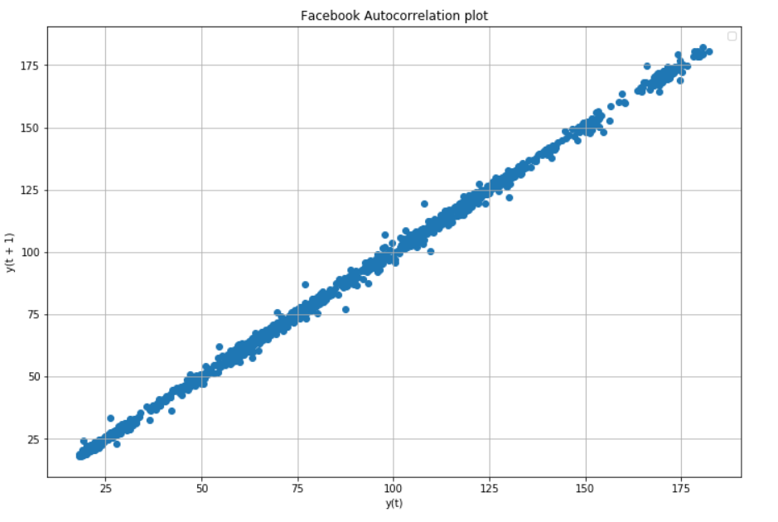
Company : Facebook
Autocorrelation Plot:

Slide 19
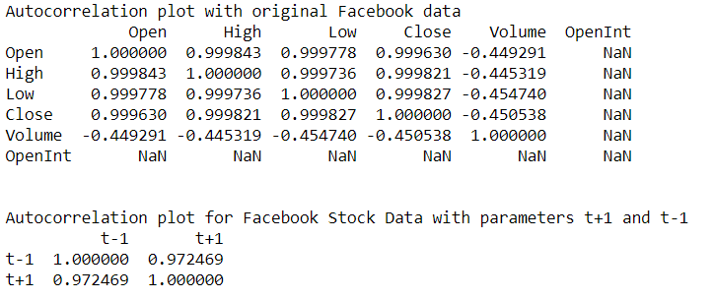
Company : Facebook
Autocorrelation Coefficients :

Slide 20
STEPS FOR AUTO-REGRESSION:
We used Statsmodel library, which provides an AutoRegression model that automatically selects an appropriate lag value.
We used this AutoRegression model by first creating the model AR() and then calling fit to train it on our dataset.
After the above step, an AR Result object is obtained.
Next, we use the model to make a prediction by calling the predict() function for several observations in the future.

Slide 21
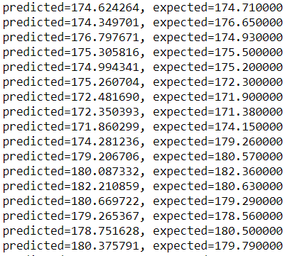
Company : Facebook
Stock prediction using Auto Regression:

Slide 22
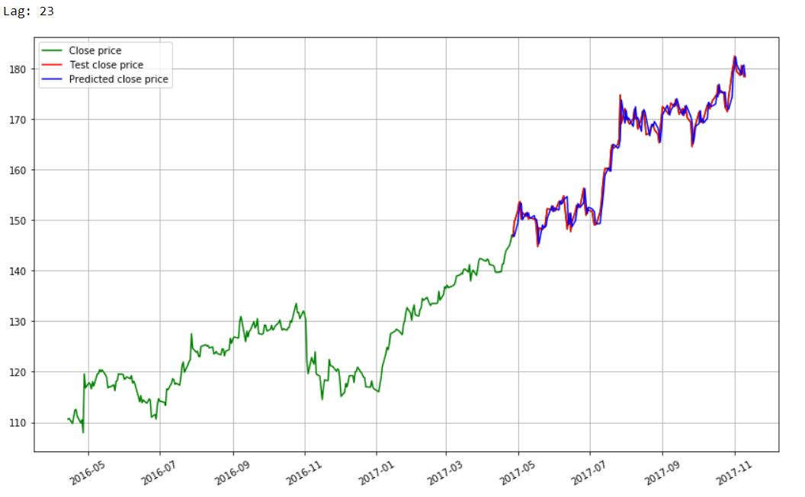
Company : Facebook
Stock prediction using Auto Regression:

Slide 23
3. ARIMA
ARIMA is an acronym that stands for AutoRegressive Integrated Moving Average.
It is a class of model that captures a suite of different standard temporal structures in time series data.
The descriptive form of ARIMA acronym is as follows:
AR: Autoregression. A model that uses the dependent relationship between an observation and some number of lagged observations.
I: Integrated. The use of differencing of raw observations (e.g. subtracting an observation from an observation at the previous time step) in order to make the time series stationary.
MA: Moving Average. A model that uses the dependency between an observation and a residual error from a moving average model applied to lagged observations.

Slide 24
STEPS FOR ARIMA:
Load the data: This step will be the same. Load the data into your notebook.
Preprocessing data: The input should be univariate, hence drop the other columns
Fit ARIMA: Fit the model on the univariate series
Predict values on validation set: Make predictions on the validation set
Calculate RMSE: Check the performance of the model using the predicted values against the actual values

Slide 25
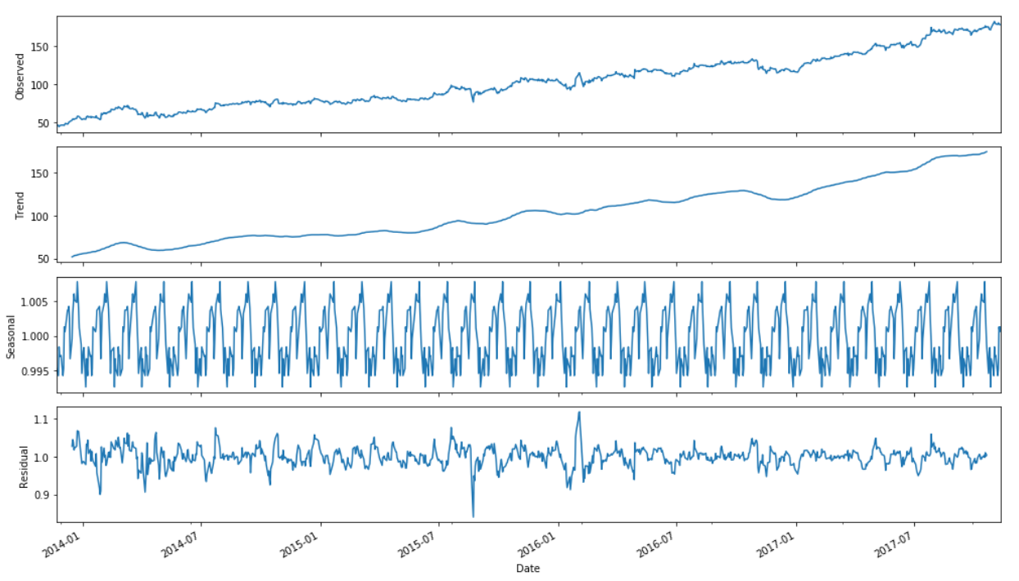
Company : Facebook
Stock prediction using ARIMA:

Slide 26
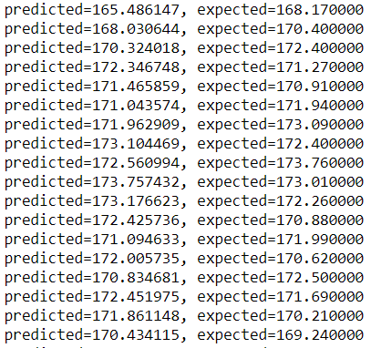
Company : Facebook
Stock prediction using ARIMA:

Slide 27
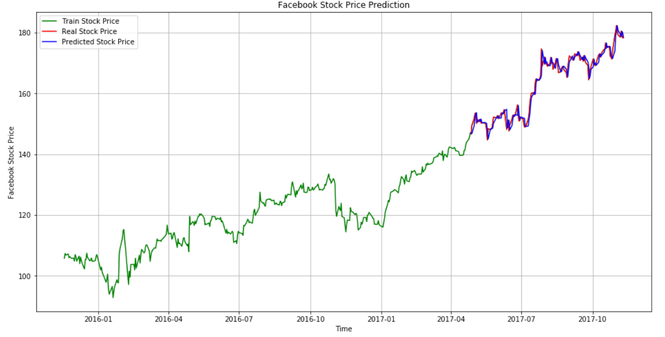
Company : Facebook
Stock prediction using ARIMA:

Slide 28
4. RNN
Recurrent Neural Networks or RNN as they are called in short, are a very important variant of neural networks heavily used in Natural Language Processing.
In a general neural network, an input is processed through a number of layers and an output is produced, with an assumption that two successive inputs are independent of each other.
RNNs are called recurrent because they perform the same task for every element of a sequence, with the output being depended on the previous computations.

Slide 29
STEPS FOR RNN:
Convert abstracts from list of strings into list of lists of integers (sequences)
Create feature and labels from sequences
Build LSTM model with Embedding, LSTM, and Dense layers
Load in pre-trained embeddings
Train model to predict next work in sequence
Make predictions by passing in starting sequence

Slide 30
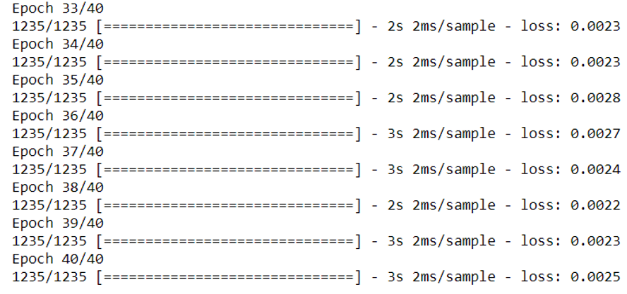
Company : Facebook
Stock prediction using RNN:

Slide 31
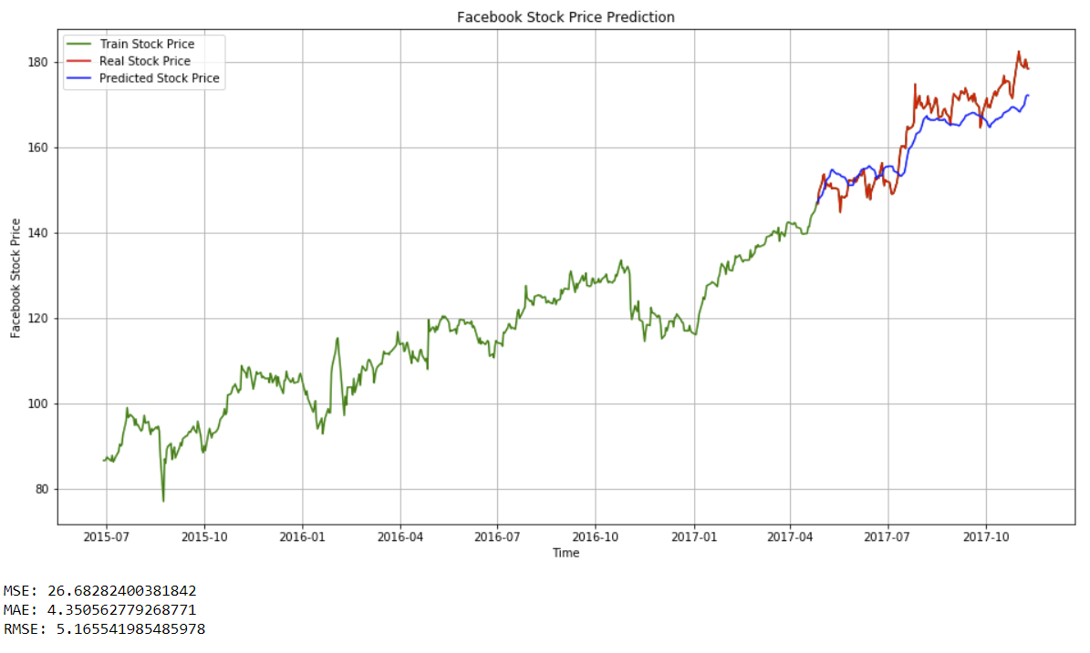
Company : Facebook
Stock prediction using RNN:

Slide 32
Conclusion
Determining the stock market forecasts is always been challenging work.
Thus, as we can see above in our proposed method, we train the data with multiple Machine Learning and Time Series algorithms using existing stock dataset that is available. We used this data to predict the stock prices of the several companies across United States.

Slide 33
Future Enhancement
The proposed model does not predict well for sudden changes in the trend of stock data
This occurs due to external factors and real-world changes affecting the stock market.
So, we can overcome this problem by implementing Sentiment Analysis on News feeds and Advanced Neural Network model to improve the results.
We can also try to modify the same system to an online-learning system that captures in real-time

Slide 34
REFERENCES:
https://www.kaggle.com/
https://machinelearningmastery.com/arima-for-time-series-forecasting-with-python
https://machinelearningmastery.com/autoregression-models-time-series-forecasting-python
Stock Market Analysis: A Review and Taxonomy of Prediction Techniques- International Journal of Financial Studies

Slide 35


