Slide 1
🦄 VENTUREPULSE: STARTUP VALUATION INTELLIGENCE
Reverse-Engineering Private Tech Pricing Across 1,447 Global Unicorns
Pratham Pradhan | CMSE 830: Foundations of Data Science | Fall 2026
TOTAL VALUE TRACKED
$7.40 Trillion
Across 1,447 private tech unicorns worldwide
DATASET COVERAGE
55 Countries
Spanning 6 core industries and 10+ tech hubs
CORE OBJECTIVE
Market Transparency
Demystifying pricing negotiated behind closed doors

Slide 2
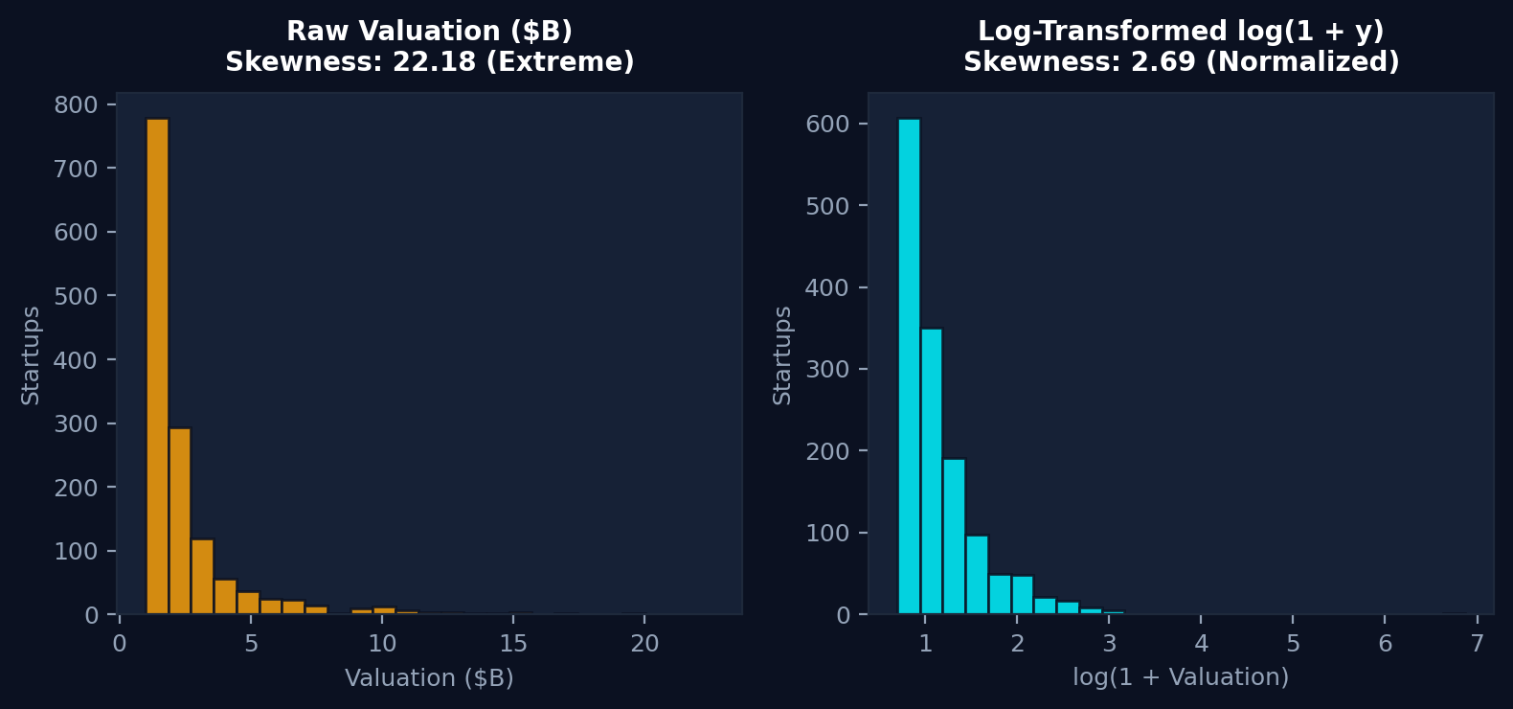
PART 2 • DATA READINESS & QUALITY
Data Hygiene: Taming the Power-Law Distribution
1. THE SKEWNESS CHALLENGE
• Extreme Skewness (22.18):
Valuations range from $1.0B to $965B (Anthropic). Modeling raw dollars causes linear regression to collapse with massive variance.
• Log Transformation log(1 + y):
Linearizes exponential compound returns, reducing skewness to 2.69 and stabilizing model errors.
2. DUPLICATES & IMPUTATION DECISIONS
• The Homonym Disambiguation:
Auditing duplicate names caught 2 copy-pasted duplicate rows (Ramp, Invoca), but preserved 3 legitimate name-collision pairs:
- Bolt US ($11B) vs. Bolt Estonia ($8.4B)
- Branch Metrics ($4B) vs. Branch Insurance ($1.05B)
- Fabric Washington ($1.5B) vs. Fabric NY ($1.0B).
• Informative Missingness (Option C):
50 companies kept investor data confidential. We coded their investor count to 1 and elite backer flags to 0 rather than fabricating fake data.
• Geospatial Centroid Imputation:
23 remote startups without listed cities were assigned national centroid coordinates with random coordinate jitter to prevent map stacking.

Slide 3
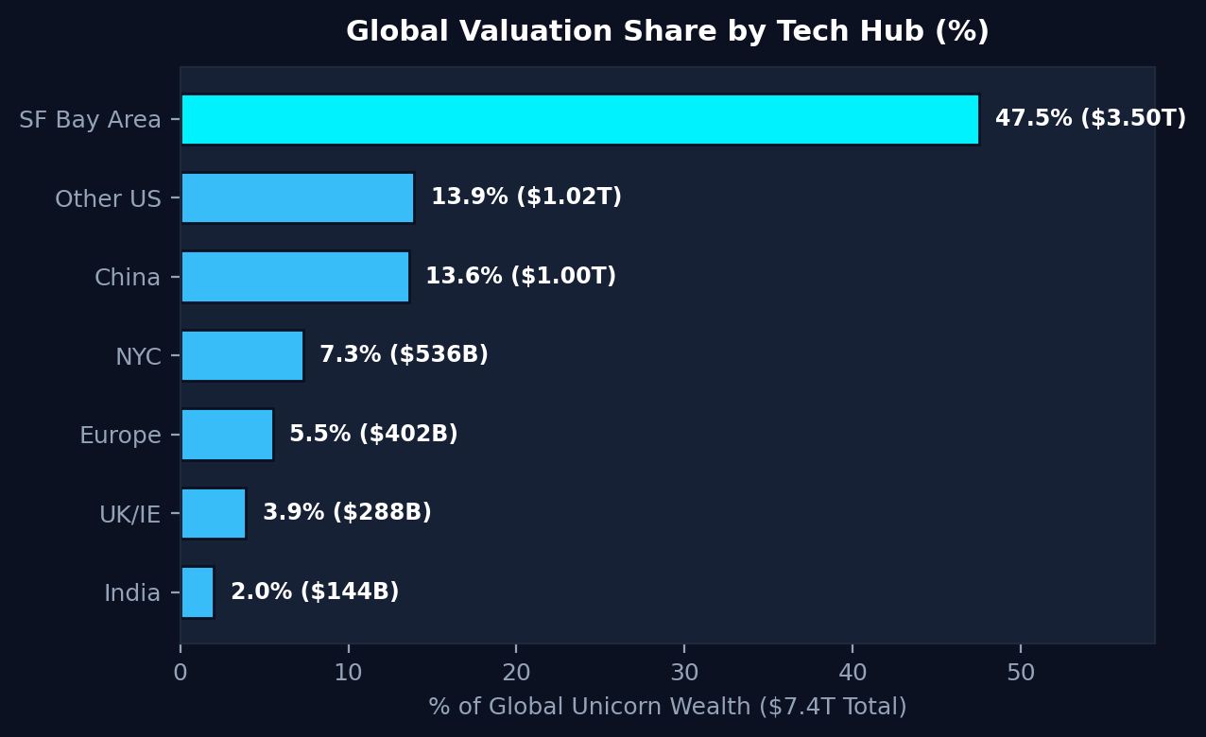
PART 3 • EXPLORATORY DATA ANALYSIS (QUESTION 1)
Key Finding 1: The Silicon Valley Wealth Monopoly
GLOBAL WEALTH SHARE
47.5%
Held by the SF Bay Area alone ($3,496 Billion out of $7,360 Billion total global unicorn capitalization).
MEDIAN BASELINE DISPARITY
$2.00B vs $1.60B
Typical Bay Area startup commands a 25% price premium over global baseline. Average is pulled to $9.90B by mega-titans.
REGIONAL ECOSYSTEM BREAKDOWN ($7.40T TOTAL)

Slide 4
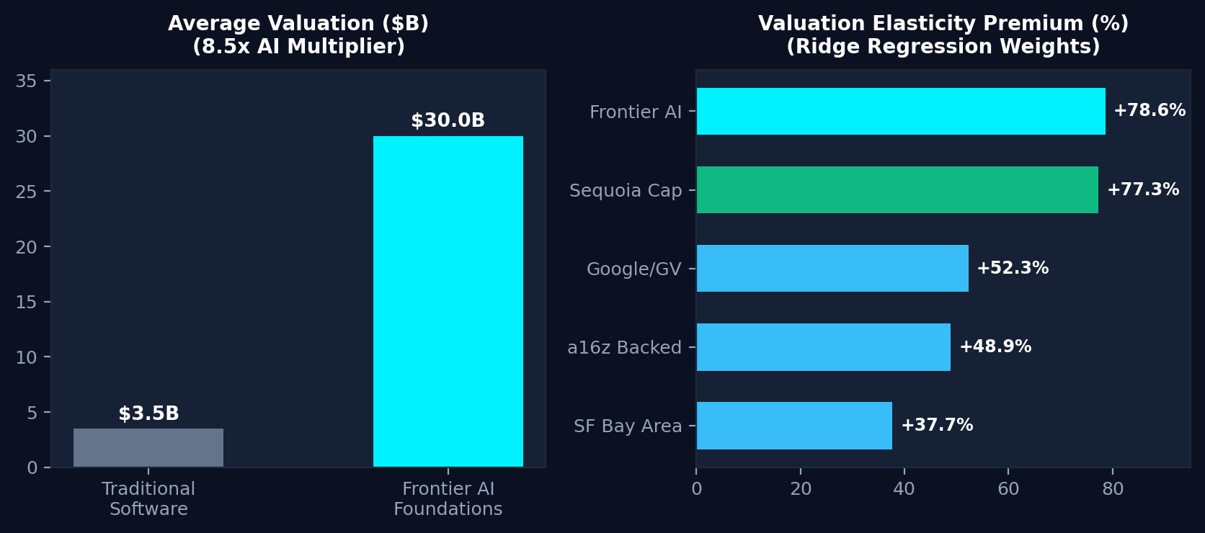
PART 3 • EXPLORATORY DATA ANALYSIS (QUESTION 2)
Key Finding 2: The Frontier AI Valuation Multiplier
THE 8.5X ARTIFICIAL INTELLIGENCE PREMIUM
• Average AI Valuation ($30.0B vs $3.5B):
Startups developing frontier foundation models average more than 8.5 times the valuation of traditional software peers.
• Enterprise Tech Dominance (54.3%):
Enterprise Tech & AI captures $3,994 Billion—over half of all global private unicorn value.
• The Centicorn Vanguard:
The top of the pyramid is dominated by foundation model creators: Anthropic ($965B), OpenAI ($840B), Databricks ($190B), and DeepSeek ($50B).
EMPIRICAL VALUATION MULTIPLIERS & REGRESSION WEIGHTS

Slide 5
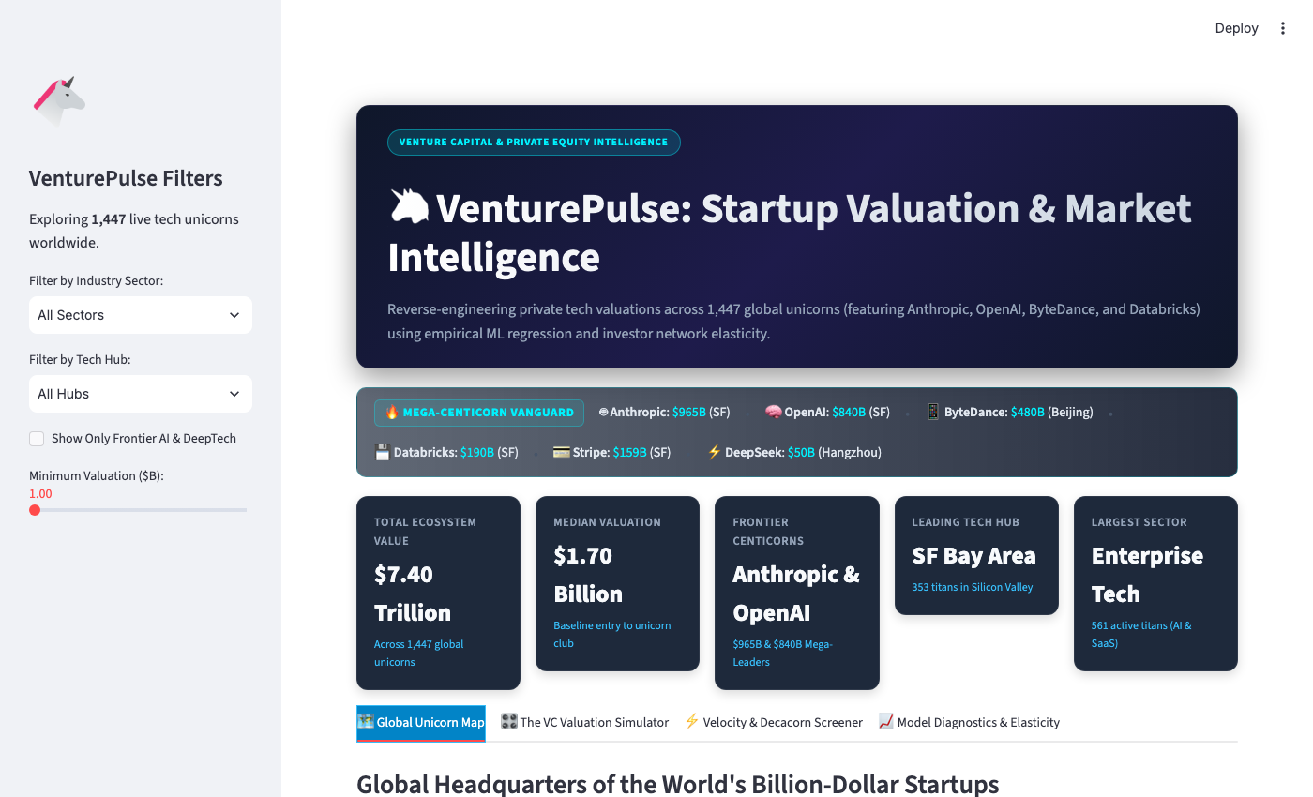
PART 5 • STREAMLIT APPLICATION & DECISION ENGINE
The Streamlit Data Product: VenturePulse Interactive Engine
PRODUCT ARCHITECTURE & CONTROLS
🗺️ TAB 1: 3D Geospatial Map:
Scatter plot of 1,447 unicorns with log-scaled bubbles and perspective toggles (Natural Earth, 3D Globe, Mercator).
🎛️ TAB 2: VC Valuation Simulator:
Predictive pricing tool with sliders (Age, Sector, Location, Elite VC Backers). Computes estimated valuation with 80% confidence interval and finds nearest 3 peer comps.
⚡ TAB 3: Decacorn Velocity Screener:
Identifies hyper-scaling outliers creating the highest annual enterprise value, plus full model weight transparency.
LIVE STREAMLIT DASHBOARD PREVIEW (app/app.py)

Slide 6
PART 6 • BOUNDARIES & ROADMAP
Limitations & Final Project Horizon
CURRENT PROJECT LIMITATIONS
• Survivorship Bias:
Our dataset only tracks startups that already crossed the $1B threshold. It does not predict early-stage startup bankruptcy or insolvency.
• Valuation Step-Function Opacity:
Private tech valuations only update when a new funding round is announced. A company's true operational health may drift between pricing events.
• Selection vs. Causation:
Elite VCs like Sequoia command high valuation correlations, but partly because they have privileged deal access to select the most promising founders.
ROADMAP FOR THE FINAL PROJECT
• NLP & Text Analytics:
Incorporate company pitch summaries and mission statements using text embeddings (TF-IDF or transformer embeddings) to identify semantic product trends.
• Unsupervised Cluster Discovery:
Apply K-Means or t-SNE / UMAP dimensionality reduction to discover emerging startup archetypes beyond broad industry labels.
• Deployment & Cloud Hosting:
Deploy the Streamlit application to Streamlit Community Cloud so classmates and instructors can interact on mobile/web without local terminal setup.

