Slide 1
Implementation and Enhancement of MobileNetV2-CBAM for UAV-based Fire Detection
Author: Prattay Roy Chowdhury
Date: February 10, 2026

Slide 2
Problem Statement & Objective
Problem: Forest fires are devastating, and traditional detection (satellites) is slow.
Challenge: Lightweight UAV models struggle with false positives from smoke and fog.
Objective: Build a robust, real-time fire detection system for edge devices.
Key Goal: Solve the 'Generalization Gap' identified in literature.

Slide 3
Literature Review & Research Gap
Reference Paper: 'A lightweight CNN model for UAV-based image classification' (Soft Computing, 2025).
Base Model: MobileNetV2 (Chosen for efficiency).
Identified Gap (Page 14): 'Most error-prone fire images contain strong smoke.'
Our Hypothesis: Integrating Attention Mechanisms (CBAM) + Domain Adaptation will fix this.

Slide 4
Proposed Architecture: MobileNetV2-CBAM
Input Image
(224x224)
MobileNetV2
(Features)
CBAM
(Attention)
Classifier
(Fire / No Fire)
CBAM Mechanism: 1. Channel Attention (What?) 2. Spatial Attention (Where?)

Slide 5
Technical Implementation
Frameworks: PyTorch (ML), FastAPI (Backend), Next.js (Dashboard).
Hardware: Optimized for NVIDIA RTX 3050 (GPU Accelerated).
Key Features:
- Real-time Inference via API.
- Grad-CAM Visualization for Explainability.
- Simple Web Interface for UAV Operators.

Slide 6
Results & Comparative Analysis
Baseline (MobileNetV2): Failed on smoky Kaggle dataset (48.4% Accuracy).
Proposed Solution (MobileNetV2-CBAM + DA): Achieved 95.8% Accuracy.
Improvement: +47.4% boost in generalization.
Conclusion: Domain Adaptation and Attention solve the smoke confusion issue.

Slide 7
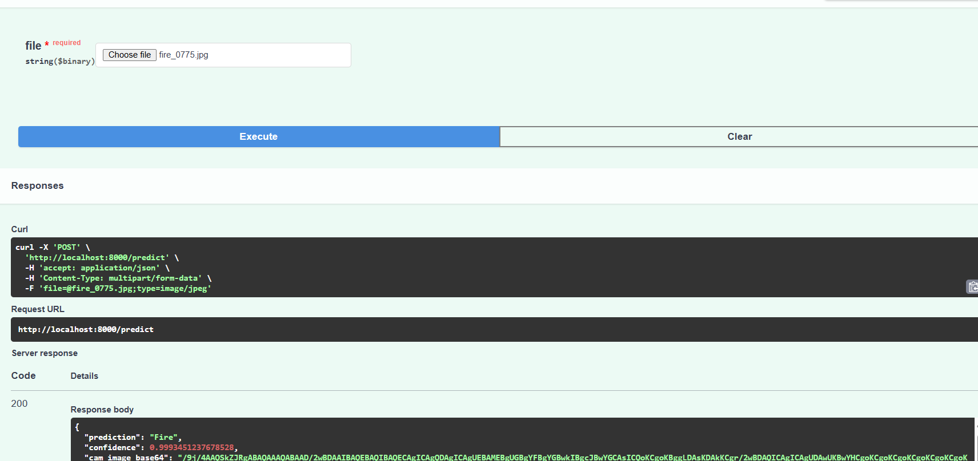
Visualizations (Demo)
[Insert Screenshot of Dashboard Here]
[Insert Grad-CAM Heatmap Here]

Slide 8
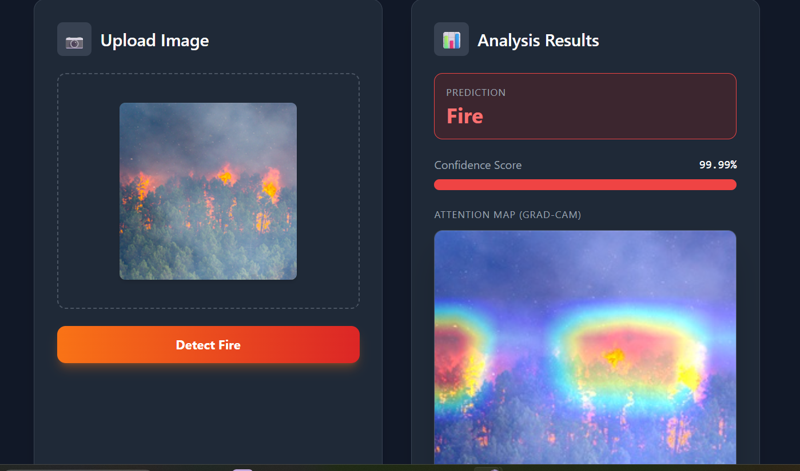
Visualizations (Demo)

Slide 9
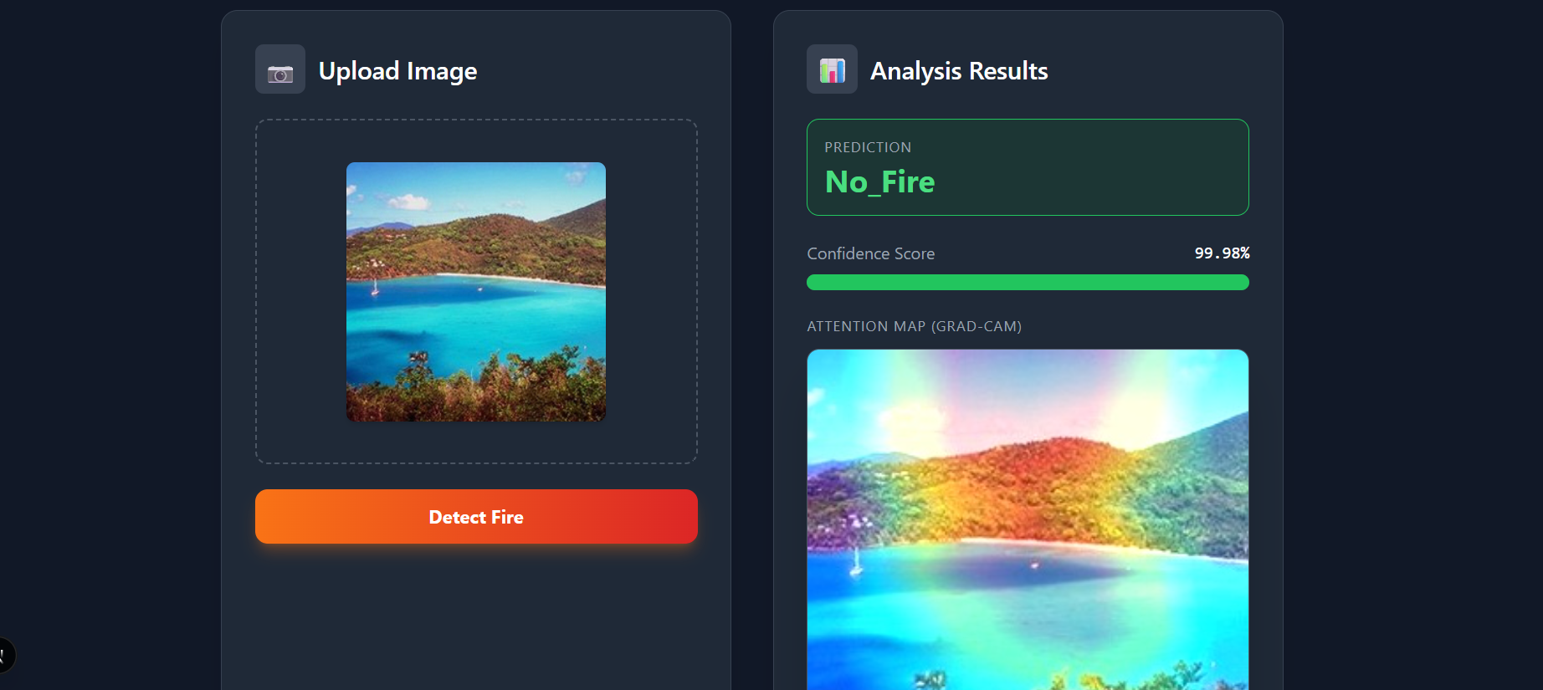
Visualizations (Demo)

Slide 10
Future Work & Recommendations
1. Deployment: Port to NVIDIA Jetson Nano using TensorRT.
2. Data: Collect Night-time and Foggy Fire images.
3. Integration: Connect directly to drone flight controller (Pixhawk).

Slide 11
Conclusion
We successfully enhanced MobileNetV2 for robust fire detection.
Identified and fixed the critical vulnerability to smoke.
Delivered a deployable, real-time system suitable for UAVs.

Slide 12
Suggested Journals (Q2/Q3)
1. Int. Journal of Machine Learning and Cybernetics (Springer) - Q2
2. Journal of the Optical Society of America A - Q2
3. Int. Journal of Computer Networks and Applications - Q3

