Slide 1
CS306: Data Analysis and Visualization
Project Presentation
Group Number : 4
Name: Pratvi Shah
Student ID: 201801407

Slide 2
Objective
Analyze how the marks of the students vary depending upon the external factors:
Amenities: Internet, TV, computer, washing machine, microwave oven, car, DVD, phone, mobile
Subjects: MAT S11, CR S11, CC S11, BIO S11, ENG S11
Family background: Education levels of mother and father, occupation of mother and father, number of people in a house
Socio-Economic factors: Stratum (Social status ranking), SISBEN ranking(well-being measure w.r.t. health,education, housing, and vulnerability)
Role of Gender

Slide 3
Data Cleaning and Grouping
Steps:
Boolean data was changed using one-hot encoding (Yes=1 and No=0)
Outliers removed using IQR methodology
Standardization to zero mean and one standard deviation
Categorical data converted to numeric data or using label encoding
Categorical data to numeric value using the description of the data

Slide 4
Analysis using visualization
Comment over marks
Comment over amenities
Comment over family background
Comment over Socio-economic factors
Comment over Gender stereotypes
Comment over traditional grading methods

Slide 5
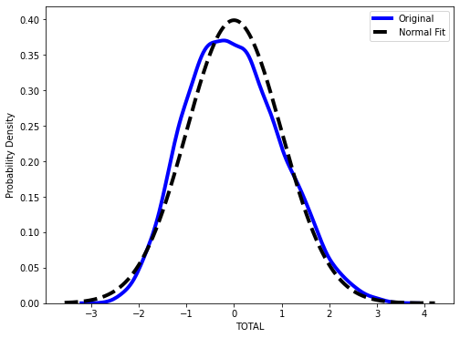
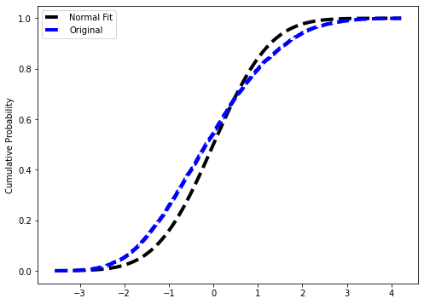
Comment over marks
The plot show the distribution of total marks obtained by taking average over all 5 subjects.
H_{.0} = Data comes from normal distribution
Sample size=100
Kstest results:
Ks2sampResult (statistic=0.1, pvalue=0.70205)
Sample size=11207
Ks2sampResult (statistic=0.096, pvalue=8.57132e-46)
Cohen’s d ≈0.325

Slide 6
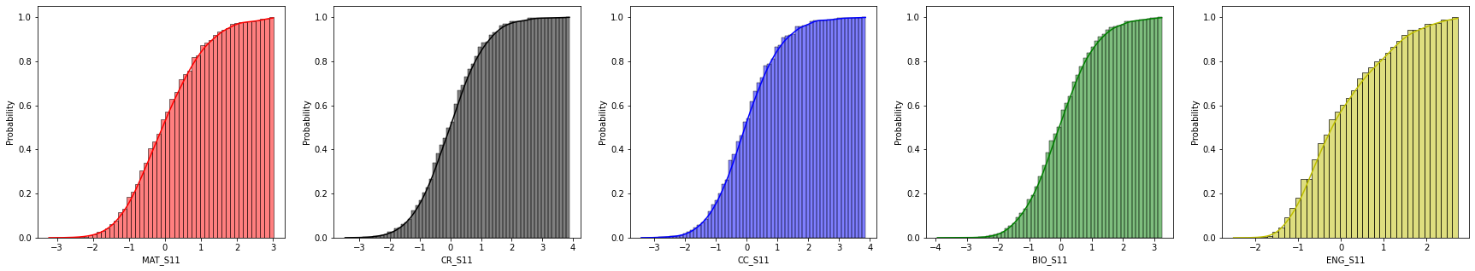
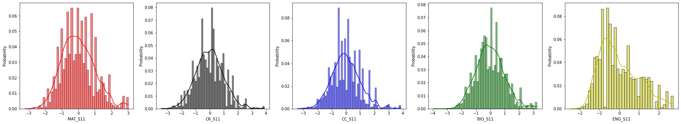
Distributions of Marks in 5 subjects

Slide 7
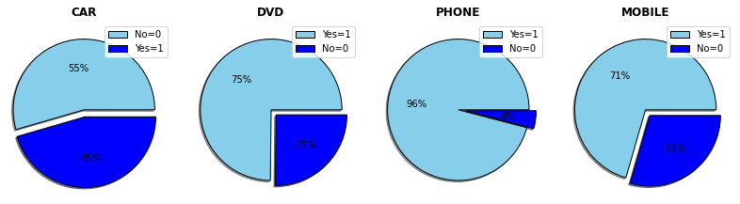
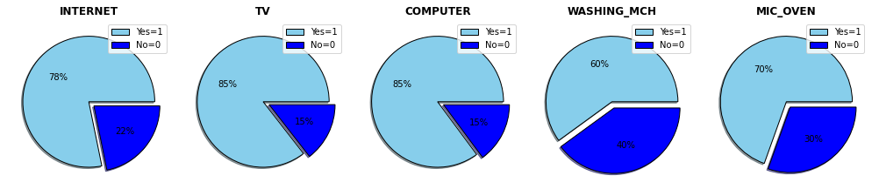
Comment over amenities

Slide 8
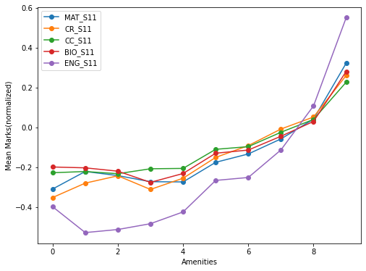
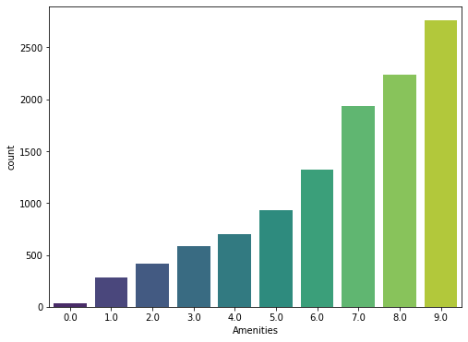
Higher amenities led to comfortable environment which allows students to focus more on studies and hence, better results.

Slide 9
Comment over family background
Factors:
Parental level of education
Parents’ occupation
People in the house

Slide 10
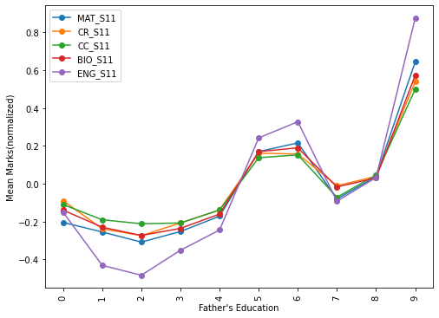
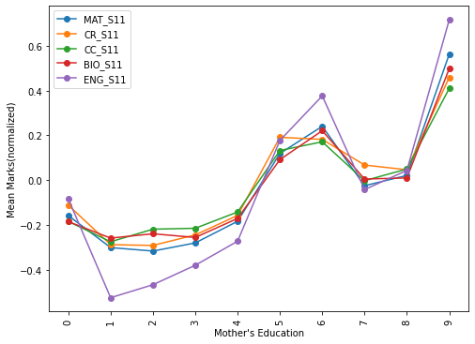
Education level of Parents

Slide 11
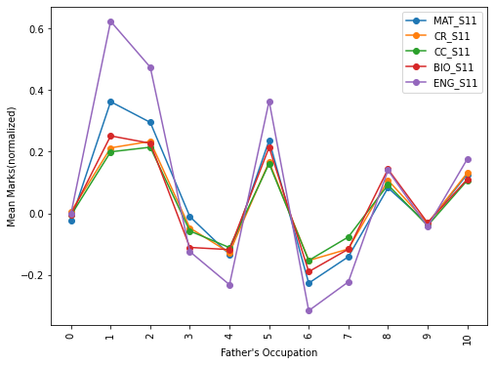
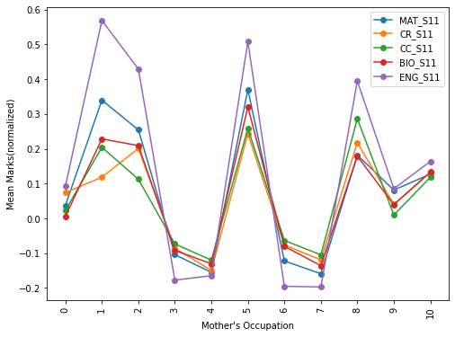
Occupation of Parents

Slide 12
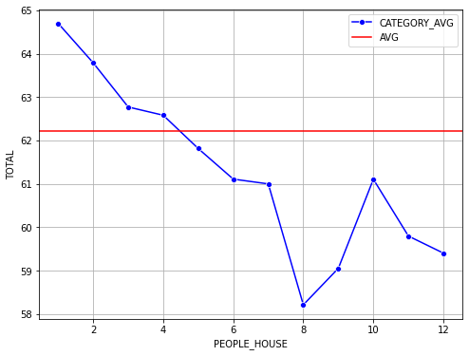
Effects of having a large number of people in the house
Students residing in nuclear families tend to perform better than the ones living/surrounded by a lot of people.
The performance of the students lie below the average performance of all the students.

Slide 13
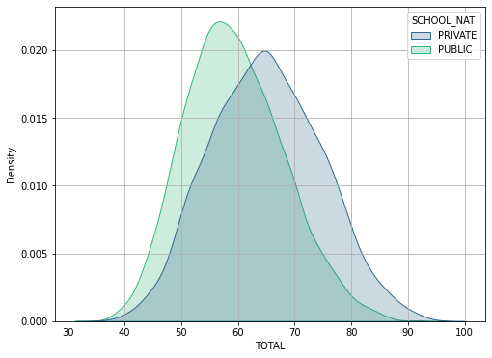
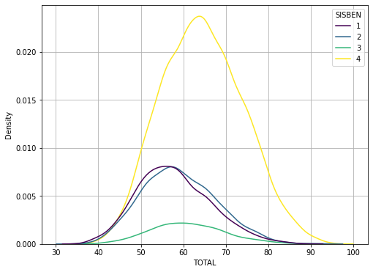
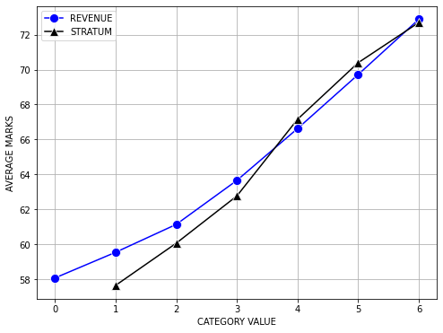
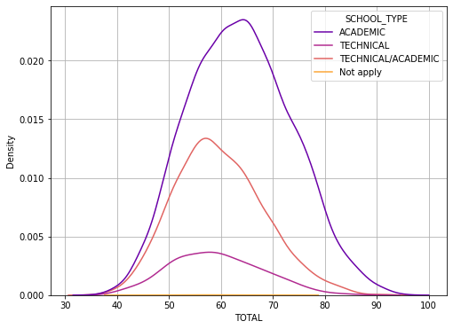
Comment over socio-economic factors

Slide 14
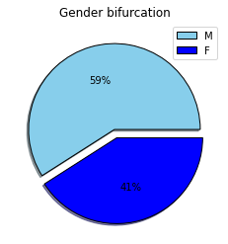
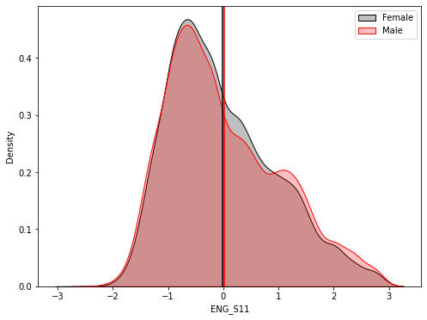
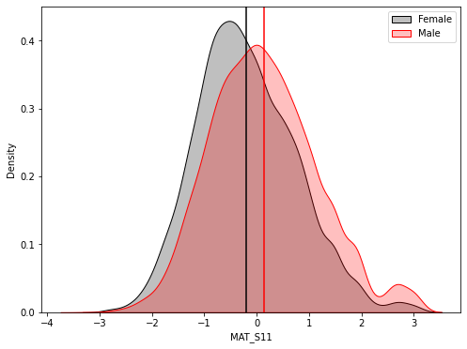
Comment over Gender stereotypes
Stereotype: Women perform worse than men in mathematics
The data is in accordance with this stereotype and also highlights the skewed gender ratio.

Slide 15
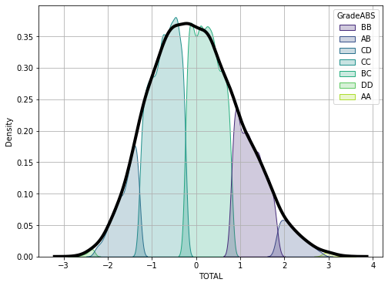
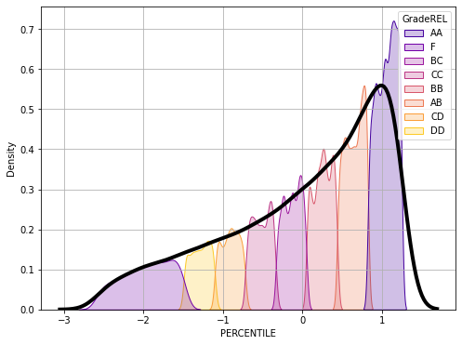
Comment over Grades
Absolute grading and the grading based on percentile of the students both have their drawbacks.

Slide 16
Conclusions
Not all curves that look normal are normally distributed
The data used for this project has majority of the population that is privileged.
The analysis based on gender suggested that the gender ratio of the population into consideration is skewed with male being in majority.
When the data is densein a certain range then the percentile grading will have distribution such that more number of students will get extreme grades in comparison to the absolute grading wherein for this data extreme values were not that prevalent
The analysis done in this project, with respect to the data available, show that the family background, socio-economic level and the access to amenities have an effect on the results of the students in their examination. So, these conditions should be factored in for evaluating in a holistic manner.

Slide 17
Thank you

