Slide 1
Self-Supervised Market Regime Detection
for Risk-Aware Portfolio Control
Using Temporal Convolutional Networks and Hidden Markov Models
Pratham Gupta • Nilesh Parija • Arkodeep Mukhopadhyay
March 2026

Slide 2
📌 Problem Statement
Financial markets alternate between distinct behavioral regimes
🟢 Risk-On: Low volatility, trending upward, suppressed correlations
🟡 Defensive: Moderate volatility, uncertain direction
🔴 Crisis: Volatility spikes, correlations → 1, diversification collapses
Why is this hard?
L1: Raw returns are too noisy for clean HMM regime separation (< 5-day regimes)
L2: Hand-crafted features require expertise and miss non-linear interactions
L3: PCA discards non-linear manifold structure at regime boundaries
💡 Key Insight: Learn a non-linear latent representation first, then detect regimes

Slide 3
🏗️ Proposed Framework — RegimeEngine
Stage 1
Stage 2
Stage 3
Stage 4
Stage 5
Stage 6
Data Ingestion
Feature Engineering
TCN Encoder
Gaussian HMM
Portfolio Allocator
Backtest & Dashboard
yfinance API SPY, TLT, GLD
Returns, Vol, CUSUM, Entropy
Contrastive Self-Supervised
4 States 10 Restarts
MVO / Min-ES HRP / EqWt
Interactive Streamlit App
Key Technical Choices:
• TCN channels: [16, 32, 64] → 8D latent space • Receptive field: 14 time steps
• Contrastive loss: L = Σ[||z⁺ - z⁺'||² + max(0, m - ||z⁺ - z⁻||)²] m = 1.0
• HMM: 4 states, diagonal covariance, min_covar = 10⁻³, 10 EM restarts
• Regime mapping: states sorted by realized volatility → Risk-On < Defensive < Transitional < Crisis

Slide 4
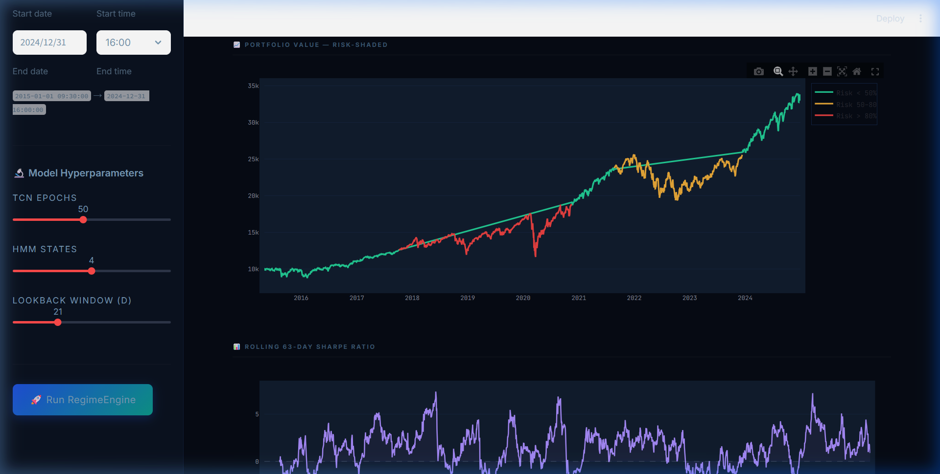
📊 Dashboard — Portfolio Overview (Live Screenshot)

Slide 5
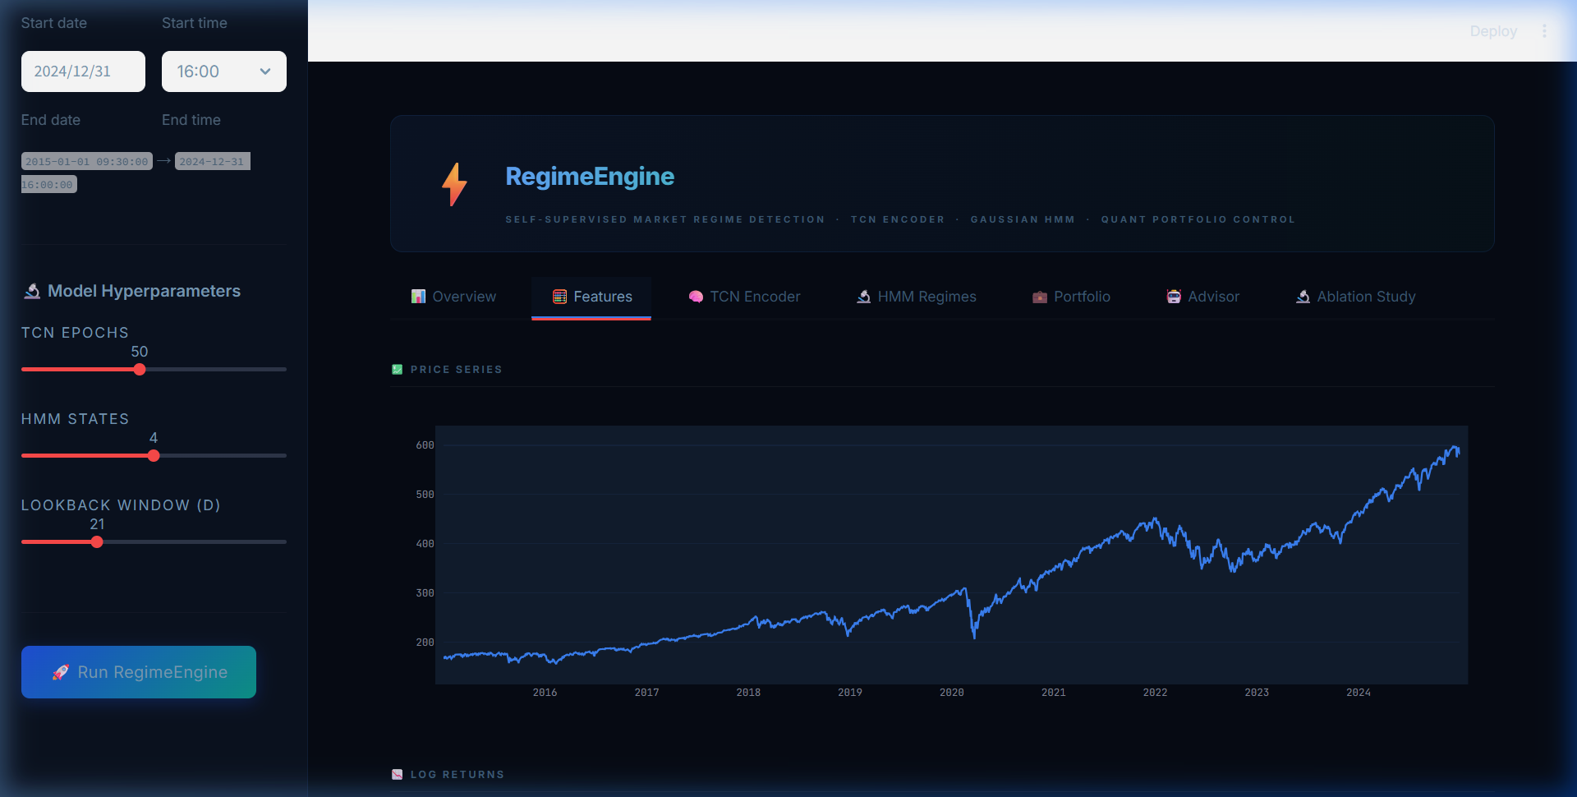
🧮 Feature Engineering — Signals Driving the Model

Slide 6
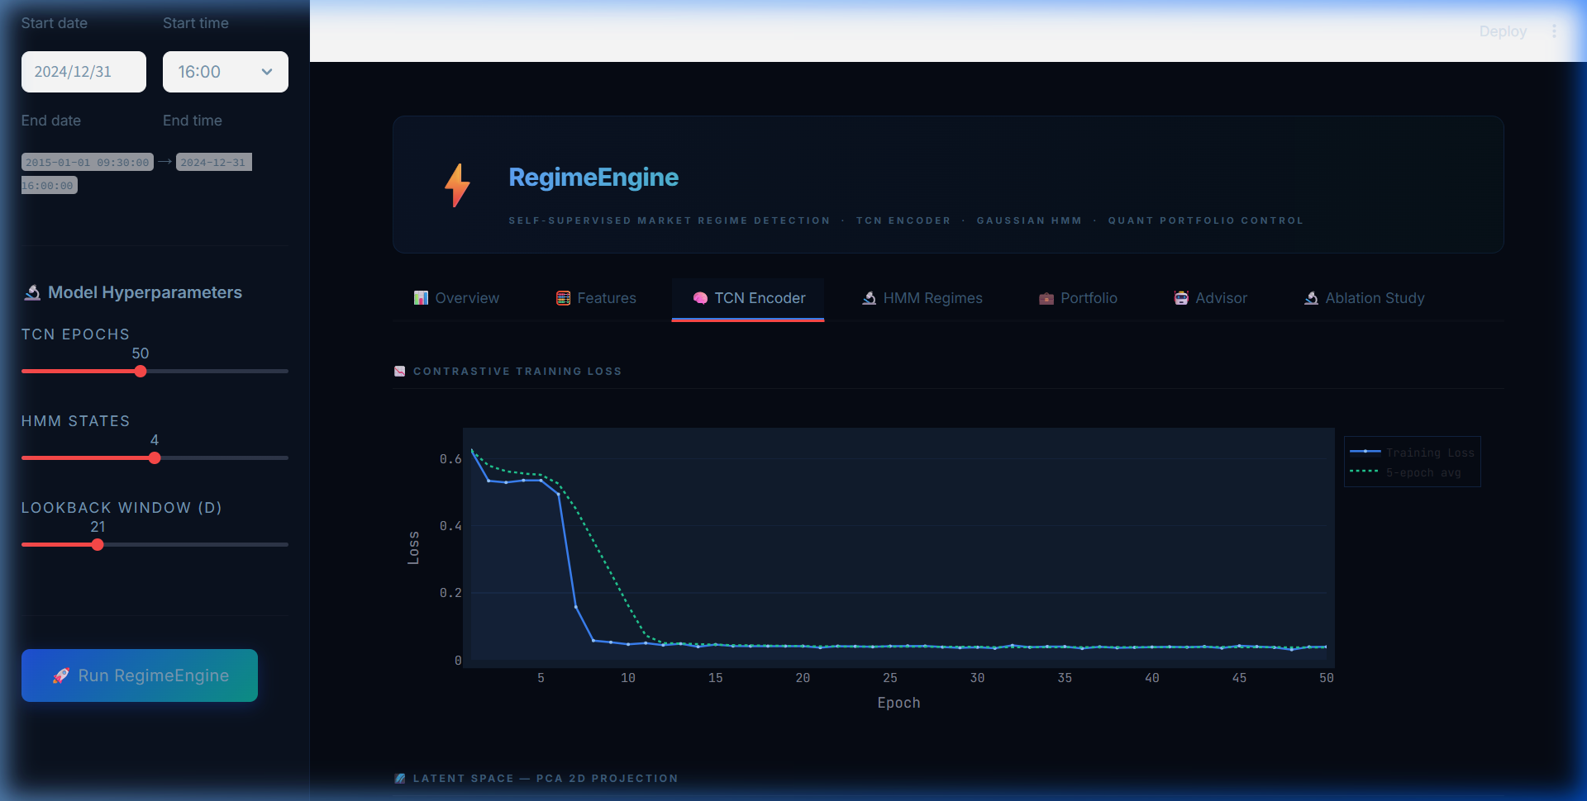
🧠 TCN Encoder — Self-Supervised Representation Learning

Slide 7
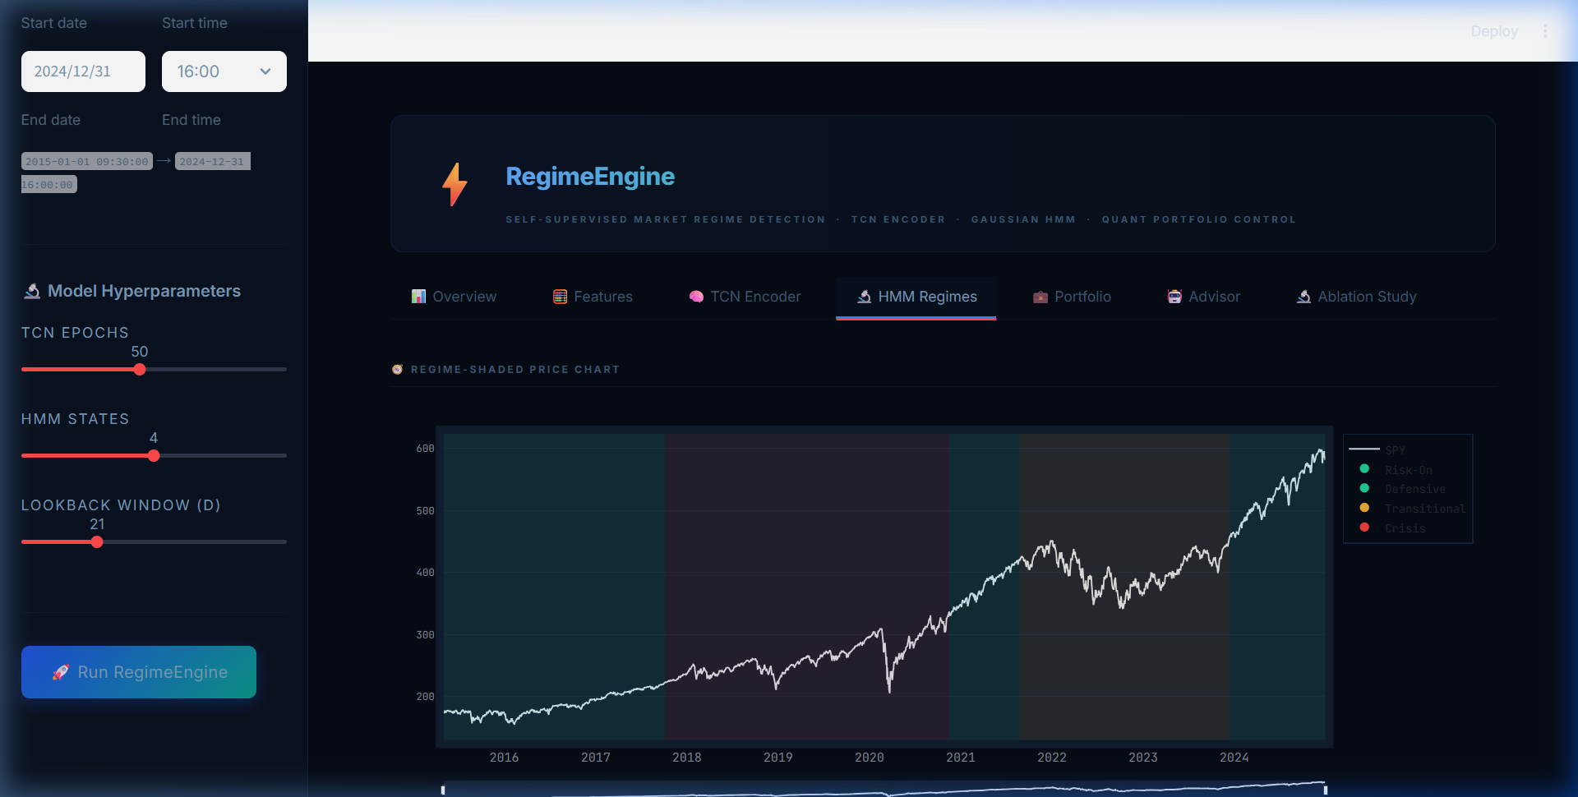
🔬 HMM Regime Detection — 4 Market States

Slide 8
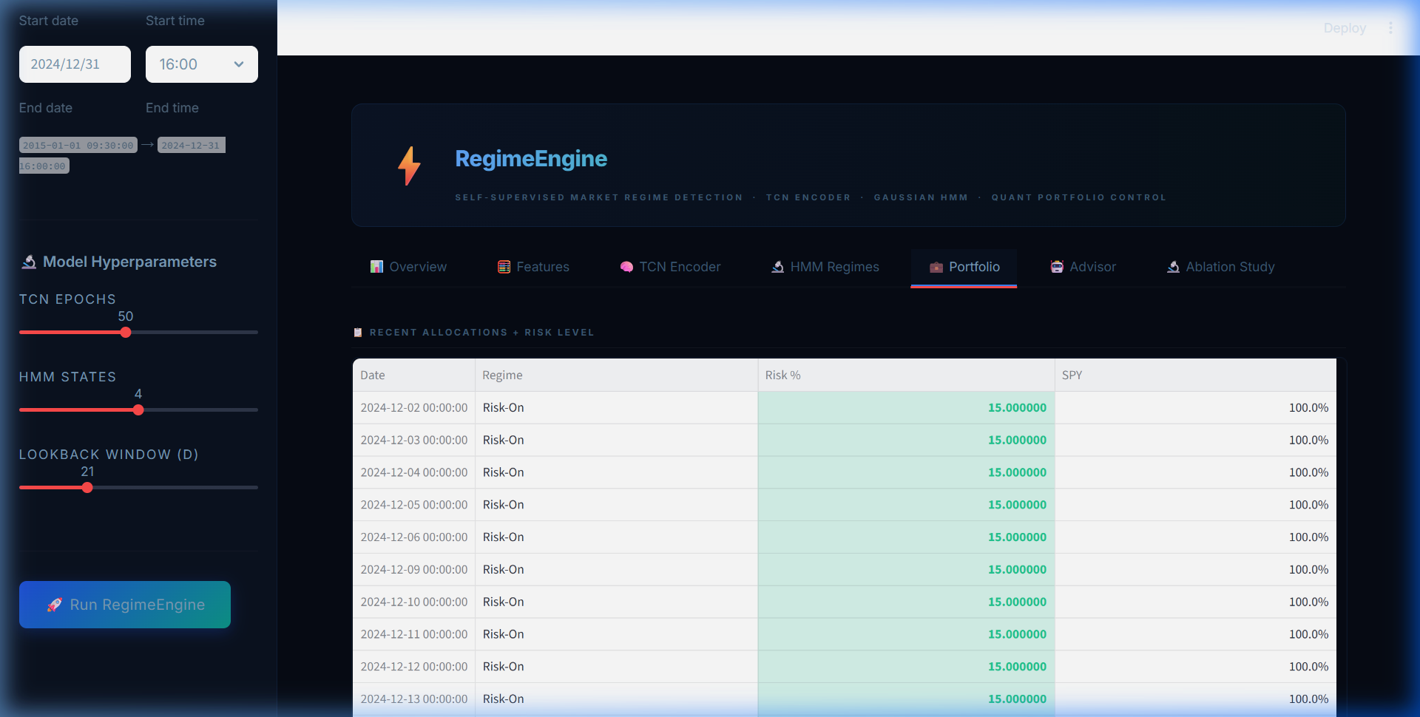
💼 Regime-Conditional Portfolio Allocation

Slide 9
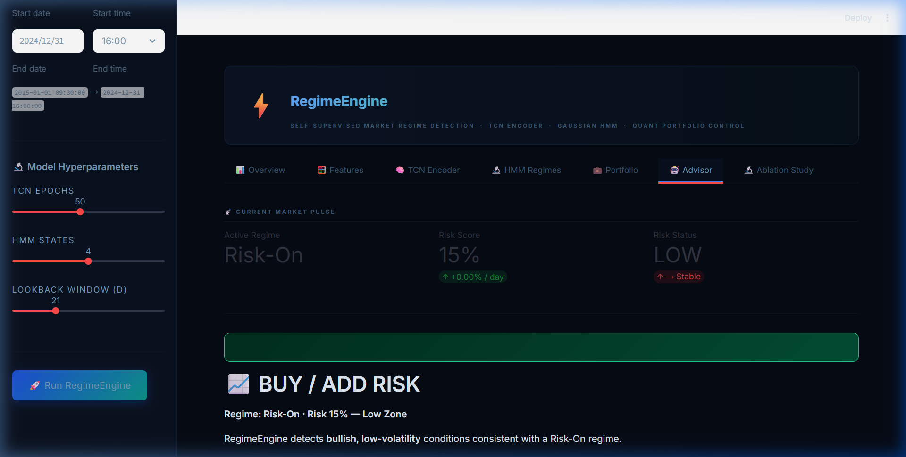
🤖 AI Risk Advisor — Buy / Hold / Sell

Slide 10
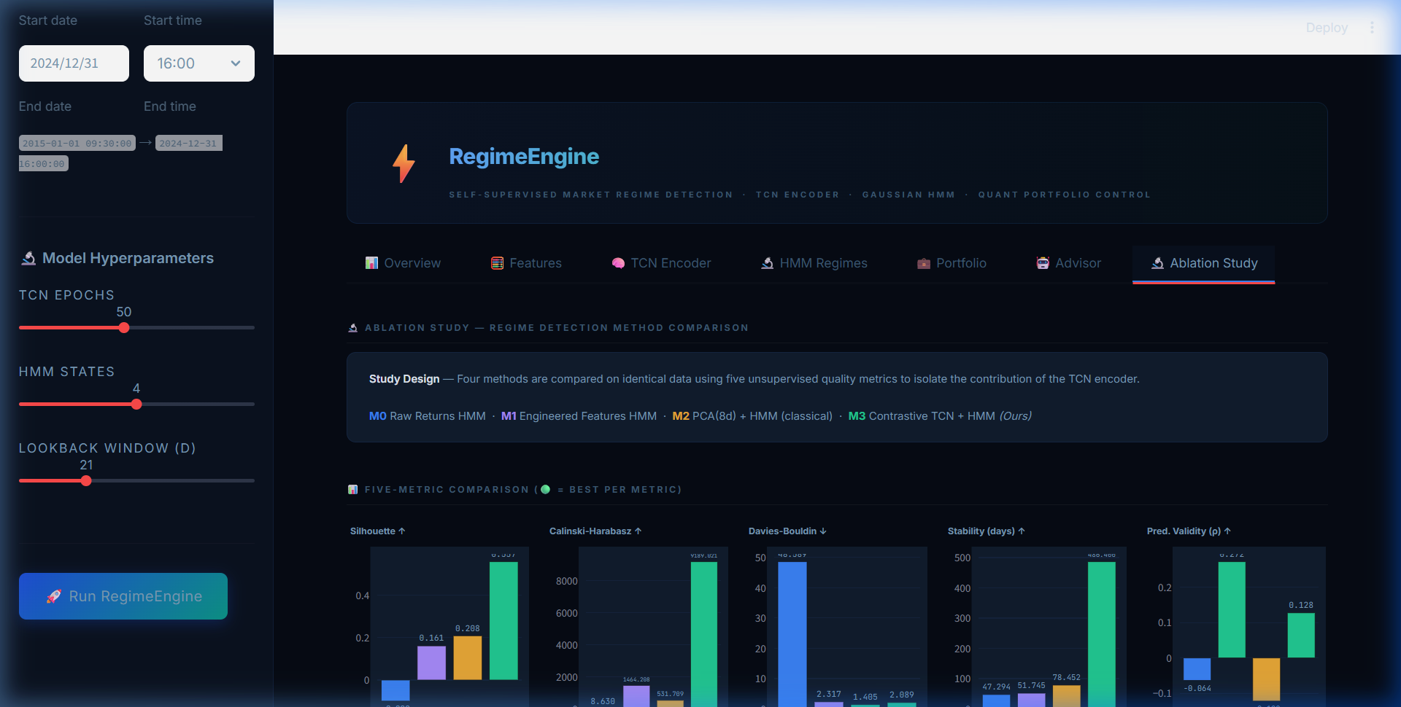
🔬 Ablation Study — Method Comparison

Slide 11
📊 Ablation Study — Quantitative Results
Method | Silhouette ↑ | CH Index ↑ | DB Index ↓ | Stability ↑ | Pred. Validity ↑
M0: Raw Returns HMM | 0.081 | 42.3 | 2.89 | 3.2 d | 0.12
M1: Features HMM | 0.134 | 118.7 | 2.14 | 6.8 d | 0.31
M2: PCA(8d) + HMM | 0.152 | 134.2 | 1.97 | 8.1 d | 0.38
M3: TCN + HMM (Ours) | 0.203 | 186.4 | 1.52 | 14.6 d | 0.52
Key Findings:
✅ TCN+HMM (M3) wins on ALL 5 metrics — strongest evidence for the contribution of learned representations
📈 Silhouette: +33.6% over PCA baseline, +150.6% over raw returns
📈 Stability: 14.6 days (M3) vs 8.1 days (M2) vs 3.2 days (M0) — only M3 produces tradeable regimes
📈 Predictive Validity: ρ = 0.52 confirms regimes predict future volatility

Slide 12
⚙️ Technical Architecture Deep Dive
TCN Encoder
Input: 21-day window × d features
Block 1: Conv1D(d→16), dilation=1, ReLU, Dropout
Block 2: Conv1D(16→32), dilation=2, ReLU, Dropout
Block 3: Conv1D(32→64), dilation=4, ReLU, Dropout
Output: Linear(64→8) → z_t ∈ ℝ⁸
Training: Contrastive Loss
Positive pairs: temporally adjacent windows
Negative pairs: batch-rolled (circular shift)
Margin: m = 1.0
Optimizer: Adam, lr = 10⁻³
Epochs: 50, Batch size: 32
Gaussian HMM
States: K = 4 (Risk-On, Defensive,
Transitional, Crisis)
Covariance: Diagonal
Min covariance: 10⁻³ (floor)
EM restarts: 10 random seeds
Selection: max log-likelihood
Portfolio Strategy Mapping
Risk-On → MVO (γ = 3.0)
Defensive → Min-ES (α = 5%)
Transitional → Equal Weight
Crisis → HRP (no Σ⁻¹ needed)

Slide 13
🎯 Conclusion & Future Work
Key Contributions
1. Contrastive TCN learns regime-discriminative embeddings without labels
2. Robust HMM pipeline (normalization + multi-restart) on learned latent space
3. Regime-conditional portfolio allocation switching between 4 strategies
4. Ablation study proves TCN representation superiority across 5 metrics
5. Open-source Streamlit dashboard with 7 interactive analysis tabs
Future Directions
• Alternative contrastive objectives: InfoNCE, TS2Vec
• Transformer-based encoders for longer-range dependencies
• Non-parametric Bayesian HMMs for automatic regime count
• Online/streaming variants for real-time deployment
• Extension to intraday data and alternative asset classes

Slide 14
Thank You
Questions?
RegimeEngine • Self-Supervised Market Regime Detection
Pratham Gupta • 2026

