Slide 1

Internship
( As FullStack Developer )
Project: Online Course & Learning Management System
Name: PRATYAKSH BHARDWAJ
Roll No.: 25SCS1003000700
Batch: 2CSE37
Program & Semester: B.Tech & Sem-3
Organization Name: CODEC Technologies
Notes:
Introduce yourself, the organization, and the one-line description of the project before moving on.

Slide 2
INTRODUCTION
INSTRUCTORS
One platform for courses, learners and the people who run them
Build and publish courses
Upload content, structure a curriculum, and set assessments.
LEARNERS
Enroll and progress
A web-based Learning Management System built during a Full Stack Developer internship at Codec Technologies.
Browse the catalogue, take courses, and see how far they have come.
ADMINS
Oversee the system
Manage users, courses, and access from one dashboard.
02
Notes:
Three roles, one system — that framing carries the rest of the deck.

Slide 3
PROBLEM STATEMENT
Classroom learning does not scale; the tools that should help are fragmented
TODAY
WHAT IS NEEDED
Learning limited by location, schedule and pace
No affordable, unified system to host courses
Learner records and progress kept separately
Existing tools hard to scale or customize
One web application
Create, manage and deliver courses online
Role-based access for admin, instructor, student
Progress tracked in the same place as the content
Institutions stitch several tools together.
This project scopes exactly that.
03
Notes:
Name the gap first, then the single-application answer. Do not oversell — this is a student project scope.

Slide 4
Project objectives
01
02
03
Full-stack LMS with three roles
Course creation and structure
Authentication and tracking
Admin, instructor and student, each with their own permissions.
Content upload and a curriculum organized into modules.
Login, enrollment, and progress recorded per learner.
04
05
Responsive interface
Secure, scalable backend
An intuitive UI that works across desktop, tablet and phone.
A REST API architecture with validation at the boundary.
04
Notes:
Five objectives; the sixth cell is deliberately a pointer, not a step.

Slide 5
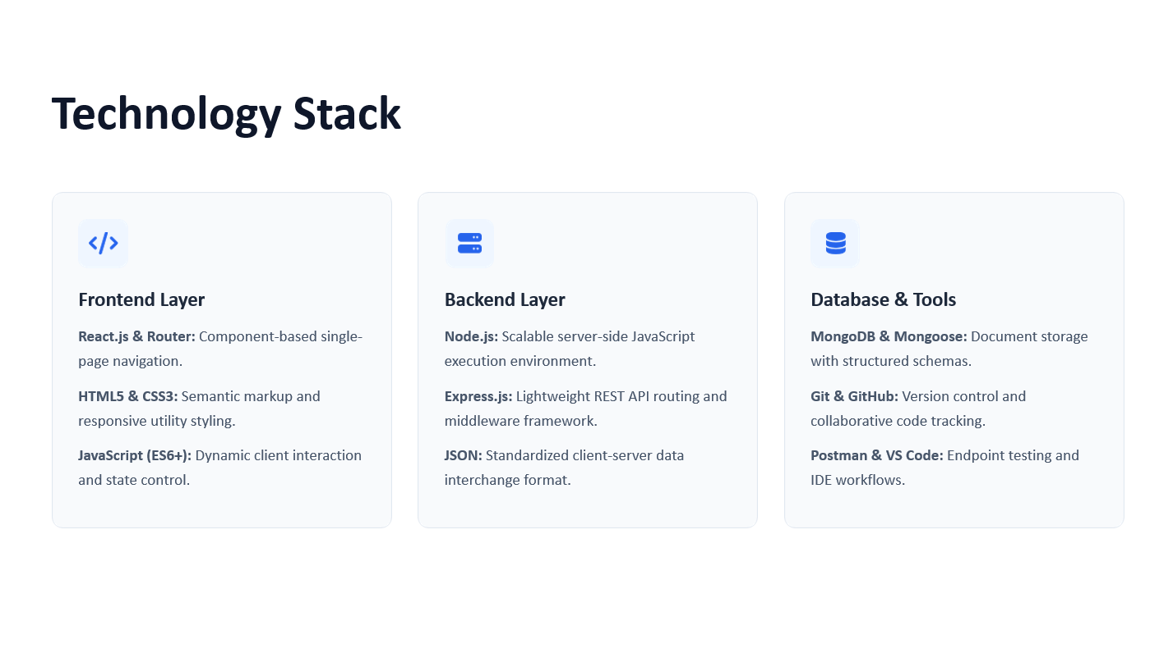

Slide 6





Functional modules
USER
COURSE
ENROLLMENT
ASSESSMENT
ADMIN
Accounts and access
Create and structure
Browse and progress
Quizzes and grading
Oversight dashboard
Registration, login, and role-based access for admin, instructor and student.
Course creation, content upload, and curriculum structuring into modules.
Browsing the catalogue, enrolling in a course, and tracking completion.
Quizzes, learner submissions, and grading tied back to the course.
A single dashboard for user and course oversight across the platform.
07
Notes:
Five modules, one per column. Say which one you built first and why.

Slide 7
Development workflow
BRANCH | Codebase on Git and GitHub — a feature branch per module.
API FIRST | Endpoints built and tested in Postman — before any frontend integration.
IN PARALLEL | Frontend and backend developed side by side — integrated at sprint checkpoints.
REVIEW | Reviewed and merged once the module passes testing — then the next branch opens.
08
Notes:
This is the working rhythm, not a calendar. Mention what Postman caught before integration.

Slide 8
EXPECTED OUTCOME
A working LMS, and the practice of shipping one
A fully functional LMS. Students browse, enroll in, and complete courses in one place.
Instructor content tools. Courses and their material are created and managed without help from an admin.
A centralized admin dashboard. Users and courses are overseen from a single view.
Hands-on full-stack experience. API design, database modelling, and real-world project delivery.
09
Notes:
Close on the learning outcome — that is what the internship is assessed on.

Slide 9
Future enhancements
Next · live classrooms and certificates build on modules already in place
Later · recommendations and analytics need usage data first
Separate track · the mobile client reuses the same REST API
1
Live virtual classrooms. Video conferencing integrated into the course page.
2
AI-based course recommendations. Suggestions tailored to learner progress.
3
Mobile app version. The same courses, available on the go.
4
Certification and badges. Issued automatically on course completion.
5
Analytics dashboard. Deeper insight into learner performance.
10
Notes:
Order matters here: the first two extend existing modules, the last three need data or a new client.

Slide 10
Thank You

