Slide 1
HR Analytics – Employee Attrition Prediction
BY- Pratyaksh Gupta
Aspiring Data Analyst

Slide 2
Executive Summary
• Built attrition prediction models using Logistic Regression and Decision Tree
• Achieved ~85% predictive accuracy
• Developed Power BI dashboards for HR decision-making
• Identified overtime, income, age, and satisfaction as key attrition drivers

Slide 3
Business Problem
Employee attrition increases hiring costs and impacts productivity.
Goal: Predict attrition risk and help HR take proactive retention actions.

Slide 4
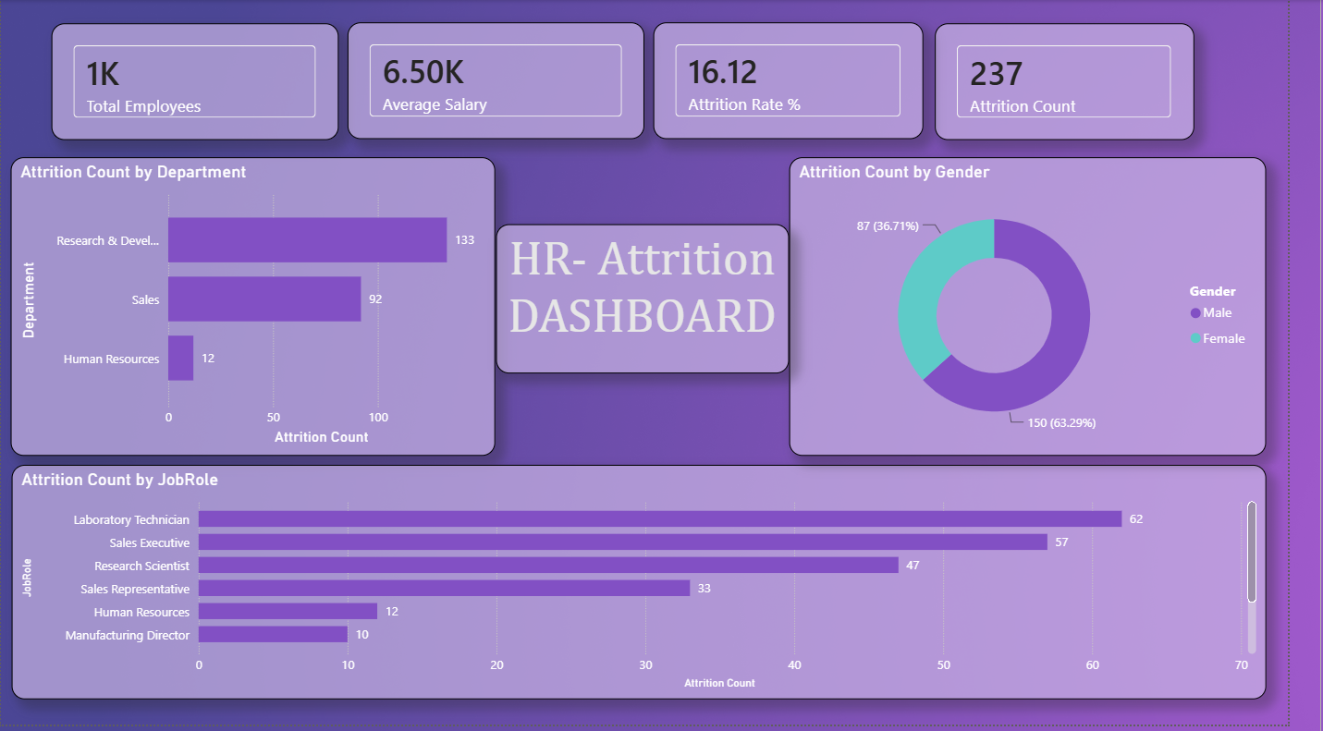
Executive Dashboard

Slide 5
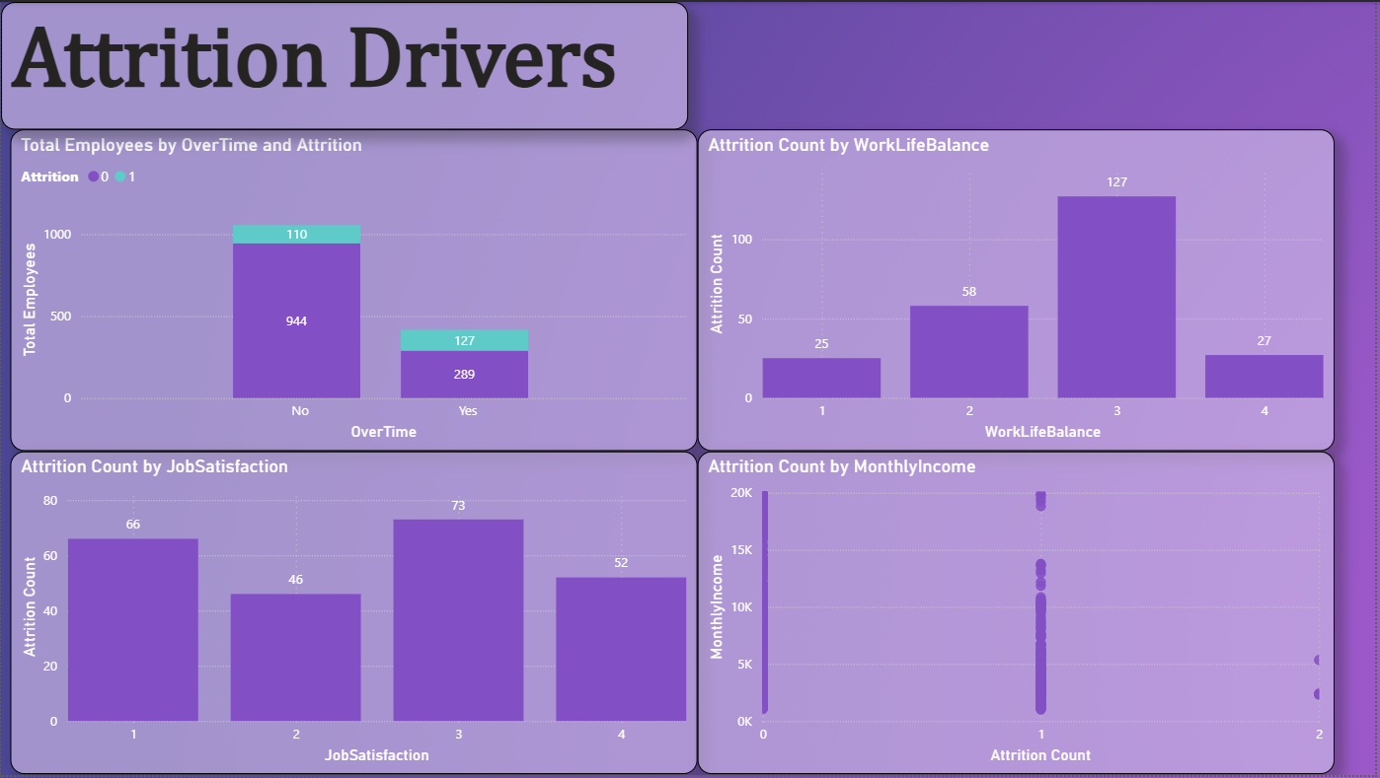
Attrition Drivers

Slide 6
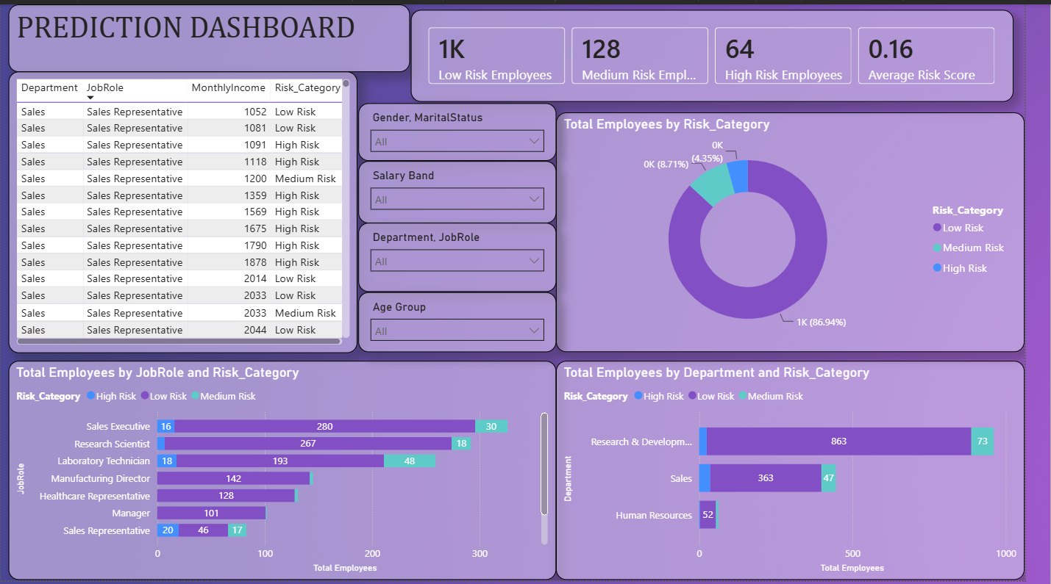
Prediction Dashboard

Slide 7
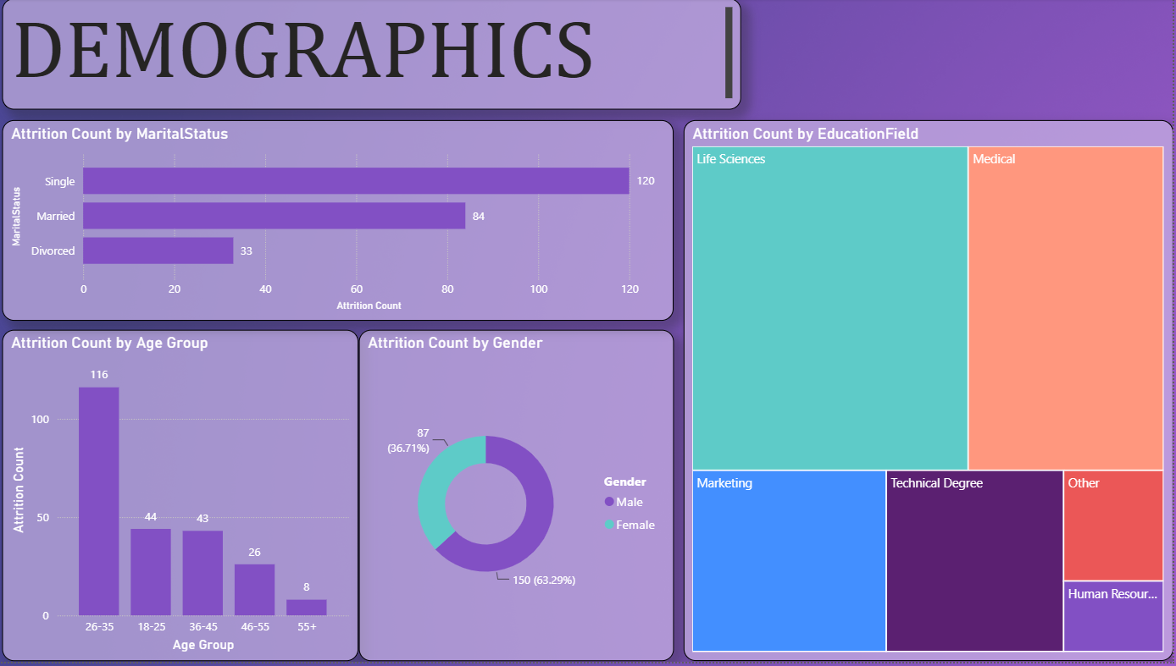
DEMOGRAPHICS

Slide 8
Key Insights
• Overtime is the strongest attrition driver
• Research & Development and Sales show highest attrition
• Laboratory Technicians and Sales Executives have elevated turnover
• Majority of employees fall into Low Risk category

Slide 9
Recommendations & Conclusion
• Monitor high-risk employees regularly
• Reduce excessive overtime
• Improve employee engagement and career growth initiatives
• Use predictive analytics to support retention strategies

