Slide 1
EDI PROJECT – PPT FOR MID SEMESTER ASSESSMENT – 13th MARCH, 2026
PROJECT_TITLE :- Reducing Hallucinations in Large Language Models Through Prompt Compression
Div:- CS-J ASEP2_GROUP No :- 1 Day:- FRIDAY Date:13/3/2026
Presented by :-
Project Guide :-
03) Prathmesh Tiwari (12414231)
06) Pratyay Patel (12413267)
40) Sagar Santhosh (12411275)
55) Ruhaan Sande(12413585)
Dr. Radhika Kulkarni
DEPARTMENT OF ENGINEERING SCIENCES AND HUMANITIES (DESH)
VISHWAKARMA INSTITUTE OF TECHNOLOGY, PUNE

Slide 2
Reducing Hallucinations in Large Language Models Through Prompt Compression
Large Language Models (LLMs) have emerged as one of the most transformative technologies in artificial intelligence, demonstrating remarkable capabilities across diverse domains. These sophisticated models are trained on massive text datasets encompassing billions of tokens, enabling them to perform an extensive range of tasks including question answering, document summarisation, logical reasoning, and engaging in natural conversational dialogue.
Prominent examples of modern LLMs include the GPT series, LLaMA architecture, and Phi-3 models, each demonstrating increasingly sophisticated language understanding and generation capabilities. Despite their impressive performance, these models suffer from a critical limitation known as hallucination—a phenomenon where the model generates responses that are factually incorrect, entirely fabricated, or unsupported by the provided context, yet presented with unwavering confidence and fluency.
Hallucinations pose significant risks in safety-critical applications such as healthcare diagnostics, educational instruction, financial decision-making, and scientific research, where factual accuracy is paramount. This project investigates whether prompt compression—removing unnecessary information from input prompts—can reduce hallucinations by eliminating redundant or irrelevant context that may confuse the model.

Slide 3
Project Objectives
This research aims to systematically study the impact of prompt compression on hallucination rates in large language models. Through rigorous experimentation and evaluation, the project addresses several key questions about the relationship between prompt length and factual reliability.
01
02
03
Analyse Hallucination Behaviour
Implement Compression Pipeline
Evaluate Response Quality
Compare answers generated using original prompts versus compressed prompts across multiple quality dimensions
Investigate how frequently language models generate unsupported or incorrect information when answering questions across diverse contexts
Develop an automated prompt compression system using advanced techniques to reduce prompt length whilst preserving semantic meaning
04
05
Measure Hallucinations
Study Prompt Length Effects
Deploy automated metrics using Natural Language Inference techniques to determine whether generated answers are supported by context
Analyse whether prompt compression effectiveness varies between large prompts compared to small prompts

Slide 4
Technical Framework
Core Technologies
Specialised Components
The project leverages modern machine learning frameworks and specialised tools to implement the experimental pipeline. Python serves as the primary programming language, selected for its extensive ecosystem of machine learning libraries and natural language processing tools.
LLMLingua serves as the prompt compression framework, designed specifically to reduce prompt length whilst preserving critical semantic information through intelligent token removal.
RoBERTa-large-MNLI acts as the hallucination detection model, employing Natural Language Inference to verify whether generated answers logically follow from the provided context.
The Hugging Face ecosystem provides streamlined access to pretrained language models, tokenisers, and evaluation frameworks, enabling rapid prototyping and experimentation.
Language Models
Compression Framework
Evaluation Model
TinyLlama
Phi-3 Mini
RoBERTa-large-MNLI for NLI-based hallucination detection
LLMLingua for intelligent prompt length reduction
Lightweight, efficient models capable of reasoning tasks

Slide 5







System Architecture
The experimental pipeline consists of six interconnected stages that systematically process input data, generate model responses, and evaluate hallucination behaviour. Each stage plays a crucial role in ensuring rigorous and reproducible experimentation.
Dataset Loading
Question answering datasets loaded and structured into samples containing context, question, and ground truth answer
Prompt Construction
Context and question combined into model-suitable format with clear instructions
Prompt Compression
Redundant tokens removed whilst preserving semantic information
Answer Generation
Language model produces responses for both original and compressed prompts
Evaluation
Multiple metrics applied: exact match, keyword matching, NLI support scores
Result Analysis
Comparative analysis of hallucination rates between compressed and uncompressed prompts

Slide 6
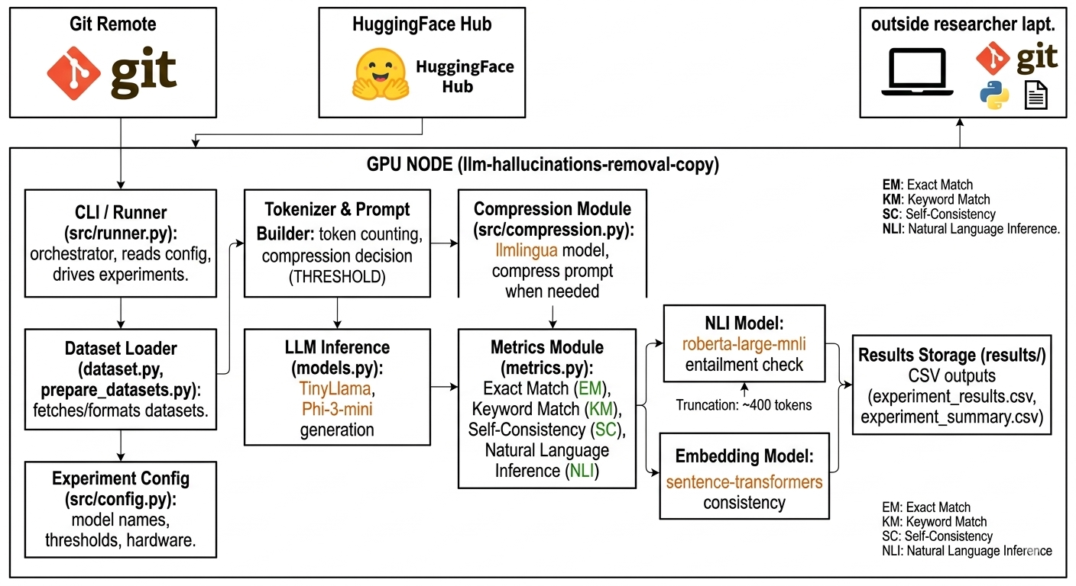
System Architecture Diagram

Slide 7
Methodological Approach
The research employs an experimental methodology designed to isolate the effect of prompt compression on hallucination rates. By systematically comparing model responses across compressed and uncompressed conditions, the study establishes causal relationships between prompt length and factual reliability.
Dataset Preparation
1
Multiple datasets with varying prompt sizes selected, including both short prompts and long context prompts to study compression behaviour under different conditions
2
Prompt Generation
For each sample, a structured prompt constructed using context and question, instructing the model to produce concise answers
Compression Experiment
3
Two parallel experiments performed: original prompt (no compression) versus compressed prompt (using LLMLingua) for direct comparison
4
Answer Generation
Selected language models generate answers for each prompt version, maintaining identical parameters and temperature settings
Hallucination Detection
5
Natural Language Inference model evaluates whether generated answer is logically supported by provided context; unsupported answers classified as hallucinations
6
Result Comparison
Hallucination scores compared between compressed and uncompressed prompts to determine effectiveness of prompt compression

Slide 8
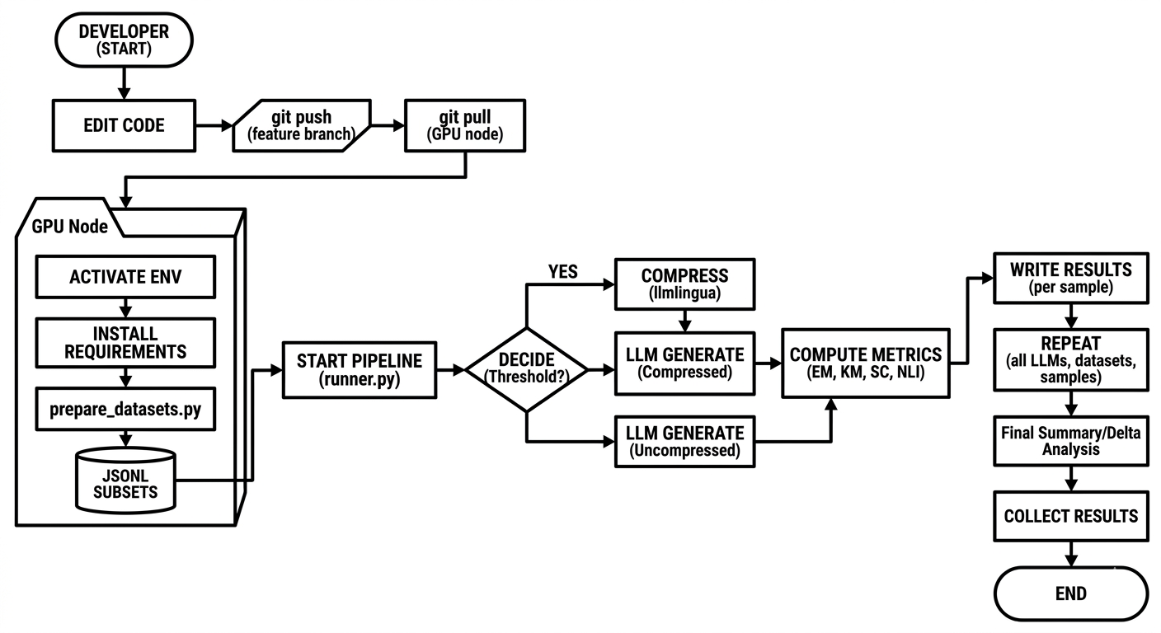
User Flow Diagram

Slide 9

Prompt Length Analysis
The effect of compression varies substantially depending on the initial prompt length. Understanding this relationship is crucial for determining when prompt compression provides practical benefits versus when alternative approaches may be more effective.
Short Prompts
Minimal hallucination reduction
Potential information loss
Compression less effective
Medium Prompts
Moderate hallucination reduction
Efficient compression ratio
Balanced trade-offs
Long Prompts
Significant redundancy removal
Improved factual consistency
Most effective application

Slide 10
Experimental Results
Key Findings
Quantitative Insights
The experimental results reveal important insights into the relationship between prompt compression and hallucination reduction. The analysis demonstrates that prompt compression significantly reduces token count in input prompts, improving computational efficiency without sacrificing response quality.
Substantial token reduction achieved
Efficiency gains demonstrated
Size-dependent effectiveness observed
Redundancy removal in longer prompts
Modest consistency improvements
However, the impact on hallucination rates depends critically on prompt size. For short prompts, compression does not significantly reduce hallucinations and may occasionally remove useful contextual information, potentially increasing error rates.
For longer prompts, compression proves more beneficial, successfully removing redundant context and achieving modest improvements in factual consistency. The reduction in hallucinations correlates with the degree of compression applied.

Slide 11






Future Research Directions
Whilst this project demonstrates the potential of prompt compression, several promising avenues for future research could substantially enhance hallucination reduction and practical applicability.
Retrieval System Integration
Larger Model Testing
Dynamic Compression
Combining prompt compression with retrieval-based systems could improve factual grounding by providing verified external knowledge sources
Evaluating the approach using larger architectures such as GPT-4 to analyse whether compression behaves differently with more powerful models
Developing adaptive compression strategies that preserve critical information more effectively through context-aware techniques
Advanced Detection
Real-world Applications
Training Integration
Implementing more sophisticated evaluation methods including fact-checking systems and knowledge graph verification
Integrating the technique into chatbots, virtual assistants, and document analysis systems to improve reliability
Exploring whether compressed prompts during training improve model robustness to hallucination

Slide 12
Conclusion
This project systematically investigated whether prompt compression can reduce hallucinations in large language models through experimental evaluation using TinyLlama and Phi-3 Mini architectures. The study implemented a comprehensive pipeline that compresses prompts before model processing and compares generated responses with those produced using original prompts.
Token Efficiency
Size-Dependent Effects
Not Standalone Solution
Prompt compression achieved substantial token reduction, improving computational efficiency
Impact varies by prompt length—limited benefit for short prompts, modest improvement for longer prompts
Prompt compression alone insufficient for robust hallucination reduction
The findings suggest that prompt compression is a promising technique for improving LLM efficiency, but should be combined with additional methods such as retrieval augmentation, fact-checking systems, and training modifications to effectively reduce hallucinations in safety-critical applications.

Slide 13

Summary
Objective
Study prompt compression impact on LLM hallucinations
Tools
Python, Hugging Face, LLMLingua, RoBERTa-MNLI
Findings
Token reduction achieved; size-dependent hallucination effects
Insight
Compression improves efficiency but requires complementary methods
Prompt compression represents one component of a broader strategy for improving LLM reliability. Future work should explore hybrid approaches combining compression with retrieval systems, dynamic strategies, and advanced hallucination detection to achieve robust factual consistency in production systems.

Slide 14
References
Du, Y., Tian, M., Ronanki, S., Rongali, S., Bodapati, S., Galstyan, A., Wells, A., Schwartz, R., Huerta, E. A., & Peng, H. (n.d.). Context Length Alone Hurts LLM Performance Despite Perfect Retrieval.
Jiang, H., Wu, Q., Lin, C.-Y., Yang, Y., & Qiu, L. (n.d.). LLMLingua: Compressing Prompts for Accelerated Inference of Large Language Models. Retrieved https://aka.ms/LLMLingua.
Jiang, H., Wu, Q., Luo, X., Li, D., Lin, C.-Y., Yang, Y., & Qiu, L. (n.d.). LongLLMLingua: Accelerating and Enhancing LLMs in Long Context Scenarios via Prompt Compression (Vol. 1). Retrieved https://cohere.com/rerank
Li, J., Cheng, X., Zhao, W. X., Nie, J.-Y., & Wen, J.-R. (2023). HaluEval: A Large-Scale Hallucination Evaluation Benchmark for Large Language Models. http://arxiv.org/abs/2305.11747
Pan, Z., Wu, Q., Jiang, H., Xia, M., Luo, X., Zhang, J., Lin, Q., Rühle, V., Yang, Y., Lin, C.-Y., Vicky Zhao, H., Qiu, L., & Zhang, D. (n.d.). LLMLingua-2: Data Distillation for Efficient and Faithful Task-Agnostic Prompt Compression. Retrieved https://aka.ms/LLMLingua-2

