Slide 1
Optimisation of Parameters in FDM Process
By Akash, Rit, Pratyay, Souhardik, Dipesh

Slide 2
CONTENTS
CHAPTER 1
INTRODUCTION
FUSED DEPOSITION MODELING
CHAPTER 2
OBJECTIVE OF WORK
CHOICE OF MATERIAL
EXPERIMENTAL DETAILS
CHAPTER 3
TAGUCHI METHOD FOR OPTIMIZATION
RESULT AND DISCUSSION
CHAPTER 4
CONCLUSION

Slide 3
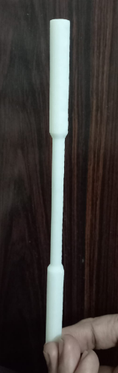
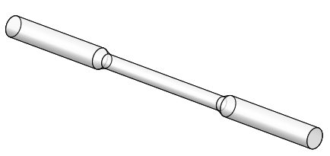
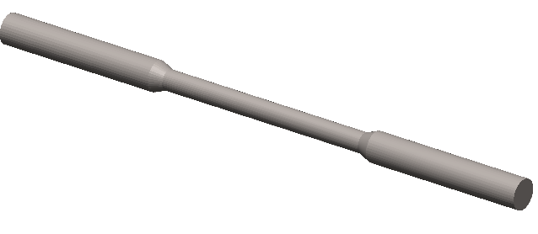
INTRODUCTION :
Additive manufacturing (AM), also known as 3D printing, is a transformative approach to industrial production that enables the creation of lighter, stronger parts and systems.
The 3d Printing Process
User Creates
CAD File
Software Converts it to
.STL File
Printer Prints
Final Product

Slide 4
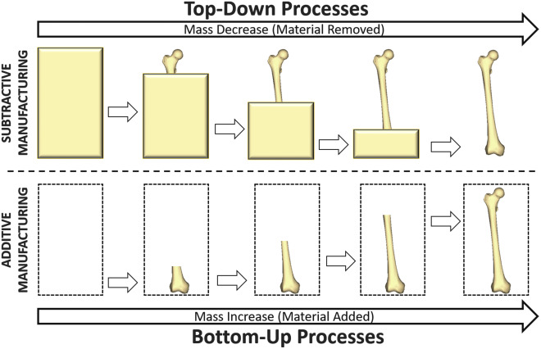
Additive Manufacturing is so Called because we add material layer by layer whereas in Traditional Machining we remove material from a chunk of Metal or Plastic.
As the first layer is created first and then the next layer, It is also called Bottom-Up Process

Slide 5
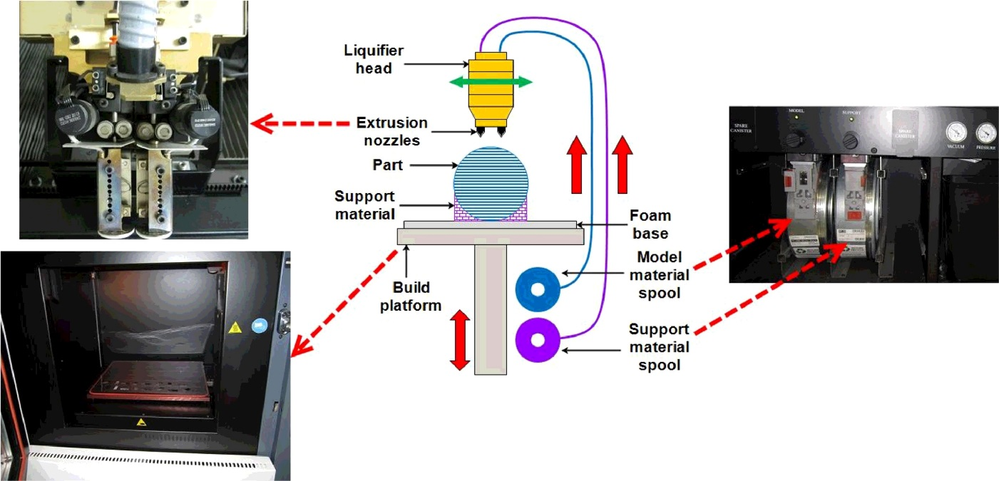
FUSED DEPOSITION MODELING
The FDM process was introduced commercially to the trade in 1990s as a concept modeling by Stratasys Inc. It is an additive manufacturing technology that is used for a wide array of functions including prototyping, modeling, and production applications
Process:
The feedstock filament model material is heated and melted to a semi-liquid state.
The semi-liquid material is then extruded through the tip of the nozzle head.
The nozzle head moves vertically and horizontally to draw the 3D object directly from a digital data in a layer by layer style.
Schematic representation of the FDM process
Supported materials include thermoplastics such as:
ABS,
Nylon 6
Polycarbonate (PC)
PC-ABS blend.

Slide 6

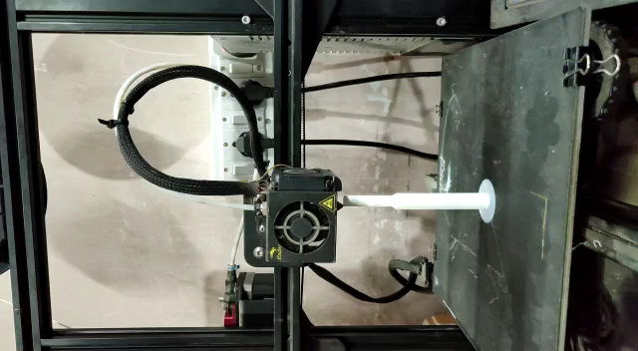

Slide 7
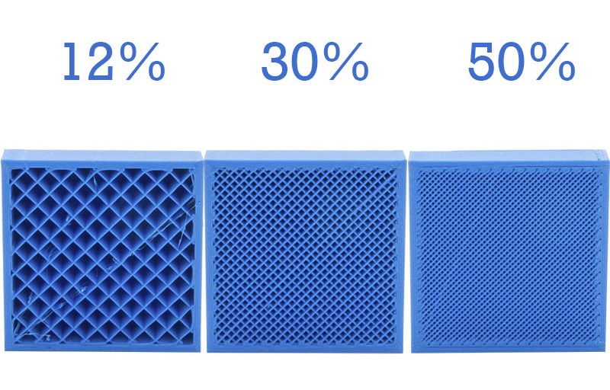
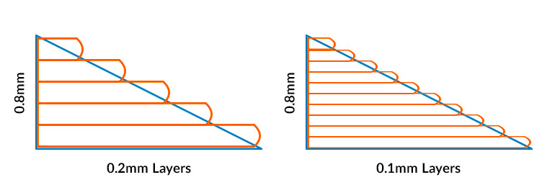
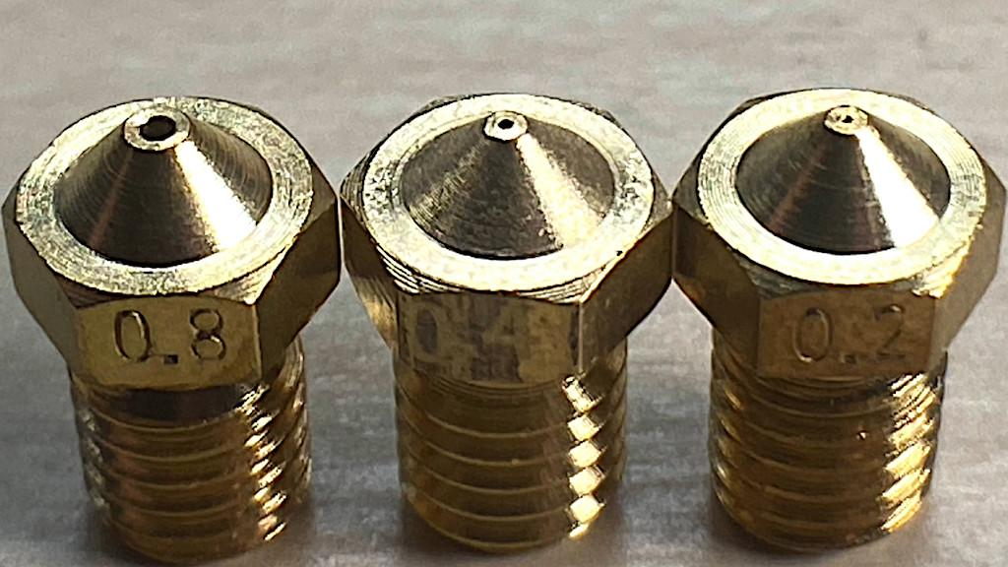
WHY OPTIMIZE?
A typical FDM type 3D printer can print is various process parameters such as:
Slice thickness (Layer height)
Nozzle Speed
Infill Density
In order to build a part with good mechanical properties with less material and less time, we predict the optimum parameter settings.
This will help manufacturers and users curtail the trial and errors of experiments saving time and money.

Slide 8
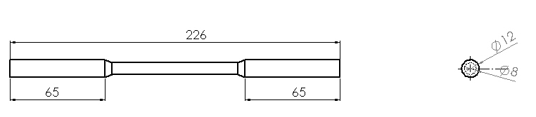
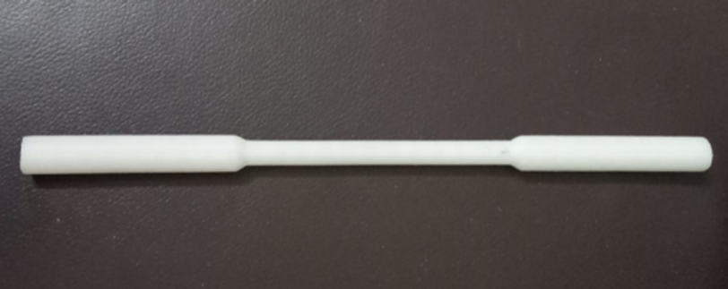
OBJECTIVE OF THE WORK
FDM process has a huge application in automotive manufacturing industries. It is capable of producing complex light weight parts in record time.
In the present work, input characters like
Nozzle head speed,
Slice thickness
Infill density
of Nylon 6 is optimized using Grey Taguchi technique.
The input parameters are optimized in order to achieve the best possible, Build time of the build parts.
Schematic diagram of specimen
Choice of material:
Nylon 6, an engineering derived thermoplastic material was used due to its excellent mechanical properties such as
toughness,
elasticity
chemical resistivity,
Nylon 6 is Hydrostatic as it reacts with ambient air. Fully enclosed FDM Printer is used to print it.
Nylon 6 Specimen

Slide 9
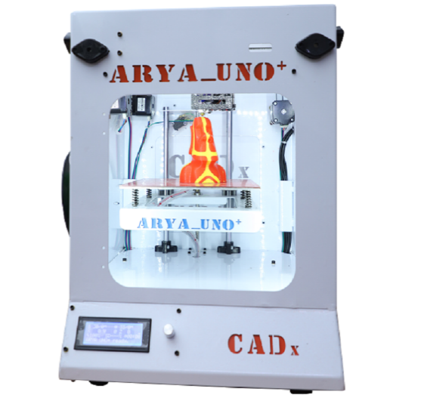
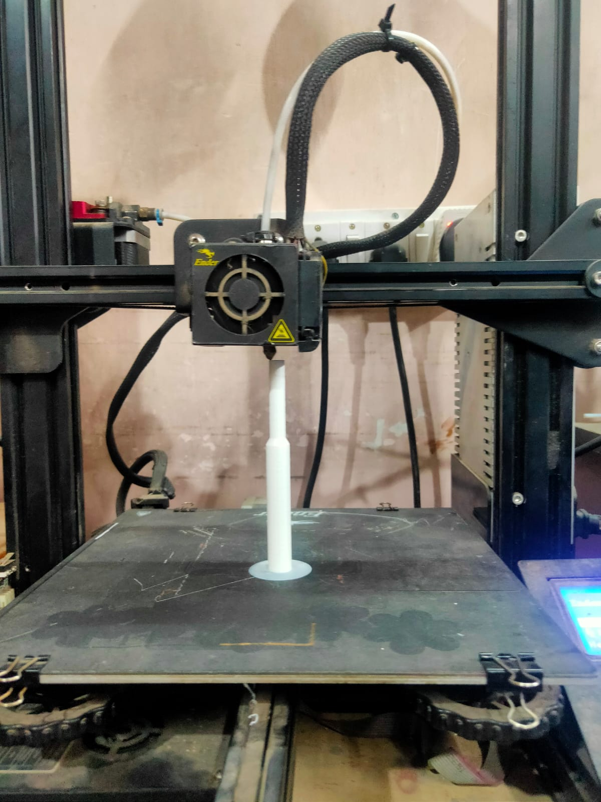
Symbol | Factors | Levels
 |  | 1 | 2 | 3
A | Slice Thickness (mm), ST | 0.1 | 0.2 | 0.3
B | Head Speed (m/min), HS | 25 | 45 | 65
C | Infill Desity (%), ID | 20 | 50 | 90
Arya_Uno+ FDM type 3D printer
Table 1: Levels of experimental input parameters
Nine experiments have been conducted based on L9 orthogonal array experimental design as given in Table 2. Time is measured using stopwatch and it is representative of the total time required to build the part i.e from printing layer1 to the final layer
Exp. No | Coded Input parameters |  |  | Output parameter
 | Slice Thickness | Head Speed | Infill Desity | Time
 | ST | HS | ID | T
 | (mm) | (m/min) | (%) | (min)
1 | 1 | 1 | 1 | 154
2 | 1 | 2 | 2 | 220
3 | 1 | 3 | 3 | 293
4 | 2 | 1 | 2 | 111
5 | 2 | 2 | 3 | 148
6 | 2 | 3 | 1 | 84
7 | 3 | 1 | 3 | 101
8 | 3 | 2 | 1 | 59
9 | 3 | 3 | 2 | 77
Table 2: Experimental dataset for Nylon 6 using L9 orthogonal array
ABS Printing

Slide 10
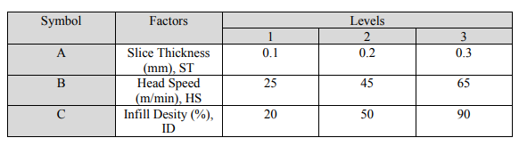
Experimentation using Taguchi method of optimization
When the control factors are high, use of Taguchi technique can minimize the number of experiments.
Here we have 3 control factors and 3 levels. Instead of performing 27 experiments, we can use only 9 to conduct our experiment.
In the Taguchi method, the term ‘signal’ represents the desirable value for the output characteristic and the term ‘noise’ represents the undesirable value for the output characteristic.
Therefore, the term ‘signal-to-noise ratio’ or S/N ratio in Taguchi method measures the deviation of quality characteristic from the desired value.

Slide 11
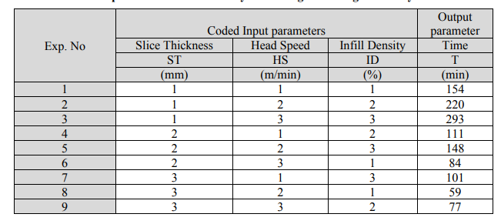
Optimization in Taguchi method means maximization of S/N ratio.
Time of the printed parts is measured and is written against the experiment number:

Slide 12
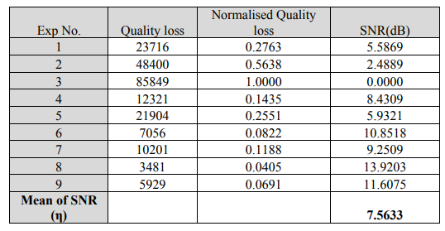
Calculating SNR
Here, Quality loss is obtained by squaring the values of time (in minutes).
Normalised Quality loss is achieved by dividing the Quality loss by the maximum quality loss (i.e. 85849)
SNR is calculated from the formula –LOG (Normalised Quality loss).

Slide 13
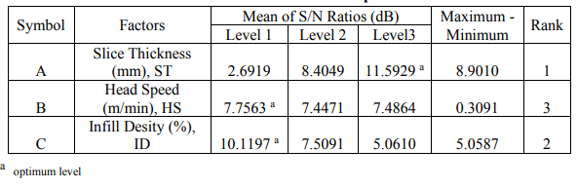
The effect of different operating parameters on S/N ratio
Optimum levels of different control factors for obtaining Time are Slice Thickness at level 3 (0.3mm), Head Speed at level 1 (25 m/min), and Infill density at level 1 (20%) Relative contribution of the controlling parameters on Time.

Slide 14
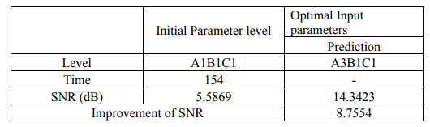
Validation experiment at optimum results level
The validation experiment has been conducted with above mentioned optimum levels of operating parameters and optimized output with corresponding SNR is given in Table5. The significant improvement in SNR is observed to be 8.7554 dB during comparison with initial parameter setting.

Slide 15
Conclusion
Results of Taguchi optimization indicate that minimum build time can be achieved by operating with input parameter setting of slice thickness is put to level 3, Head speed is put to level 1, and infill density is put to level 1.
Variation of Head speed is insignificant across the 3 levels even if our result yields level 1 as optimum.
The S/N ratio compared to initial conditions has been improved by 8.7554 dB.

Slide 16
Future Scope of Work
It has been initially planned to optimize four output parameters i.e Tensile Strength, Surface roughness, weight and build time. But due to the closure of the institution as the situation outside worsened, we were unable to perform the Tensile testing and Surface roughness testing of the 9 printed specimens. But we will continue the pending work as soon as the situation permits and we will complete the work through computing the optimization of the process based on three output parameters.

