Slide 1
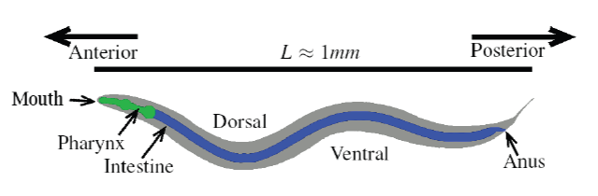
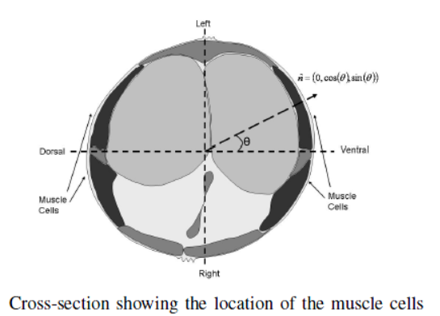
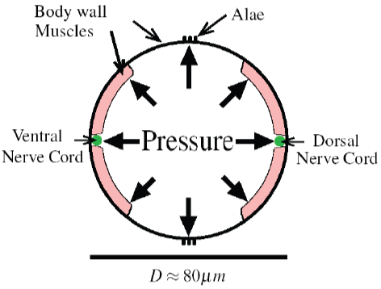
pressure value is unknown for me

Slide 2
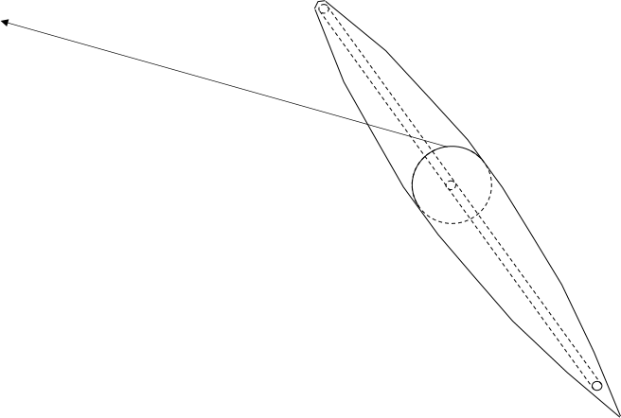
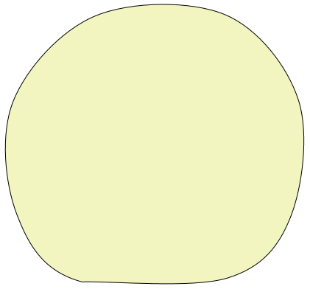
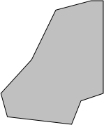
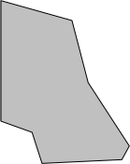
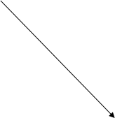
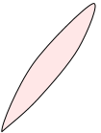




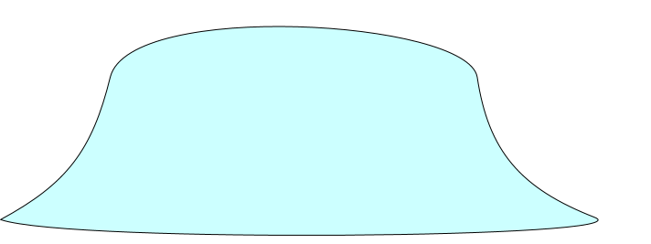







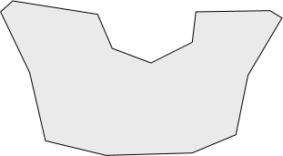
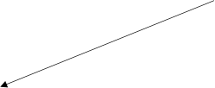

Alternatives:
Simulate each cell / organ inside C. elegans + elastic connections between them
Simulate each cell / organ inside C. elegans sharing adjacent surfaces (never heard about possibility of this)
Simulate only outer worm shell, approximate positions of inner cells / organs at each iteration basing on current shell spatial form. Contract mesh ribs corresponding to muscles when muscles should be activated.
Calculate physics only for the 2D area of contact between worm and substrate, approximate 3D worm shell form and then all other stuff as in (3)
intestine
muscles
DNC
VNC
liquid
can it crawl over a clean
flat glass without agar gel?
substrate

Slide 3
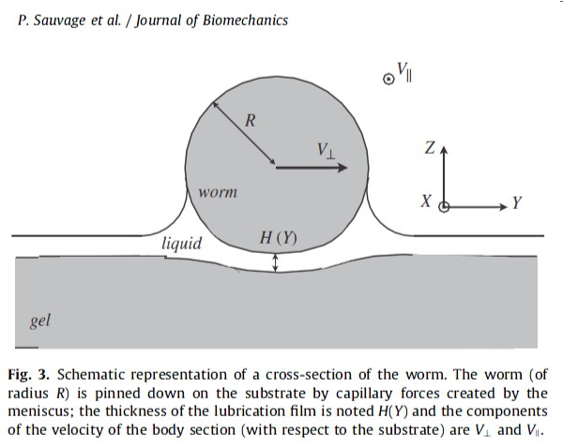
In support of 2D-representation of physics:
Since the length of the adult worm is about twenty times the diameter, the mechanical problem can be reduced to an essentially 2D problem as sketched on Fig. 3. The substrate is assumed to be semi-infinite, i.e. the thickness of the gel is much larger than any other length of the problem.
(P. Sauvage et al. / Journal of Biomechanics 2011)
In support of 3D of physics:
Along most of the body, muscles in the two dorsal quadrants (and similarly the two ventral quadrants) are controlled by the same set of neurons. As a result, most of the body is only capable of bending in the 2D dorso-ventral plane. In contrast the head (first four muscles per row) and neck (next four muscles per row) receive input from head motor neurons that enable bending in 3D.
Correct sensory input can be provided only in case of 3D (forces, temperatures, etc)

Slide 4
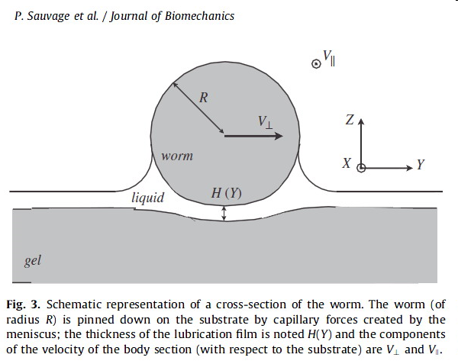
Although the mass of the worm is negligible, a thin film of water gives rise to strong capillary forces which press it against the surface, allowing it to carve a groove (Wallace 1958, 1969). The body can then push against the side-walls of this groove, increasing thrust. The effect of the groove can be represented by the ratio of forces resisting motion in the normal (perpendicular) and longitudinal directions to the local
body surface, denoted K. In a viscoelastic environment K reduces to the ratio of the normal and longitudinal drag coefficients (Gray and Hancock, 1955).
Forces associated with worm movement
There are very few studies on the influence of the mechanical environment on worm locomotion: Wallace (1958) reported the influence of the thickness of the wetting film coating the worm substrate and underlined the role of capillarity; Alexander (2002) reported the kinematic description of the undulating swimming motion originally presented by Gray and Lissmann (1964) and outlined the role of the anisotropy of the viscous friction but ignored the deformation of the substrate and capillary phenomena. Some models have been developed which incorporate the neural wiring of the worm (Niebur and Erdos, 1991) but these still ignore the physics of the worm–substrate interactions.

Slide 5
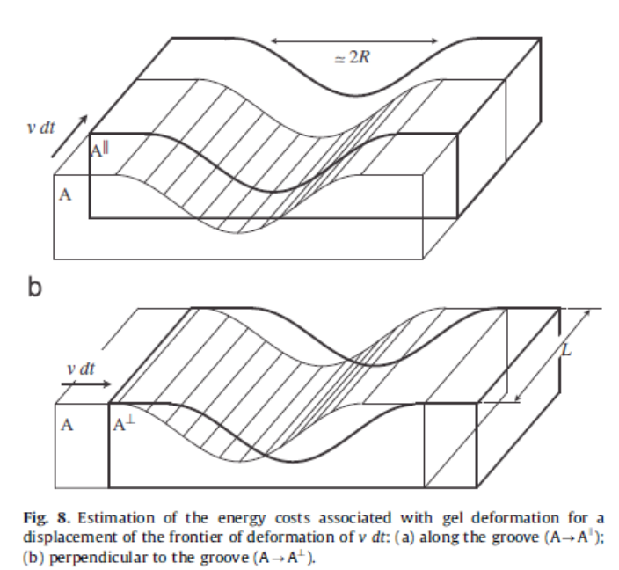
Forces associated with worm movement (continue)

Slide 6
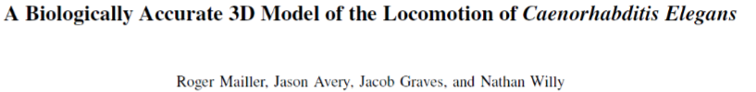
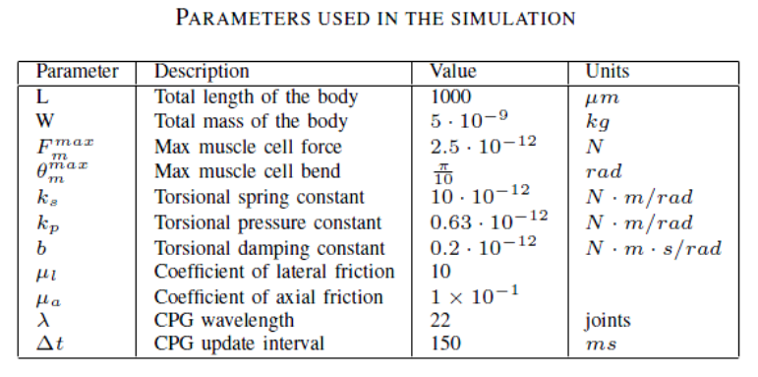

Slide 7
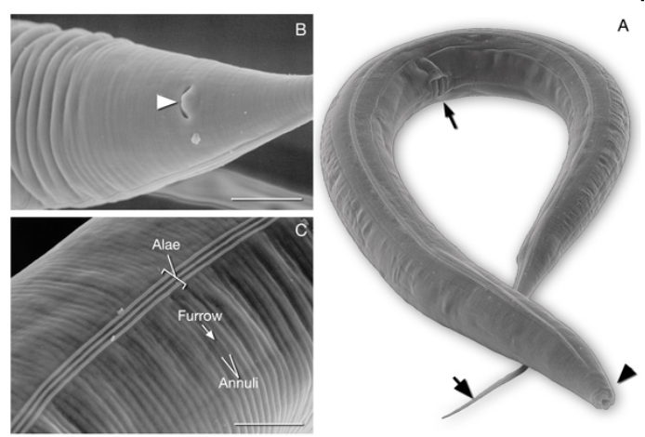
This microstructure of the cuticle and alae – is it important for locomotion?
It could possibly affect friction coefficient(s).
“We modelize the body of the worm by a homogeneous elastic cylinder of radius R, ignoring the surface texture of the cuticle and the alae” // (P. Sauvage et al. / Journal of Biomechanics 2011)

Slide 8
Time to think about the choice of physics simulation engine
To my mind, the key statement here is that all physics simulation engines (except Flow-3D) include the fluid, possibly some rigid walls or obstacles and allows the simulation of a simple animal's body, but there is no possibility to simulate a surface between liquid and air, which is so important at our (c.elegans) conditions.
2D modelling allows to perform simulations in the range from water to agar without these complex calculations, but does it seems satisfactory for our purposes?
Possibly we can split our simulation into 2D physics and 3D visualization in which every current worm body position is buit based on that of 2D (at least at earlier stages of the project)?
When we'll start simulation of the sensory system, 3D physics will become more necessary for simulation of 1) locomotion, 2)correct work of sensors, especially mechanosensors and 3) digestion system, and it will be necessary to modify one of existing methods of liquid+air+elastic worm body 3D simulation or implement our own...

Slide 9

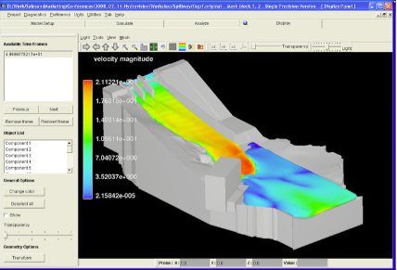
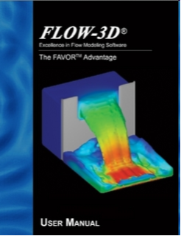
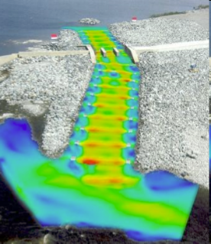
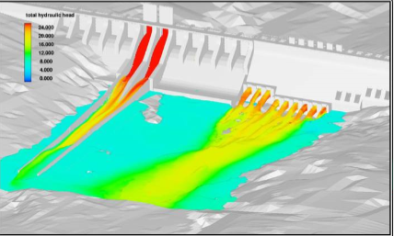
Flow-3D v.9.4 supports liquid/air surface and takes into account surface tension (they use specific high-precision so-called volume-of-fluid TruVOF® method for this). Besides it has the following features which are interesting to us:
Wall adhesion • Wall roughness • Solidification & melting (heat-of-transformation table) • Shear, density & temperature-dependent viscosity • Elastic stress • Elastic membranes & walls • Molecular & turbulent diffusion • Temperature-dependent material properties • and other features.
The largest amount of features necessary for us.
Seems almost ideal, but unfortunately, this is a commercial software, and the price is unknown. Their web-site says that “Flow Science offers FLOW-3D under flexible licensing arrangements. Users can either purchase or lease licenses”. Possibly we can get is at lowest prices for academic purposes, if there will be no other variant among existing free software.

Slide 10
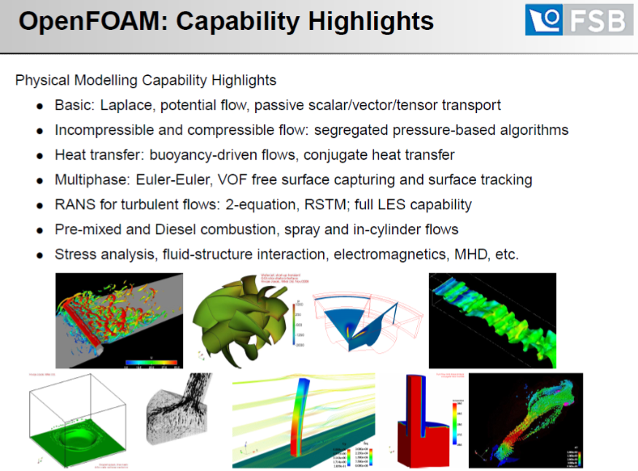

Slide 11
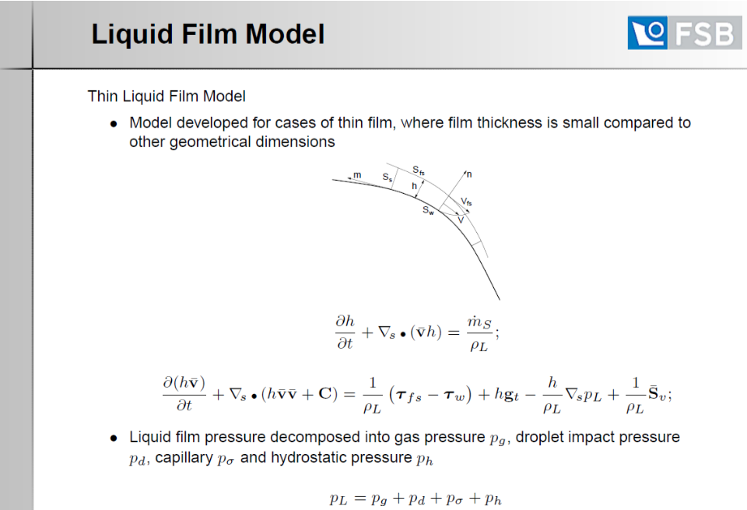
OpenFOAM features:

Slide 12
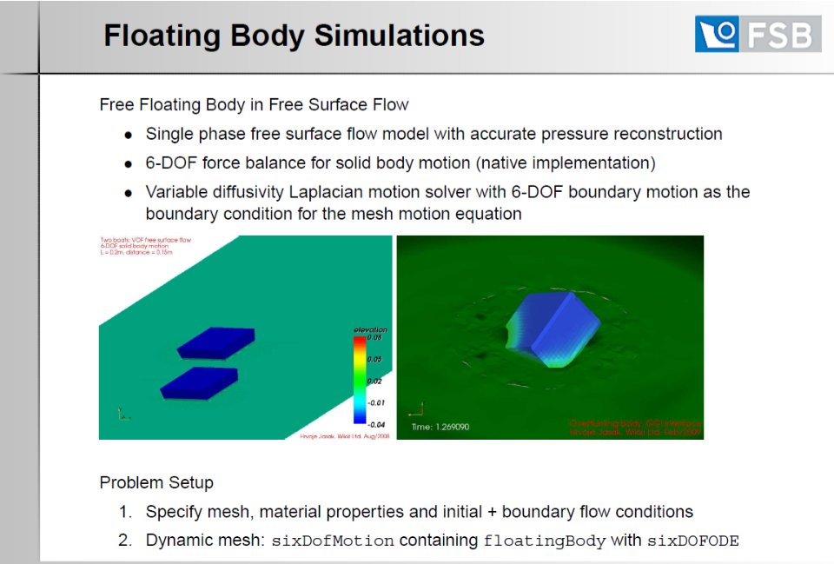
OpenFOAM example:

Slide 13
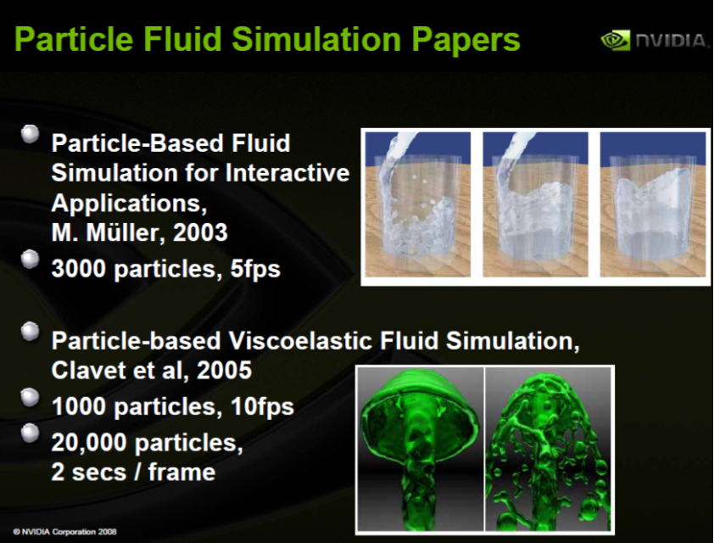
Support of flexible elastic objects interacting with liquid and other environment
- unknown

Slide 14
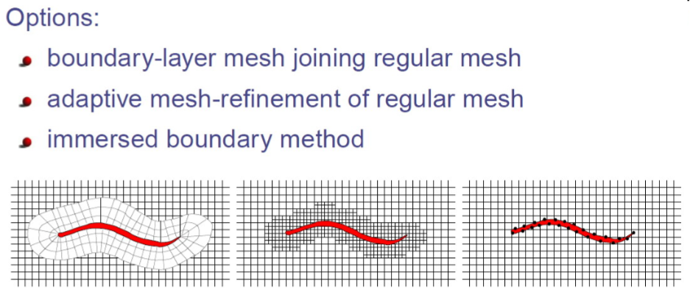
Simulation of swimming organisms: coupling internal mechanics with external fluid dynamics (2004). R. Cortez, L. Fauci, N. Cowen, R. Dillon. Simulation of 3D c. elegans (interaction of an elastic structure with its surrounding fluid) is discussed among other things. Modeling nematode swimming (2008) R. Tyson, J. Hebert, C. Jordan, L. Fauci.
Options: boundary-layer mesh joining regular mesh / adaptive mesh-refinement of regular mesh / immersed boundary method.

Slide 15
Preconditions for our own physics simulation engine implementation / using existing one / modification of existing one
Volume-of-fluid method – detailed description available
Split Lagrangian method – detailed description available
Improved FlowScience Volume-of-fluid TruVOF® method – unaccessible, nothing in the Internet now
“In the new VOF scheme, given a function of fluid fraction, F, the free surface is reconstructed using a piecewise linear interface representation, often called PLIC(some information is available). The key to this construction is to accurately find a normal vector in each cell. A newly developed scheme based on the least-square method developed earlier was adopted for this purpose. After free surface reconstruction, the fluid volume passing between adjacent cells in all three directions in the computational domain can be then calculated.” // Flow-3D
OpenFOAM has probably less features than Flow-3D but it’s free and open-source, so it can be modified for our purposes, which is obviously much better than implementation of something new from the very beginning

