Slide 1
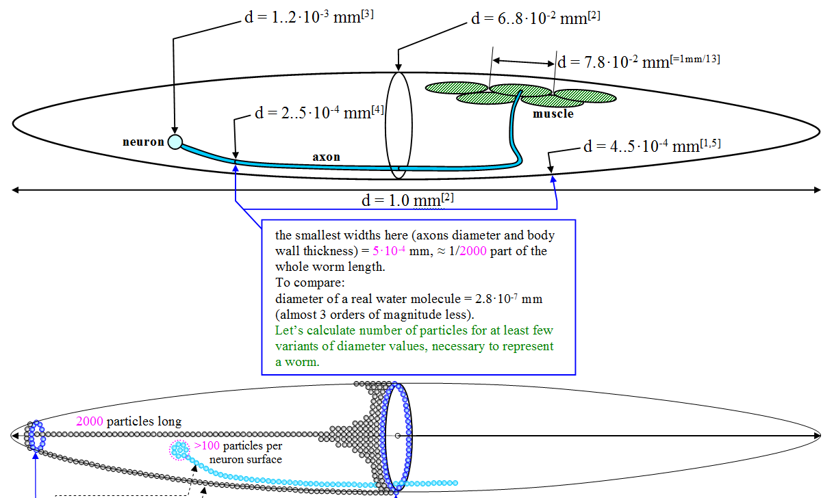
Linear sizes

Slide 2
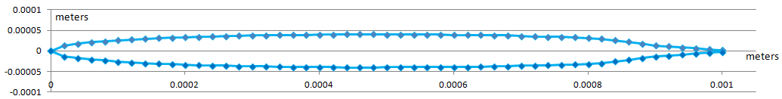
Worm measurements
d = 6..8·10⁻² mm
d = 1.0 mm
Numerical integration over worm slices gives the following results:
Adult worm volume = 0.0033 mm³
Adult worm mass = 3.25E-06 grams
To be done: calculate correct single particle mass depending on how many particles will compose a whole worm; the same with distances
Then calculate corresponding correct integration timestep. Add a function, which makes this calculations automatically, because we’ll experiment with number of particles composing a worm to find a balance between computational performance and biological details

Slide 3
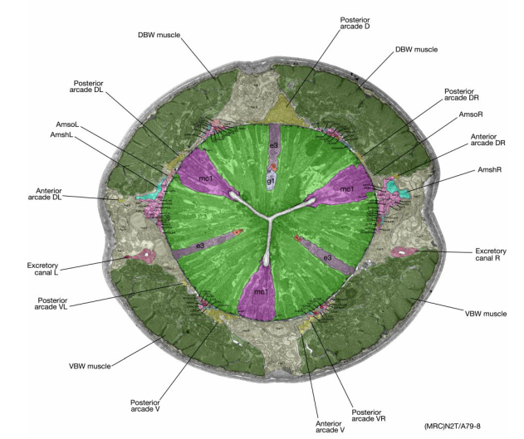
Worm structure at particle level
liquid
elastic matter
elastic matter (muscle)
elastic connection (spring)

Slide 4
liquid
Worm structure at particle level
elastic matter
elastic matter (muscle)
repulsive triangular
membrane, impermeable
for particles
To be done
elastic connection
elastic connection which can contract
when signal comes from neuron

Slide 5
Muscle cell model inner structure: proposed variant 1
relaxed
contracted
3D

Slide 6
Muscle cell model inner structure: proposed variant 1

Slide 7
Muscle cell model inner structure: proposed variant 2
расслабленна
сокращена

