Slide 1
Objectives
A searching mechanism based on file name and user generated keywords
An algorithm to automatically extract keywords from documents during runtime and evaluate using all the keywords as well as the file name
A prediction algorithm which allows:
Extraction of keywords from documents for auto tagging
Prediction of the general intent and sentiment of individual files with the correct extensions
Ranking files on the basis of scores computed using these methods
Sorting the files based on their ranks and displaying them

Slide 2
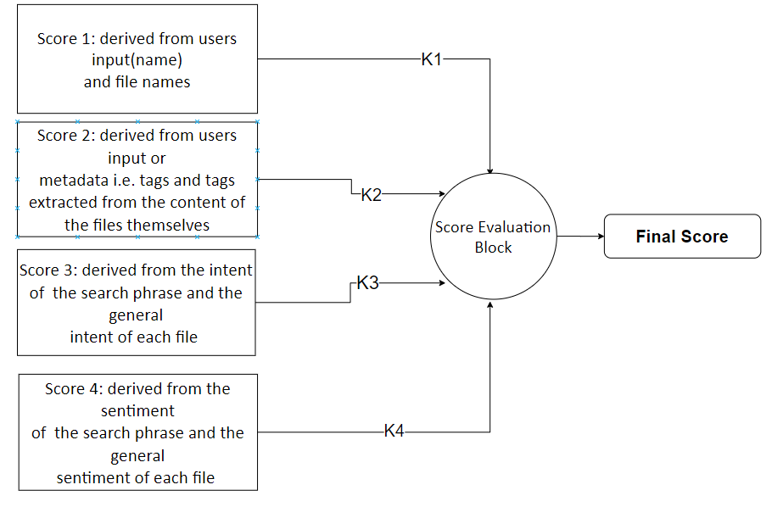
Final Score Evaluation Block
K1, K2,K3 and K4 are weights for allowing us to give preferential treatment to different scores during final evaluation
All scores are normalised

Slide 3
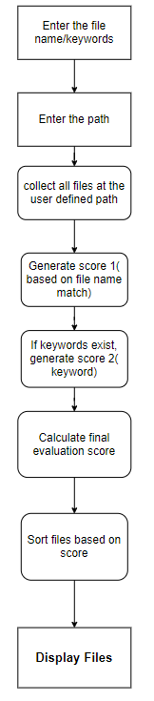
Simplified Implementation
THE PIPELINE
The algorithm: (also shown in the flow chart)
User inputs the file name/keywords
User enter the working directory
Generate Score 1
Generate Score 2
Calculate final evaluation score
Sort files and display them
This implementation is the simplest one as we don’t dive into the content of each file. We only deal with the file name and the tags(keywords) assigned by the user beforehand.
The tags are part of the files meta data and can be directly accessed.
This method is the fastest and works best when the confidence with which the user can recall the name is good and the files are tagged appropriately

Slide 4
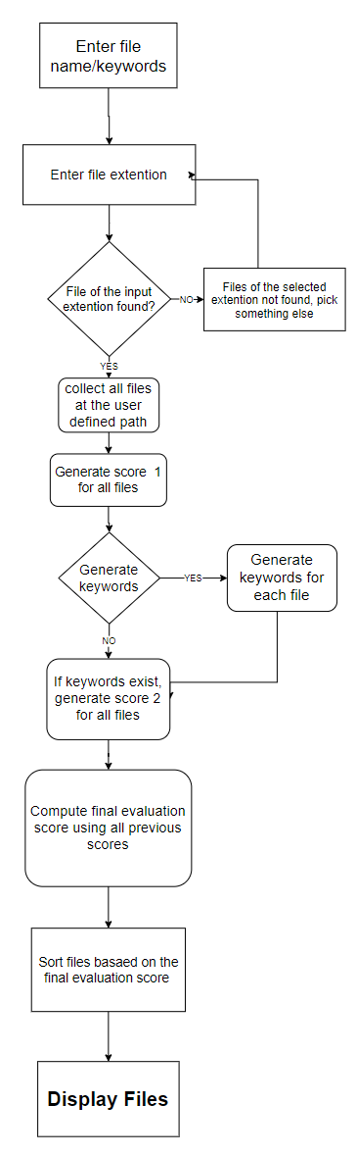
Advanced Implementation 1
The Extractor
The algorithm: (also shown in the flow chart)
User inputs the file name/keywords
User enter the working directory
User Selects an appropriate extension
Generate Score 1
Generate Score 2
Calculate final evaluation score
Sort files and display them
This implementation is the simplest one as we don’t dive into the content of each file. We only deal with the file name and the tags(keywords) assigned by the user beforehand.
The tags are part of the files meta data and can be directly accessed.
This method is the fastest and works best when the confidence with which the user can recall the name is good and the files are tagged appropriately

Slide 5
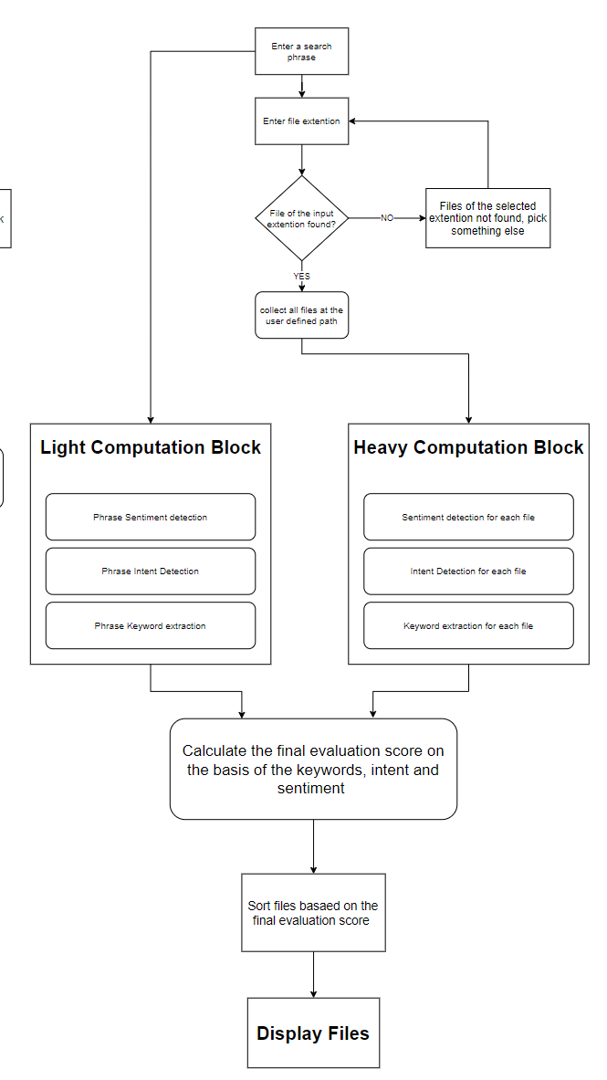
Advanced Implementation
The Predictor
This implementation is the most compute intensive as we dive into the content of each file for keywords extraction and tag generations.
We also take the content of the file to predict the intent and sentiment of the general document and try correlating the search quarry and the documents

