Slide 1

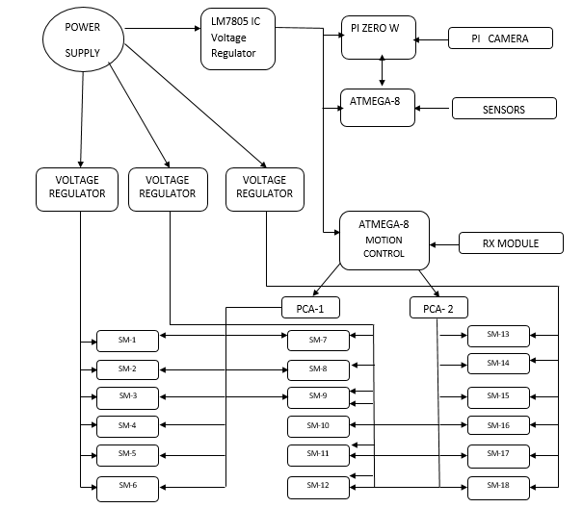
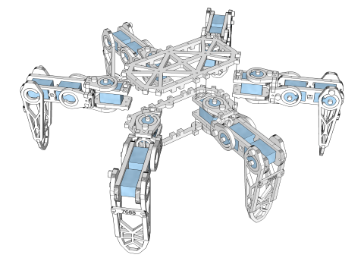
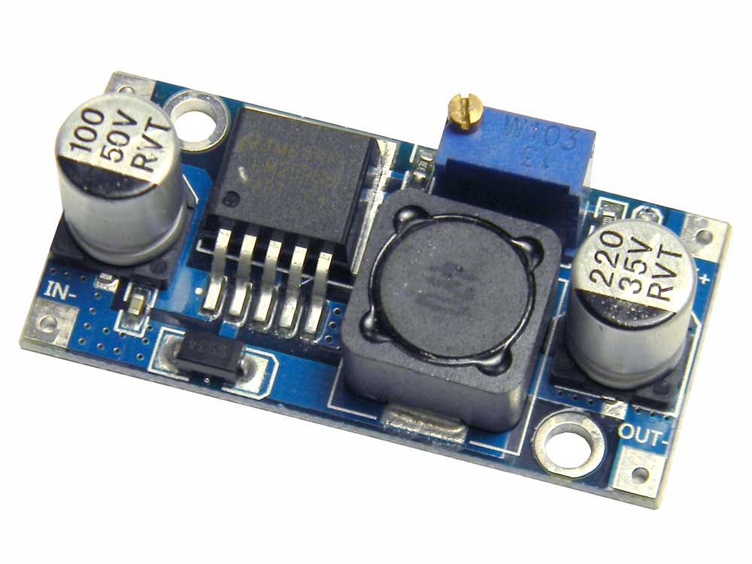
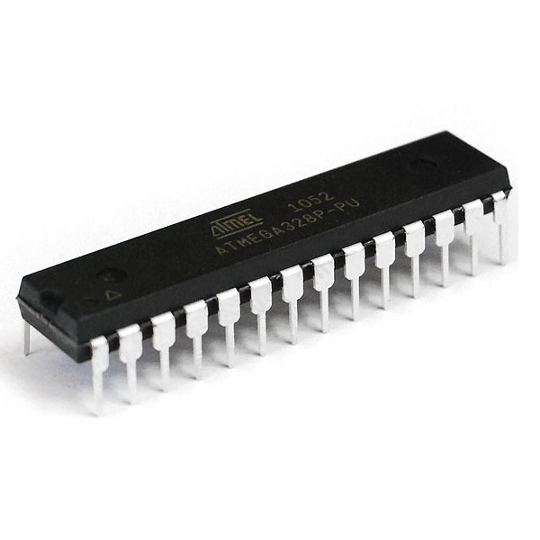
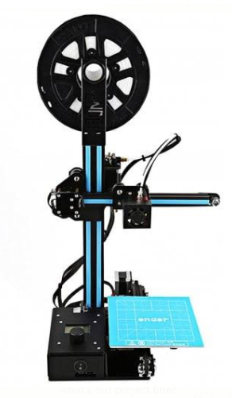
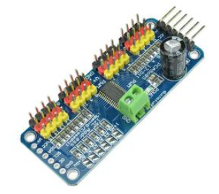
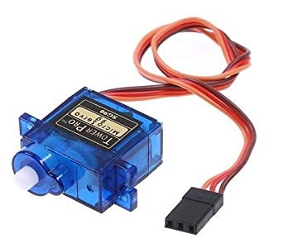
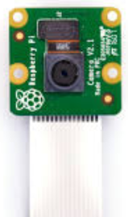
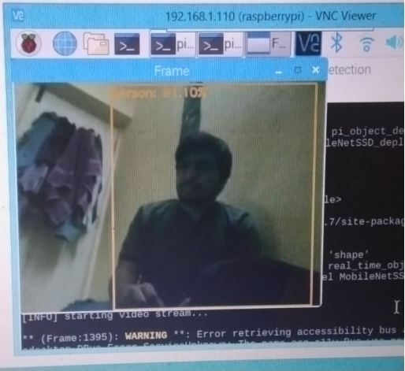
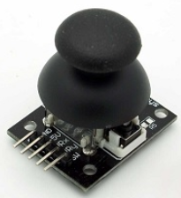
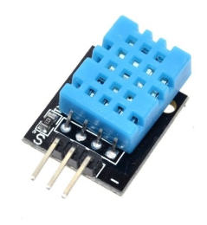
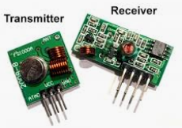
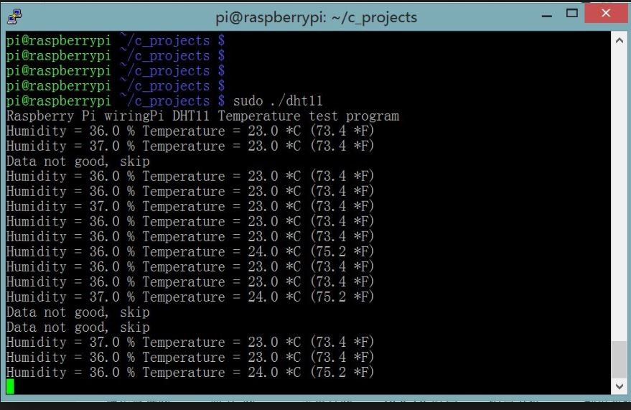
DAYANANDA SAGAR COLLEGE OF ENGINEERING
(An Autonomous Institute affiliated to VTU, Belagavi - 590018)
Shavige Malleshwara Hills Bengaluru-560078, Kumaraswamy Layout
Accredited by National Assessment & Accreditation Council (NAAC) with ‘A’ grade
Hexapod Based Automated System for Disaster Management
Members :Prakruthi BK (1DS15EC087)
Prateek Mohta (1DS15EC090)
Prateti (1DS15EC091)
Pratyush Shukla (1DS15EC092)
Under the guidance of : Dr. K.N. Pushpalatha ,Associate Professor
APPLICATION
Hexapod robots have a large number of real life applications, from crossing potentially dangerous terrain to carrying out search and rescue operations in hazardous and unpredictable disaster zones.
Wheeled robots are faster on level ground than legged robots, hexapods are the fastest of the legged robots, as they have the optimum number of legs for walking speed - studies have shown that a larger number of legs does not increase walking speed. Hexapods are also superior to wheeled robots because wheeled robots need a continuous, even and most often a pre-constructed path. Hexapod robots however can traverse uneven ground, step over obstacles and choose footholds to maximize stability and traction
HEXAPOD OVERVIEW
A hexapod robot is built which serves a purpose of identify hazard and aid to the victims. The robot will be able to navigate, sense the environment and communicate its findings to a remote locations. A survivor robot model inspired by the physique of a spider which can be used in the case of search and rescue operations. The control of the robot has been done by a PS2 joystick controller. The navigation of the spider-bot has been implemented based on a six-leg system, which will be very convenient in rough terrains. Each of the legs has been designed using three servo motors controlling the limbs from different joints. It can detect the number of people present and sense the environment. A prototype has been developed for experimental purpose. This focuses on aiding and assisting the affected people and the rescuer team to get to trapped people in buildings.
BLOCK DIAGRAM
EXPLANATION
COMPONENTS & DEVICES
Atmega 328p
LM 2596
3D Printer
Motor driver
PCA9685
The robot has two modes of motion:
1) Auto mode- In auto mode we, the image processing is being done where a live video is being is being streamed on a web page and if a human is detected it captures a picture and mails it.
2) Manual mode- In manual mode the robot is controlled by RF module that is the transmitter is connected to the joystick module and this module has 8 functions that is to move front, back, left, right , turn right ,turn left, body movement up and down. Once this is transmitted the RF module is connected to an atmega328p which consists of the code of movements and that gets executed. On the Hexapod temperature sensors is connected. They read the temperature sends those value to pi’s terminal.
Servo Motor
Pi Camera
RESULTS
Joystick
DHT11
RF module

