Slide 1
AGRICULTURAL DIGITAL TWINS
When sensor data fail,
irrigation decisions
can go wrong.
Research evidence, prototype design and validation roadmap
SOIL CARBON
SOIL MOISTURE
SMART IRRIGATION
OBSERVE
PREDICT
GATE
Evidence-led design for an uncertainty-aware irrigation twin
Notes:
Sources: supplied papers and project prototype documentation.

Slide 2
PROBLEM STATEMENT
A faulty reading can reverse the right irrigation decision
A sensor may report a dry field when soil is saturated—or hide a real moisture deficit.
FALSE-DRY SIGNAL
MISSED DEFICIT
Sensor says “dry”
Sensor says “wet”
Actual soil is already wet
Actual crop is under-watered
Unneeded irrigation wastes water and may increase crop or disease risk.
A confident point forecast can hide missing, drifting or out-of-range inputs.
Need: estimate the field state, show uncertainty, then gate action.
02
Notes:
Problem framing synthesizes the supplied smart-irrigation review and prototype README, which discuss sensor dropout, drift and data quality.

Slide 3
RESEARCH PAPER 1 • AIM AND METHOD
Paper 1 | Can soil-carbon predictions show when they may be wrong?
Kakhani et al. (2024) · Remote Sensing
AIM
Test whether conformal prediction can make ML estimates of soil organic carbon (SOC) more reliable for end users.
EVALUATION DESIGN
Train
Validate / calibrate
Held-out test
Reference data
Predictors
Conformal scores adjust the RF quantiles
2015 LUCAS topsoil samples (0–20 cm) across Europe; SOC ranged from 0.1 to 560.2 g/kg.
28 covariates: TerraClimate, Landsat-8 bands / indices, and terrain variables.
α = 0.10 targets 90% interval coverage
Model under test
5 test seeds · 10 validation iterations
Conformalized Quantile Random Forest (CQRF), compared with bootstrap RF, quantile boosting, quantile neural network and quantile linear regression.
α is the target miscoverage rate: 10% nominally means 90% of true values should fall inside intervals.
03
Notes:
Source: Kakhani, N. et al. (2024), “Uncertainty Quantification of Soil Organic Carbon Estimation from Remote Sensing Data with Conformal Prediction,” Remote Sensing 16(3), 438. https://doi.org/10.3390/rs16030438.

Slide 4
RESEARCH PAPER 1 • RESULTS AND PROJECT GAP
Paper 1 | Calibrated intervals covered more cases—but were wider
Held-out mean results across five test seeds
Method
PICP ↑
PINAW ↓
MAE ↓
RMSE ↓
CQRF
90%
111.91
42.20
80.79
QGB
89%
124.30
48.15
82.39
QNN
89%
165.58
72.05
111.73
Bootstrap RF
25%
15.67
26.07
69.03
Quantile LR
2%
2.24
41.15
86.59
PICP = % of observed SOC values inside intervals (target 90%). PINAW = interval width normalized by data range; lower is narrower.
MAE = average absolute prediction error. RMSE = square root of average squared error, so large misses count more. Both errors are in g/kg SOC; lower is better.
Key result
CQRF reached 90% coverage with the narrowest intervals among strong-coverage methods. Bootstrap RF had lower MAE/RMSE, but covered only 25% of test values.
Gap this solution targets: static European SOC mapping does not handle in-season moisture forecasts, faulty telemetry or action gating. AgriTwin extends uncertainty-aware decisions to irrigation; it remains a prototype pending field validation.
04
Notes:
Source: Kakhani et al. (2024), Table 4. PICP is prediction interval coverage probability; PINAW is prediction interval normalized average width; MAE is mean absolute error; RMSE is root mean square error. Results are from European SOC estimation and do not validate irrigation use. https://doi.org/10.3390/rs16030438.

Slide 5
RESEARCH PAPER 2 • AIM AND METHOD
Paper 2 | Which model best predicts soil moisture across depth and time?
Wang et al. (2024) · Hydrology and Earth System Sciences
AIM
Compare machine-learning and deep-learning structures for soil-moisture forecasting across sites, soil depths and lead times.
DATA + INPUTS
MODELS
PROTOCOL
30 ISMN sites; five depths (0.05–1.0 m). Inputs include precipitation, air temperature, long- and shortwave radiation, wind, humidity, soil temperature and prior moisture.
3 ML baselines (RF, ELM, SVR) plus 10 deep models: CNN, LSTM, Transformer, hybrids, attention-LSTM variants and GAN-LSTM.
Four-day input history; forecast 1, 3 and 7 days. Time-ordered 6:2:2 train / validation / test split; 25 repeated training runs.
Metrics: R² measures variance captured (1 is perfect; 0 matches a mean baseline). RMSE is the root-mean-square forecast error; it penalizes large misses and uses the moisture data’s units.
05
Notes:
Source: Wang, Y. et al. (2024), “A comprehensive study of deep learning for soil moisture prediction,” Hydrology and Earth System Sciences 28, 917–943. https://doi.org/10.5194/hess-28-917-2024.

Slide 6
RESEARCH PAPER 2 • RESULTS AND PROJECT GAP
Paper 2 | Feature attention improved skill; horizon still mattered
FA-LSTM · 0.20 M DEPTH
OTHER REPORTED FINDINGS
R² 0.965
•
FA-LSTM ranked ahead of temporal-attention variants in most cases; gains were also seen at deeper layers.
1-day forecast · reported 10-site subset
•
GAN-LSTM outperformed standard LSTM in most settings, especially at 3–7 days, with similar computational cost.
At 7 days, R² = 0.849 at 0.20 m
•
LSTM was a strong baseline; accuracy varied by site, depth and forecast horizon.
R² ranges from 0 to 1 in the positive range: higher means more observed variation is captured; a negative value means worse than predicting the mean.
Gap this solution targets: forecasts alone do not quantify decision confidence or test safe irrigation actions during sensor faults and pathogen risk. AgriTwin adds an uncertainty band and explicit safety gates; these additions need real-data validation.
RMSE = square root of mean squared forecast error; lower is better, and large errors weigh more heavily.
06
Notes:
Source: Wang et al. (2024), Table 5 and Sections 4.1, 4.4, 4.5. FA-LSTM R² values at 0.20 m are 0.965 (1 day), 0.925 (3 days) and 0.849 (7 days), for the 10-site subset. Authors report FA-LSTM best among attention variants in most situations and GAN-LSTM outperforming LSTM in most scenarios. https://doi.org/10.5194/hess-28-917-2024.

Slide 7
RESEARCH REVIEW • SCOPE AND METHOD
Review | What data and methods are converging in smart irrigation?
Bautista, Gallegos & Lampayan · online 2025 / issue 2026
Aim: synthesize how ML and digital twins combine for irrigation scheduling, simulation and control.
EVIDENCE GROUPED BY
Soil and crop state
Weather and climate
246
96
records initially retrieved
articles included
Remote sensing / GIS
IoT telemetry
Structured review of 2019–2024 literature; searches included Scopus, ScienceDirect, IEEE Xplore and Google Scholar.
ML methods and twin architecture
A literature synthesis, not a new field experiment.
07
Notes:
Source: Bautista, C. J. C., Gallegos, R. K. B., & Lampayan, R. M., “Machine learning and digital twins in smart irrigation: optimising water use through agricultural data analytics,” Digital Twin 3(1), Article 2562418. Published online 12 Nov 2025. https://doi.org/10.1080/27525783.2025.2562418.

Slide 8
RESEARCH REVIEW • FINDINGS AND OPEN CHALLENGES
Review | A twin joins sensing, prediction, simulation and action
01
02
03
04
05
06
Sense
Align
Predict
Simulate
Decide
Act + learn
Soil · crop · weather
Clean and fuse
Moisture / demand
Compare scenarios
Schedule / gate
Feedback loop
Promise
Research gaps in practice
Adoption gap
ML forecasts plus simulation can test schedules before action.
Noisy / missing sensors; mismatched data; weak rural networks; site-specific models; limited interpretability.
Many examples are pilots; cost, interoperability and grower workflow still constrain deployment.
Project relevance: AgriTwin prototypes uncertainty-aware control and simulated fault testing; it does not yet resolve field validation or adoption barriers.
08
Notes:
Source: Bautista et al. (2025/2026), system integration, limitations and future directions. The stages shown synthesize the review architecture.

Slide 9
FIELD LANDSCAPE • SELECTED PROJECTS
Other teams are building field-linked crop and irrigation twins
CropTwin
AI4WATER
DigiTom
University of Nebraska–Lincoln
UPC · Segarra-Garrigues, Spain
Netherlands · greenhouse tomato
Low-cost IoT and deep models infer crop and environment states with day-to-day updates.
Combines soil-moisture IoT, satellite observations and ground-penetrating radar for irrigation.
Combines crop-growth and logistics models with camera-based crop status.
EVIDENCE POSTURE
EVIDENCE POSTURE
EVIDENCE POSTURE
Planned evaluation through a soybean growth season on a real research farm.
Reported twin implementation with Ivars and Bell-lloc cooperatives.
Validation uses historical and current TOM4.0 crop cycles.
Shared direction: fuse sensors with models, update the virtual state, and test against operating conditions.
09
Notes:
Sources: CropTwin, University of Nebraska–Lincoln (https://int-lab.unl.edu/croptwin/); AI4WATER, UPC (https://agrotech.upc.edu/en/projects-events/ai4water/view); DigiTom, EU CAP Network (https://eu-cap-network.ec.europa.eu/projects/practice-abstracts/digitom_en). Project evidence stages are stated as described by each page; they are not directly comparable.

Slide 10
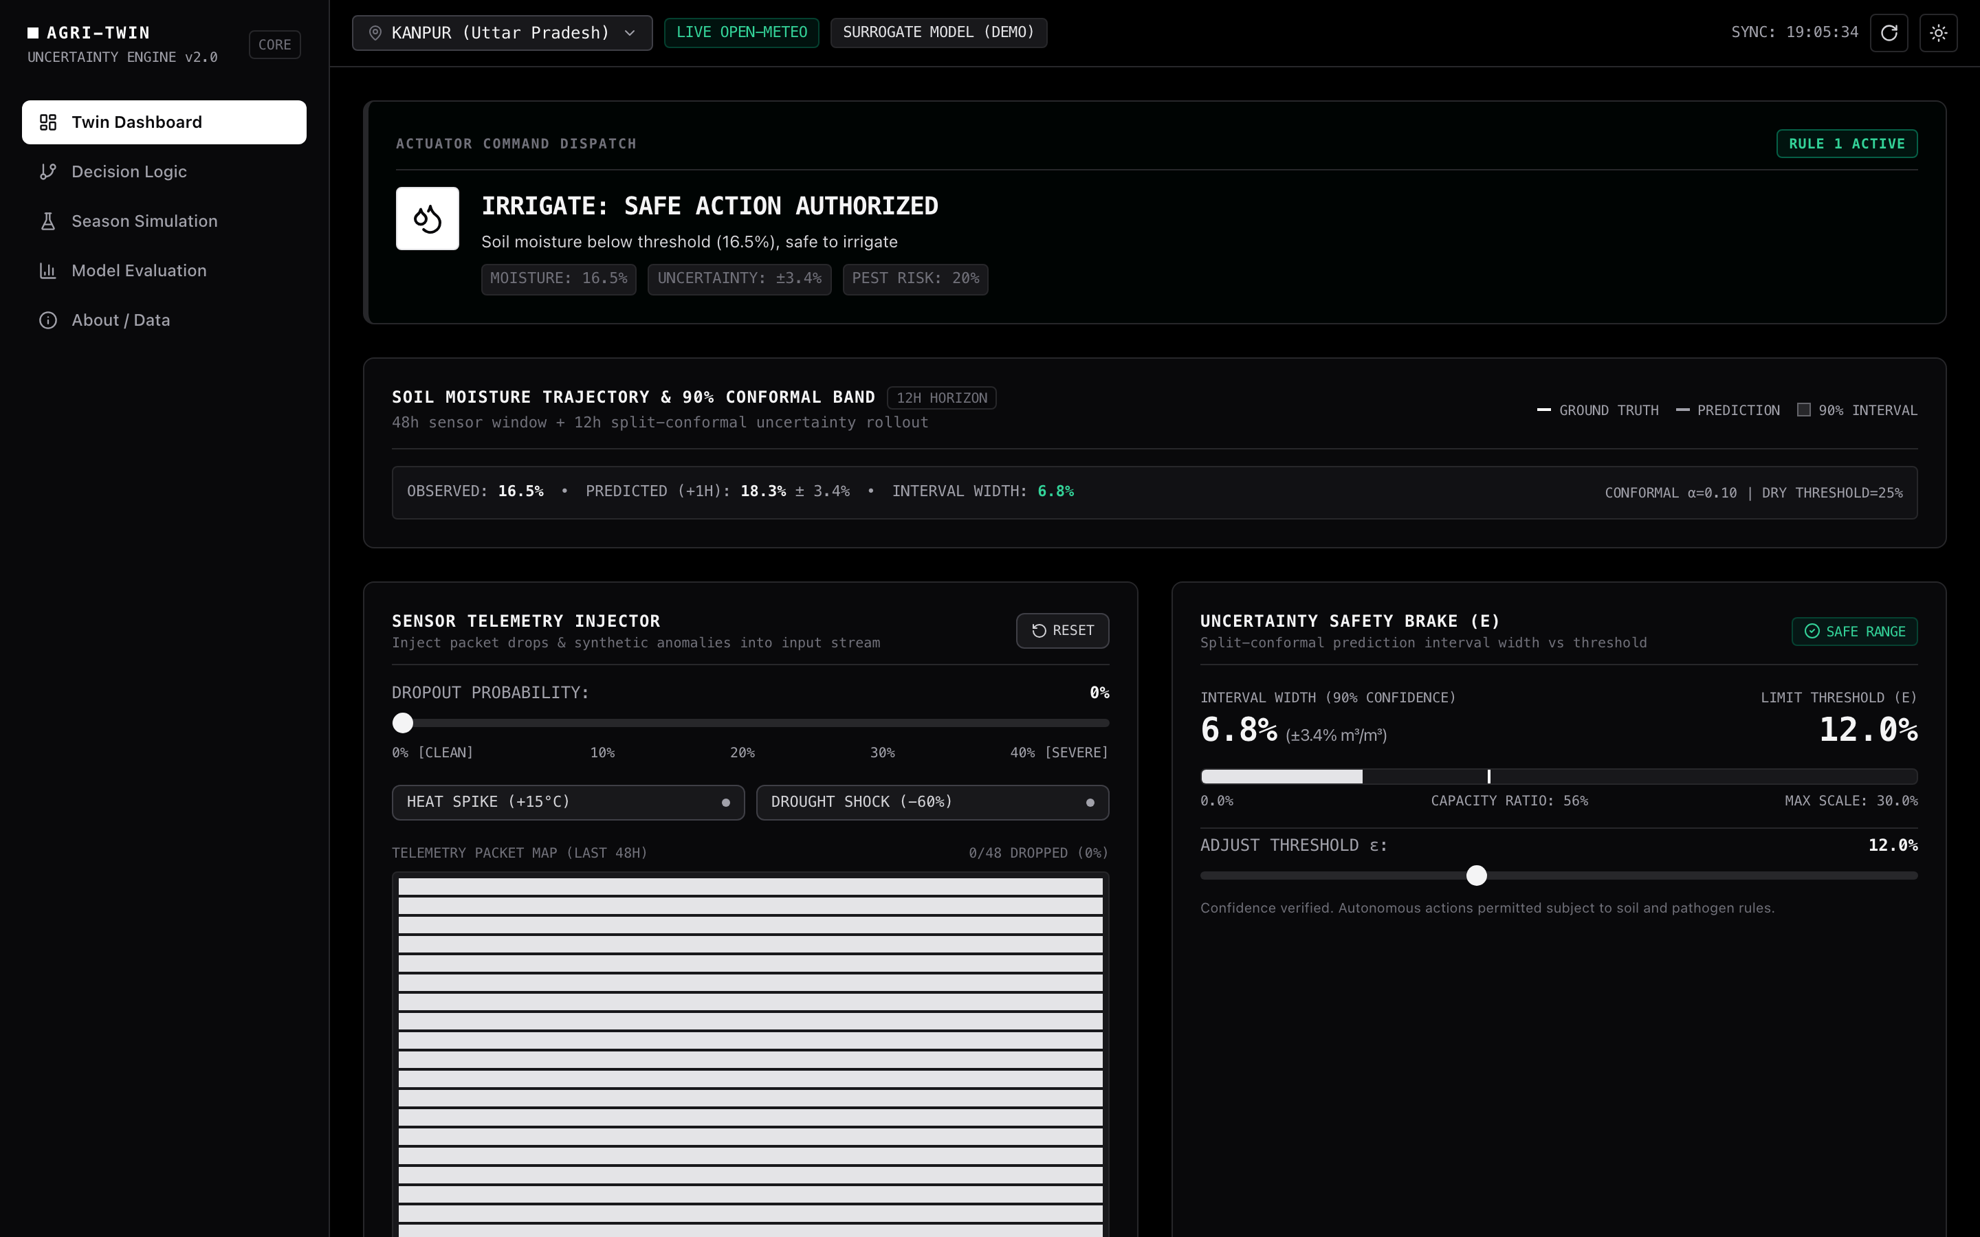
PROTOTYPE FROM SUPPLIED ZIP
Proposed solution | Make uncertainty visible before action
A browser-based twin for sensor faults, moisture forecasts and irrigation safety.
•
Open-Meteo telemetry or a synthetic season
•
Ridge surrogate with 16 lag / rolling features
•
Split-conformal residual band; dropout widening is heuristic
•
Moisture, blight proxy and uncertainty gates drive command state
Prototype interface · illustrative state
Research demo; no field validation claimed.
Research prototype only; not a validated farm controller.
10
Notes:
Source: supplied Digital-Twin.zip README.md, DESIGN.md and docs/images/dashboard.png.

Slide 11
PROTOTYPE • OPERATING LOOP
From telemetry to a traceable irrigation decision
01 INPUTS
02 ESTIMATE
03 CONTEXT
04 CONTROL
Hourly signals
Moisture twin
Risk + confidence
Decision gate
Moisture · temperature
RH · rain · missing packets
Ridge model · 16 lag features
forecast + nominal interval
Blight proxy from temperature,
humidity and leaf wetness
Dry threshold · hazard check
uncertainty brake
Operator review and action outcome become the next observation.
Dropout widening is heuristic; nominal coverage is not guaranteed under distribution shift.
11
Notes:
Source: supplied Digital-Twin.zip README.md.

Slide 12
PROTOTYPE • ACTION POLICY
Safety rules | Check uncertainty before the moisture trigger
GATE 1
Is uncertainty too high?
YES → LOCK · request human review
Interval width ≥ safety bound ε
GATE 2
Is the soil below the dry limit?
NO → HOLD · no irrigation
Moisture ≥ threshold
GATE 3
Is blight risk elevated?
YES → SUSPEND · pest conflict
Risk index > 0.70
Only when confidence is adequate, soil is dry and pathogen risk is low → IRRIGATE.
Thresholds are prototype rules and require agronomic calibration.
12
Notes:
Source: supplied Digital-Twin.zip README.md. The risk index threshold is a prototype heuristic, not a validated agronomic standard.

Slide 13
PROTOTYPE • SIMULATION BEFORE FIELD TRIALS
Evaluation plan | Define metrics before comparing policies
Forecast quality
Uncertainty under faults
Control outcomes
Clean held-out data by site and horizon.
MAE · RMSE · R²
0–40% dropout; heat / drought shocks.
PICP · MPIW
Same season and faults: point-only vs gated twin.
Water use + failure classes
Metric key
MAE
Average absolute miss; lower is better.
RMSE
Root mean squared miss; large errors weigh more.
R²
Variance explained; 1 is perfect, 0 is mean baseline.
PICP
Share of actual values inside the prediction interval.
MPIW
Mean prediction-interval width; narrower is sharper if coverage holds.
Boundary
The simulator can expose logic failures; synthetic runs cannot establish field water savings, yield benefit or safe operation. Compare measured PICP with its nominal target.
13
Notes:
Source: supplied Digital-Twin.zip README.md. Metric definitions: MAE mean absolute error; RMSE root mean square error; R² coefficient of determination; PICP prediction interval coverage probability; MPIW mean prediction interval width.

Slide 14
NEXT STEPS
Future work | Move from a credible demo to a field-tested twin
1
Validate the signals
Connect in-situ soil moisture and crop-stage observations; measure sensor drift, packet loss and time mismatch.
2
Calibrate by place and crop
Test forecast skill, interval coverage, pathogen rules and dry limits across soils, cultivars and horizons.
3
Run a supervised pilot
Compare recommendations with grower practice; log water, energy, crop outcomes and overrides before valve automation.
4
Scale responsibly
Improve interoperability and low-connectivity operation; evaluate edge deployment after safety evidence.
Scale-up gate: verified uncertainty behavior + safe, human-supervised outcomes.
14
Notes:
Roadmap synthesized from supplied prototype documentation and irrigation review.

Slide 15
THANK YOU
Questions?
Agricultural digital twins should make uncertainty
visible before they make a decision.
Research evidence · AgriTwin prototype · Field validation next
Notes:
Thank you.

