Slide 1




GapFill
AI-Powered Knowledge Gap Engine & Exam Preparation Companion
Team Non Challengers • IIITDM Kancheepuram

Slide 2
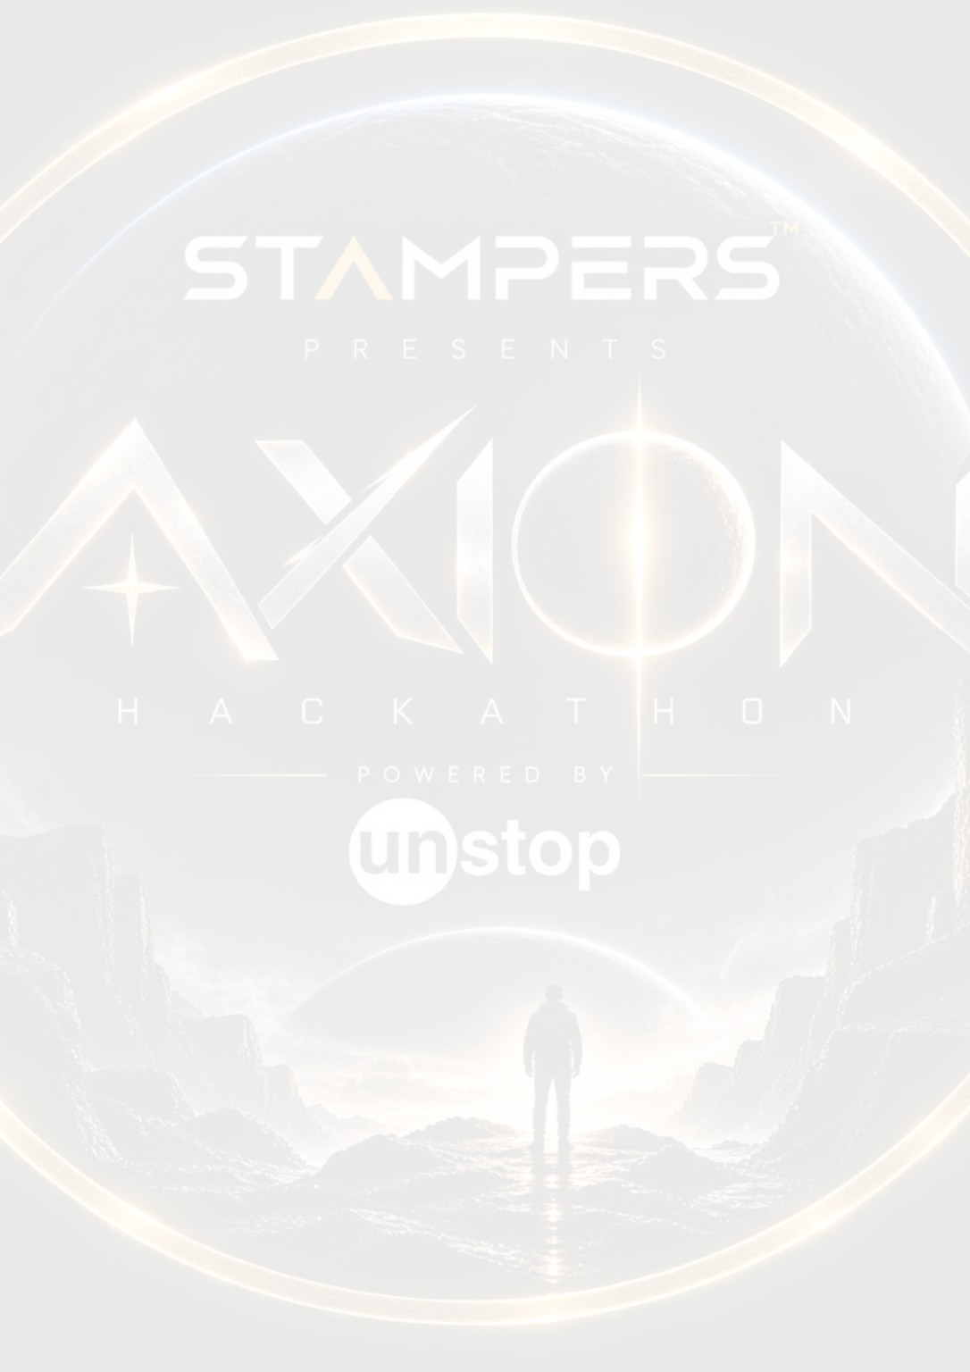





AXION HACKATHON • PPT TEMPLATE • 02 / 06
01 | TEAM DETAILS
Team Name
Non Challengers
Clg Name
IIITDM Kancheepuram
Leader Name
Pratyush Singh
State
Tamil Nadu
Leader Mail ID
cs25i1064@iiitdm.ac.in
TEAM MEMBERS (CONTRIBUTORS)
Member 2: Pooraw Kumar Dhurwey
Member 3: Spandan Saha
Member 4: Surabhi Sri Vyshnavi
PROJECT DETAILS & LIVE DEMO
Project: GapFill — Intelligent Knowledge Gap Engine
Live App: https://pratyush-singh123.github.io/Study-Planner/
GitHub: https://github.com/Pratyush-Singh123/Study-Planner
STAY CLEAR • STAY STRUCTURED • LET YOUR IDEA SPEAK
02 / 06

Slide 3
AXION HACKATHON • PPT TEMPLATE • 03 / 06
02 | PROBLEM STATEMENT
The Core Problem
Students want to master their entire syllabus independently — but they struggle to find targeted explanations, identify true conceptual gaps, and evaluate their actual readiness.
Four Broken Links in Every Student's Learning Loop
Fragmented exam patterns hinder independent prioritization — Past exam papers are scattered across informal groups or unavailable. Without clear frequency data, students struggle to make informed decisions on which topics deserve their self-directed focus.
Time wasted hunting for targeted concept explanations — When tackling difficult concepts independently, students waste hours sifting through generic videos and textbooks instead of accessing focused conceptual guidance that builds intuition.
Flawed self-assessment without diagnostic evidence — Independent learners often assume they understand a concept ("I think I know this"), but without objective diagnostic tracking, underlying blind spots stay hidden until exam day.
Surface-level answer checking instead of concept diagnosis — Standard practice platforms reveal correct answers without diagnosing why reasoning broke down, creating answer dependency rather than building strong mental models.
Who This Affects
Independent learners and college students preparing for exams — especially in technical fields like CSE, where concepts build sequentially and unaddressed conceptual gaps cascade.
STAY CLEAR • STAY STRUCTURED • LET YOUR IDEA SPEAK
03 / 06

Slide 4
AXION HACKATHON • PPT TEMPLATE • 04 / 06
03 | SOLUTION APPROACH
GapFill — Know What You Don't Know
GapFill is an AI-powered learning companion that takes your syllabus, maps it to curated resources and past exam questions, tracks your knowledge gaps in real time, and explains exactly why your answers are wrong — not just what the right answer is.
Why GapFill is different from just asking an AI chatbot
A raw AI has zero context about you. GapFill knows your syllabus, your exam dates, your past mistakes, and your current gaps — and uses all of it to give answers a generic chatbot never could.
Four Core Features
Syllabus Mapper — paste your syllabus, get every topic tagged with its best resource and exam relevance score
PYQ Engine — upload past papers or let the community pool contribute; AI maps questions to topics and tracks frequency
Gap Tracker — quiz performance automatically updates your knowledge status per topic; no self-assessment bias
AI Explainer — when you get something wrong, GapFill explains the conceptual mistake, not just the correct answer
STAY CLEAR • STAY STRUCTURED • LET YOUR IDEA SPEAK
04 / 06

Slide 5
AXION HACKATHON • PPT TEMPLATE • 05 / 06
04 | SOLUTION APPROACH — DEEP DIVE
Step-by-Step Flow
Step 1 — Syllabus Input
Student pastes their syllabus. AI extracts individual topics, estimates difficulty and exam-weightage, and presents them for review.
Step 2 — PYQ Mapping
Student uploads past papers (PDF or text). If none available, the community pool for their college is checked. If still empty, AI generates exam-style questions from the syllabus.
Step 3 — Resource Tagging
Each topic gets tagged with a curated resource — the single best video, doc page, or book chapter — not a generic search.
Step 4 — Quiz & Gap Tracking
Student attempts practice questions. Every wrong answer is logged, categorized by concept, and used to update the gap score for that topic automatically.
Step 5 — AI Explanation
After each wrong answer, GapFill explains the conceptual error — not just the solution — so the student understands why, not just what.
What Makes It Genuinely Different
PYQ Frequency Intelligence
"Sorting algorithms appear in 80% of your past exams. Hash tables have never been asked. Focus accordingly." — a raw AI can never say this.
Mistake Memory
Every wrong answer is remembered and categorized. The app surfaces your recurring mistakes automatically the next time you approach a related topic.
Works Without PYQs
Upload what you have. Benefit from your college's community pool. Or get AI-generated exam-style questions. Every student is covered.
Bring Your Own AI Model
Students connect their own API key (Anthropic, OpenAI) or run a free local model via Ollama. Zero cost to run, zero data stored on any server.
Exam Countdown Prioritization
As exams approach, GapFill re-ranks topics by gap score × PYQ frequency × days remaining — so you always study what matters most, right now.
STAY CLEAR • STAY STRUCTURED • LET YOUR IDEA SPEAK
05 / 06

Slide 6
AXION HACKATHON • PPT TEMPLATE • 06 / 06
05 | TECH STACK USED
Frontend
React.js
Onboarding flow, syllabus input, quiz interface, gap tracker dashboard, chatbot UI
Backend
Python + Flask
API routing, prompt orchestration, PYQ parsing, session management
AI Layer
Unified LLM Abstraction (llm.js)
Supports Anthropic Claude API, OpenAI GPT API, and local Ollama models interchangeably
Storage & Processing
Browser Session + LocalStorage
No database — all user data stays in the browser session. Zero server-side data retention.
PDF.js / PyMuPDF
PYQ document parsing and text extraction from uploaded past papers
Key Libraries
Marked.js — schedule and content rendering
Chart.js — gap score visualization
Tailwind CSS — UI styling
Ollama API — local model support
Domain
EdTech + AI/ML
Addressing exam preparation, knowledge gap analysis, and personalized learning
STAY CLEAR • STAY STRUCTURED • LET YOUR IDEA SPEAK
06 / 06

