Slide 1
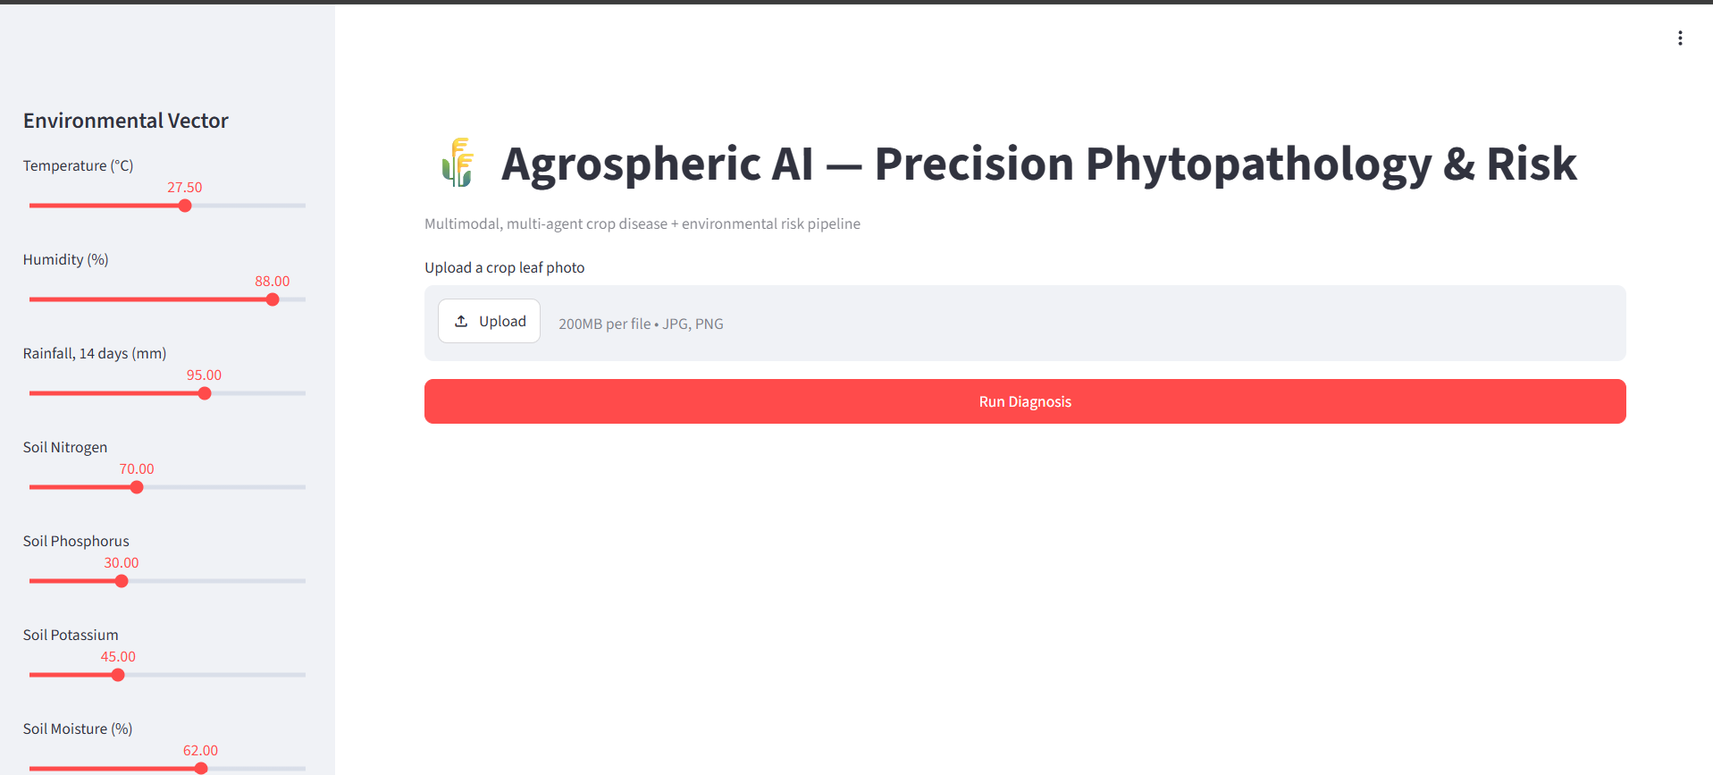

Agrospheric AI
Multimodal Multi-Agent Pipeline for Precision Phytopathology & Risk Mitigation
Multimodal Fusion
Multi-Agent Architecture
Responsible AI
Computer vision + environmental data, unified in a single pipeline
Deterministic LangGraph state machine with strict JSON contracts
Hard safety gate, SHAP explainability, and native-language output

Slide 2
The Problem
The Modality Gap:
Vision apps detect disease after damage is visible; weather apps don't know crop health history. Predictions are reactive, not proactive.
The Black-Box Dilemma :
"Your crop has Late Blight" with no evidence shown erodes farmer and agronomist trust.
The Accessibility Barrier :
Technical PDF reports fail rural farmers facing language barriers and low literacy.
Our Approach
Fuse computer vision and environmental data through a deterministic multi-agent state graph — with a hard safety gate and
native-language output, not just another disease classifier.
The pipeline is designed from first principles to be proactive, explainable, and accessible — addressing all three problem-statement gaps simultaneously through a single, coherent architecture.

Slide 3
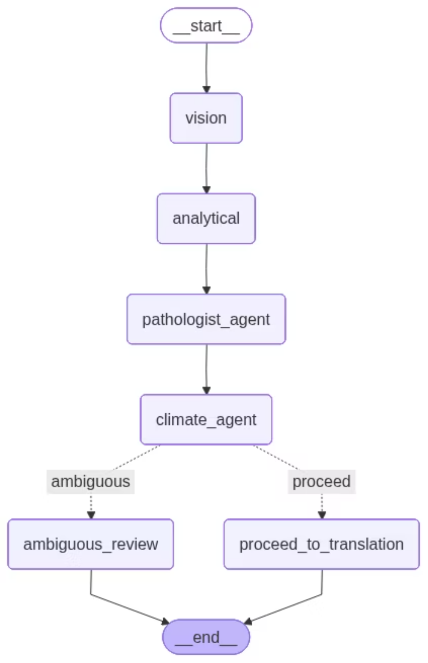
System Architecture
Core Components
1
Vision Node
Hugging Face ViT + attention-map extraction
2
Analytical Node
XGBoost classifier + SHAP explainability
Orchestration Layer
3
LangGraph multi-agent state machine + Groq LLM
Deterministic graph, strict JSON contracts between every node — not a fragile prompt chain

Slide 4
The ROI Localized Crop Diagnostics
Why early, low-cost, trustworthy detection changes the economics of crop loss
Cost & Speed per Diagnosis
$220B
A
Traditional Agronomist Visit
AI
Agrospheric AI
lost to plant disease globally, every single year
$15–$50
< $0.05
20–40% of global crop production affected annually
plus a 2–5 day wait for results
result in under 60 seconds
Illustrative unit economics — open-weight models (ViT, XGBoost, NLLB, gTTS) self-hosted on commodity CPU/T4 hardware, no per-call proprietary API fees for inference
Source: FAO — Scientific Review on the Impact of Climate Change on Plant Pests
11
languages localized — reaches farmers no English-only tool can
2x
explainability layers (attention + SHAP) — trust, not a black box
0
GPU fleet required to scale — runs on CPU

Slide 5

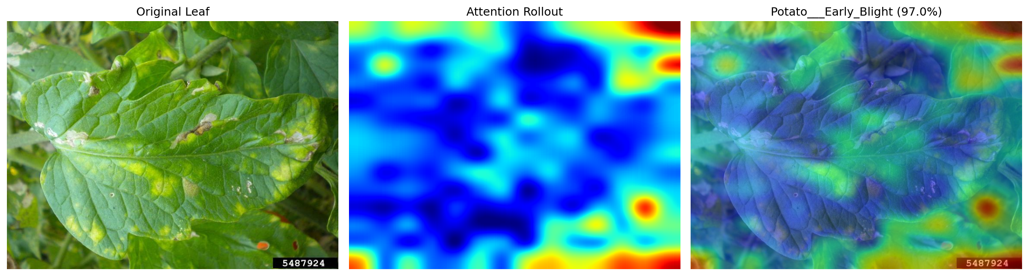
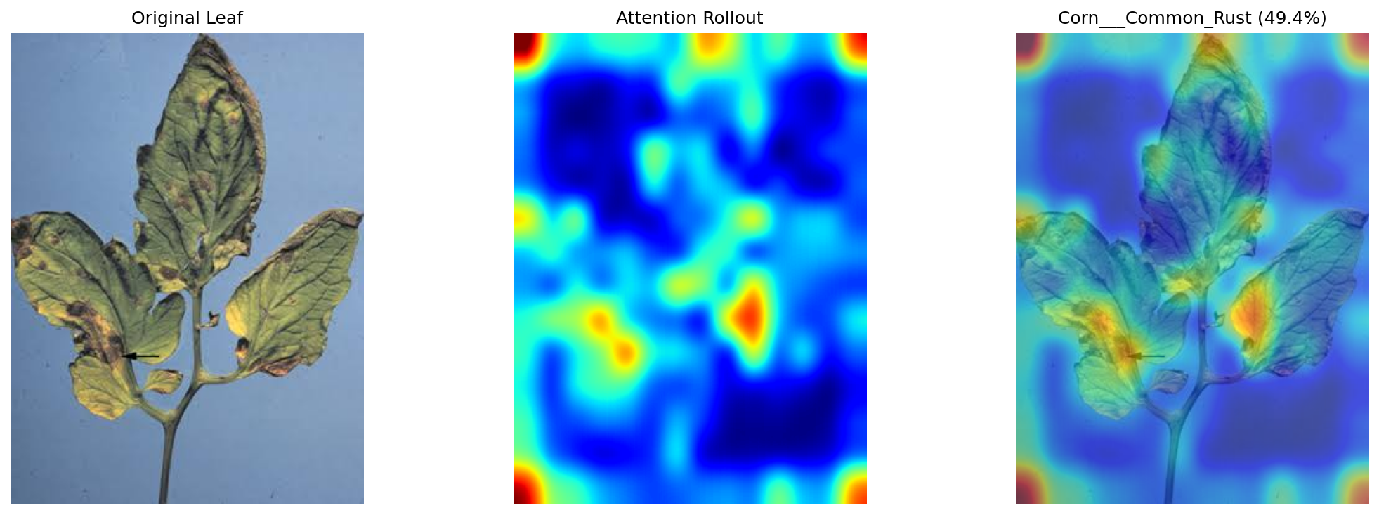
Vision Node — Seeing the Problem
Model & Method
Vision Transformer (vit-base-patch16-224 family), pretrained on crop disease imagery
Attention rollout extracts a heatmap showing exactly where the model looked
Pretrained, not fine-tuned — a deliberate scope call under time constraints, revisited only if demo crops fell outside the label set
Attention rollout provides spatial interpretability — the farmer and agronomist can see exactly which leaf regions drove the classification decision.
Heatmap Output :

Slide 6
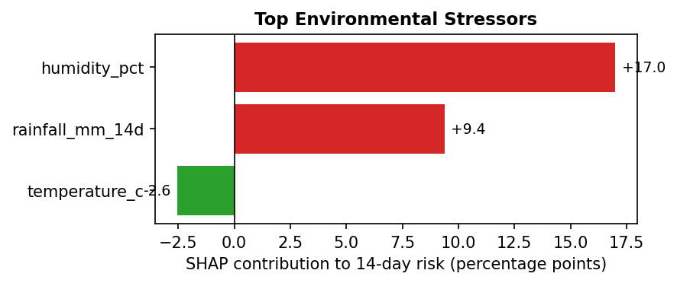
Analytical Node — Quantifying Risk
Risk Model Design
SHAP Explainability
XGBoost regressor predicts 14-day disease-conducive risk from soil + weather data
SHAP attributes the prediction to specific stressors — humidity, rainfall, NPK levels, temperature
Trained as a smooth, differentiable surrogate for a documented agronomic heuristic — not a black box, and retrainable on real field-trial data without changing the downstream contract
SHAP values make every risk prediction auditable — agronomists can verify which environmental stressors are driving the 14-day forecast.

Slide 7
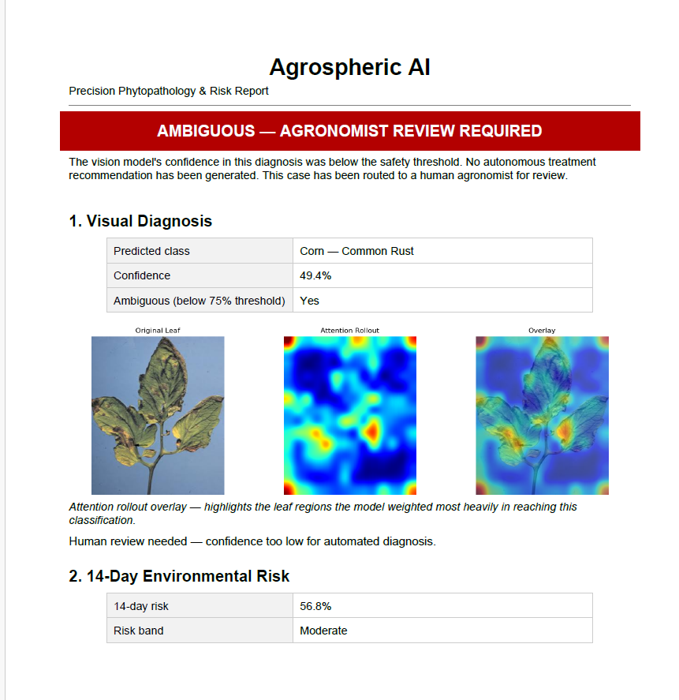
The Human-in-the-Loop Safety Gate (HITL)
A responsible-AI design decision, not just a feature — the confidence threshold is a hard architectural constraint
that governs all downstream action.
≥ 75% Confidence
Autonomous pipeline proceeds — environmental risk scoring, SHAP attribution, and localized output are generated without interruption.
< 75% Confidence
System halts autonomous action and routes to human agronomist review — regardless of what the environmental risk score says.
Both the confident and ambiguous paths still produce a translated, localized explanation — a farmer is never left with silence
(PDF report of the crop leaf generated by the multi-agent system)

Slide 8
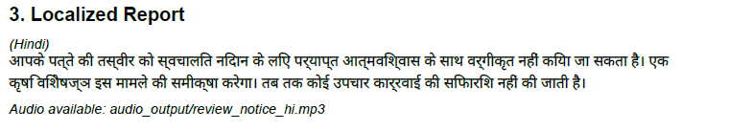
Localization & Accessibility
Language Coverage
Graceful Degradation
11 Indian languages + English
Hindi, Marathi, Tamil, Telugu, Bengali, Gujarati, Kannada, Punjabi, Malayalam, Odia, Urdu
Text Always Delivered
No Silent Failures
Odia is translatable but not speakable by gTTS — text still reaches the farmer, audio is cleanly omitted with a documented reason, not a crash.
Every degradation path is documented and handled explicitly — the system communicates its limitations rather than failing opaquely.
Technology Stack
NLLB-200-distilled-600M for translation
gTTS for spoken audio output
Runs on CPU or a shared T4 GPU — no expensive proprietary APIs

Slide 9
Team
Pratyush Sharma
Agentic AI Engineer
AI, ML and agentic AI enthusiast who loves to code and create AI projects in free time.

