Slide 1
DevOps Driver for sustainable digitalization journey
Presented by
Ravi Kulkarni

Slide 2
☺ What we are going to cover ☺
World is Changing, so do expectation
IT in BFSI: Emerging Questions
What is DevOps?
Role of testing in DevOps
CI-CD overview
Tools of DevOps
Containers and orchestration
Cloud service platforms

Slide 3
World is Changing, so do expectation
Consumer going digital and want mobility
Customer want experience along with service
Continuous feedback and improvement are the key factors sustainable growth

Slide 4
Emerging Questions
???
How we can build world class application at faster rate
How can we be capable of scaling our applications from quality and quantity
How to make sure, we , being in most regulated and compliance sector, to be innovative and agile
How to be more digitally proactive ?

Slide 5

DevOps : Technology or Methodology
Understanding DevOps from layman prospective
Benefit of DevOps for different teams
- Better communication and collaboration
- Faster delivery cycle
- highly scalable, available and fault tolerant systems
- Better predictability causing informed decisions

Slide 6
What is DevOps ☺
DevOps (hybrid from “Development” and “Operation “) is strategy or cultural mindset which follows set of best practices and tools to deliver quality service/ product at faster rate.
Some of traits are as follows
Collaboration
Automation
Data based decision making
Continuous feedback
Responsibility throughout application lifecycle

Slide 7
Role of testing in DevOps
Early defect detection
Testing integrated into development process
Quick and efficient issue resolution
Continuous testing
Automated testing throughout pipeline
Rapid feedback to developers
Integration with development and deployment
Testing at every stage
Early issue identification
Ensuring quality
Reliable, stable, and high-performing software
Improved user experience
Improved collaboration
Collaboration between development and operations teams
Continuous improvement culture

Slide 8
CICD Overview
CI (Continuous Integration):
It is primary DevOps practice, where developer will frequently merging changes to central code repository. Each check-in is then verified by an automated build and test, allowing teams to detect problems early.
CD (Continuous Delivery/Continuous Deployment):
Continuous Delivery is practice where once code is committed to central repository, it will be automatically built, tested, promoted to higher environment and will be ready to deploy for Production environment.
Production deployment and release will happen only on approval.
Continuous Deployment is practice where once is committed to central repository, it will be automatically built, tested, deployed and promoted to
Production without requiring any approval.

Slide 9
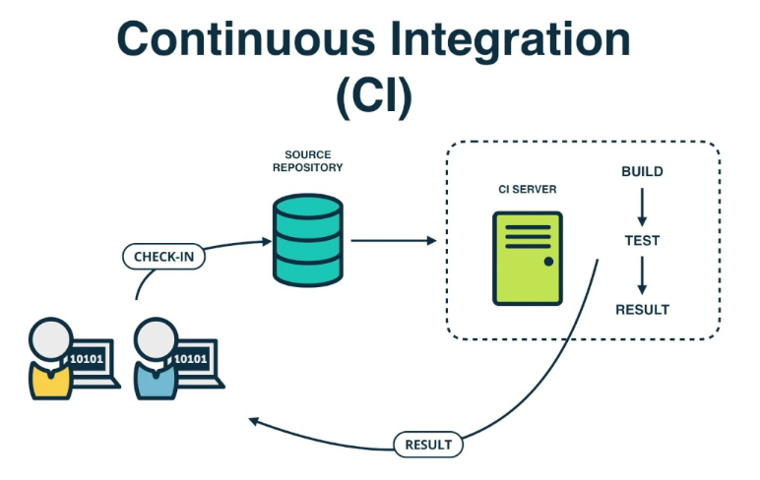
Continuous Integration

Slide 10
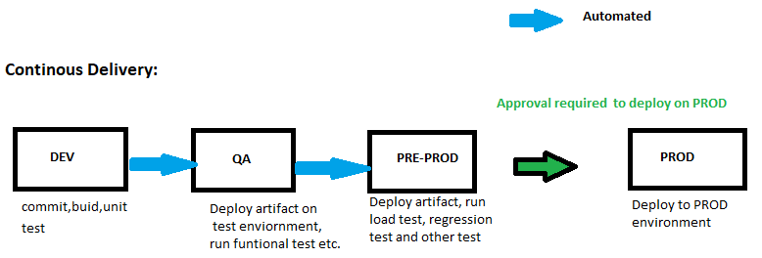
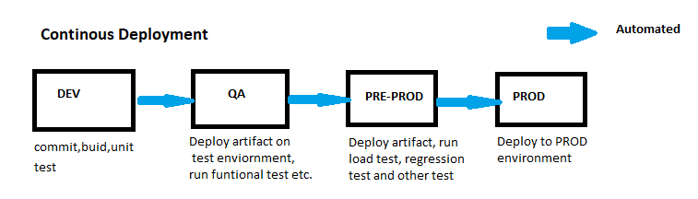
Continuous Delivery/Continuous Deployment

Slide 11
DevOps ToolsChain
Process | Tools /Application
Source Code Management | GITHUB
 | GITLAB
 | BITBUCKET
Build Management | Maven
 | Gradle
 | ANT
 | NANT
 | MS BUILD
CI Automation | GITHUB ACTIONS
 | GITLAB CI
 | JENKINS
 | BITBUCKET CI
 | CIRCLE CI
 | HARNESS
Process | Tools /Application
DEPLOYMENT | ANSIBLE
 | TERRAFORM
TESTING | SELELIUM
 | JUNIT
 | HP LOAD-RUNNER
 | JMETER
 | TOSCA
 | APPIUM
MONTORING & LOGGING | GRAFANA
 | PROMETHEUS
 | ELK
 | DATADOG
 | NEW RELIC
 | NAGIOS
 | SPLUNK

Slide 12
Architecture flow for DevOps
Nexus/Jfrog
Artefact
Repository
Build & TEST
Quality check
Create
Package
code repository
GITHUB/
GITLAB
developers
SonarQube
Maven /Docker
Build tools like Maven
CI TOOL
Deployment
DEV
TEST
Infra/Platform team
Infra Provisioning tool
Datadog/ ELK
PROD
Monitoring system
Terraform/
Ansible
Environments

Slide 13
Questions and Answers time
?????? …… ???????

