Slide 1

Skadooler
Pratik Divedi – E21CSEU0096
Pratyush Chauhan – E21CSEU0101
Tejasvee Sheokand – E21CSEU0090

Slide 2


Contents
Different Modules and how they work.
GUI.
Mail Scheduler Module
Whatsapp automation Module

Slide 3
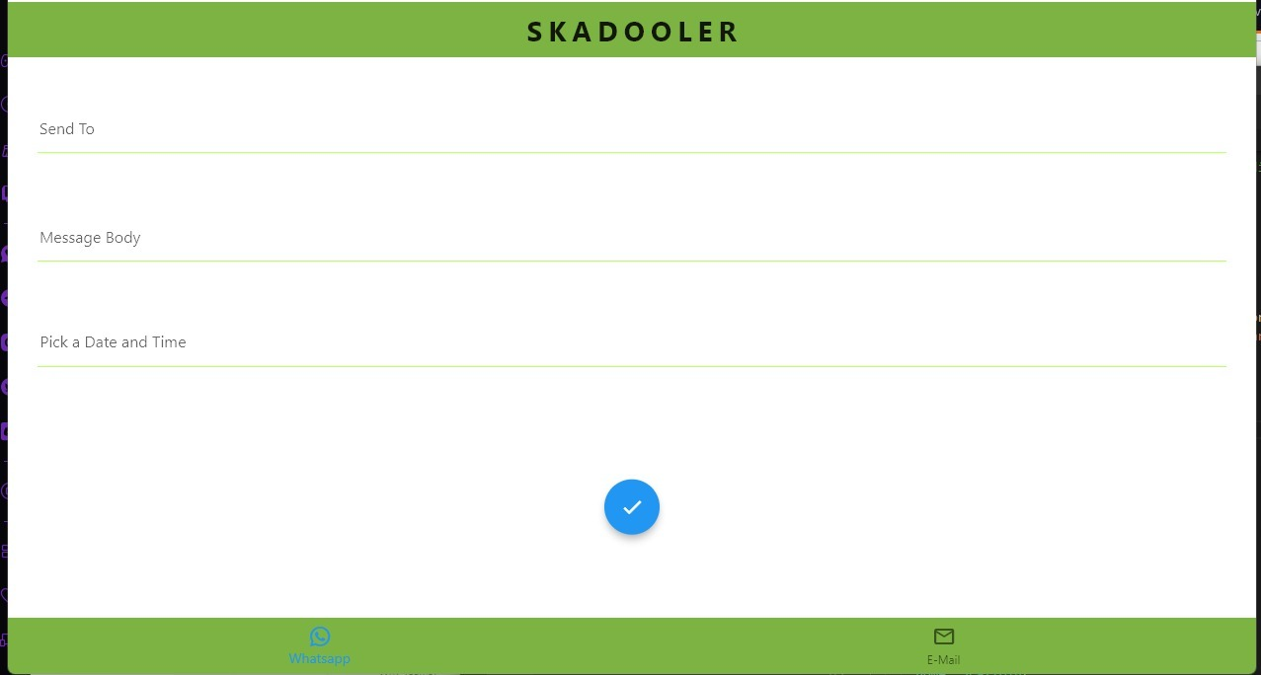
GUI

Slide 4
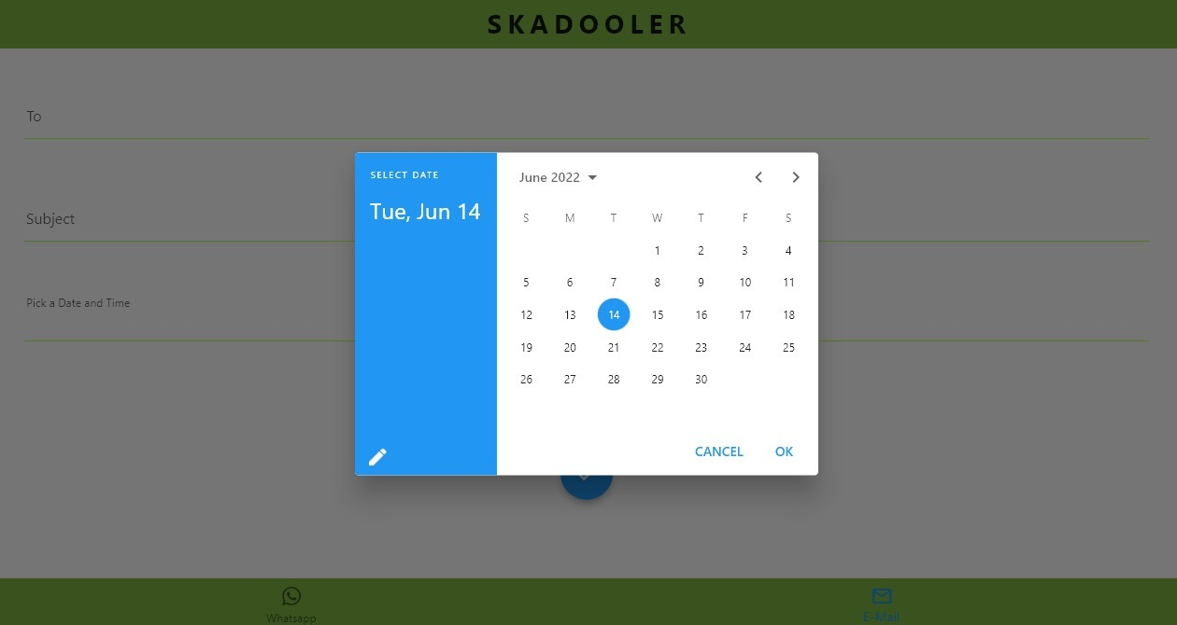
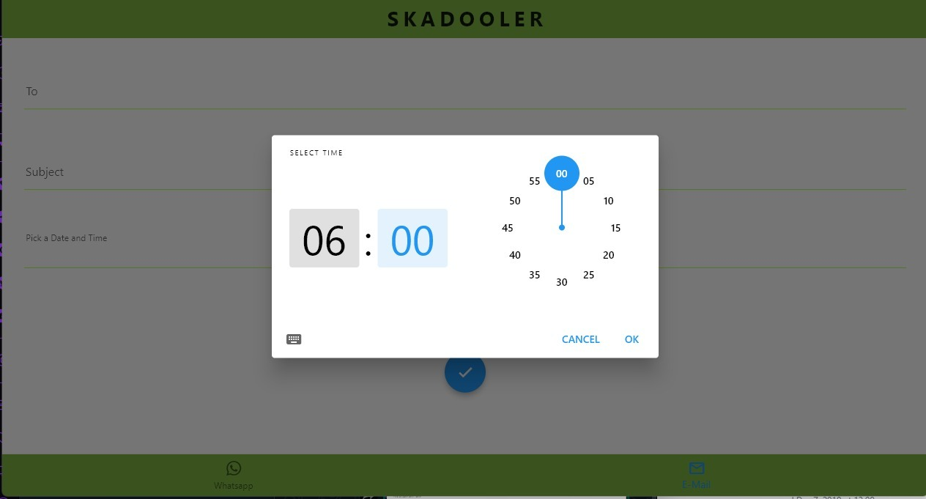

Slide 5
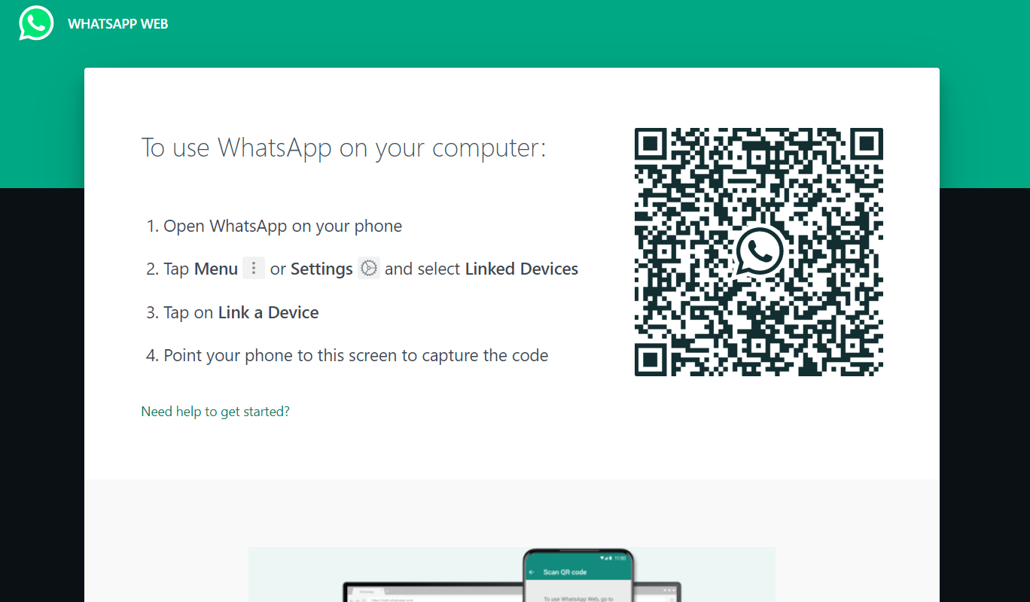
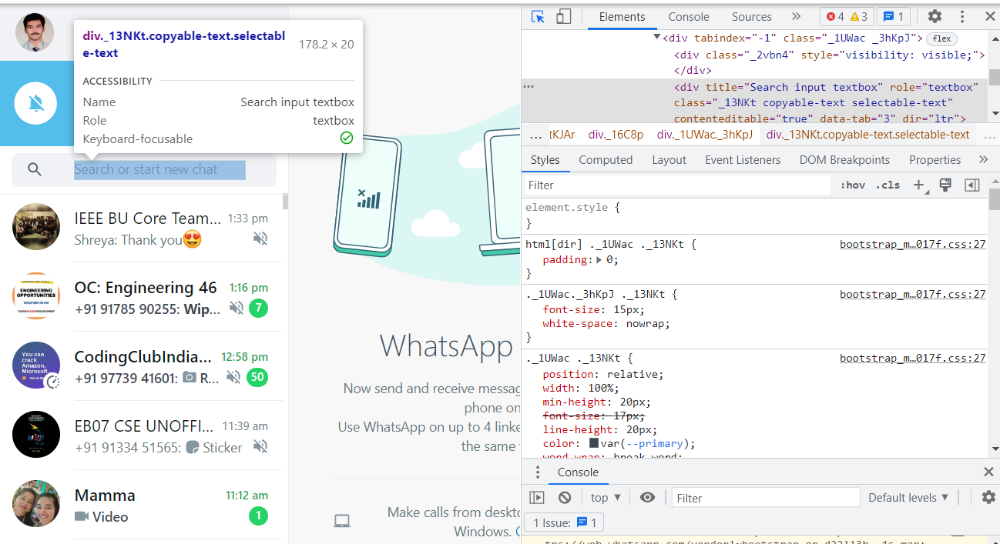
Whatsapp Module
1. Program Opens WhatsApp web
2. After given time the program Identifies Searchbox using xpath and clicks on it.

Slide 6
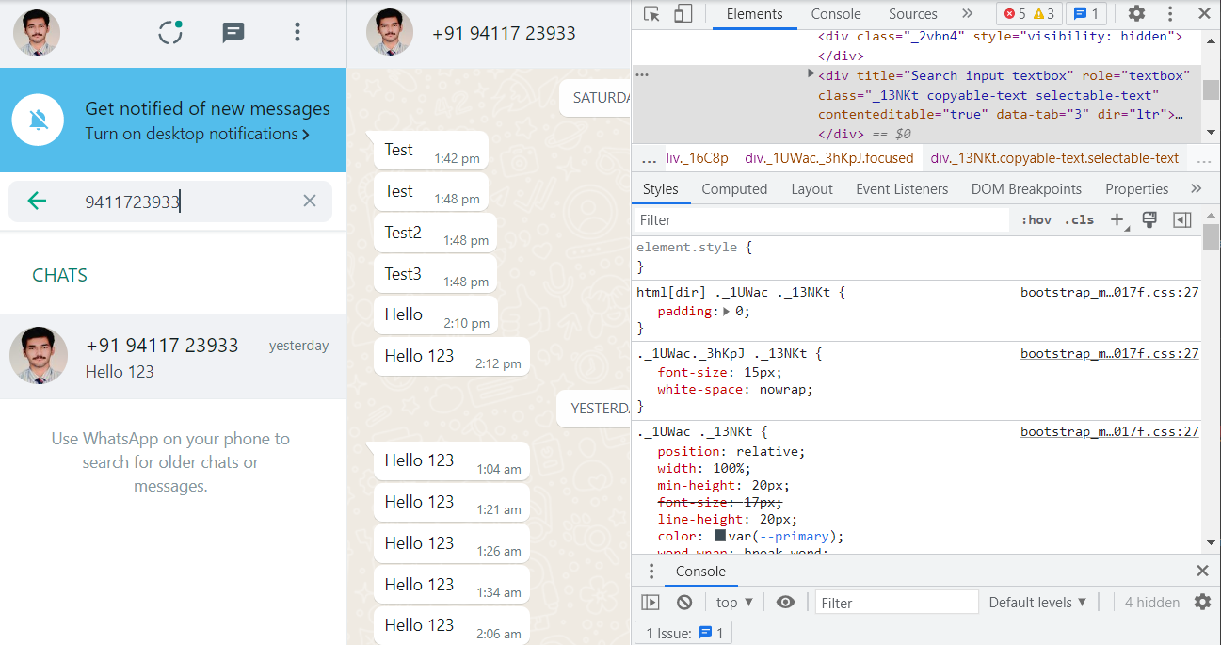
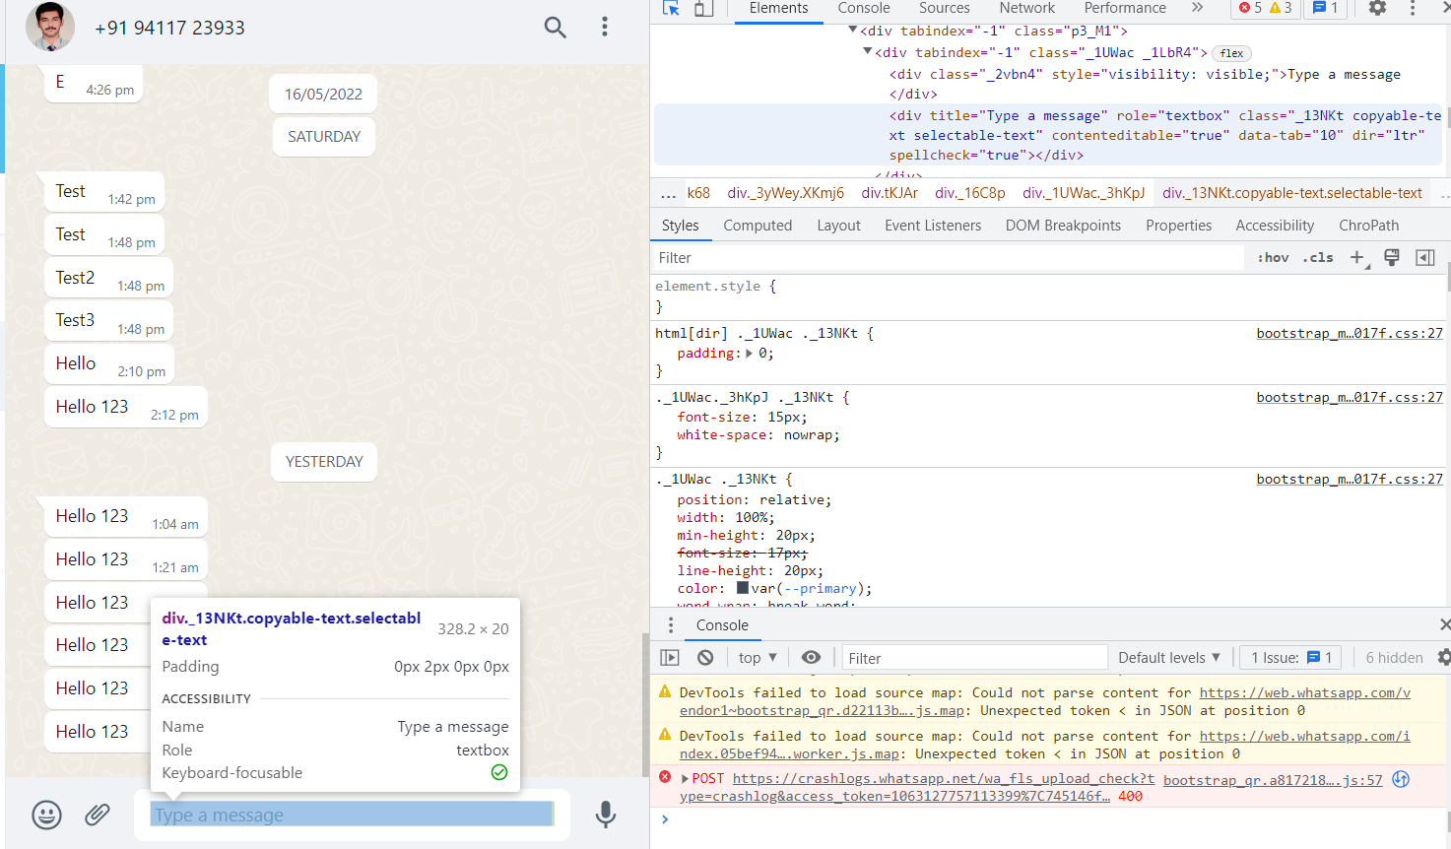
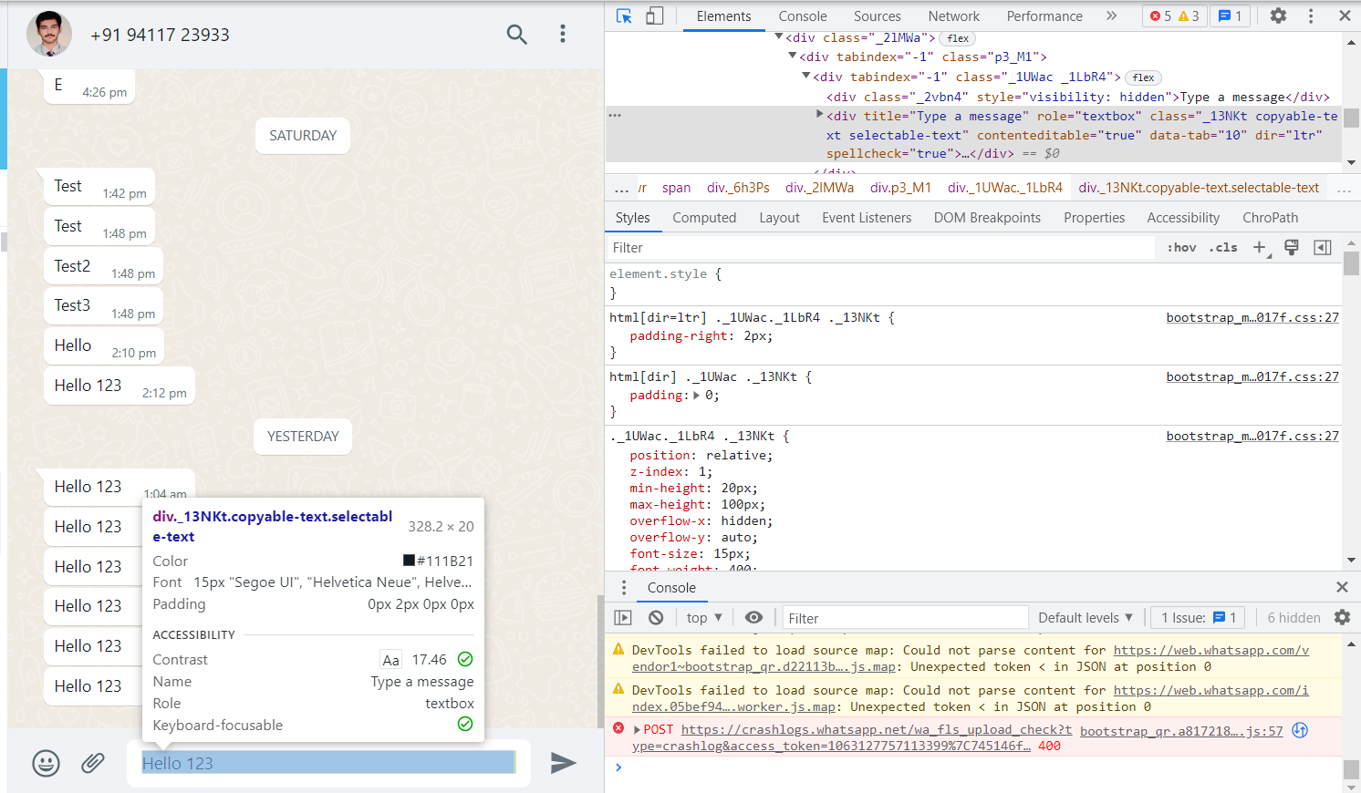
3. Enters the value provided by user
4. Identifies Message box.
5. Enters text message and sends.

Slide 7

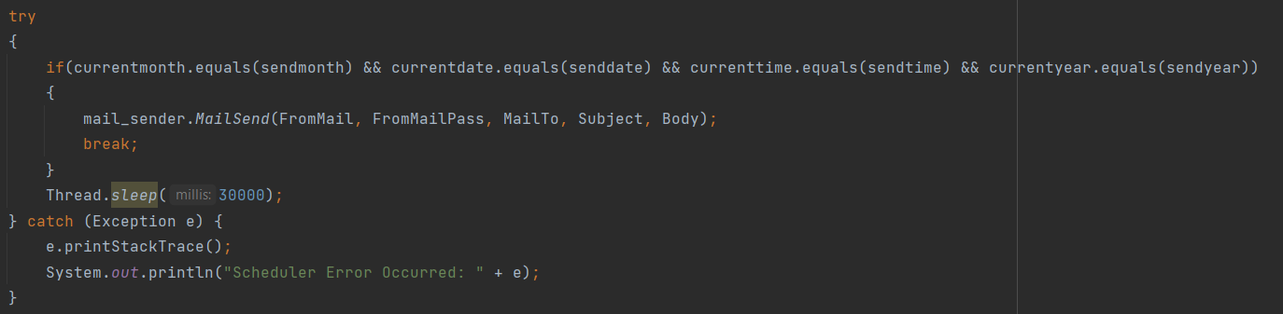
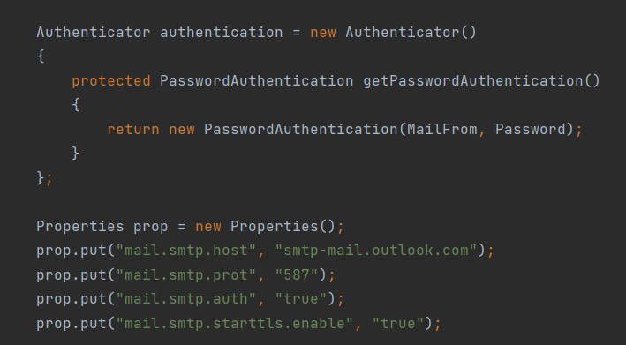
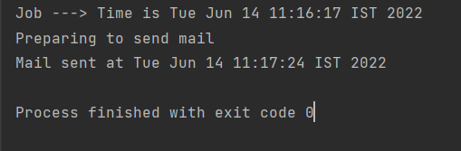
E – Mail module
1. Gets input from the user and displays current time.
2. Scheduler for the mails to be sent.
3. Authenticates Username and Password using Oracle mail API.
4. Mail is sent with confirmation.

