Slide 1

Integrated Spatio-temporal Storyline Visualization with Low Crossover
CSC 8930
Team members:
Shilpa Batthineni

Slide 2
Introduction
A story is a chain of events. Each event has multiple dimensions: time, location, characters, actions, and context.
Storyline visualizations: It attempts to visually present the many dimensions of a story’s events and their relationships.
Time and space challenge: It is tricky to make a map that combines when things happen (time) and where they happen (location/space). Time is like a straight line (1D), and space is like a flat surface (2D). Combining them is not easy.
Notes:
Lets see what Secure 2PC is, let’s consider two parties with private inputs, who wish to do some computation of their inputs without revealing their part of the computation.
Now Cryptography aims for privacy: There should be a secure protocol that performs the computation and reveals no more information than the output of the computation i.e., the process of protocol computation reveals nothing.
Privacy: The ideal-model party B cannot learn about the honest party’s A input. Thus, the same is true of party A.
Correctness: In the ideal model, the function is always computed correctly. Thus, the same is true in the real model. Others: For example, independence of inputs
Obvious solution is: Existence of a fully Trusted Party(TP) All players send their values to the TP do the computation and sends each player what he is supposed to know.

Slide 3
Storyline Visualization
We propose a Storyline visualization technique that integrates time and location information in a single view.
This is a timeline-based visualization method that maintains regular ordering of temporal and spatial dimensions. When you look at it, it keeps the order of events in both time and space. It's like organizing the information neatly.
The basic idea behind the Storygraph is to visualize spatiotemporal
or 3D data in a 2D coordinate system.
Notes:
Lets see what Secure 2PC is, let’s consider two parties with private inputs, who wish to do some computation of their inputs without revealing their part of the computation.
Now Cryptography aims for privacy: There should be a secure protocol that performs the computation and reveals no more information than the output of the computation i.e., the process of protocol computation reveals nothing.
Privacy: The ideal-model party B cannot learn about the honest party’s A input. Thus, the same is true of party A.
Correctness: In the ideal model, the function is always computed correctly. Thus, the same is true in the real model. Others: For example, independence of inputs
Obvious solution is: Existence of a fully Trusted Party(TP) All players send their values to the TP do the computation and sends each player what he is supposed to know.

Slide 4
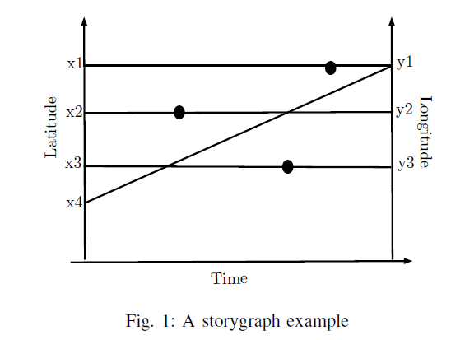
Spatio-temporal Visualization
Fig. 1 is an example of a Storygraph.
Storyline Visualization consists of two parallel vertical axes which represent the location pair (e.g., latitude and longitude) and a horizontal axis represents time.
Notes:
Lets see what Secure 2PC is, let’s consider two parties with private inputs, who wish to do some computation of their inputs without revealing their part of the computation.
Now Cryptography aims for privacy: There should be a secure protocol that performs the computation and reveals no more information than the output of the computation i.e., the process of protocol computation reveals nothing.
Privacy: The ideal-model party B cannot learn about the honest party’s A input. Thus, the same is true of party A.
Correctness: In the ideal model, the function is always computed correctly. Thus, the same is true in the real model. Others: For example, independence of inputs
Obvious solution is: Existence of a fully Trusted Party(TP) All players send their values to the TP do the computation and sends each player what he is supposed to know.

Slide 5
Spatio-temporal Visualization
Each location (x,y) or (latitude, longitude) is represented as a line segment referred to as a location line. Location lines are created by joining the corresponding location values on the two vertical axes.
.Events occurring at the same location on different times are plotted as markers along the location line.
Circles on the line represent the events that happen at the same place at different times.
Notes:
Lets see what Secure 2PC is, let’s consider two parties with private inputs, who wish to do some computation of their inputs without revealing their part of the computation.
Now Cryptography aims for privacy: There should be a secure protocol that performs the computation and reveals no more information than the output of the computation i.e., the process of protocol computation reveals nothing.
Privacy: The ideal-model party B cannot learn about the honest party’s A input. Thus, the same is true of party A.
Correctness: In the ideal model, the function is always computed correctly. Thus, the same is true in the real model. Others: For example, independence of inputs
Obvious solution is: Existence of a fully Trusted Party(TP) All players send their values to the TP do the computation and sends each player what he is supposed to know.

Slide 6
Requirements
Objective: Visualizing spatiotemporal data efficiently using minimal resources in Google Colab.
Resource Constraints:Python, pandas, matplotlib.pyplot, DASH, Plotlyexpress
Dataset: https://www.kaggle.com/datasets/usgs/earthquake-database?resource=download&select=database.csv
Toolset Overview:
Utilizing Python for scripting.
pandas for data manipulation.
matplotlib.pyplot, DASh and Plotlyexpress for data visualization.
Notes:
Lets see what Secure 2PC is, let’s consider two parties with private inputs, who wish to do some computation of their inputs without revealing their part of the computation.
Now Cryptography aims for privacy: There should be a secure protocol that performs the computation and reveals no more information than the output of the computation i.e., the process of protocol computation reveals nothing.
Privacy: The ideal-model party B cannot learn about the honest party’s A input. Thus, the same is true of party A.
Correctness: In the ideal model, the function is always computed correctly. Thus, the same is true in the real model. Others: For example, independence of inputs
Obvious solution is: Existence of a fully Trusted Party(TP) All players send their values to the TP do the computation and sends each player what he is supposed to know.

Slide 7
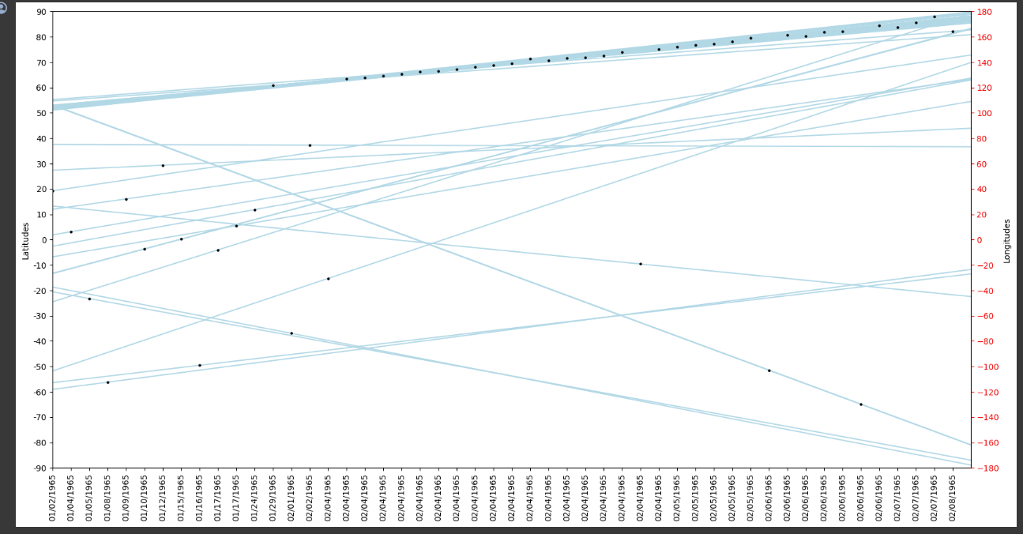
Implementation
Notes:
Lets see what Secure 2PC is, let’s consider two parties with private inputs, who wish to do some computation of their inputs without revealing their part of the computation.
Now Cryptography aims for privacy: There should be a secure protocol that performs the computation and reveals no more information than the output of the computation i.e., the process of protocol computation reveals nothing.
Privacy: The ideal-model party B cannot learn about the honest party’s A input. Thus, the same is true of party A.
Correctness: In the ideal model, the function is always computed correctly. Thus, the same is true in the real model. Others: For example, independence of inputs
Obvious solution is: Existence of a fully Trusted Party(TP) All players send their values to the TP do the computation and sends each player what he is supposed to know.

Slide 8
Code Execution
https://colab.research.google.com/drive/1Jd3k-t4WPTr_u5Y5ueVLCC716k2xGtld#scrollTo=Tf5seW92vKcm
Notes:
Lets see what Secure 2PC is, let’s consider two parties with private inputs, who wish to do some computation of their inputs without revealing their part of the computation.
Now Cryptography aims for privacy: There should be a secure protocol that performs the computation and reveals no more information than the output of the computation i.e., the process of protocol computation reveals nothing.
Privacy: The ideal-model party B cannot learn about the honest party’s A input. Thus, the same is true of party A.
Correctness: In the ideal model, the function is always computed correctly. Thus, the same is true in the real model. Others: For example, independence of inputs
Obvious solution is: Existence of a fully Trusted Party(TP) All players send their values to the TP do the computation and sends each player what he is supposed to know.

Slide 9
Challenges
One of the major challenges in Storygraph construction and other data visualization practices is the visual clutter created due to
large data set plotted on the display with a limited area.
Reducing confusion: When you have a lot of information, like in a big story, it's easy for lines on the graph to get tangled up. We also developed a heuristic method to reduce excessive line crossovers for large data sets.
Notes:
Lets see what Secure 2PC is, let’s consider two parties with private inputs, who wish to do some computation of their inputs without revealing their part of the computation.
Now Cryptography aims for privacy: There should be a secure protocol that performs the computation and reveals no more information than the output of the computation i.e., the process of protocol computation reveals nothing.
Privacy: The ideal-model party B cannot learn about the honest party’s A input. Thus, the same is true of party A.
Correctness: In the ideal model, the function is always computed correctly. Thus, the same is true in the real model. Others: For example, independence of inputs
Obvious solution is: Existence of a fully Trusted Party(TP) All players send their values to the TP do the computation and sends each player what he is supposed to know.

Slide 10
Low Cross-over Implementation
Line Intersection Points:
This Heuristic algorithm starts by calculating intersection points for all pairs of lines formed by latitude and longitude values.
It identifies the x-coordinates of these intersection points within the range of the data frame.
Maximum Adjacent Difference:
It then finds the maximum adjacent difference among these x-coordinates, indicating a segment on the x-axis where lines have the most significant separation.
Visualization of Identified Segment:
The algorithm sets the x-axis limits to focus on this segment with the maximum adjacent difference.
Notes:
Lets see what Secure 2PC is, let’s consider two parties with private inputs, who wish to do some computation of their inputs without revealing their part of the computation.
Now Cryptography aims for privacy: There should be a secure protocol that performs the computation and reveals no more information than the output of the computation i.e., the process of protocol computation reveals nothing.
Privacy: The ideal-model party B cannot learn about the honest party’s A input. Thus, the same is true of party A.
Correctness: In the ideal model, the function is always computed correctly. Thus, the same is true in the real model. Others: For example, independence of inputs
Obvious solution is: Existence of a fully Trusted Party(TP) All players send their values to the TP do the computation and sends each player what he is supposed to know.

Slide 11
Low Cross-over Implementation
It adjusts latitude and longitude values based on this segment and plots lines on the graph.
Scatter Plot of Intersection Points:
Intersection points within the identified segment are plotted as black dots on the graph.
Customization of Axes:
The y-axes are labeled for both latitudes and longitudes.
The visualization aims to provide insight into areas on the map where rearranging latitude and longitude values could potentially reduce line crossings. By focusing on the segment with the maximum adjacent difference, the script highlights regions where lines are more separated, and the scatter plot of intersection points helps identify key points within that segment.
Notes:
Lets see what Secure 2PC is, let’s consider two parties with private inputs, who wish to do some computation of their inputs without revealing their part of the computation.
Now Cryptography aims for privacy: There should be a secure protocol that performs the computation and reveals no more information than the output of the computation i.e., the process of protocol computation reveals nothing.
Privacy: The ideal-model party B cannot learn about the honest party’s A input. Thus, the same is true of party A.
Correctness: In the ideal model, the function is always computed correctly. Thus, the same is true in the real model. Others: For example, independence of inputs
Obvious solution is: Existence of a fully Trusted Party(TP) All players send their values to the TP do the computation and sends each player what he is supposed to know.

Slide 12
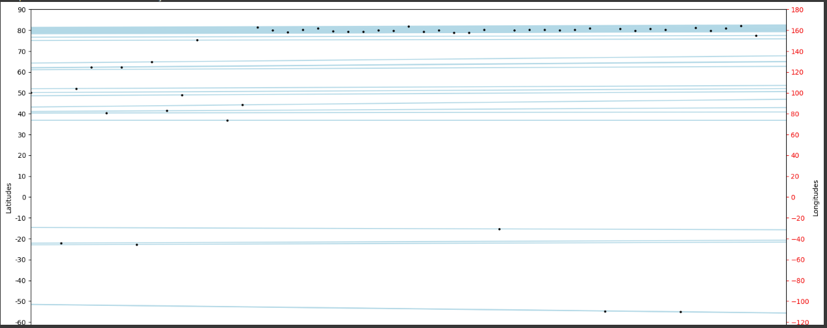
Implementation
Notes:
Lets see what Secure 2PC is, let’s consider two parties with private inputs, who wish to do some computation of their inputs without revealing their part of the computation.
Now Cryptography aims for privacy: There should be a secure protocol that performs the computation and reveals no more information than the output of the computation i.e., the process of protocol computation reveals nothing.
Privacy: The ideal-model party B cannot learn about the honest party’s A input. Thus, the same is true of party A.
Correctness: In the ideal model, the function is always computed correctly. Thus, the same is true in the real model. Others: For example, independence of inputs
Obvious solution is: Existence of a fully Trusted Party(TP) All players send their values to the TP do the computation and sends each player what he is supposed to know.

Slide 13
Demo

Slide 14
Conclusion
Reducing line crossings in geographical visualizations can be valuable for improving clarity and interpretability, especially when dealing with complex datasets or routes. This new heuristic method attempts to achieve this by identifying and visualizing areas of interest on the map where line crossings can potentially be minimized.
This method does not require time-consuming data preparation and is relatively fast. It works well with a regular spreadsheet. The only
requirement is that the spreadsheet has time and location columns.

