Slide 1
Travel Agency Database Systems
Pratyush Kakkar
(20022933)

Slide 2
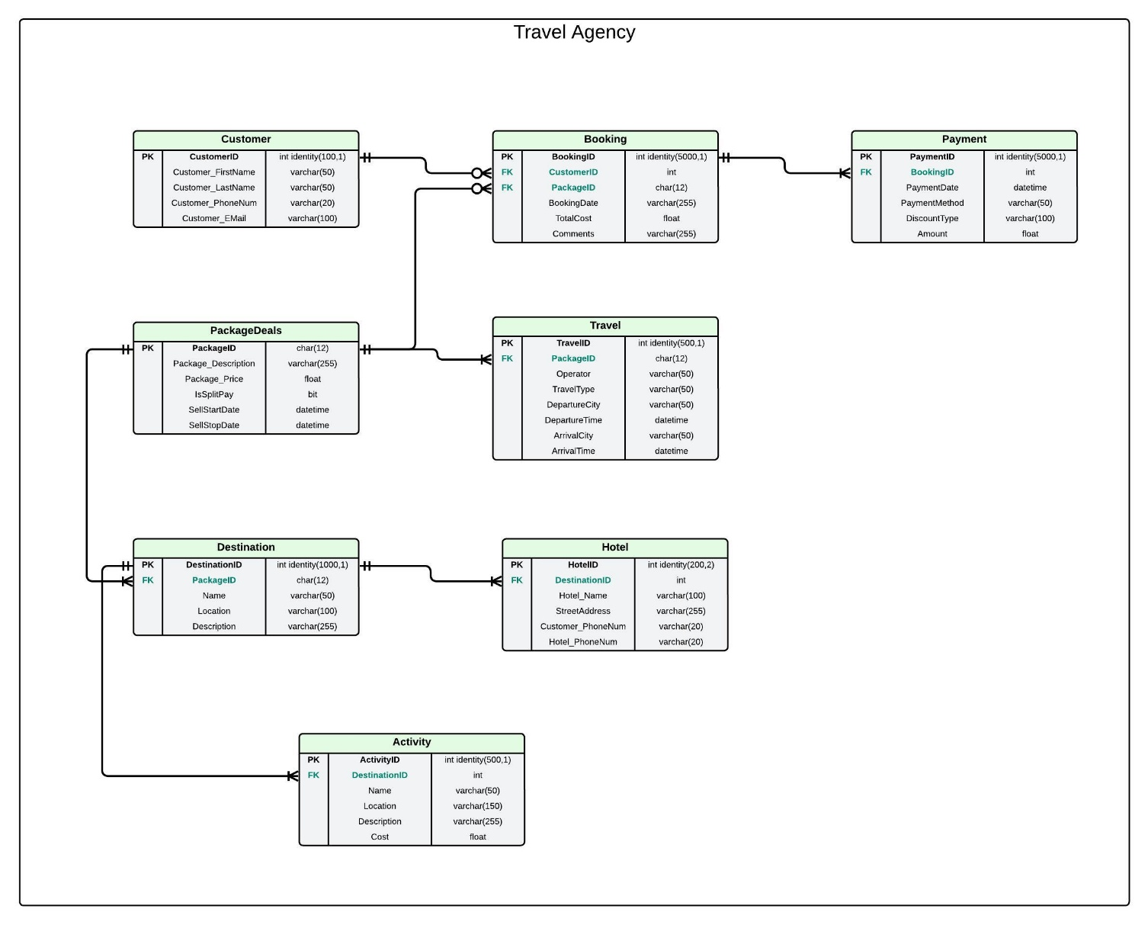
Entity Relationship Diagram

Slide 3
Security Risks:
1. Data Breaches & Unauthorized Access
Customer & payment data at risk from hackers & insider threats.
Solution: Azure Entra ID (MFA, RBAC), Data Encryption.
2. Data Loss & Integrity Issues
Accidental deletion, ransomware, or software bugs can corrupt records.
Solution: Azure SQL Automatic Backups (weekly & daily).
3. Insecure Payment Processing
Weak encryption & firewalls allow payment data interception.
Solution: Azure SQL Firewalls, Azure Key Vault (secure encryption keys).

Slide 4
Stratergies to Mitigate Cloud Outages:
1. Multi-Cloud & Regional Redundancy
Deploy across multiple cloud providers or regions for workload distribution.
2. Disaster Recovery Planning
Regular backups in diverse locations & routine recovery tests.
3. Incident Response & Communication
Define roles, escalation paths & stay updated with vendor alerts.
4. Third-Party Risk Management
Assess cloud providers' disaster recovery & security practices.
5. Zero Trust Model
Enforce strict access controls & encryption for data protection.

Slide 5
Q & A

