Slide 1
Tamper Detection in Academic Credentials
AI Development Intern – Pratyush Kaushal
Date: May 2025

Slide 2
Problem Statement
Educational document fraud is on the rise. Nearly 15–20% of academic credentials are forged or manipulated.
This project aims to detect tampering in academic documents like degree certificates and transcripts using automated methods.

Slide 3
Project Objectives
Analyze PDF metadata for inconsistencies
Detect layout or template mismatches
Identify suspicious content using OCR and anomaly detection

Slide 4
Methodology & Tools Used
PDF Metadata Extraction – PyPDF2
Layout Analysis – OpenCV template matching
OCR-based Content Extraction – Tesseract
Anomaly Detection – Rule-based logic on extracted fields

Slide 5
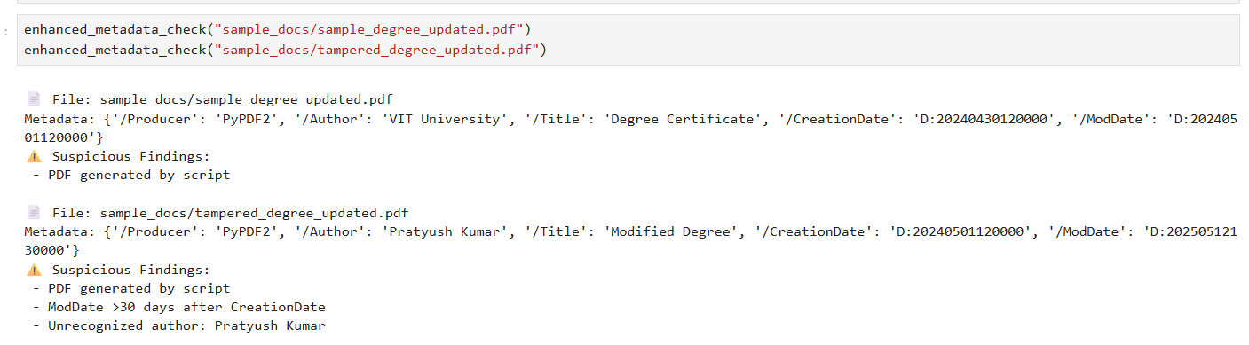
Demo Snapshots
Example 1: Future-dated modification detected via metadata

Slide 6
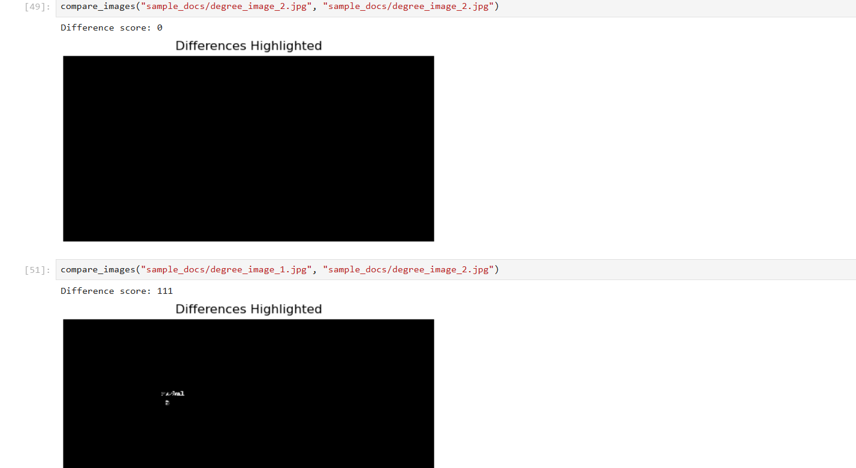
Example 2: Layout mismatch detected with OpenCV

Slide 7
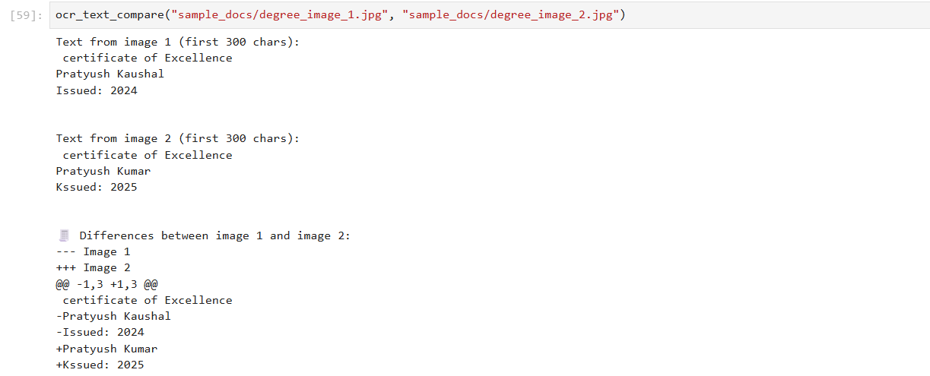
Example 2: Edited text revealed through OCR text comparison

Slide 8
Challenges & Learnings
Challenges:
Extracting consistent metadata across PDF types
Aligning templates for layout comparison
Dealing with noisy OCR outputs
Learning:
Learned how to apply image processing and text extraction for digital forensics.

Slide 9
Conclusion & Future Scope
This prototype provides a rule-based framework for detecting tampering in educational PDFs.
Future improvements could include:
AI-based anomaly scoring
Template database for layout comparison
Integration into verification platforms

Slide 10
Thank You

