Slide 1
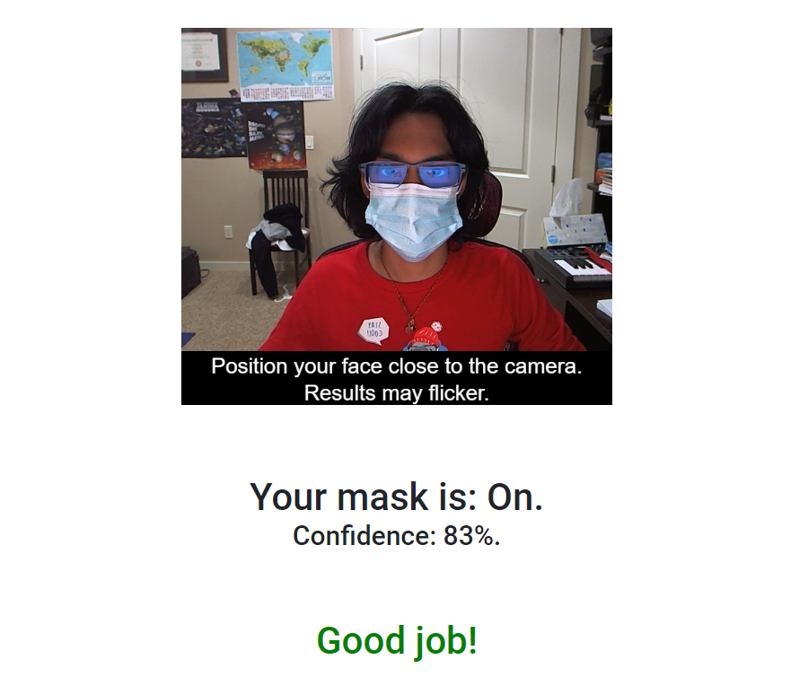
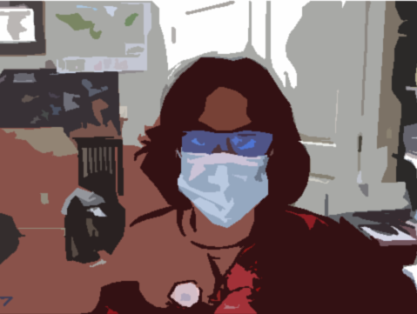

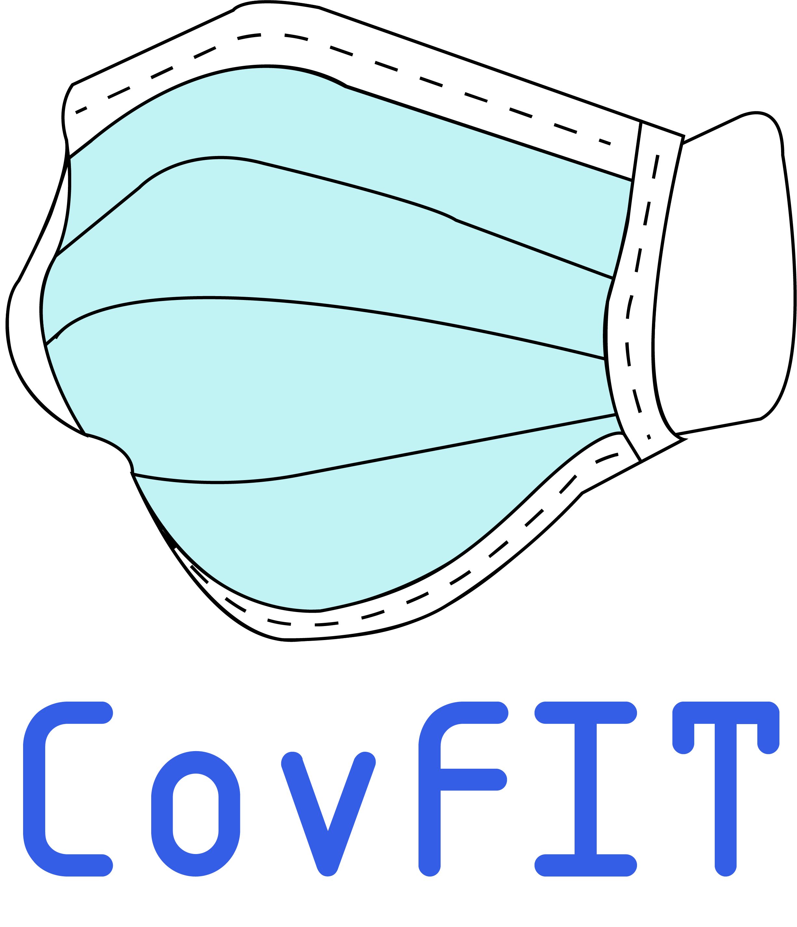
CovFIT
Pratyush Kore
Saathvik Somujayabalan
Med-o-Vate Hackathon 2021

Slide 2

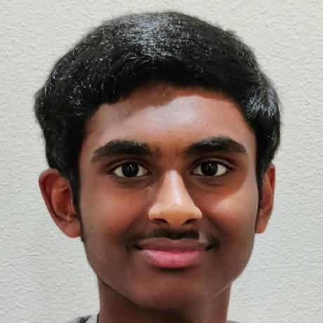
Introductions
Pratyush Kore
Saathvik Somujayabalan
"I am a freshman in Redmond High School. I have a strong interest in biology and healthcare. Combining my drive to help people and my fascination for machine learning and software development, this software is part of the quest to make sure everyone is masked."
"My name is Saathvik and I am a freshman at Tesla STEM High School. I have interests with engineering and software development and with Pratyush CovFIT was made, a software application to make sure people are wearing their masks."

Slide 3
The Problem
Data from covid19pulse.usc.edu
People are forgetting to wear their masks.

Slide 4
The Problem
Data from covid19pulse.usc.edu
*Large gatherings include 10+ attendees
As schools return to in-person learning, and large gatherings become more and more common, we need to make sure everyone is masked.

Slide 5
Current Solutions
Propaganda
Currently, many people focus on spreading the word and ensuring that people around them are masked
Enforcement
Many people also enforce wearing a mask
But it doesn’t stop people from forgetting or simply avoiding their mask.
Most people still fail to wear a mask at a large gathering
Washington issued a statewide order for masks in public spaces
Just like a teacher cannot keep track of everyone, laws are poorly enforced and do not make much of a difference
In a large gathering, you cannot keep track of everyone who enters the door

Slide 6
Our solution: CovFIT
Simple, Cost-Free, and Effective
A machine-learning software which checks everyone for a mask, and reminds them to wear one
Hands-Free!
No specialized equipment or training needed
This is better than other solutions because it is free, accurate, and doesn’t require any manpower at all
Is part of treatment in the healthcare process

Slide 7
CovFIT: Target Population
This solution is something simple you could place in a doorway to check everyone for a mask
This is targeted towards large, in-person gatherings
This helps students, healthcare workers, government workers, and even at sporting events

Slide 8

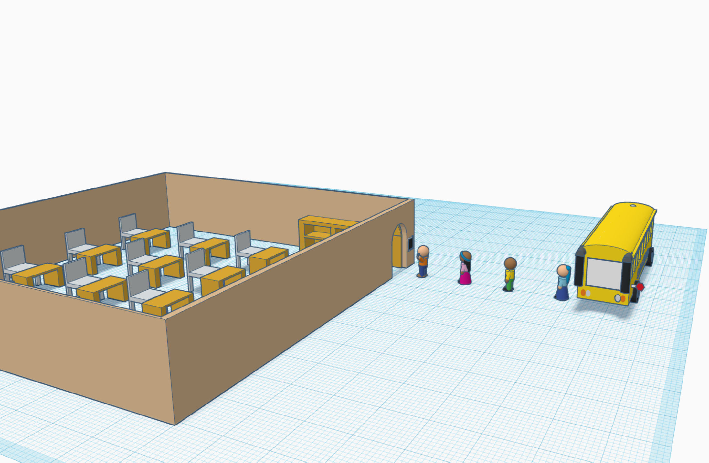
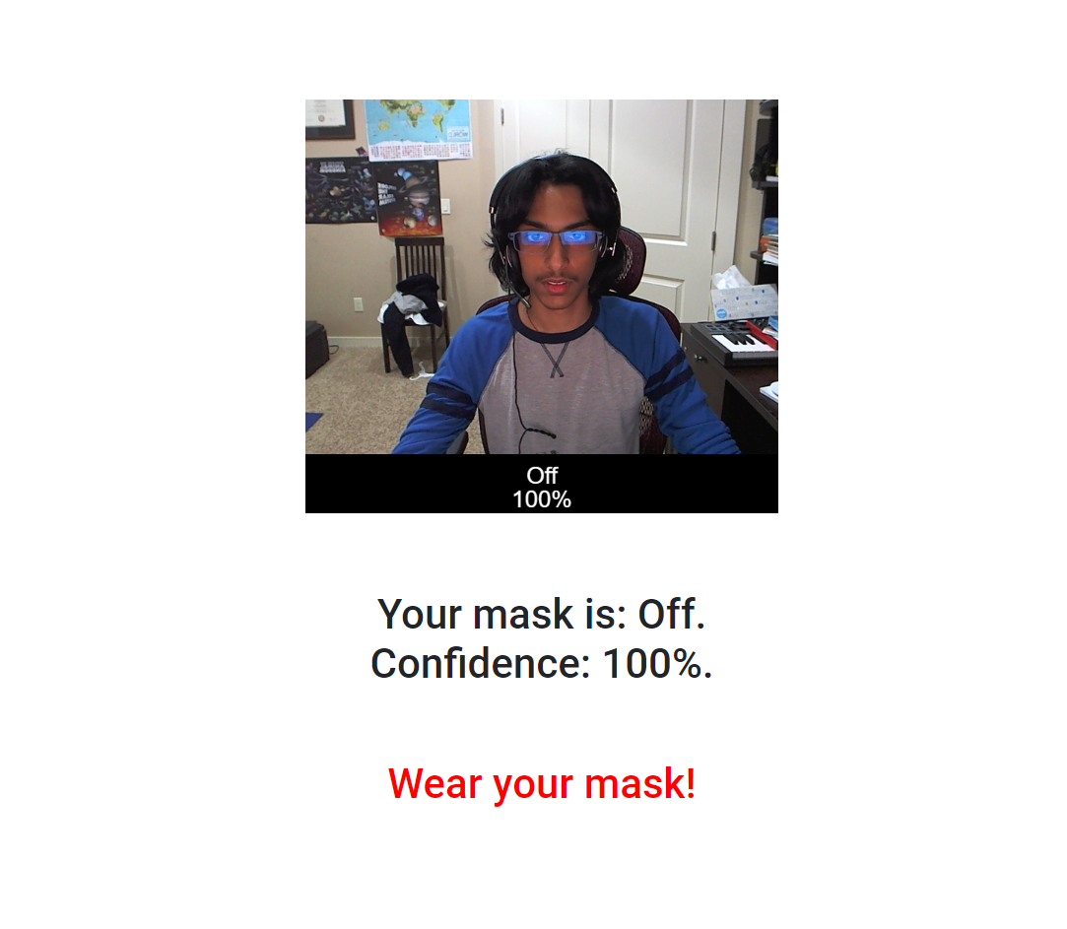
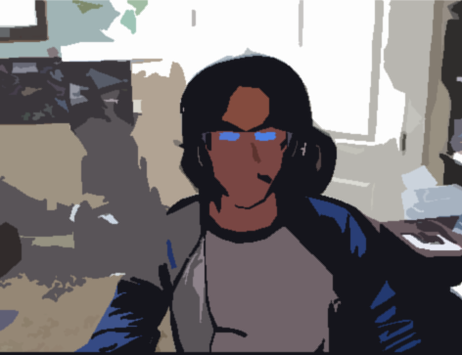
CovFIT: Application

Slide 9
The Prototype
Because it the easiest to show on a computer, we coded a website with html5, JavaScript, CSS, and a TensorFlow JavaScript machine learning model
Follow along!
Link to the repository is in the description!

Slide 10
Future additions
Optimize machine learning for 100% accuracy and avoid flickering
Improve face detection
Compatibility with other devices
Connect to a door which it can lock and unlock
Connect to an external monitor so a teacher can monitor the students as they enter

Slide 11
Works cited

Slide 12
Thank you
“The worst has passed, but we need to stay masked”

