Slide 1




Twin-Pulse
Cardiometabolic Digital Twin
Between clinic visits, a
90-day gap
90 days
we can’t see what is happening
Three critical information gaps
Today’s
visit
Next
visit
What’s happening right now
What’s driving the change
What will happen next
India diabetes prevalence
~101 million adults
Source: ICMR-INDIAB

Slide 2






Objectives and need
01
02
03
Predict a spike early
Show the whole-body picture
Let the doctor test actions safely
Detect deterioration sooner to give time for interventions that can change the outcome.
Integrate vital systems and trends to reveal what's
driving the risk.
Explore possible actions and see likely impact before deciding at the bedside.

Slide 3










Research and alternatives
Twin-Pulse conceptually covers the full spectrum of what matters at the bedside.
Clinic
HbA1c
CGM
app
Risk
score
Black-box ML
Twin-Pulse
Early deterioration signal
Whole-body system view
Explains why
Tests actions safely
Shows likely impact
All approaches have value. This is a conceptual comparison; no direct head-to-head benchmark exists.

Slide 4




















One patient. Three questions.
NORMAL
01
How long until
they cross the line?
EHR
Clinical history
and labs
02
EARLY DETERIORATION
Will it keep getting worse?
ADVERSE EVENT
CRITICAL THRESHOLD
03
Will it become
life-threatening?
ONE PATIENT
04
DECOMPENSATION
WEARABLES
DOCTOR
What happens next, and how do we act safest?
Continuous signals and trends
Interpret, decide,
act safely

Slide 5



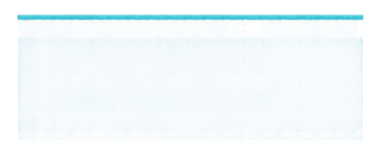










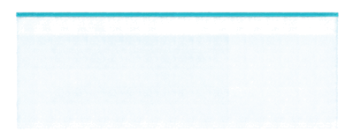




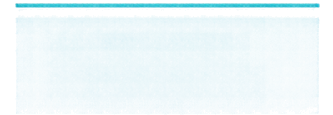

Architecture and stack
Synthetic datasets
De-identified and standards-aligned
DATA
50,000+ patients
3M+ encounters
120+ sources
Models and reasoning
Hybrid AI pipeline
with local LLM fallback
ENGINE
Risk models
Time-series models
Clinical rules
APIs and interoperability
FHIR R4 export
and integrations
SERVE
Secure APIs
FHIR R4
Audit and logging
Clinician experience
Built with Tailwind
for speed and clarity
FACE
Dashboard
3D body
Alerts
Patient timeline

Slide 6














Outputs and
synthetic test results
Sensitivity
88%
SYNTHETIC EXAMPLE
SYNTHETIC CONFUSION MATRIX
Predicted
Rajesh Sharma
Spike
No spike
Specificity
70%
Spike risk (15 min)
0.86
Time to peak
32 min
Spike
198
22
Actual
Precision
81%
Predicted peak
212 mg/dL
Suggested action
+2U insulin
No spike
28
52
F1 score
0.84
Confidence
High
+2U insulin is a synthetic fixture for testing only.
This is not treatment advice.
300 synthetic
test windows

Slide 7










Impact, Limits and next steps
VALIDATION ROADMAP
FOUR STAKEHOLDER BENEFITS
Better decisions
NOW
NEXT
LATER
See risk earlier and act with
greater confidence.
Retrospective validation
Prospective pilot
Scale and expand
Confirm performance using
historical data.
Test in real time and validate
clinical usefulness.
Broaden deployment and
measure system impact.
Safer care
Prevent deterioration and reduce unnecessaryEscalations.
More efficient systems
Focus time and resources where impact is greatest.
From reactive visits to continuous foresight.
Clearer evidence
Turn data into actionable insight that drives outcomes.

