Slide 1




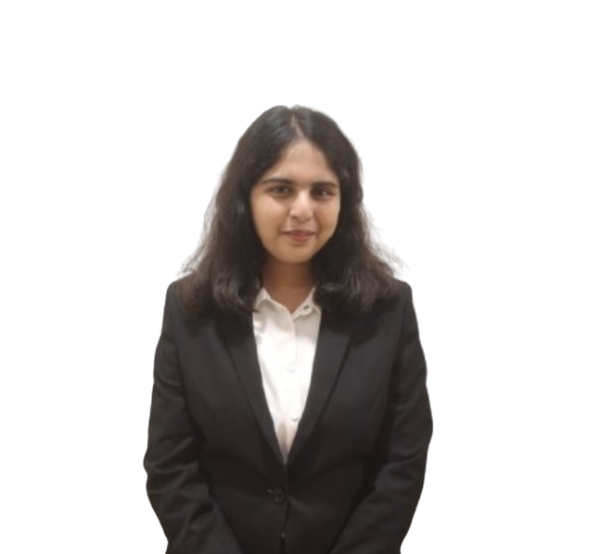
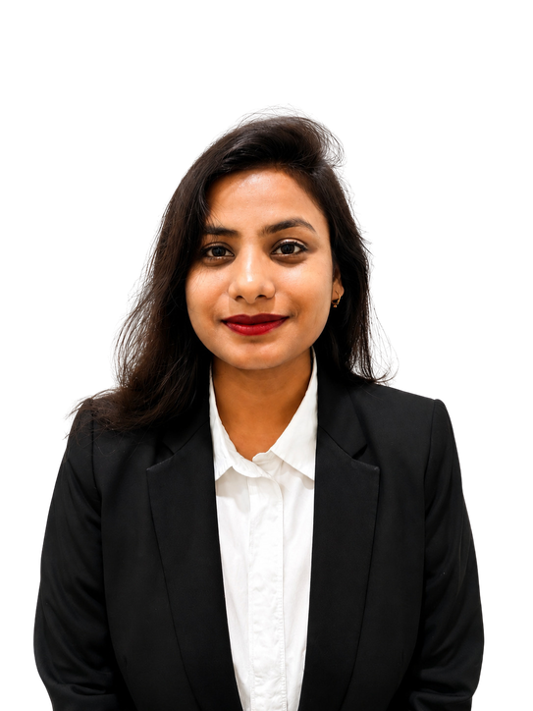
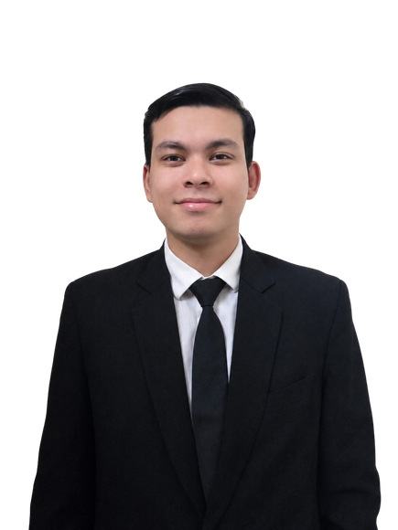
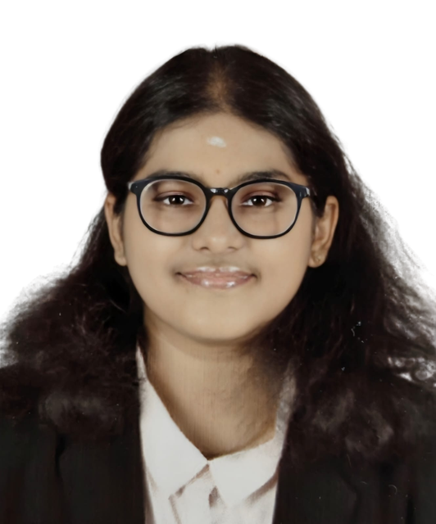

College: NMIMS Mumbai
PGP: 2nd Year
Team: Finsighters
Itishree Agarwal
Pratyush Mathur
Sai Mahima K
Sonakshi Mathur

Slide 2



PROBLEM 01 / 02
A Motor OD claim costs 9.8 days and ₹1,750 to settle — on a book already underwriting at 104.7%. Here turnaround is not service quality. It is cash.
Problem Statement
CLAIM TURNAROUND TODAY
₹
COST TO SERVE
MANUAL TOUCHES
GROUP COMBINED RATIO
9.8 days
₹1,750
7.0 per claim
104.7 %
per Motor OD claim · B-09
handling cost per claim · B-02 × B-28
human handoffs before settlement · B-02
Q1 FY27, up from 103.6% · FACT
Problem Statement Appreciation (Context and Understanding)
FROM FILED PREMIUM TO THE CLAIMS POOL CLAIMPULSE ACTS ON · FY2025-26, Motor OD
THE FILED FINANCIAL CONTEXT · why now
Motor OD gross direct premium
₹3,317.3 Cr
Q1 FY27 underwriting loss, annualised
₹520 Cr
Motor OD net earned premium
₹1,654.7 Cr
Net incurred claims ratio, from 71.1%
74.3%
₹
Motor OD premium at risk, per 1 pp share
₹427.5 Cr
₹1,234.4 Cr Annual incurred claims pool
GI grievances, +20% YoY, 69% claims-related
257,790
₹314 Cr addressable 274,307 claims a year
Solvency ratio — the capacity to act exists
254%
INSIGHT Every day of turnaround sits in the expense ratio and every undetected claim in the loss ratio — on this book both are cash.
BAJAJ FINSERV LTD.
SOURCE ClaimPulse Investor Dashboard R6 — Sheet 1 (Tables A, B, K); Sheet 3 Workings (Part A, W-01 to W-05). GI Council GDPI filings Jun’25–Jun’26; Bajaj Finserv Q1 FY2027 results, 31 Jul 2026.
Notes:
Open on 104.7%. The book loses money before we say a word about AI. That reframes TAT from a service metric to an expense-ratio metric — and the funnel shows the pool ClaimPulse is acting on.

Slide 3
PROBLEM 02 / 02
The 9.8 days do not sit in one department. They accumulate across nine points — and four of them are outside Bajaj’s direct control.
Problem Statement
CLAIMS-HANDLING HOURS A YEAR
CLAIMS PHYSICALLY SURVEYED TODAY
GARAGE ESTIMATE TO APPROVAL
HANDOFFS OUTSIDE BAJAJ’S CONTROL
384,030
55 %
4 days
4 of 9
7 touches × 20 min · W-88 · MODEL
against 10% structurally required · J-03
a held bay earns nothing · J-06
claimant, police, garage, surveyor
Problem Statement Appreciation (Context and Understanding)
OUTSIDE BAJAJ’S DIRECT CONTROL
INSIDE BAJAJ’S PROCESS
Claimant
Police / FIR
Garage
Surveyor
Documents
Fraud check
Claims ops
Validation
Settlement
Reports, then chases
Only where an FIR applies
Estimate raised, then waits
Physical visit by default
Reconciled by hand
Rules catch 62%
Queues and rework
Coverage confirmed
A mean, not a spread
FIELD RESEARCH
FIELD OBSERVATION
FIELD OBSERVATION
WAITING ACCUMULATES
day 1.4
day 4.4
day 6.6
day 8.9
9.8 d
day 0.6
day 2.6
day 5.6
day 7.8
day 9.8
INSIGHT Digitising any single step leaves the waiting in the steps around it — which is why the answer has to be orchestration, not another point automation.
BAJAJ FINSERV LTD.
SOURCE ClaimPulse Investor Dashboard R6 — Sheet 3 Workings (W-88); Sheet 1 (J-01, J-03, J-06, B-02, B-13); Sheet 7 U-08. Nodes are MODEL-class unless tagged; tagged nodes are our own field conversations.
Notes:
Four orange nodes are the ones a point solution cannot reach. The rail underneath is the whole argument: the days accumulate between the boxes, not inside them.

Slide 4
ANALYSIS 01 / 02
Four trend domains converge on one conclusion: digital evidence is now abundant and cheap to fabricate, so speed is only bankable if integrity is verified first.
Analysis: Key Insights/Opportunities/Challenges
THE TREND FIELD · 21 trends, four domains, each with a named publisher, a date and an evidence class
CONSUMER
SOCIAL
TECHNOLOGY
INDUSTRY
₹
Claims are where the customer judges the insurer
Claims experience ranks second only to price
Photographic evidence is cheap to fabricate
Soft motor pricing against stressed underwriting
the pool grows faster than premium
~1 pp retention per 5-point NPS gain
95% manipulated-image detection in 3 s
GWP +11.3% into a loss-making book
IRDAI Annual Report 2024-25 · FACT
Retently / CustomerGauge · BENCHMARK
NVIDIA / ControlExpert · BENCHMARK
Bajaj Q1 FY27, 31 Jul 2026 · FACT
Low comfort with unaided AI claim decisions
The speed benchmark is set outside insurance
Electric vehicles change what a claim looks like
Leakage concentrated in the mid-ticket band
only 22% comfortable
UPI and e-commerce reset the reference
battery is 40–50% of insured declared value
₹8,000–10,000 Cr a year
Insurity, Feb 2026 fieldwork · BENCHMARK
direction only, not monetised · PROXY
Zurich Kotak, 2026 · EV retail share crossed 12% · BENCHMARK
BCG & Medi Assist, Nov 2025 · PROXY
THREE OBLIGATIONS LAND INSIDE THE INVESTMENT WINDOW
THE ONE THAT THREATENS US
No published incidence of synthetic claim media exists anywhere.
1 APR 2026
JUN 2026
13 MAY 2027
The only vector that moves this case materially, and the only one nobody can size — so we built the architecture around it rather than pricing it in.
IRDAI Fraud Monitoring Framework
IRDAI AI Working Group constituted
DPDP Rules 2025 — full compliance
board-governed fraud monitoring becomes compulsory
governance, safeguards and an AI audit framework
penalties to ₹250 Cr, with no grace period
EVIDENCE DISCIPLINE
18 verified
9 lower tier
8 declared
INSIGHT The trend work constrained the model rather than decorating it — we capped our own fraud target and left repair-network gains out of the case entirely.
BAJAJ FINSERV LTD.
SOURCE ClaimPulse Investor Dashboard R6 — Sheet 7 Trend Analysis (Parts 1, 3, 5). IRDAI Annual Report 2024-25; Insurity Feb 2026; NVIDIA / ControlExpert; BCG & Medi Assist Nov 2025; vendor pricing pages, 12 Aug 2026.
Notes:
This is the why-now slide. Three regulatory dates land inside the investment window, and the one threat that could break the case is the one with no published incidence. That is exactly why the gate comes first.

Slide 5
ANALYSIS 02 / 02
Not every claim needs the same treatment. 65% of Motor OD claims are structurally deterministic — the delay is not difficulty, it is that nothing today decides which claims are which.
Analysis: Key Insights/Opportunities/Challenges
ROOT CAUSE · five drivers, each a costed line in the model
THE ADDRESSABILITY TEST · what routing has to decide
1
Manual, document-heavy verification
GATE 00 · SCREENED FIRST
100%
Nothing decides which files actually need a person to read them MODEL
Is the evidence real?
Physical inspection as the default
every claim, before any engine runs
2
GREEN · DECIDABLE
65%
Surveyors’ own top complaint is re-inspection caused by poor first images FIELD RESEARCH
Repair cost inside the IRDAI ₹50,000 corridor, fraud graph clean, policy clause matched
3
Rules cannot see a ring
all three must hold
A rule scores one claim at a time; organised fraud only shows up across claims MODEL
AMBER · JUDGEMENTAL
25%
Structured, but one signal is inconclusive
4
₹
Leakage is priced in, not detected
It is carried as a cost of doing business rather than found PROXY
a person decides, on a built dossier
RED · AMBIGUOUS
10%
5
Nothing today tests whether the evidence is real
Signals contradict, or the claim is contested
The whole process assumes the photograph is what it claims to be PRIMARY RESEARCH
investigation, not automation
INSIGHT The expensive part of a claim is not the decision. It is assembling evidence nobody has verified, on claims that never needed a person at all.
BAJAJ FINSERV LTD.
SOURCE ClaimPulse Investor Dashboard R6 — Sheet 3 Workings (Part B, W-10 to W-17); Sheet 1 (Tables B and J). Leakage benchmark: BCG & Medi Assist, Nov 2025.
Notes:
Five drivers, each a costed line — not a list of complaints. The right panel is the design brief: something has to decide which claims are which, before any of them is worked.

Slide 6
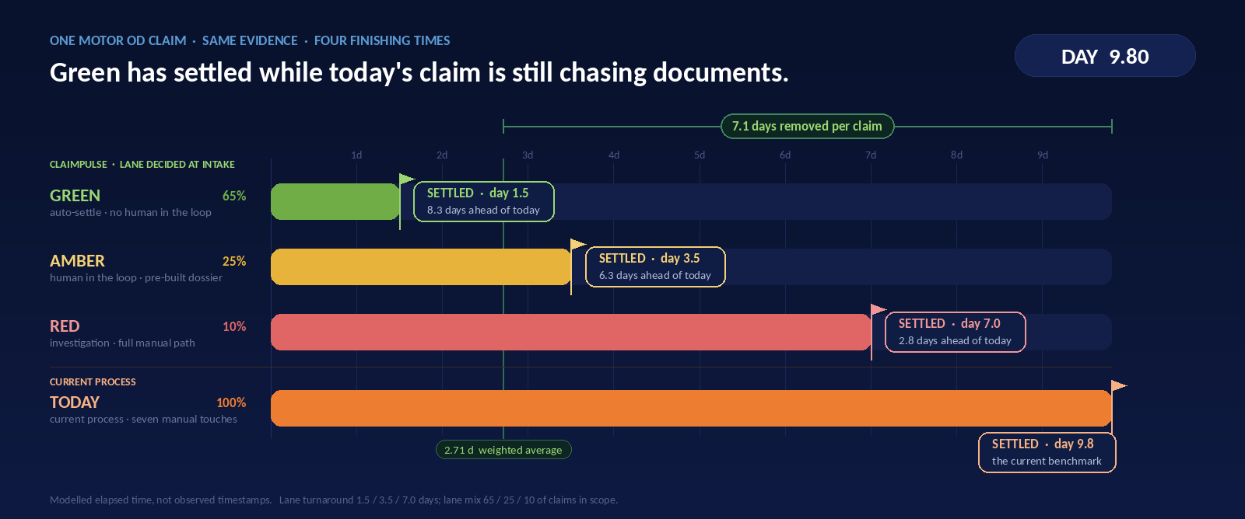
SOLUTION 01 / 05
The same claim, four clocks. Green settles on day 1.5, while today’s file is still chasing documents.
Solution Proposed
ONE CLAIM, FOUR FINISHING TIMES — TODAY’S PROCESS AGAINST THE THREE CLAIMPULSE LANES, ON ONE CLOCK
BAJAJ FINSERV LTD.
SOURCE ClaimPulse Investor Dashboard R6 — Sheet 3 Workings (Part B, W-12 to W-17). Lane turnaround and lane mix are team estimates, calibrated on live claims during the 90-day pilot.
Notes:
Let it run once before speaking. Everything advances on one clock; the flags differ. Green is settled and sitting still while the current process is still in document chase. Do not explain the mechanism yet — that is the next three slides.

Slide 7
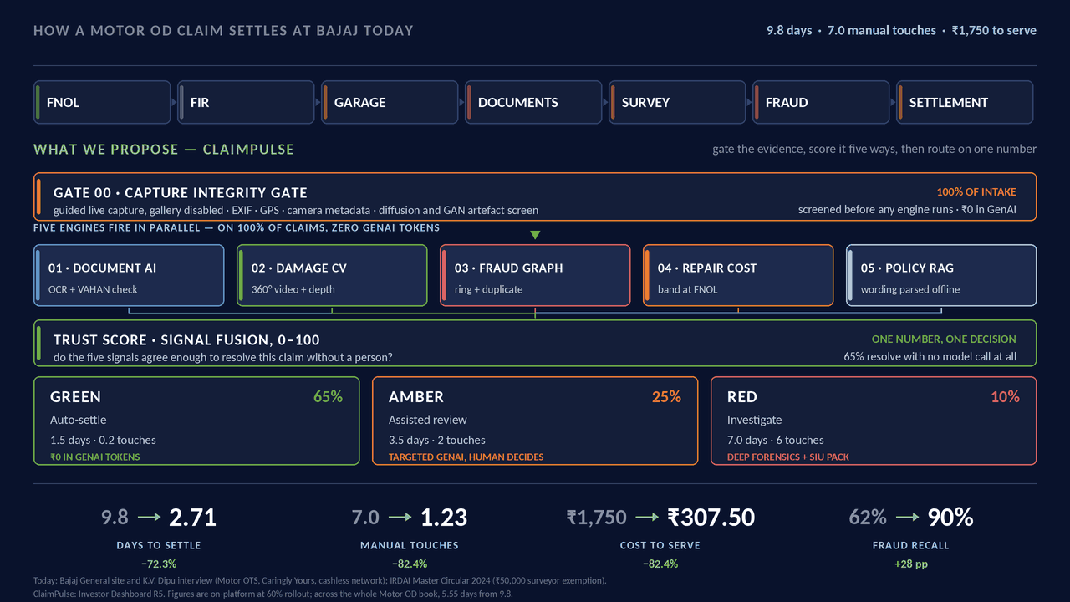
SOLUTION 02 / 05
One claim, one architecture: gate the evidence, score it five ways, then route on one number.
Solution Proposed
HOW A CLAIM SETTLES TODAY, AND WHAT CLAIMPULSE PROPOSES INSTEAD
GATE 0 — THE MODEL BUILD · before any engine can score a claim
Every engine is a model that has to be built before it can be trusted. Gate 0 is that foundation, and it runs across all five.
1
BUILD
labelled claim media, ICE and EV
2
TRAIN
on Bajaj’s own archive, not a vendor’s
3
VALIDATE
held-out claims, shadow mode first
4
GOVERN
drift, audit trail, human override
WHERE STEP 1 BRANCHES
ICE
EV
Panel, paint and
structural parts
— already labelled
in the archive
Battery-pack integrity,
thermal-event triage,
high-voltage handling
hold before survey
Same gate, same Trust Score, same three lanes. Only the damage models differ — which is why this is one platform, not two.
INSIGHT The cheapest inference is the one never run — two-thirds of claims clear on rules and integrity checks without a single model call.
BAJAJ FINSERV LTD.
SOURCE ClaimPulse Investor Dashboard R6 — Sheet 3 Workings (Parts B and D); Sheet 1 Assumptions (Tables B and D). Our primary research: gallery uploads silently break metadata forensics, so capture is live-only.
Notes:
Let the animation play once. Top band is today. Everything below it is what we propose. The right rail is the dependency the animation cannot show: none of the five engines exists until the models are built, trained, validated and governed — and step 1 is the only step where ICE and EV diverge. If asked about the figures on screen: cost-to-serve of ₹307.50 and fraud recall of 62% → 90% are unchanged in the current model. The ₹30.86 Cr on slide 12 is the R6 net annual benefit and nets off run cost and capture friction, which those two figures do not.

Slide 8
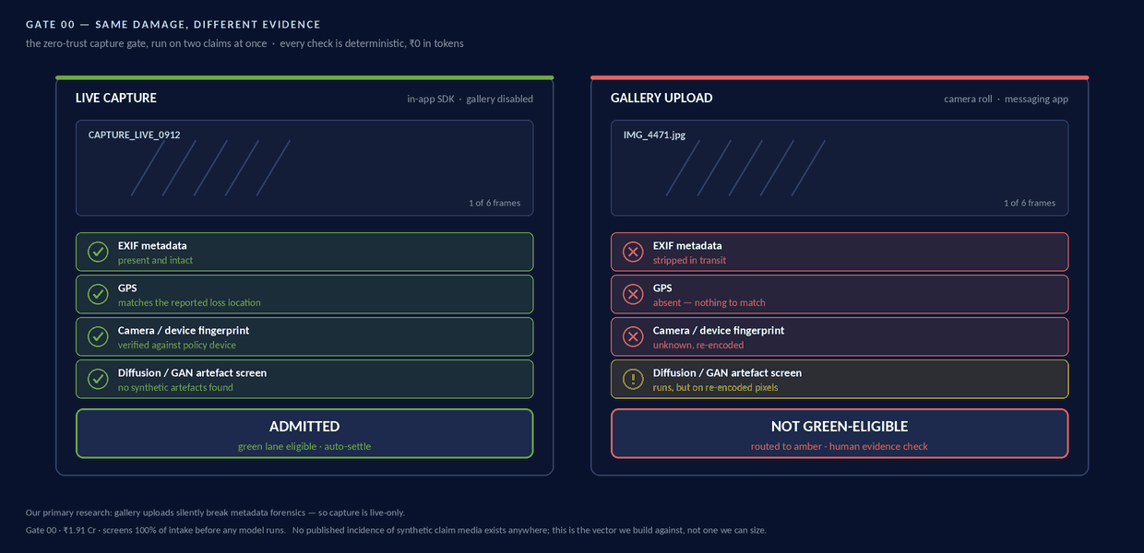
SOLUTION 03 / 05
Same damage, different evidence. Gate 00 screens integrity before any model runs — and it costs ₹0 a claim.
Solution Proposed
TWO CLAIMS, IDENTICAL DAMAGE — ONE CAPTURED LIVE, ONE UPLOADED FROM THE GALLERY
FNOL
First notice of loss — the moment a claimant reports the accident. ClaimPulse starts here, in the app, with the camera.
₹
₹0 API COST
Every Gate 00 check is deterministic. No model is called, so screening 100% of intake costs nothing per claim.
VERIFIED BY THE GATE
Not by a person. Metadata, GPS, device fingerprint and the artefact screen either pass, or the claim is not green-eligible.
INSIGHT A deterministic gate means nobody has to be believed — the claim either carries its own proof, or it does not qualify for the fast lane.
BAJAJ FINSERV LTD.
SOURCE ClaimPulse primary research on metadata survival through gallery and messaging pipelines, August 2026. Investor Dashboard R6 — Sheet 3 Workings (Part D).
Notes:
The gate is deterministic, so nobody has to be believed. Answer to "verified by whom" is: by the gate, not by a person.

Slide 9
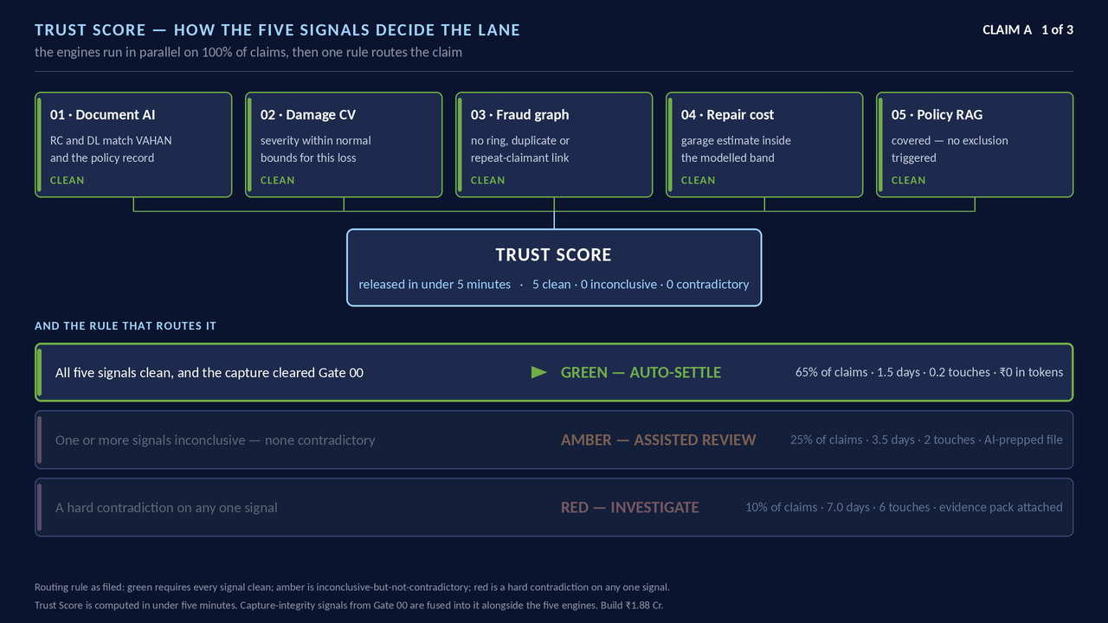
SOLUTION 04 / 05
The Trust Score is one number between 0 and 100 that answers a single question: can this claim be resolved without a person?
Solution Proposed
HOW FIVE SIGNALS FUSE INTO ONE SCORE — TWO WORKED CLAIMS
WHAT IT REPRESENTS · measured, not asserted
Agreement, not confidence. A high score means the five signals corroborate each other. The cut-points are calibrated on live Bajaj claims during the 90-day pilot and reviewed quarterly — we are not asking you to accept a threshold we invented.
NOTHING IS UNATTENDED · the controls
Override a surveyor can overturn any lane
Audit trail every decision, reason and model version stored
Explanation the dossier shows why, not only what
Rollback any model reverts in a single release
Escalation Red hands to SIU with the pack already built
GenAI never sees raw customer data — only the prepared dossier.
WHAT THE SCORE DECIDES · the lane, and what that lane costs
GREEN
₹0 API cost · no model call
AMBER
API included · dossier pre-built
RED
Deep forensics · SIU pack attached
INSIGHT One number, taken once, at intake — and every downstream decision inherits it rather than re-deriving it.
BAJAJ FINSERV LTD.
SOURCE ClaimPulse Investor Dashboard R6 — Sheet 3 Workings (Part B). Band cut-points are calibrated on live claims during the 90-day pilot; they are not asserted here.
Notes:
Claim A: five of five agree, it settles. Claim B: the fraud graph flags a repairer cluster and the estimate is above band, so it lands in assisted review and a person decides.

Slide 10
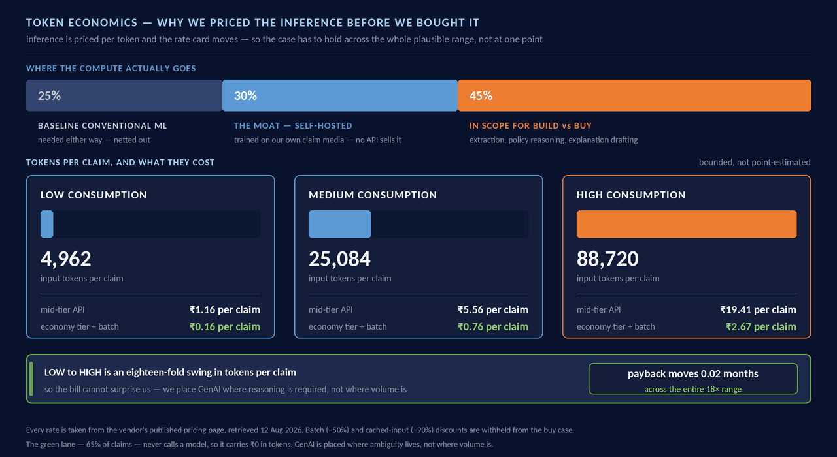
SOLUTION 05 / 05
Inference is priced per token and the rate card moves, so the case is built to hold across the whole plausible range.
Solution Proposed
WHAT A CLAIM ACTUALLY COSTS IN TOKENS, LOW TO HIGH
₹
COST PER CLAIM, MEDIUM CASE
₹0.76
economy tier with batching · ₹5.56 at mid-tier list price
LOW TO HIGH SWING
18×
and payback moves 0.02 months across all of it
BUILD VS BUY · on the in-scope 45%
Buy — 5-year NPV advantage
₹2.70 Cr
GPU-seconds breakeven per claim
77 s
Assumed today — 8.4× over
648 s
INSIGHT Buy the commodity, build the moat. We placed generative AI where ambiguity lives, not where volume is — so the bill cannot surprise us.
BAJAJ FINSERV LTD.
SOURCE Every rate taken from the vendor’s own published pricing page, retrieved 12 Aug 2026; batch (−50%) and cached-input (−90%) discounts withheld from the buy case. Investor Dashboard R6 — Sheet 12.
Notes:
Prelude first: AI is getting more expensive to reason with and the rate card moves. That is why we priced the inference before we bought it.

Slide 11
IMPACT 01 / 03
One routing decision, seven stakeholders — and we name the group it costs.
Solution Proposed
WHO INTERACTS WITH CLAIMPULSE, AND WHAT EACH ONE RECEIVES · Base plan, 60% rollout
THE CAPACITY LOOP · W-66 → W-69
STAKEHOLDER
TODAY
CLAIMPULSE
VALUE RECEIVED
949,652
manual touches automation removes
Customer
1,166,904 claimant-days returned a year MODEL
316,551
claims-handling hours released a year
9.8 d
2.71 d
176 FTE
of capacity — redeployed, not removed
Claims operations
The queue becomes a short exception list MODEL
5.69×
adjuster throughput from the same team
7.0
1.23
Those hours go to the 57,605 claims a year that still need a person. Capacity, not cash — no salary is removed, so no salary funds the marketing below.
Surveyors
90,521
16,458
74,063 physical visits avoided a year MODEL
MARKETING — HUNT AND FARM · ₹ Cr at full coverage
Garages
4 d
1 d
3 days cut from estimate to approval MODEL
HUNT acquire ₹8.27 Cr
FARM retain ₹0.61 Cr
Used-car dealerships
3.35
WhatsApp assistant
0.23
Fraud / SIU
undetected share falls 38% → 10% MODEL
New-car showrooms
2.42
Loyalty ladder
0.15
62%
90%
Google Search + SEN
1.79
Refer & earn fuel
0.12
Garages, PB, LinkedIn
0.49
No-claim jackpot
0.08
Regulator
Every decision carries its evidence and its reason REGULATION
Press release
0.15
Predictive renewal
0.03
no trail
auditable
Car expo — stall, kiosks
0.07
+ dealer commission
1.96
Marketing / renewal
Scenario assumption — retention value, to be validated TIER 2
₹8.88 Cr at full coverage · ₹5.33 Cr in the Base case · W-23a · 1.18 M qualified leads
not costed
₹0.58 Cr
Dealer commission is costed on the sheet but sits outside its own total, so it is shown apart. Only the ₹0.58 Cr renewal-retention line (W-22) is carried in the case — acquisition value from those leads is upside, not modelled.
INSIGHT Effort is reduced and resources are redeployed — and the group it costs, 13,167 claimants a year who cannot use live capture, is on this slide unprompted.
BAJAJ FINSERV LTD.
SOURCE ClaimPulse Investor Dashboard R6 — Sheet 6 Stakeholder Analysis (SC-01 to SC-18); Sheet 3 Workings (Part I, W-56 to W-80). 1,800 productive hours per FTE a year; 70% realisation on released capacity.
Notes:
Marketing and renewal is the only row carried as a scenario assumption, and it is labelled as one. Everything above it is a formula reading the P&L.

Slide 12
IMPACT 02 / 03
₹30.86 crore a year, and the Motor OD combined ratio improves by 1.15 points.
Solution Proposed
₹
NET ANNUAL BENEFIT
PAYBACK FROM KICKOFF
THREE-YEAR NPV
GROUP COMBINED RATIO
₹30.86 Cr a year
20.1 months
₹50.88 Cr
104.51 %
steady state, Base plan · W-35
includes the 10-month build · 3.8 mo steady state · H-19
at a 12% discount rate
from 104.7%, on ₹10,205.9 Cr of NEP · W-46
Analysis: Key Insights/Opportunities/Challenges
WHERE THE ANNUAL BENEFIT COMES FROM · ₹ Cr a year, Base plan at 60% rollout
HOW IT REACHES THE COMBINED RATIO · combined ratio = loss ratio + expense ratio · lower is better
16.62
0.58
−0.59
−5.33
Loss ratio
+1.42 pp
34.76
−3.90
fraud and leakage avoided, ₹23.49 Cr
30.86
Expense ratio
−0.27 pp
6.30
run cost and capture friction, ₹4.49 Cr
6.14
The ₹16.62 Cr of released capacity is in the benefit total but kept out of this ratio: headcount is redeployed, not removed, so claims-handling cost does not fall. Booking it would add a further 1.0 pp we have not claimed.
11.05
Motor OD combined ratio
+1.15 pp better
Fraud avoided
graph engine
Fraud avoided
capture gate
Synthetic media
avoided
Capacity
redeployed
NOT CASH
Renewal retention
SCENARIO
less capture
friction
less marketing
investment
GROSS
BENEFIT
less annual
run cost
NET ANNUAL
BENEFIT
Net of every line above
₹30.86 Cr a year
INSIGHT The loss ratio carries this case. The expense ratio moves against us because we refuse to bank a headcount reduction we are not proposing.
BAJAJ FINSERV LTD.
SOURCE ClaimPulse Investor Dashboard R6 — Sheet 2; Sheet 3 Workings (W-19 to W-46). ₹ Cr a year, steady state, Base plan at 60% rollout. Motor OD NEP ₹1,654.7 Cr; group NEP ₹10,205.9 Cr.
Notes:
Answer the investor question directly: ₹9.89 Cr in, ₹30.86 Cr a year out, payback 20.1 months from kickoff. Then the bridge — plus signs are improvements. The expense ratio deliberately gets worse because we do not claim the labour saving.

Slide 13
IMPACT 03 / 03
Ten months to build, four gates that can each stop the spend, and one scenario that does not clear.
Solution Proposed
IMPLEMENTATION ROADMAP · 15 costed components · ₹9.89 Cr · 10 months
MONTHS 1–3 · ₹1.44 Cr
MONTHS 3–6 · ₹2.73 Cr
MONTHS 5–7 · ₹1.00 Cr
MONTHS 7–10 · ₹3.07 Cr
CROSS · ₹1.65 Cr
Gate 00 and capture
Document AI and damage CV
Fraud and duplicate graph
Trust Score and routing
Integrations
live capture SDK, integrity screen
the moat, trained on our own media
ring detection in shadow mode
routing live, with audit and override
VAHAN, garage, policy DB, CRM
THREE ROLLOUT SCENARIOS · the plan is the middle one
THE STRESS TEST · all three assumptions miss at the same time
SCENARIO
NET / YR
3-YR
PAYBACK · STEADY
Fraud detection reverts
90% → 62%
the rule-based baseline returns
Conservative · 20%
₹10.15 Cr
₹25.10 Cr
11.7 mo
Green-lane share falls
65% → 50%
fewer claims are decidable
Base · 60%
₹30.86 Cr
₹78.73 Cr
3.8 mo
Rollout drags
60% → 35%
adoption is slower than planned
Aggressive · 100%
₹47.30 Cr
₹121.11 Cr
2.5 mo
RESULT net ₹0.38 Cr a year, three-year NPV −₹10.82 Cr, no payback inside three years. This is the case that does not clear — and gates 2 and 3 detect it in ninety days, before the spend. That is why capital is released against measurements rather than against this deck.
THE FOUR 90-DAY PILOT GATES · each one can stop the spend
1
Measured GPU-seconds per claim
2
Shadow-mode fraud detection
3
Green-lane share on live claims
4
Exception queue and P90 turnaround
GO
below the 77-second breakeven
GO
82% or better on held-out claims
GO
50% or better
GO
within operations capacity
STOP
above it — GenAI is bought, not built
STOP
below 82% — the fraud lines are rebuilt
STOP
below 50% — rollout pauses at the pilot region
STOP
if P90 slips — rollout holds
BAJAJ FINSERV LTD.
SOURCE ClaimPulse Investor Dashboard R6 — Sheet 3 Workings (Part D build stack); Sheet 4 Forecast; Sheet 8 Scenario Simulation; Sheet 0 Investment Committee (IC-31 to IC-34).
Notes:
This is the risk-control slide. The stress test is not decoration: it names the three levers, moves them together, and shows the case failing — then points at the two gates that would catch it inside ninety days.

Slide 14
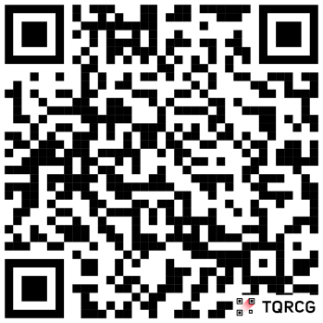
WHY US
We buy what any insurer can buy. We build the capture gate, the decision layer and the governance — and that is the part that cannot be procured.
Your Solution’s USP / Value Proposition: Why should we consider you?
ENGINE BY ENGINE · build · buy · integrate · govern
BUILD
BUY
INTEGRATE
GOVERN
Gate 00 capture-integrity checks
Document AI and OCR
Parts, labour and garage network
Model-risk policy and version control
Damage CV trained on Bajaj’s archive
Foundation models for language
Policy administration and payments
DPDP consent and data residency
Fraud graph across claims, garages, people
IRDAI reporting and SIU workflow
IRDAI-ready decision audit
Trust Score fusion and lane routing
SCAN · RUN IT YOURSELF · DOWNLOAD OUR WORKINGS
WHERE THE DURABLE ADVANTAGE SITS
ClaimPulse Executive Decision Simulator
Evidence integrity at capture
NOT BUYABLE
claimpulse-simulation.vercel.app
Bajaj’s own claim archive
Stream live claims through Gate 00 and watch the Trust Score route each one
NOT BUYABLE
Switch the rollout plan, fire a shock, inspect any module’s logic
Orchestration
COPYABLE ~18 MO
Download the detailed Excel workings — our own source workbook
Component AI
COMMODITY
GITHUB github.com/PratyushMathur2000/claimpulse-simulation
REFERENCES GI Council GDPI filings · Bajaj Finserv Q1 FY2027 · IRDAI Annual Report 2024-25, Master Circular 2024, Surveyors Regulations 2015, Fraud Monitoring Guidelines 2025, AI Working Group 2026 · DPDP Rules 2025 · BCG & Medi Assist 2025 · Insurity 2026 · NVIDIA / ControlExpert · Retently & CustomerGauge · Zurich Kotak EV knowledge centre 2026 · vendor pricing pages, 12 Aug 2026.
INSIGHT Two of the four are commodity and we say which. What is left needs Bajaj’s own claim history and Bajaj’s own point of capture — and nobody can buy either.
BAJAJ FINSERV LTD.
SOURCE ClaimPulse Investor Dashboard R6 — the complete workbook, the detailed report and the running simulator are all part of this submission.
Notes:
Close here. Top band answers "what did you actually build" — read it left to right, and note we are honest that two of the four columns are commodity. Bottom right is the ladder: orchestration is copyable in about eighteen months, and we say so. What is not copyable is evidence integrity at the point of capture and a fraud graph trained on Bajaj’s own archive. Then send them to the QR — the model is built to be challenged, not admired.

