Slide 1
DEVSECOPS CAPSTONE · OCTOBER 2026
PantryPulse
Stock, expiry and dispatch tracking for community food banks —
shipped through a gated, observable, GitOps-driven delivery platform.
Pratyush Mishra
github.com/PratyushMishra-2nd/DevopsProject
Notes:
PantryPulse is a stock and expiry tracker for community food banks. This talk covers the application and the DevSecOps platform around it: tests, containers, a gated CI/CD pipeline, Terraform for AWS, Kubernetes with Helm, GitOps with Argo CD, and monitoring with Prometheus and Grafana.

Slide 2
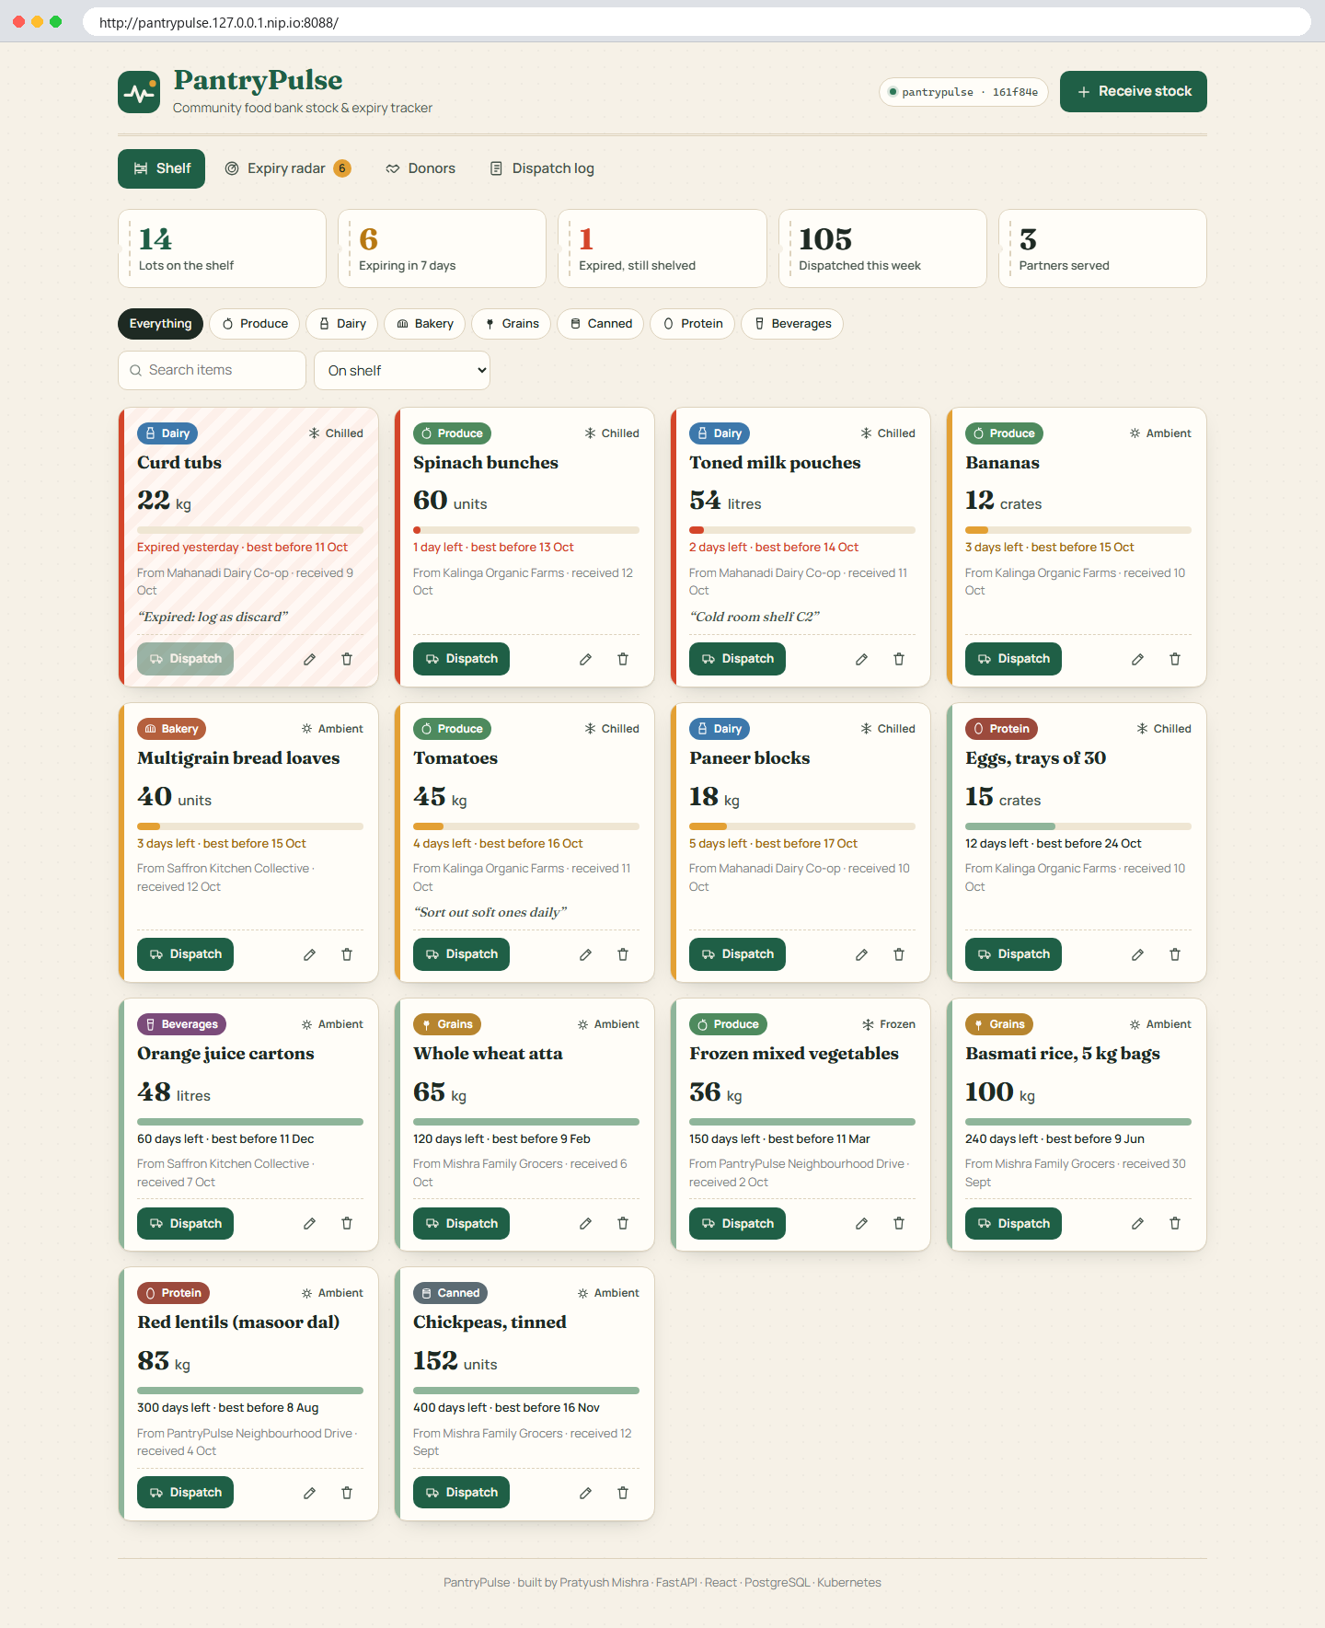
THE APPLICATION
What PantryPulse does
■ Shelf: every lot with a freshness bar and KPIs
■ Expiry radar: what to move first
■ Donors and a dispatch log to partner shelters
■ Business rules enforced by the API
– over-dispatch → 422, expired/held lot → 409
– lot with dispatch history cannot be deleted → 409
– voiding a dispatch restores the quantity
■ Version badge shows the deployed commit SHA
PantryPulse · DevSecOps capstone · Pratyush Mishra
2 / 15
Notes:
Food banks receive donations with very different shelf lives. PantryPulse shows what is on the shelf, what expires soon, who donated it and where it went. The API enforces the rules that matter: no dispatching expired or held stock, never more than what is left, and no deleting a lot that has dispatch history.

Slide 3
ARCHITECTURE
Three tiers, one chart, many gates
namespace pantrypulse · Pod Security restricted
GitHub Actions
tests · scans · build
frontend ×2–4
nginx + React
migrate Job
alembic
GHCR
:<commit-sha> only
Browser
Traefik
Ingress
backend ×2–5
FastAPI
PostgreSQL 17
StatefulSet+PVC
Argo CD
syncs Git → cluster
HPA (CPU) · PDB · NetworkPolicy · ServiceMonitor
Prometheus + Grafana
metrics · dashboard
Same Helm chart everywhere: CI's throwaway kind cluster, the local GitOps environment, and the EKS profile (values-eks.yaml).
PantryPulse · DevSecOps capstone · Pratyush Mishra
3 / 15
Notes:
The browser reaches Traefik. Slash goes to the React frontend on unprivileged nginx; slash api goes to the FastAPI backend, which talks to PostgreSQL. Alembic migrations run once per release as a Job. Prometheus scrapes every API pod through a ServiceMonitor and Grafana visualises it. GitHub Actions builds and scans images and pushes them to GHCR tagged by commit SHA; Argo CD keeps the cluster in sync with Git.

Slide 4
TECHNOLOGY
Stack and why
App
FastAPI · SQLAlchemy 2 · Alembic · React 19 + Vite · PostgreSQL 17
Quality
pytest (89% cov) · vitest · ruff · eslint/prettier
Security
bandit · pip-audit · npm audit · gitleaks · Trivy image + IaC · SBOM · provenance
Delivery
Docker multi-stage · GitHub Actions · GHCR (SHA tags) · Argo CD
Platform
Terraform → AWS VPC + EKS 1.35 · kind 1.37 · Helm 4 · Traefik 3.7 · HPA
Observe
Prometheus · Grafana 13 · ServiceMonitor · JSON logs
7 ADRs · e.g. Traefik instead of ingress-nginx (retired upstream March 2026)
PantryPulse · DevSecOps capstone · Pratyush Mishra
4 / 15
Notes:
Each layer uses mainstream, current tooling. One notable decision: the course examples use ingress-nginx, but that project was retired upstream in March 2026, so I chose Traefik. Every decision like this is written down as an ADR in docs slash adr.

Slide 5
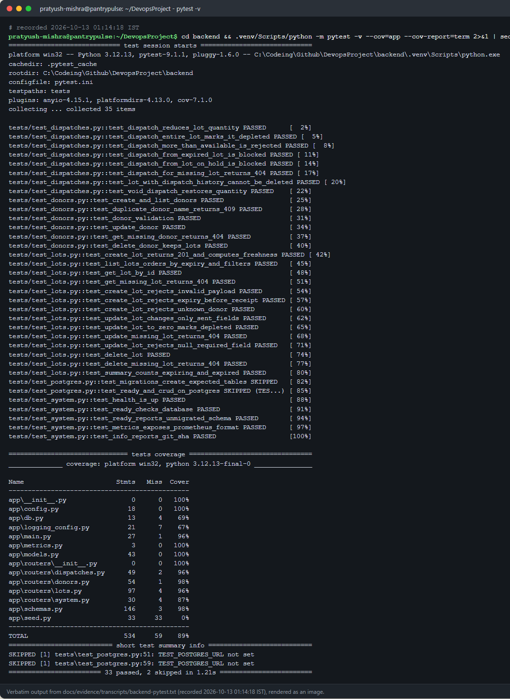
M2 · M4
Tests, quality and containers
■ 33 pytest + 2 PostgreSQL integration tests, 89% coverage
– SQLite in-memory via dependency override; never the real DB
■ 15 vitest tests for the UI
■ Backend: python:3.12-slim-trixie, 2-stage, UID 10001
■ Frontend: Node build → nginx-unprivileged, UID 101
■ Compose: health-gated start, named volume, migrations + seed
PantryPulse · DevSecOps capstone · Pratyush Mishra
5 / 15
Notes:
The backend has 33 unit tests on an in-memory SQLite database through FastAPI dependency overrides, plus two integration tests that run Alembic and the API against real PostgreSQL in CI. The frontend has 15 vitest tests. Both images are multi-stage and run as non-root: UID 10001 for the API and UID 101 for nginx. Docker Compose starts all three services with health-gated ordering and a persistent volume.

Slide 6
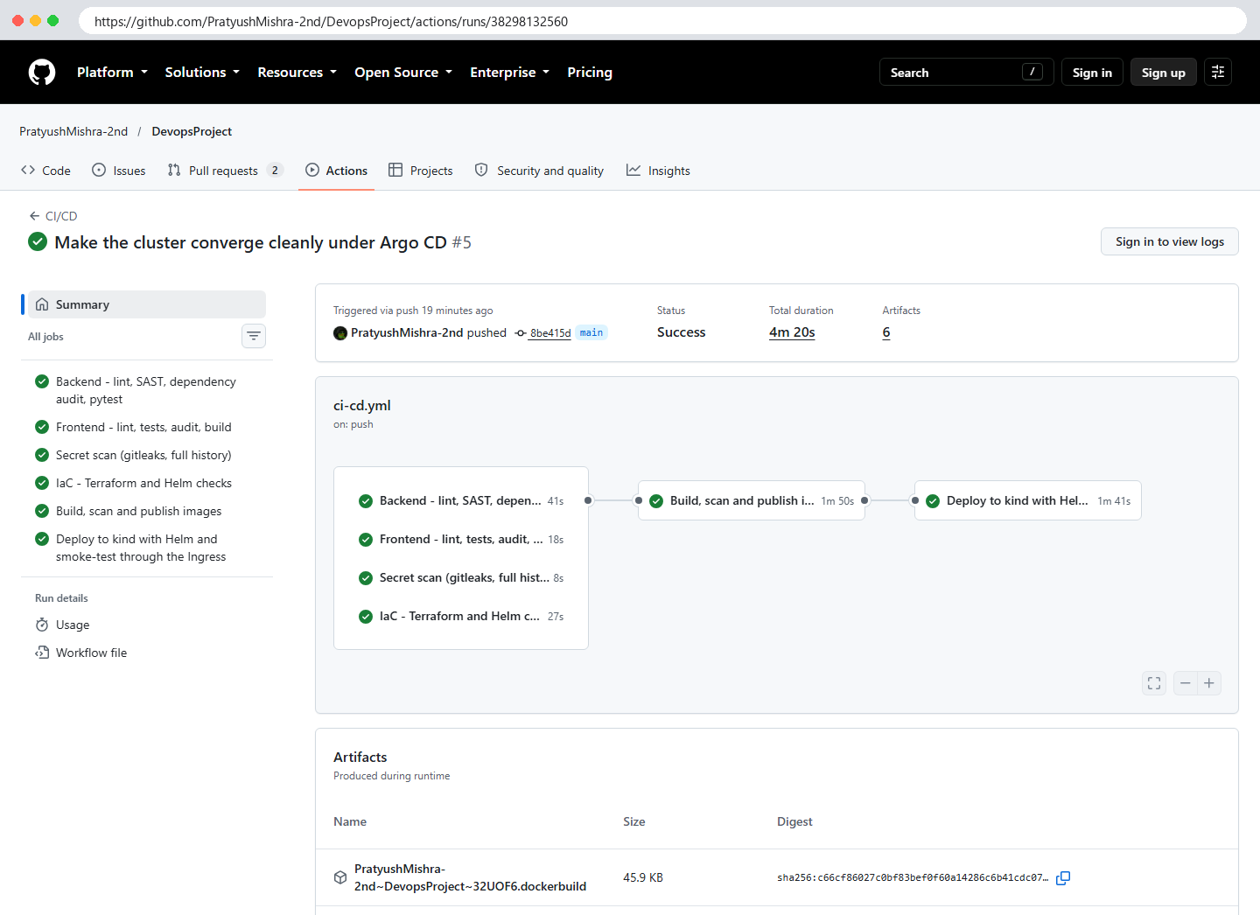
M5
CI/CD: nothing ships unless every gate passes
backend
ruff · bandit · pip-audit
pytest + Postgres
frontend
eslint · vitest
npm audit · build
build-scan-push
Trivy gate → GHCR :sha
SBOM · provenance
deploy-kind
verify attestation
helm + smoke test
secret-scan
gitleaks
full history
iac
terraform test
helm lint · Trivy config
Run 38298132560: 6/6 green. Run 38282550447 failed for real (Traefik values schema) and was fixed in 54a966e.
All actions pinned by commit SHA · least-privilege job permissions · PRs never publish
PantryPulse · DevSecOps capstone · Pratyush Mishra
6 / 15
Notes:
Four gate jobs run in parallel: backend, frontend, secret scan and infrastructure checks. Only if all pass are the images built and scanned by Trivy, and only a clean scan is pushed to GHCR, tagged with the full commit SHA. The last job verifies the build provenance, deploys that exact SHA to a throwaway kind cluster and smoke-tests it through the Ingress.

Slide 7
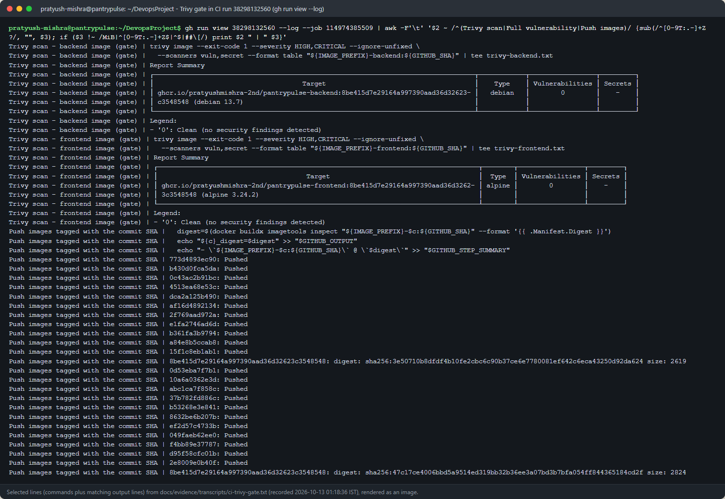
M6
DevSecOps: a clean Trivy gate, and why it is clean
■ trivy image --exit-code 1 --severity HIGH,CRITICAL --ignore-unfixed
■ Result: 0 / 0 (Debian 13.7, Alpine 3.24.2)
■ Why clean: slim/alpine bases, no build tools at runtime, pinned + Dependabot
■ Also: gitleaks, bandit, pip-audit, npm audit, Trivy IaC
■ Runtime: non-root, read-only rootfs, PSA restricted, NetworkPolicy
PantryPulse · DevSecOps capstone · Pratyush Mishra
7 / 15
Notes:
Trivy scans both images before they are pushed and fails the job on any fixable high or critical CVE. The current result is zero for both images. That is a consequence of choices: current minimal base images, a multi-stage build that leaves compilers out of the runtime image, and pinned dependencies kept current by Dependabot. The full report with all severities is still uploaded for visibility.

Slide 8
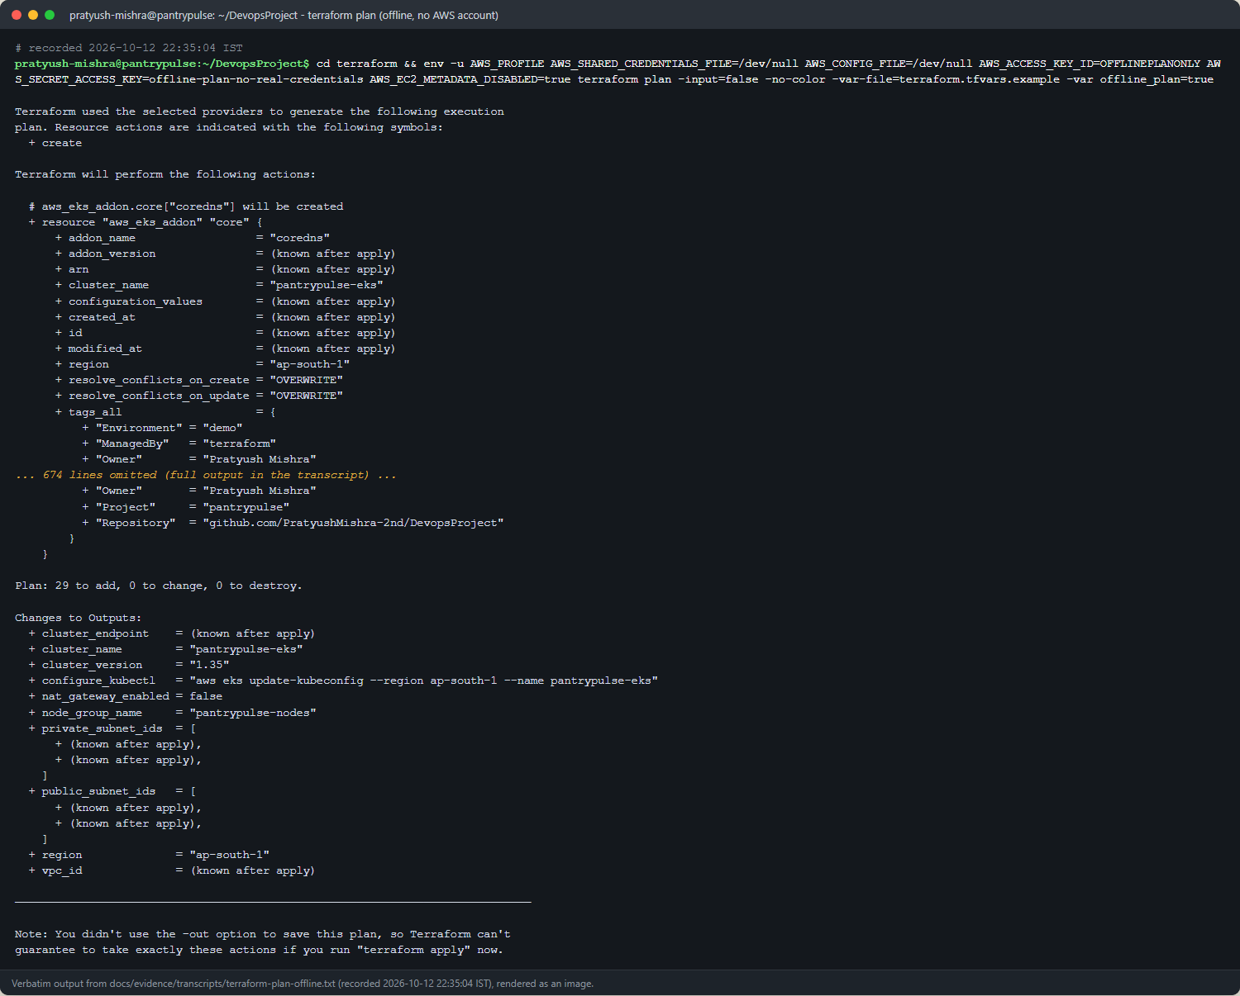
M7
Terraform: AWS VPC + EKS, as code
■ VPC 10.42.0.0/16 · 2 public + 2 private subnets (ap-south-1a/b)
■ EKS 1.35 · node group t3.medium × 2 (1–3)
■ IAM · add-ons · EBS CSI via Pod Identity
■ API endpoint limited to your /32
■ NAT / KMS / logs behind cost switches (ADR 0003)
■ init · validate · test (4 pass) · plan: 29 to add
AWS status: PENDING EXTERNAL ACCESS
Not applied: no valid AWS credentials. No console screenshots.
PantryPulse · DevSecOps capstone · Pratyush Mishra
8 / 15
Notes:
Terraform defines a VPC with two public and two private subnets, EKS 1.35 with a managed node group of two t3 medium nodes, IAM roles, add-ons and the EBS CSI driver. Costly extras like a NAT gateway are behind switches. It passes validate, four terraform tests and an offline plan of 29 resources. Honest status: it has not been applied, because no valid AWS credentials were available, so there are no AWS console screenshots. The runbook has the exact apply and destroy steps.

Slide 9
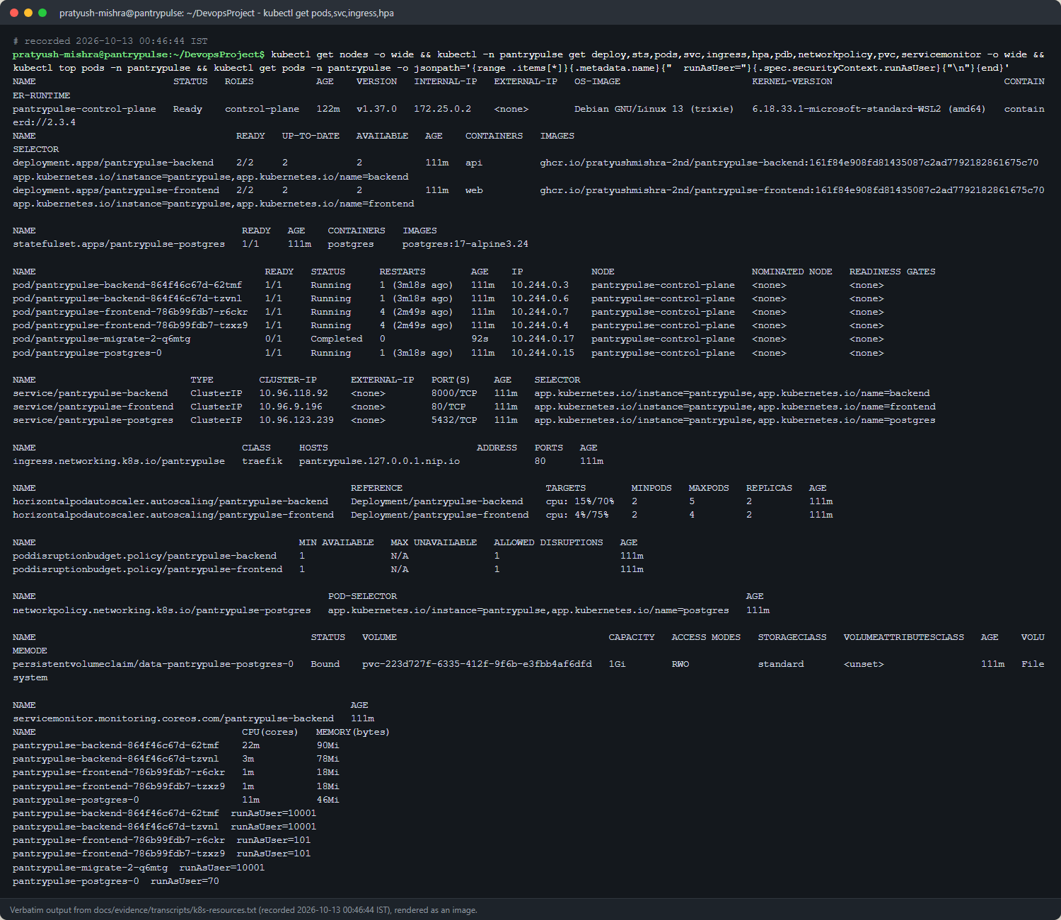
M8
Kubernetes + Helm on kind
■ helm upgrade --install with the image SHA required
■ Ingress (Traefik): / → frontend, /api → backend
■ HPA 2→3→5 at 357% CPU, back to 2 after load
■ PostgreSQL StatefulSet · migrate Job per release
■ PSA restricted · non-root · read-only rootfs
■ Real incidents fixed: Docker Hub DNS, hostPort rollout deadlock
■ 4 troubleshooting labs: ImagePullBackOff, empty Service, DB failure, not Ready
PantryPulse · DevSecOps capstone · Pratyush Mishra
9 / 15
Notes:
The Helm chart deploys the frontend and backend with at least two replicas each, ClusterIP services, PostgreSQL as a StatefulSet, the migration job, an Ingress, autoscalers, disruption budgets, a network policy and a ServiceMonitor. Under load the backend autoscaler went from two to five replicas and back.

Slide 10
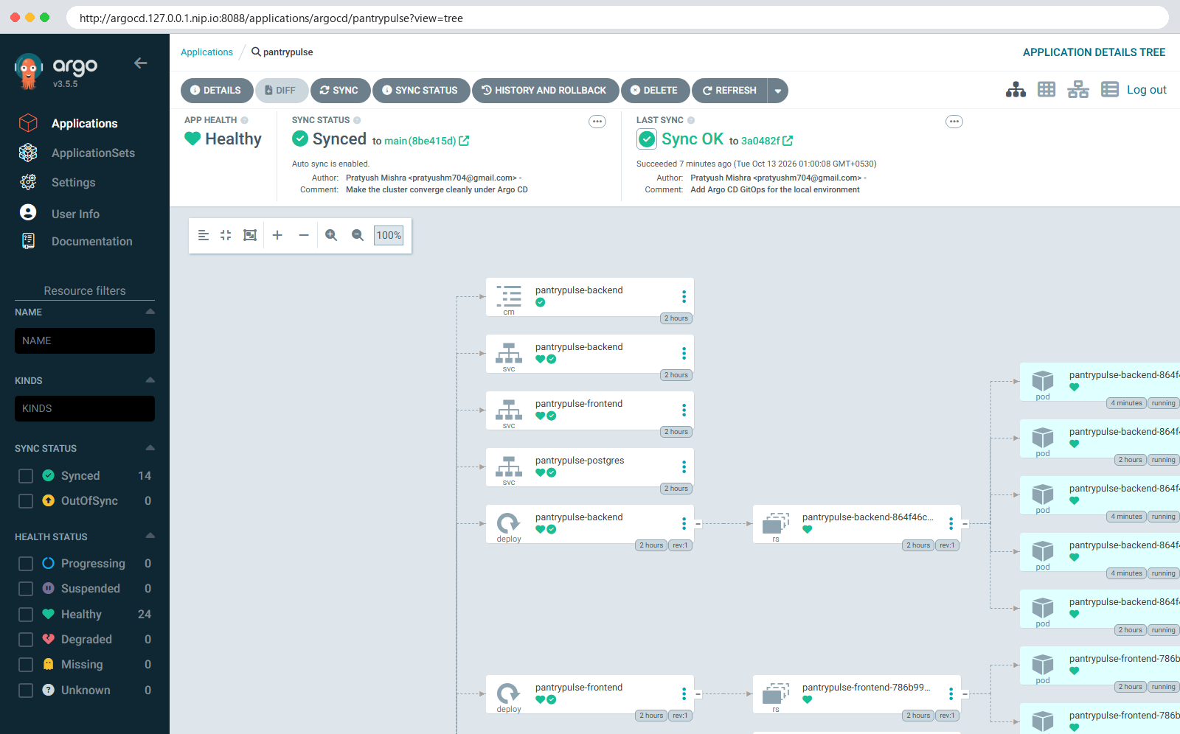
GITOPS
Argo CD: Git is the source of truth
■ Automated sync · prune · self-heal
■ Promote: scripts/promote.sh <sha> → commit
– 161f84e → 8be415d (7038d15)
■ Rollback: git revert (c1fc74c)
■ DB password in a pre-created Secret, never in Git
■ Migrations as an Argo CD Sync hook
PantryPulse · DevSecOps capstone · Pratyush Mishra
10 / 15
Notes:
Argo CD watches the chart and an environment values file on main. Promoting a build is a commit that changes the image SHA, made by a script that refuses builds that are not in GHCR. Rolling back is a git revert. In the recorded drill, both converged in under a minute.

Slide 11
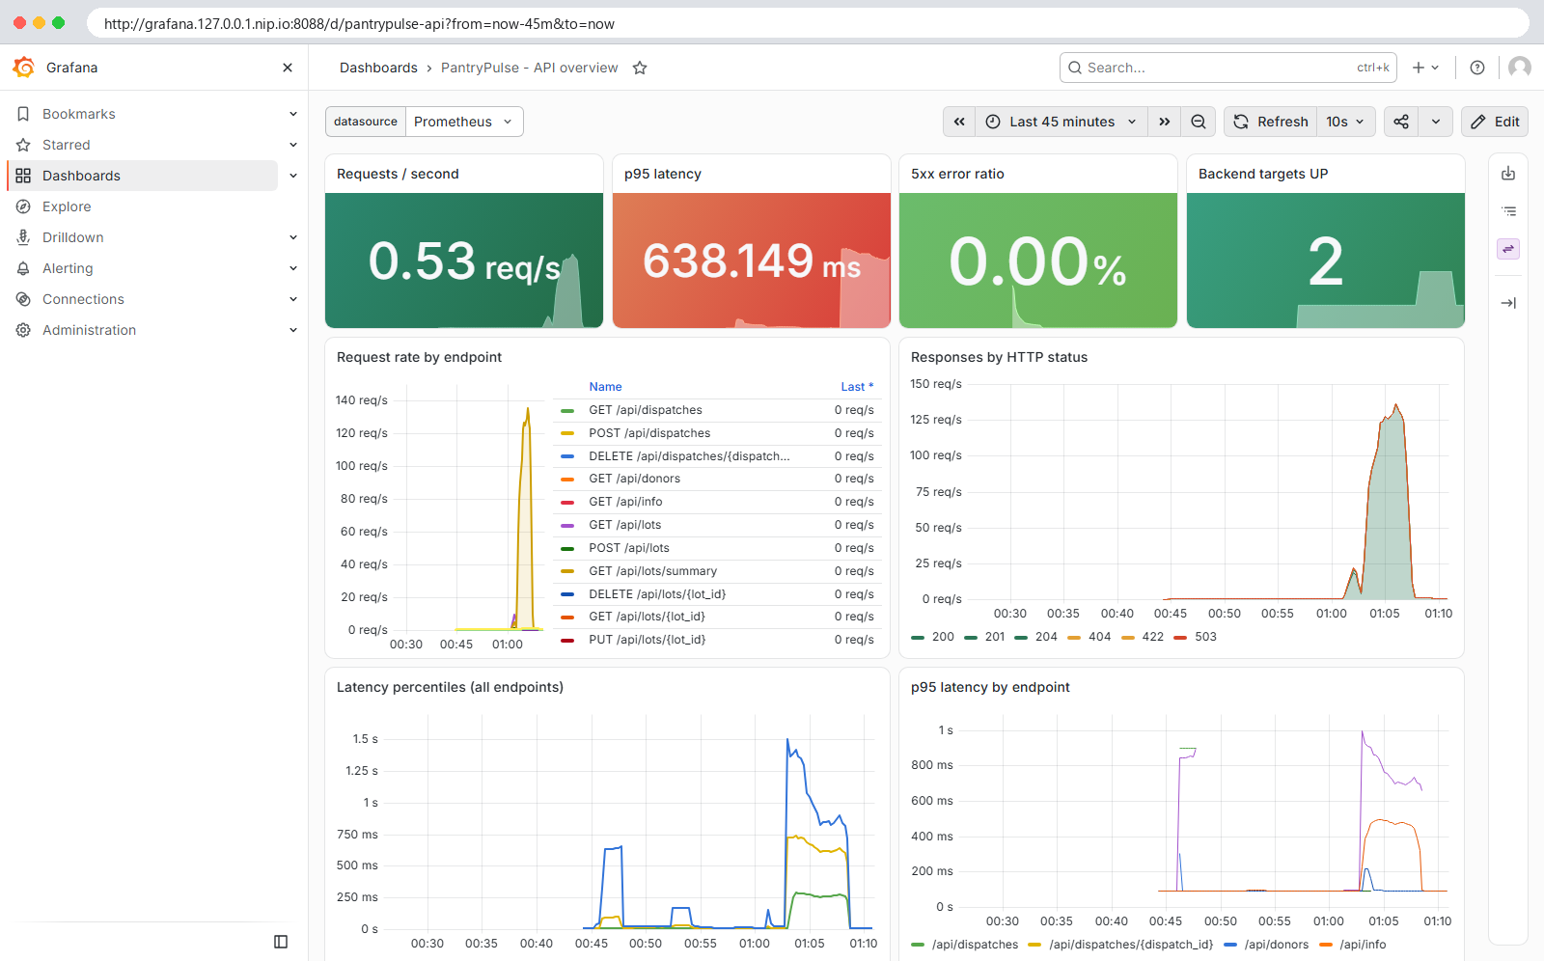
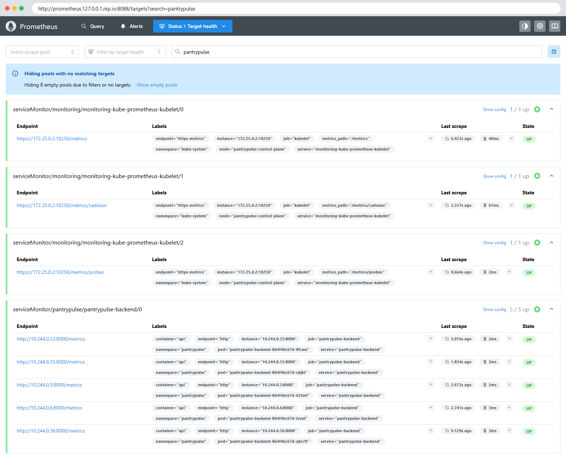
M9
Observability: Prometheus + Grafana
/metrics · ServiceMonitor 5/5 UP · provisioned dashboard
Found and fixed: Grafana GC thrash (GOMEMLIMIT 345MiB vs 344Mi used)
PantryPulse · DevSecOps capstone · Pratyush Mishra
11 / 15
Notes:
The API exposes Prometheus metrics: request counts and latency by endpoint, plus business counters for stock received and food dispatched. Prometheus discovers every API pod through the ServiceMonitor: five out of five were up during the scale-out. Grafana shows a provisioned dashboard with request rate, latency percentiles, error ratio, replicas and CPU.

Slide 12
OPERATIONS
Failure labs and real incidents
Lab 1
ImagePullBackOff
tag never built → set image to a published SHA
Incident
Docker Hub DNS failure
first helm install timed out → retry, revision 2
Lab 2
Service, no endpoints
selector typo → patch selector
Incident
Traefik hostPort deadlock
surge pod Pending → maxSurge 0
Lab 3
Migration can't reach DB
wrong host → recreate Job
Incident
Grafana GC thrash
384Mi limit → 768Mi + CPU cap
Lab 4
Running, never Ready
/ready 503, no schema → run migrations
Incident
CI caught schema error
Traefik chart rejects 'logs' key
Every lab and incident has a verbatim transcript in docs/evidence/transcripts.
PantryPulse · DevSecOps capstone · Pratyush Mishra
12 / 15
Notes:
Four labs break something on purpose in an isolated namespace, and each was diagnosed and fixed with kubectl. More valuable were the real incidents found while building: a Docker Hub DNS failure, a Traefik rollout deadlock caused by host ports, Grafana thrashing its garbage collector, and a schema error that the CI pipeline caught.

Slide 13
EVIDENCE
How every claim is backed
■ scripts/record.sh runs the command and saves verbatim output (40 transcripts)
■ 63 screenshots mapped to rubric modules in docs/evidence/EVIDENCE-MANIFEST.md
■ docs/SUBMISSION-CHECKLIST.md: every instructor checklist item with status and link
■ 7 ADRs · 4 engineering notes · 4 runbooks (incl. EKS apply/destroy, rollback)
■ Pending, stated plainly: AWS apply, console screenshots, terraform destroy
PantryPulse · DevSecOps capstone · Pratyush Mishra
13 / 15
Notes:
Every terminal output in the evidence folder was recorded by a script that runs the real command and saves its output verbatim. Screenshots of terminals are renders of those transcripts and name their source; browser screenshots carry the URL they came from. Nothing about AWS is claimed beyond what ran offline.

Slide 14
REFLECTION
What I learned
■ Scan before you push: a gate after publishing is only a report
■ Commit-SHA tags + GitOps turn rollback into git revert
■ Readiness that checks the schema keeps half-working pods out of traffic
■ Most real failures were platform issues (DNS, host ports, memory limits)
■ Write down trade-offs (ADRs) instead of hiding them; be honest about what is pending
PantryPulse · DevSecOps capstone · Pratyush Mishra
14 / 15
Notes:
The biggest lessons: gates only matter if they run before publishing; immutable SHA tags make rollbacks trivial; readiness probes and migration jobs turn data problems into visible, contained failures; and most of the real problems were in the platform, not the code, which is exactly what monitoring and runbooks are for.

Slide 15
Thank you
Next in this video: a live walkthrough of the codebase, CI/CD, Terraform,
Argo CD, Kubernetes, Prometheus and Grafana.
github.com/PratyushMishra-2nd/DevopsProject
Notes:
Thank you. Next, the live walkthrough: the codebase, CI/CD, Terraform, Argo CD, Kubernetes, Prometheus and Grafana.

