Slide 1


BE-Computer Science & Engineering (Cybersecurity)
Semester Review Presentation
BE Project-I Presentation
A.Y. 2026-27 (Odd)
TnP Connect
Unified Training & Placement Management Solution
Presented By:
1. Neev Jain (31)
2. Pratyush Pandey (34)
3. Ankush Sahu (45)
Name of Guide:
[Guide Name]

Slide 2


Outline
Planning
Literature survey
Architecture and algorithms / Flow chart
Methodology
Parameters for performance evaluation
Software and hardware setup

Slide 3
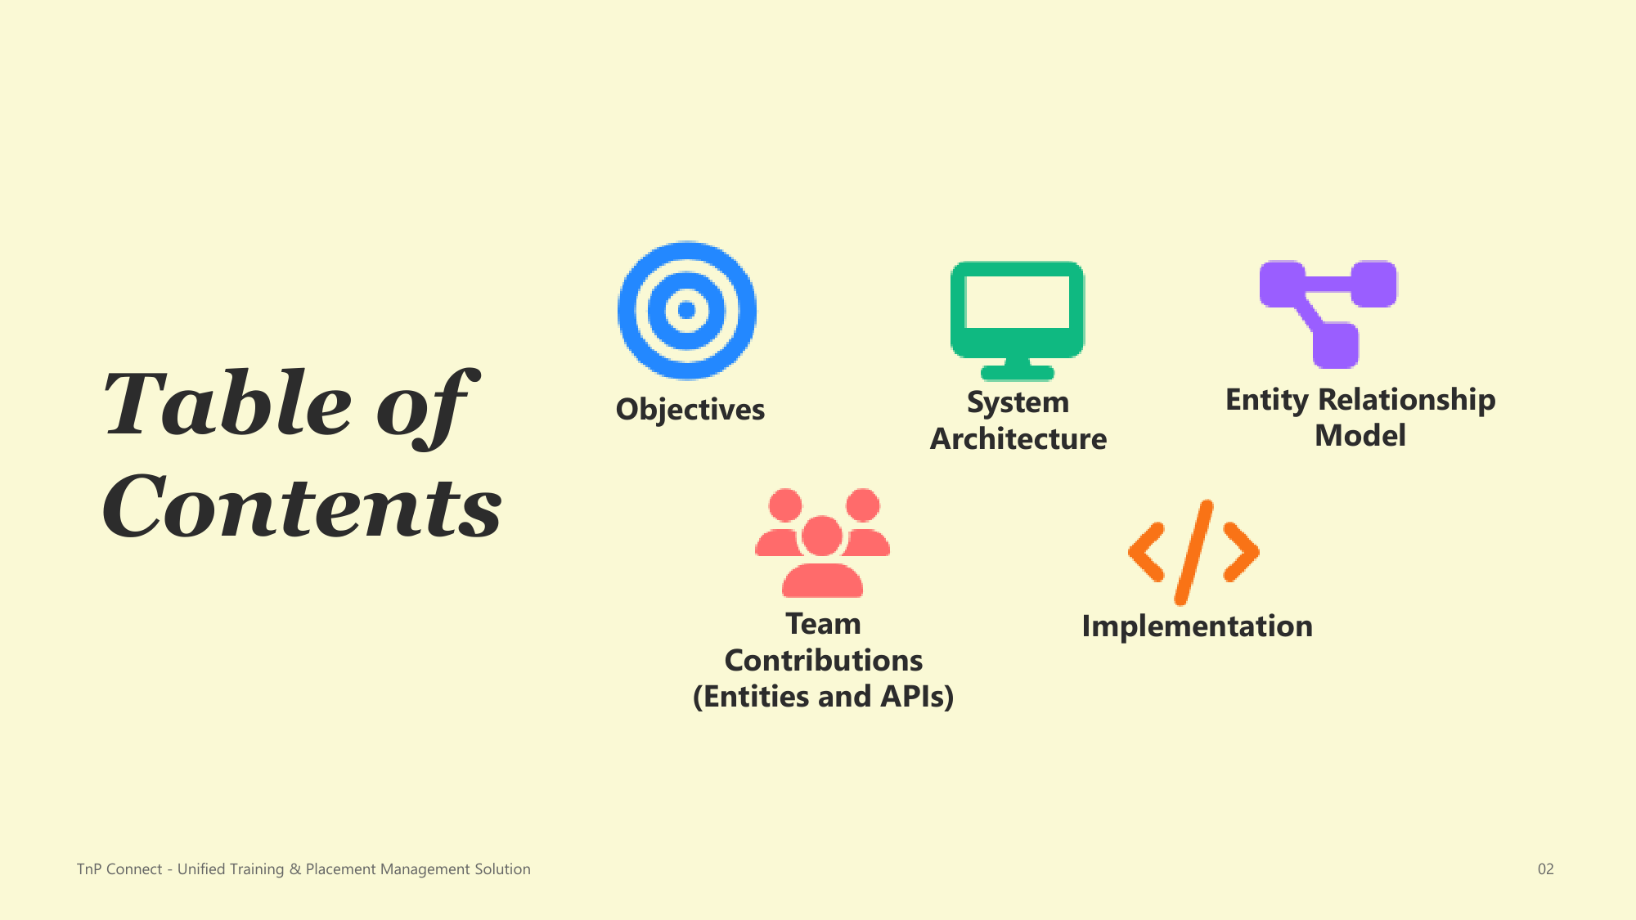
Table of Contents
2

Slide 4
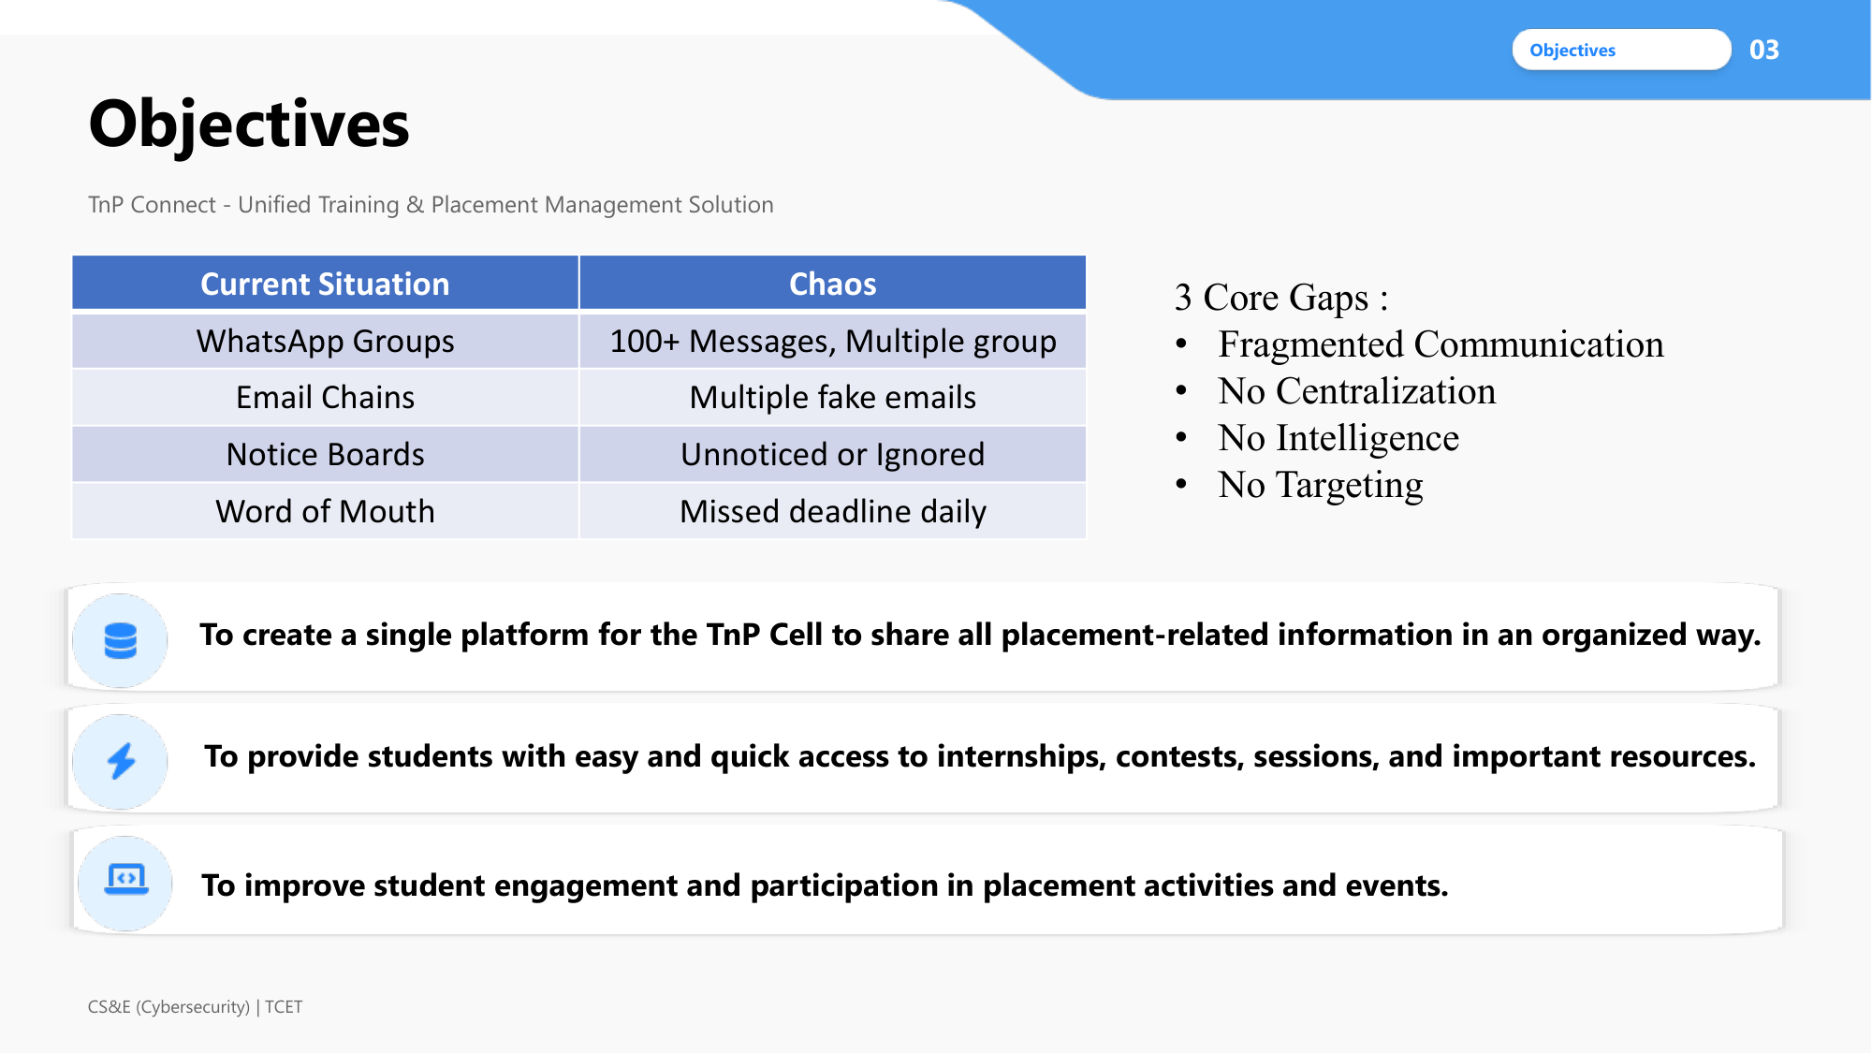
Objectives
3

Slide 5
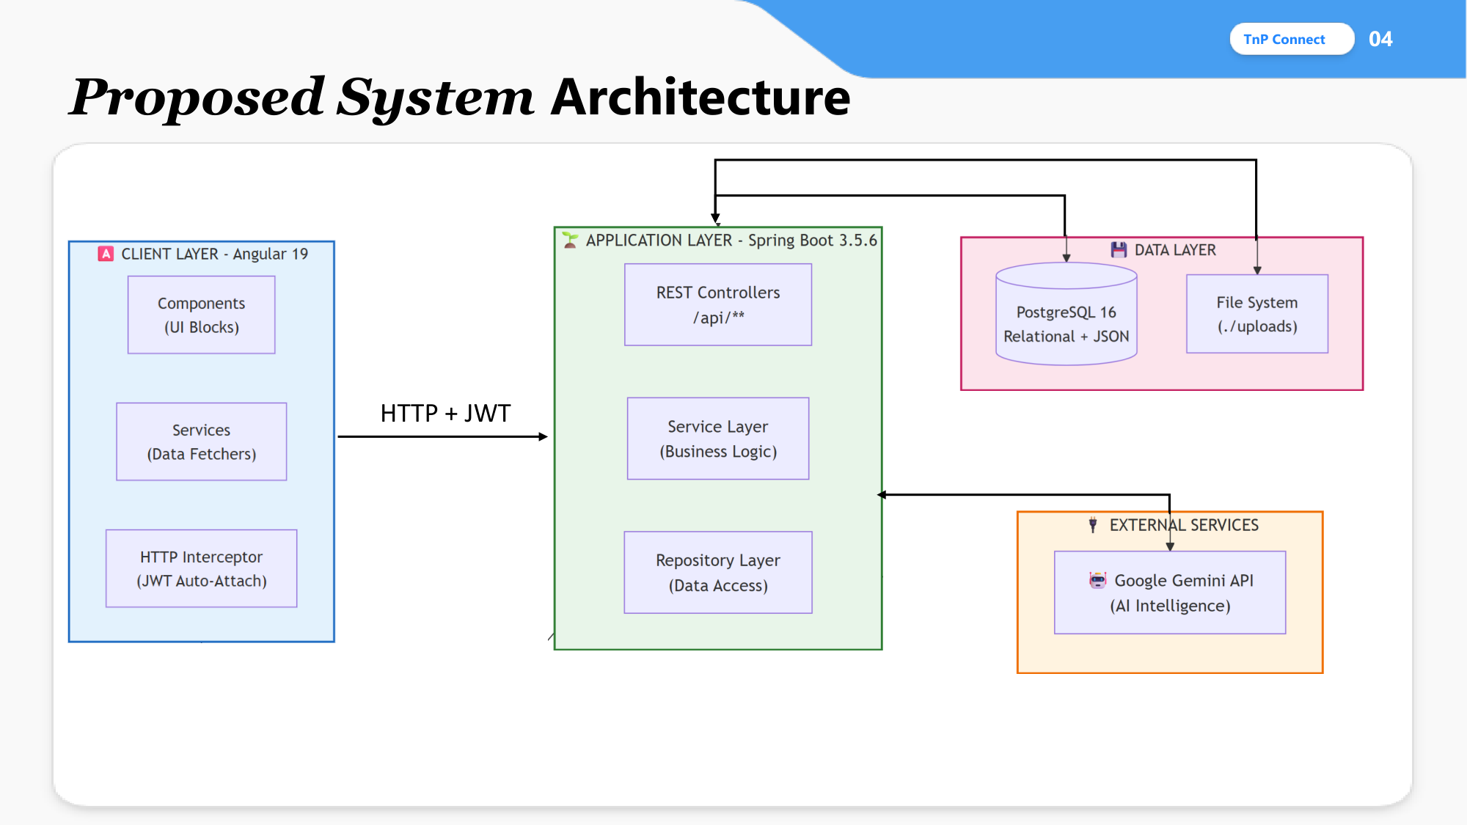
Proposed System Architecture
4

Slide 6
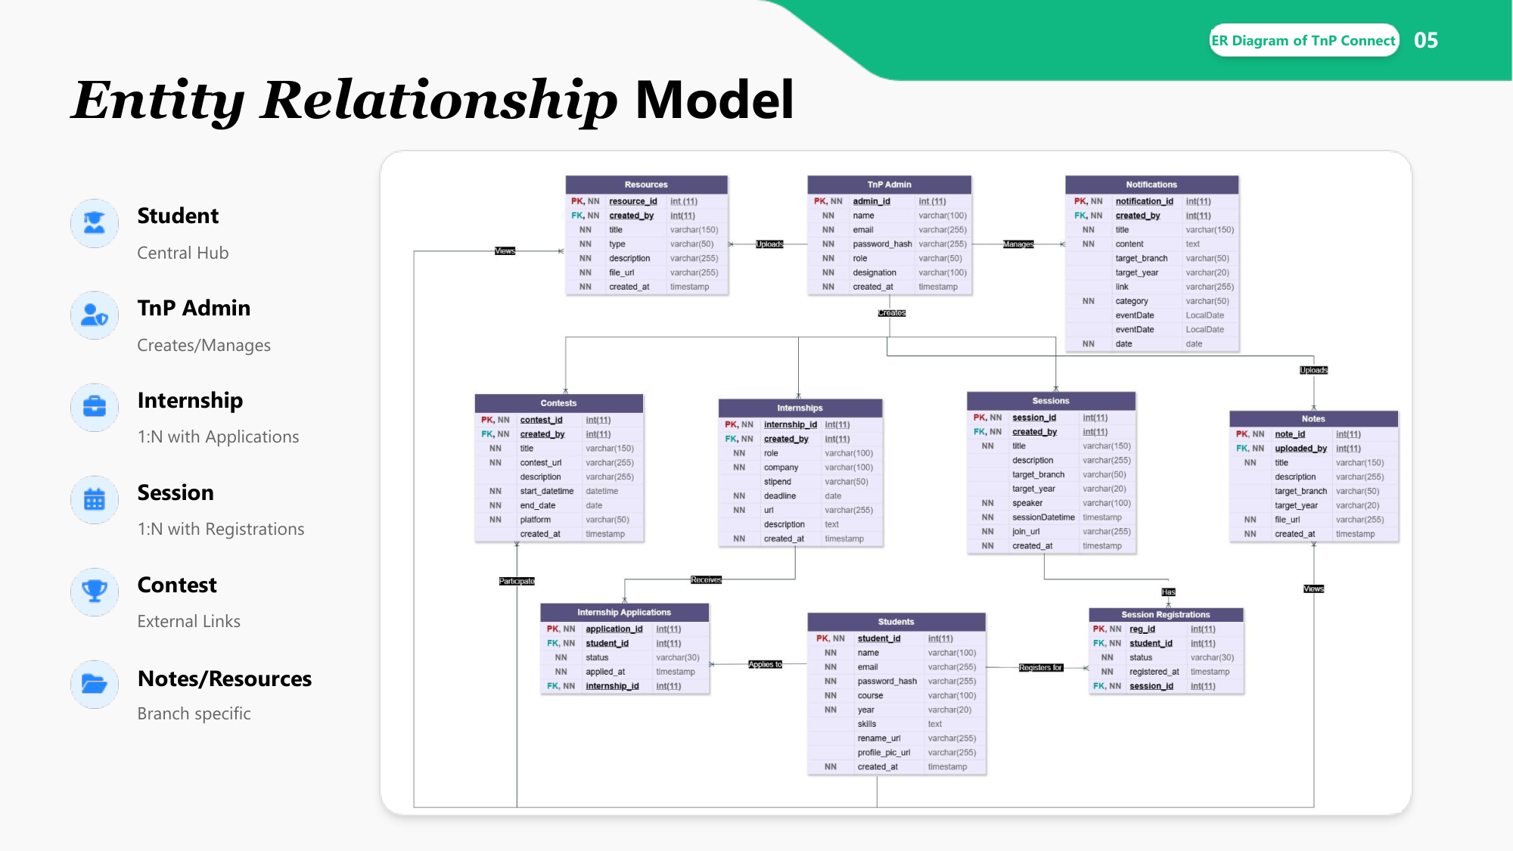
Entity Relationship Model
5

Slide 7
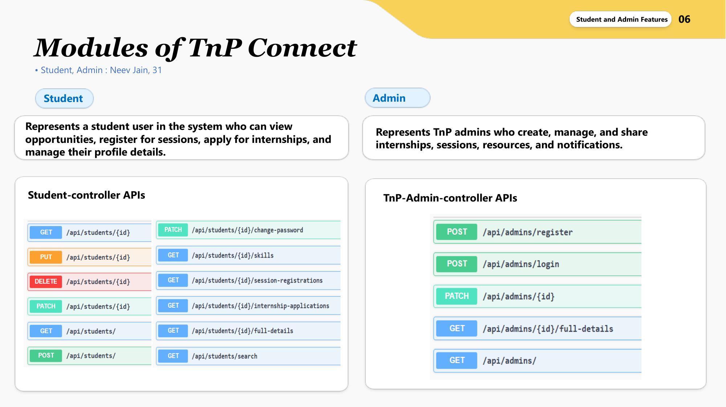
Modules of TnP Connect
6

Slide 8
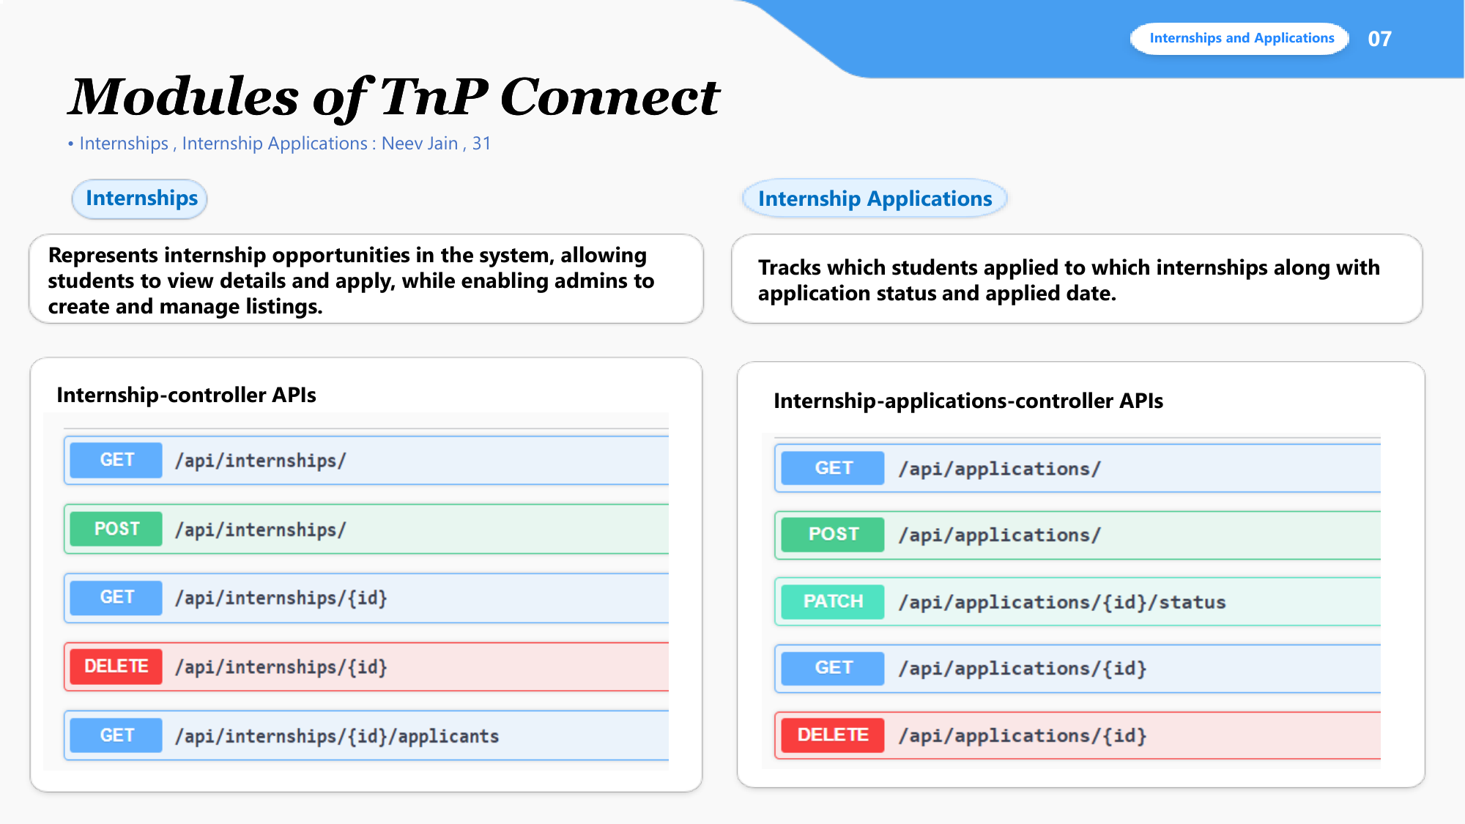
Modules - Internships & Applications
7

Slide 9
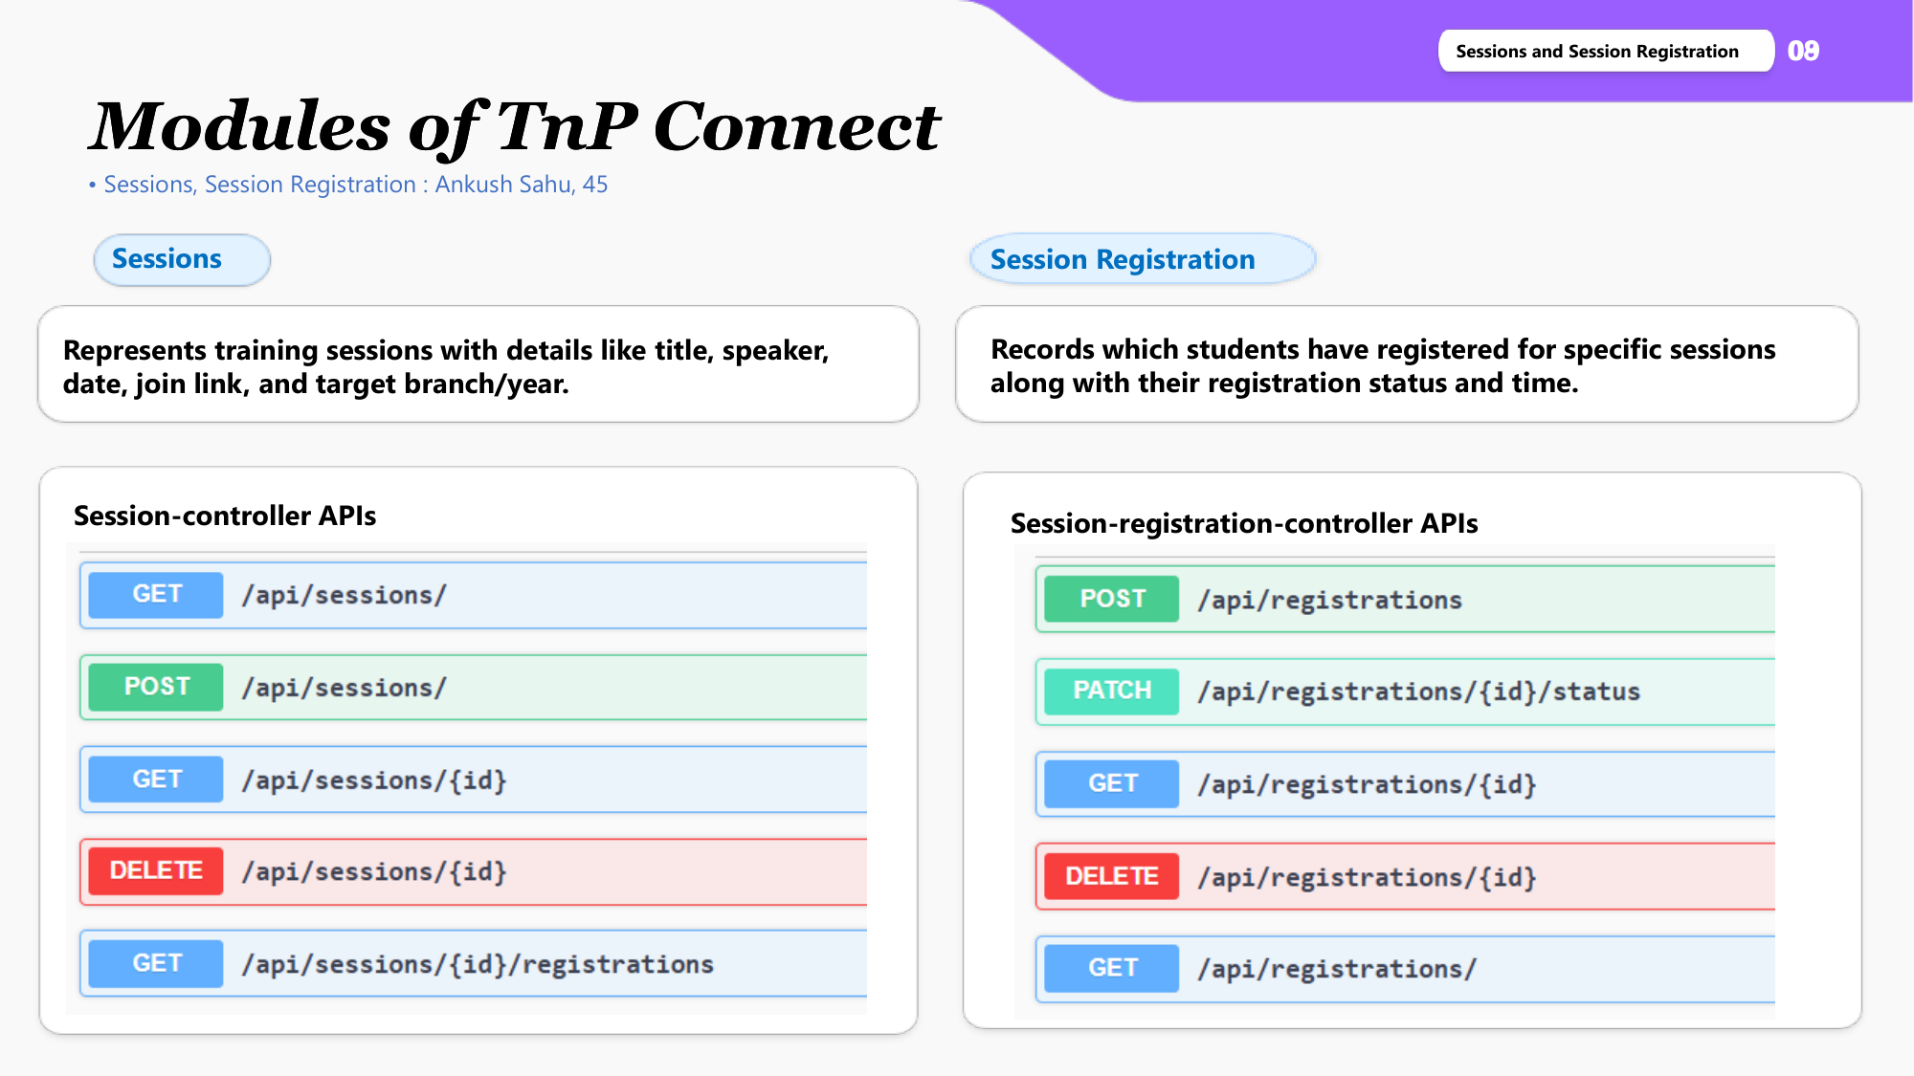
Modules - Sessions & Registration
8

Slide 10
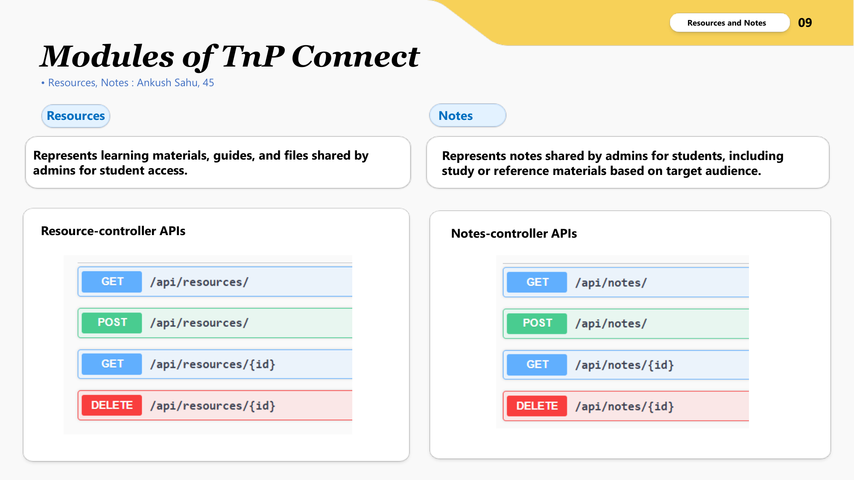
Modules - Resources & Notes
9

Slide 11
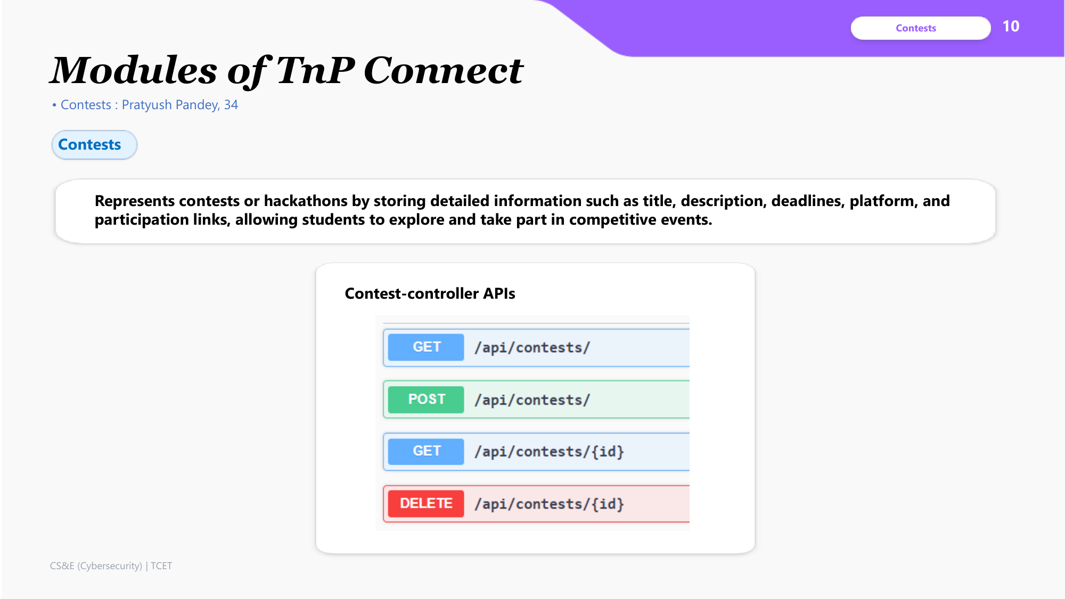
Modules - Contests
10

Slide 12
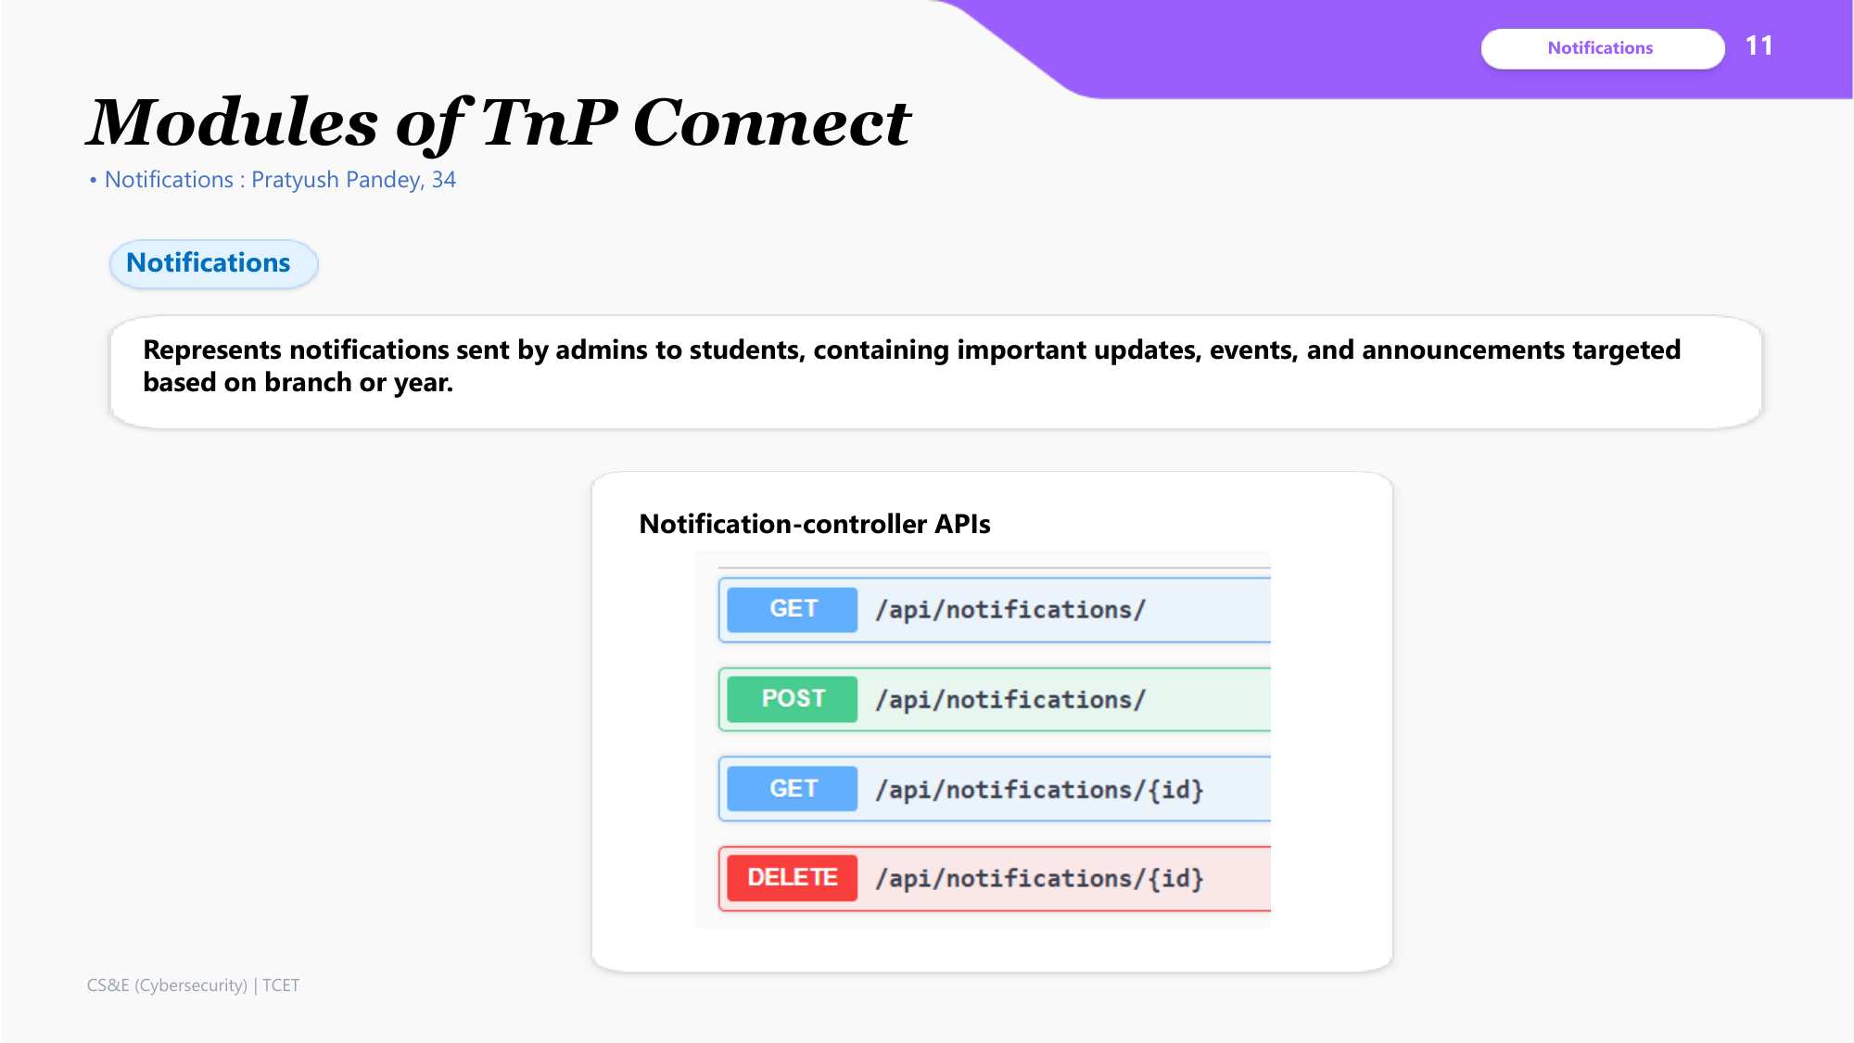
Modules - Notifications
11

Slide 13
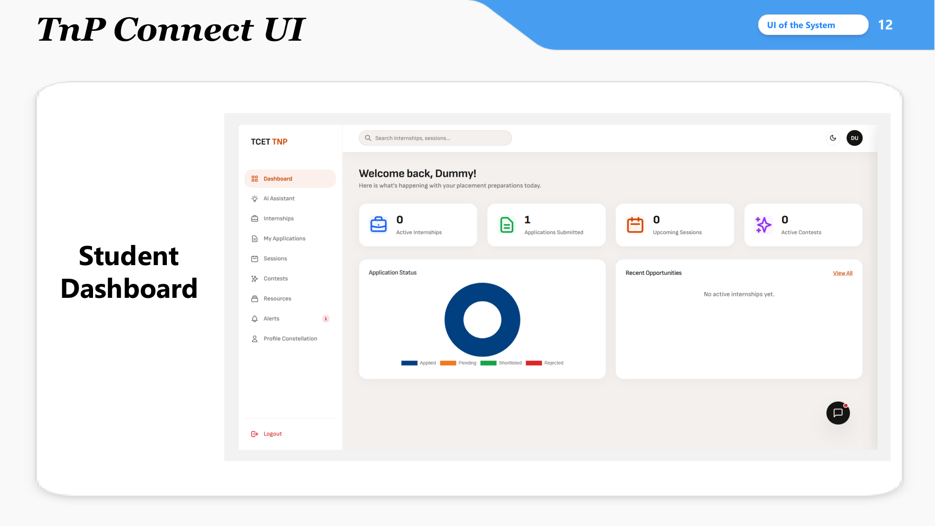
TnP Connect UI - Student Dashboard
12

Slide 14
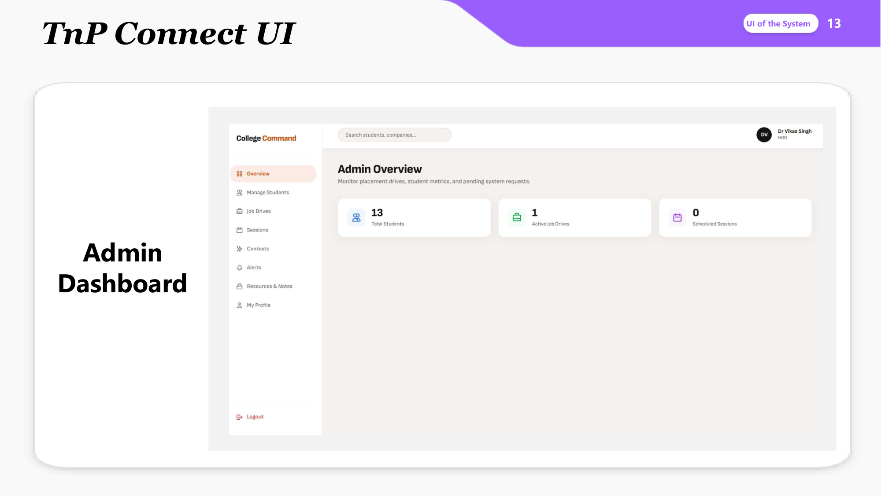
TnP Connect UI - Admin Dashboard
13

Slide 15
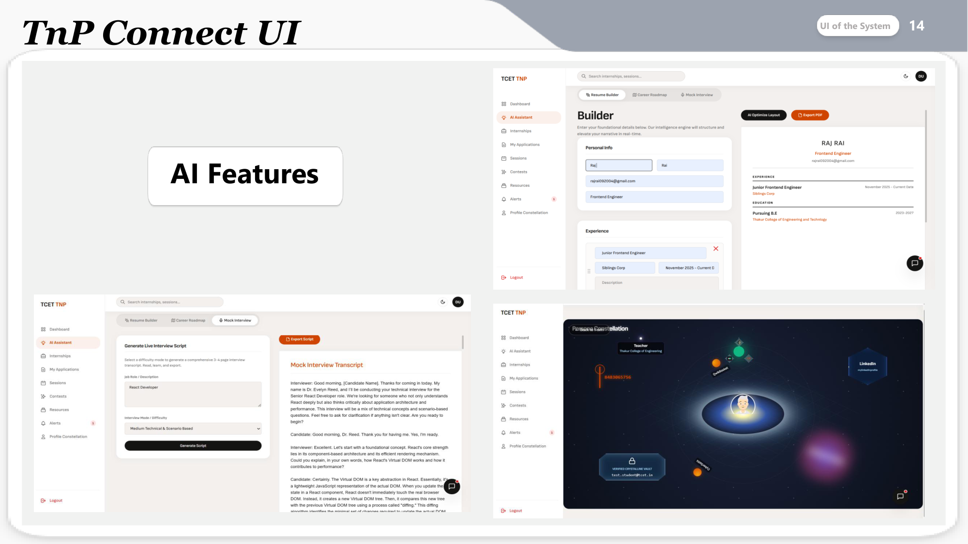
TnP Connect UI - AI Features
14

Slide 16
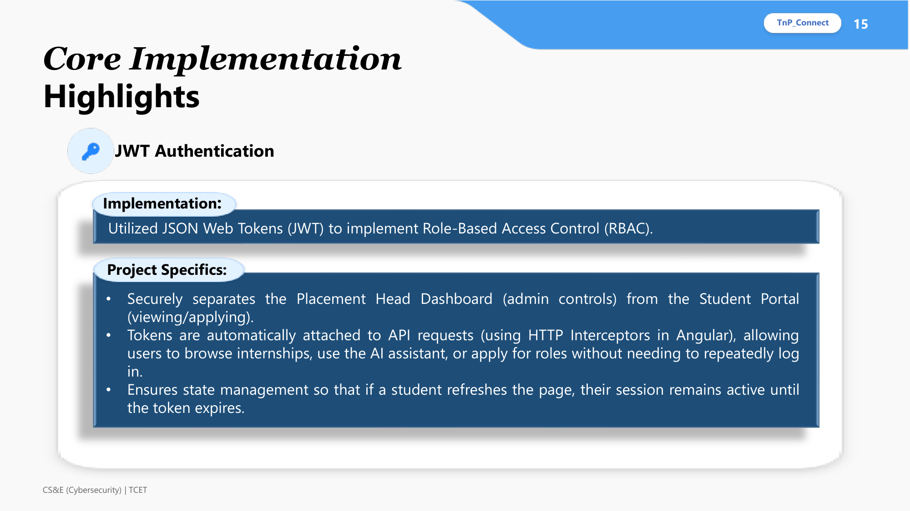
Core Implementation - JWT Authentication
15

Slide 17

Core Implementation - CRUD Operations
16

Slide 18
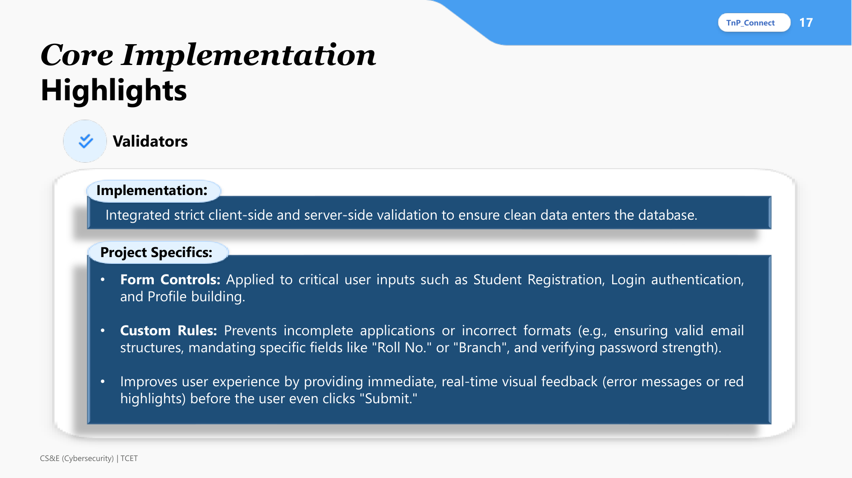
Core Implementation - Validators
17

Slide 19
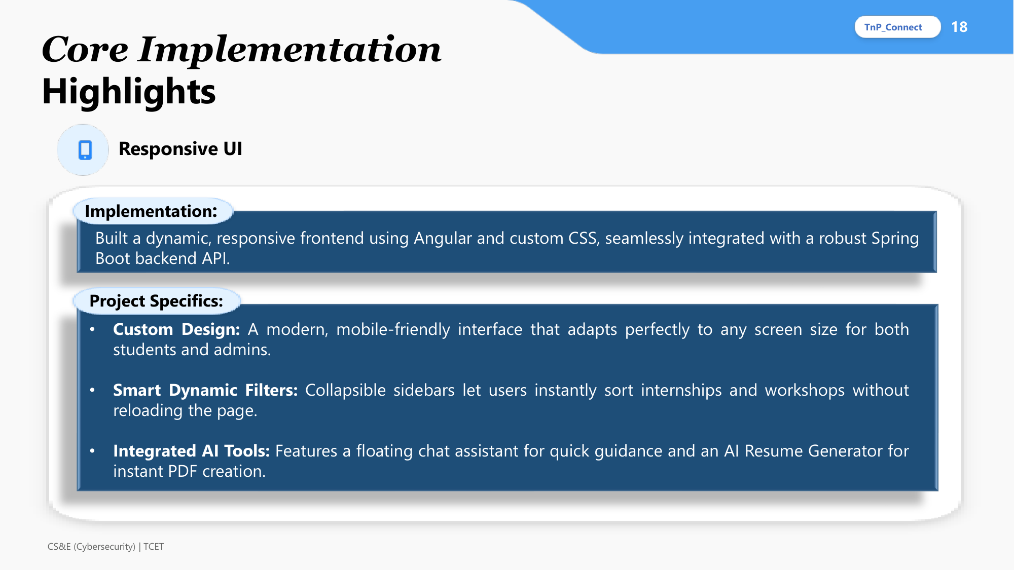
Core Implementation - Responsive UI
18

Slide 20

Thank You
19

