Slide 1
Zero Annotation Object Detection
Implementation on Fruits
Built and presented By Pratyush Nakka

Slide 2
Problem Statement
Traditional Object Detection Models need Annotations while training.
It poses a challenge to train the model with an unannotated dataset (like new bacterial or virus samples or any unorthodox dataset)
Need for a system that can: Accurately classify different types of objects, Identify the features of the object, and draw the bounding boxes around the object.

Slide 3
Solution Analysis

Slide 4
System Architecture
Utilizes MobileNetV2 as the base CNN architecture
Implementation of Grad-CAM for feature visualization
Template matching for feature detection and localization

Slide 5
Key Components
Deep Learning Classification Model
Pre-trained MobileNetV2 architecture
9 fruit classes including apple, Mango, Orange, etc.
Input image size: 224x224 pixels

Slide 6
Key Components
Feature Visualization
Grad-CAM implementation for heatmap generation
Convolutional layer analysis
Heatmap generation for model interpretability
Notes:
Creates the final heatmap:
Combines weighted feature maps
Records how the last conv layer's output affects the final prediction
Normalizes values between 0 and 255
Returns a heatmap showing which parts of the image influenced the classification

Slide 7
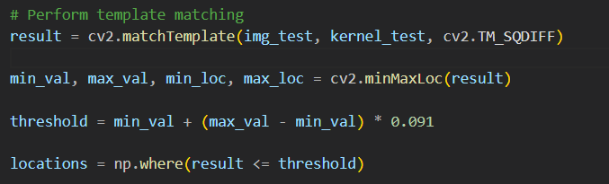
Key Components
Feature Detection System
Kernel extraction from high-activation regions
Template matching using cv2.TM_SQDIFF
Adaptive thresholding for feature matching
Notes:
The TM_SQDIFF (Squared Difference) method calculates the sum of squared differences between the template (in your case, the kernel extracted from high-activation regions) and the input image.
A threshold was calculated based on the minimum and maximum values:
threshold = min_val + (max_val - min_val) * 0.08 # Used 8% threshold
Multiple matches were found using this threshold:
locations = np.where(result <= threshold)

Slide 8
Experimental Results

Slide 9
Classification Performance
Model successfully identifies fruit types from input images
Demonstrates robust feature extraction capabilities
Visualization Analysis
Model successfully identifies fruit types from input images
Shows regions of high importance for classification
Provides interpretable visualization of model focus
Demonstrates robust feature extraction capabilities
Successfully extracts key features using Template-based approach
Implements bounding box visualization for detected features
Multiple feature matches consolidated into single bounding rectangle

Slide 10
Conclusions

Slide 11
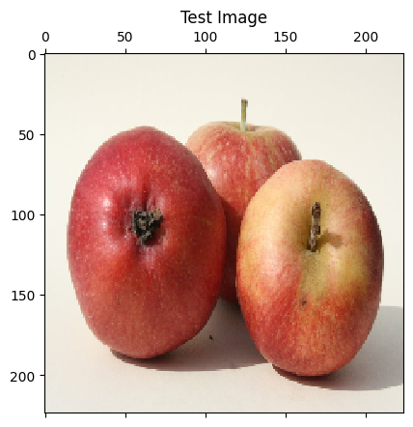
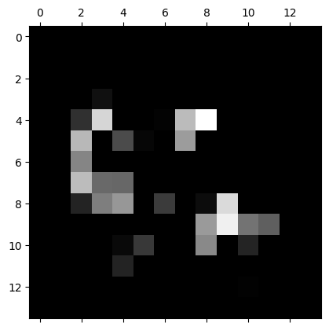
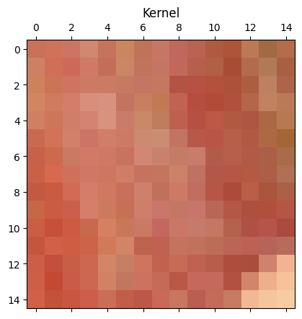
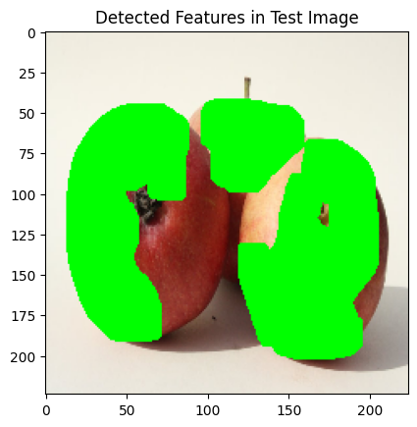
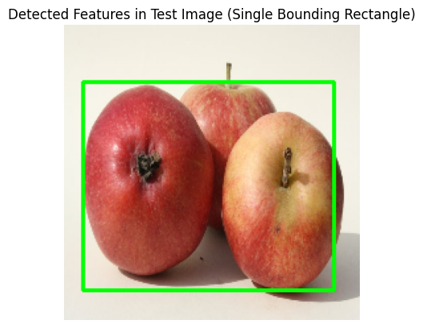
Feature Kernel Extracted from ‘block_13_expand_BN’

Slide 12
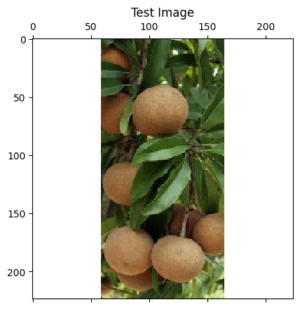
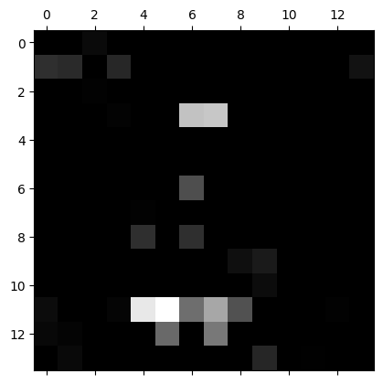
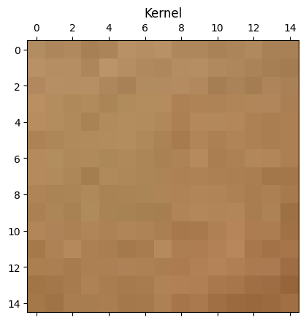
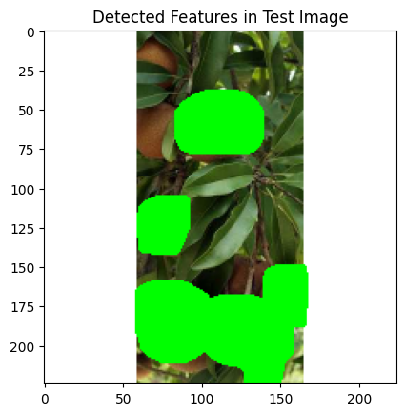
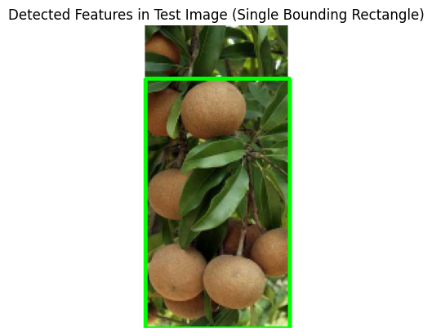
Feature Kernel Extracted from ‘block_13_expand_BN’

Slide 13
Key Achievements
Technical Innovations
Successfully implemented end-to-end fruit classification system
Added interpretability through Grad-CAM visualization
Developed feature detection and localization mechanism
Integration of classification, visualization, and detection
Novel approach to kernel extraction from activation maps
Adaptive threshold-based feature matching

Slide 14
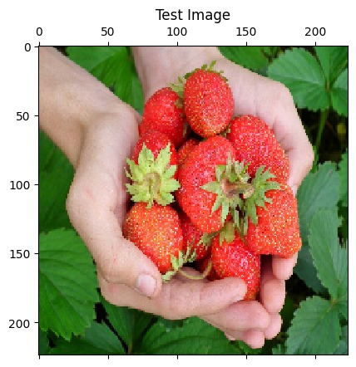
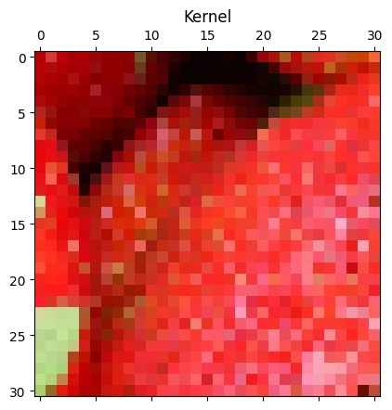
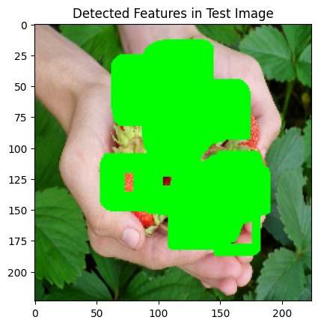
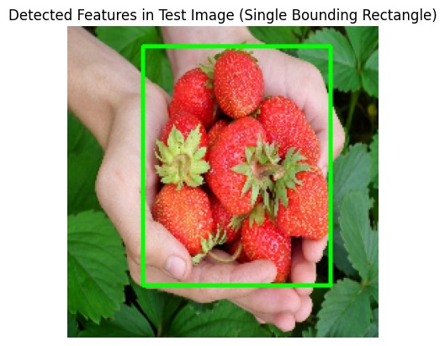
Challenges to be addressed
Feature Kernel Extracted from ‘block_16_expand_BN’

Slide 15
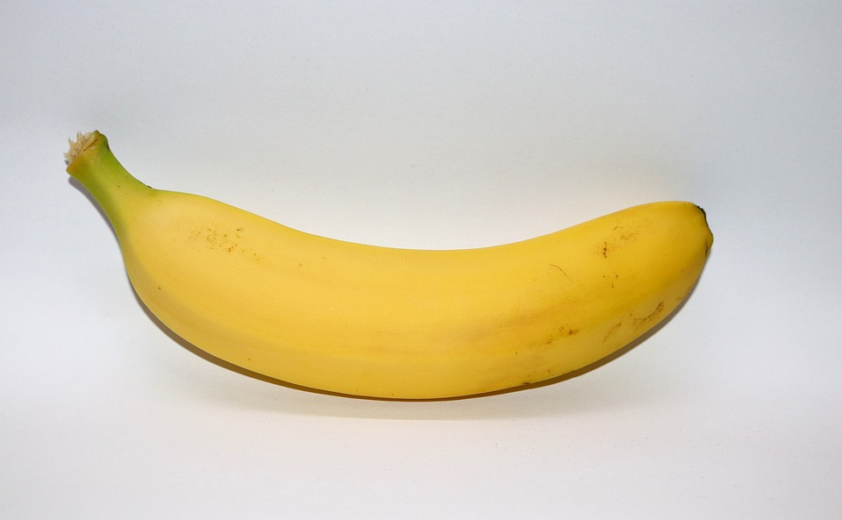
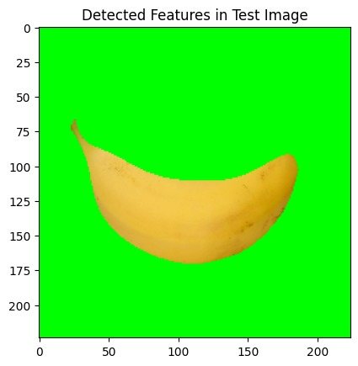
Challenges to be addressed
Feature Kernel Extracted from ‘block_13_expand_BN’

Slide 16
Challenges to be addressed
threshold = min_val + (max_val - min_val) * 0.091
The threshold becomes a new important parameter in segmenting an image and choosing the value of the threshold is critical. The demo is shown in real code.

Slide 17
Future Improvements
Enhance model accuracy with a larger diverse dataset
Optimize feature detection parameters
Implement real-time processing capabilities
Potential Implementation after complete development
Extracting Template from the trained dataset
Image Segmentation
Annotation Generation

Slide 18
Thank you

