Slide 1

Sales Exploratory Data Analysis & Business Insights
Presented by: Pratyush Puri

Slide 2
Agenda
What We Will Cover Today
Project Objective & Data Overview
High-Level Sales Trends
Customer Demographics & Retention
Product & Seller Performance
Purchasing Behaviour & Payment Trends
Conclusion & Future Scope

Slide 3
Data Overview & Objective
Understanding the E-commerce Ecosystem
Objective: To analyze historical sales data to extract actionable business metrics and understand market dynamics
Data Scope: Merged multiple datasets including Customers, Orders, Payments, Products, and Sellers.
Scale: Consolidated and analyzed over 112,000 order instances.
Key Focus: YoY Growth, Customer Retention, and Revenue Drivers.

Slide 4
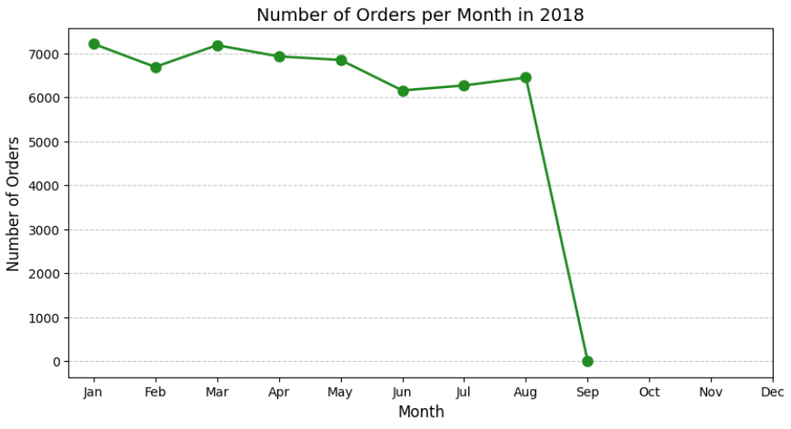
High-Level Sales Trends
Growth and Revenue Trajectory
Peak order volumes are observed during specific months, indicating clear seasonal trends in 2018.
Cumulative sales show a strong upward trajectory year over year.
Year-over-Year (YoY) growth rate serves as a key indicator of our market expansion.

Slide 5
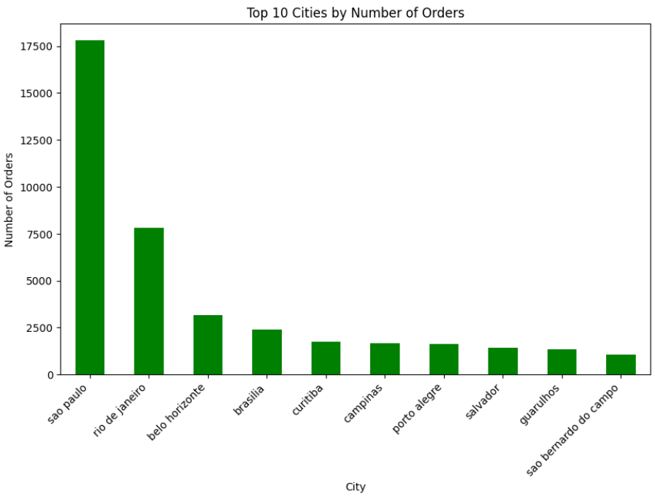
Customer Insights & Demographics
Who Are Our Customers?
Strong customer base spread across thousands of unique cities, with massive concentration in top states.
6-Month Retention Rate: Monitored the percentage of users returning for repeat purchases within half a year.
Identified top VIP customers annually based on total money spent to understand high-value behavior.

Slide 6
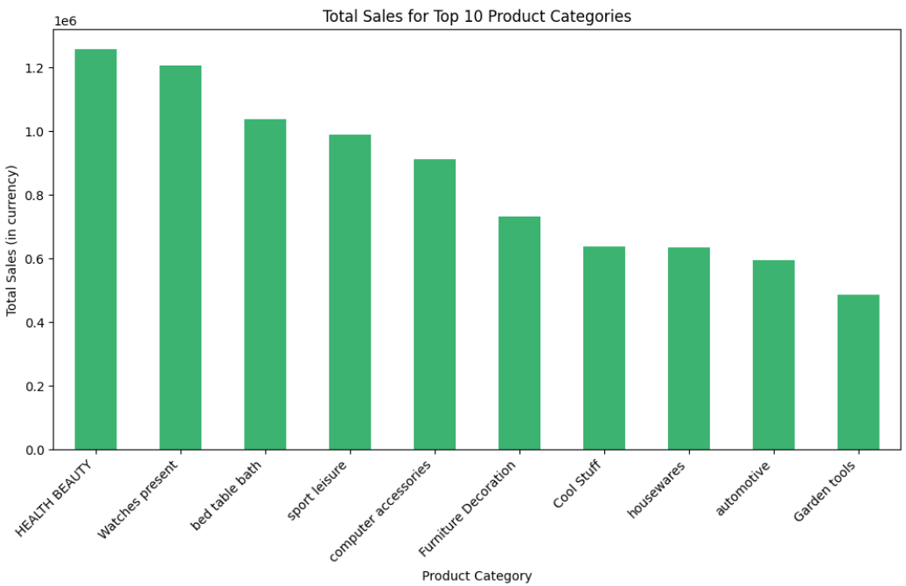
Product & Seller Performance
What Drives Our Revenue?
Identified the Top 5 product categories generating the absolute highest total sales.
A distinct correlation exists between product price and purchase frequency.
Revenue generation is heavily concentrated among the Top 10 Elite Sellers.

Slide 7
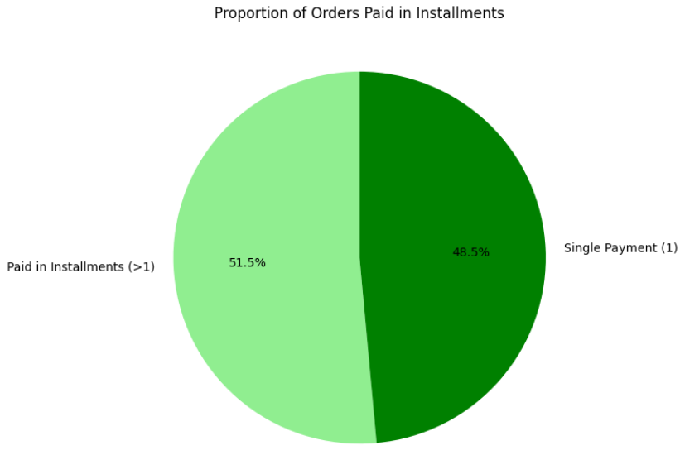
Purchasing & Payment Behavior
How Customers Buy and Pay
Analyzed the average number of products per order across different customer cities.
Tracked the Moving Average of order values to observe shifting customer purchasing power over time.
A significant percentage of orders are paid in installments, highlighting a strong consumer preference for flexible payment options.

Slide 8
Conclusion & Next Steps
Key Takeaways & The Road Ahead
Geographical distribution dictates where we should focus our targeted marketing efforts.
Installment payments are a strong driver for conversions and should be promoted.
Next Steps: Use these engineered features and insights to build predictive Machine Learning models for forecasting sales, anticipating churn, and optimizing inventory.

