Slide 1
NPU Event Master
Project Team # 1

Slide 2
Project Members:
ShaliniPriya Tholupunuri (11142 )
Yashaswini Bakkeshwarappa (11131)
Pratyusha Dommata (11091)
Vishnu Priya Reddy Naredulla (11087 )

Slide 3
Introduction
NPU Event Master is an Internal site for people at NPU i.e. students,faculty,admin etc., to know the current events hosted and based on their interest can book ticket for the event.
Events are categorized as 2014 Summer Cultural Fest, Technical Seminar on Bigdata etc.,

Slide 4
Technologies Used
Front End Technology : .NET with Microsoft Visual Studio 2010 (Visual basics.net, C#.net, Asp.net)
Database : Microsoft SQL Server 2012

Slide 5
Database objects & functions used
Database
Tables
Declarative Constraints – UNIQUE,CHECK
REFERENTIAL INTEGRITY for foreign keys
IDENTITY Property
SELECT/INSERT/UPDATE/DELETE
Stored Procedures
ERD

Slide 6
List of tables
Registration – Contain User details such as User_name,Password etc.
Category – Contain category name such as Cultural Fest etc.
Subcategory - Contain subcategory name for a category such as Cultural Fest – Dance etc.
Location – contain the details of location,date,time where the events will be held

Slide 7
List of tables
Performer – contain performer name who will host the event
Event – contain event details such as Summer 2014 Cultural Fest etc.
Ticket – contain the price for each event
Reviews – contain review by users after completion of event for each event and performer

Slide 8
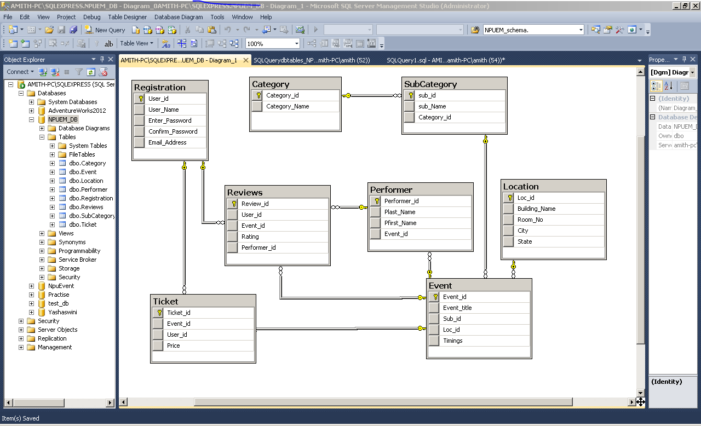
Database Diagram

Slide 9
Logical View
Login
Yes
Admin
Login User
Register
No
Yes
Yes
Add
Event
Update
Event
Delete
Event
View Events
And book the ticket
View Events

Slide 10
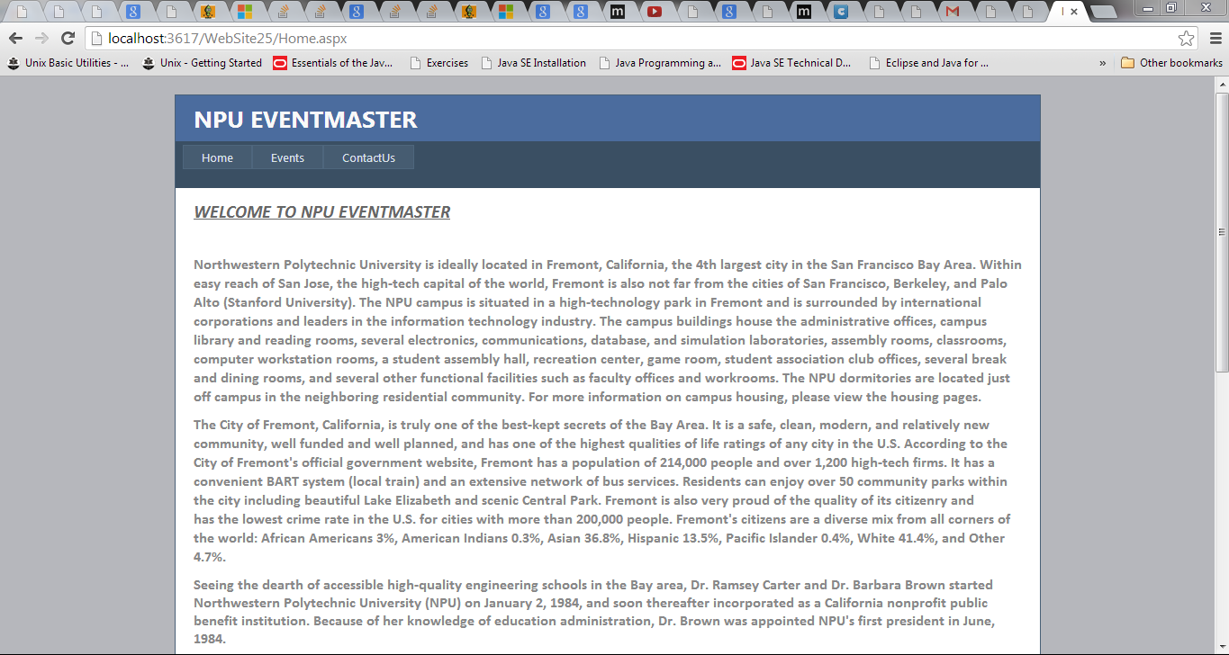
Home Page

Slide 11
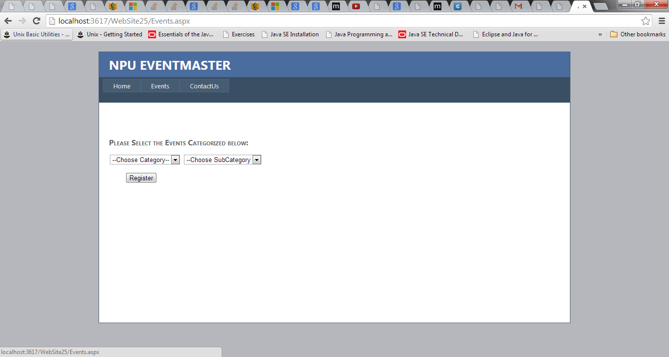
Event Page

Slide 12
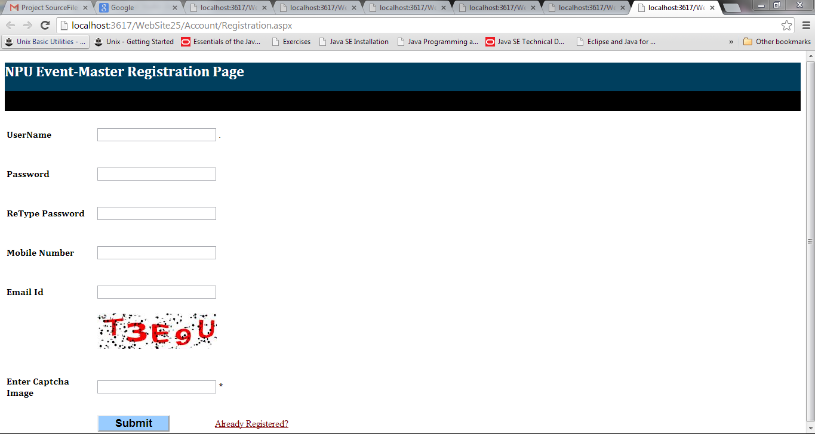
Register Page

Slide 13
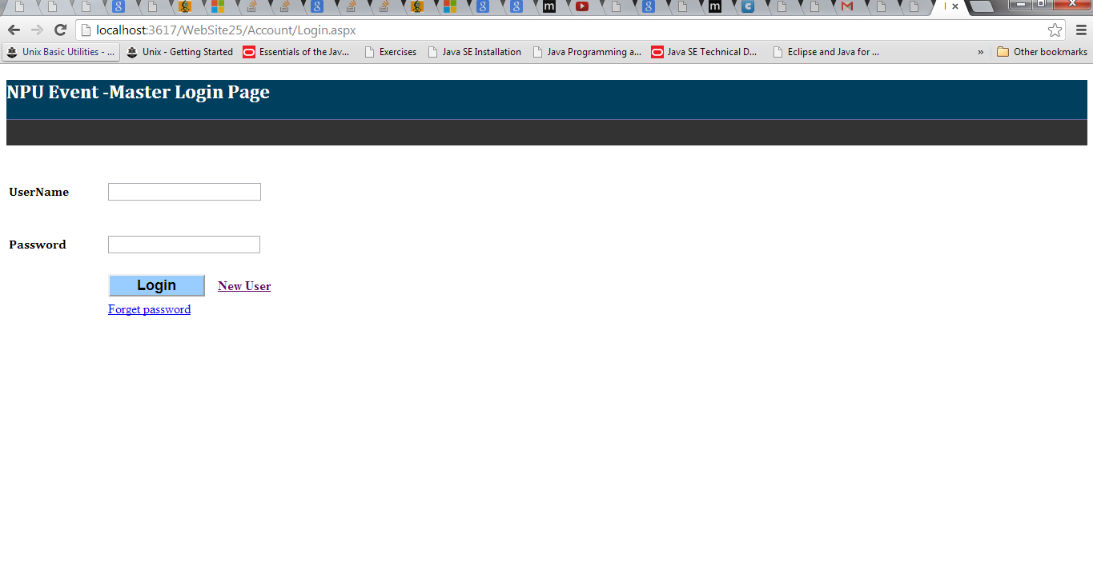
Login Page

Slide 14
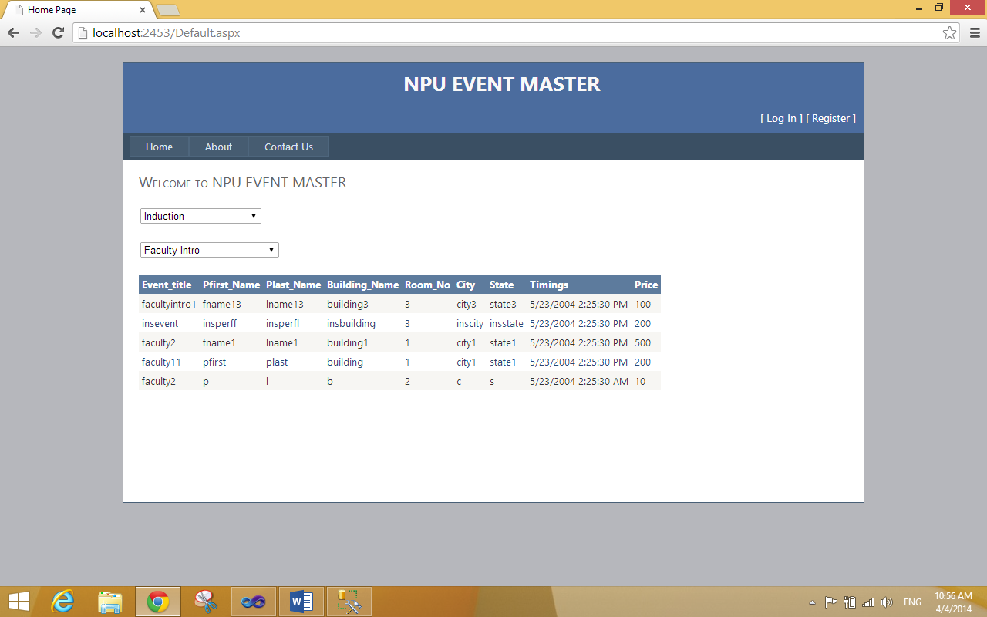
User Page

Slide 15
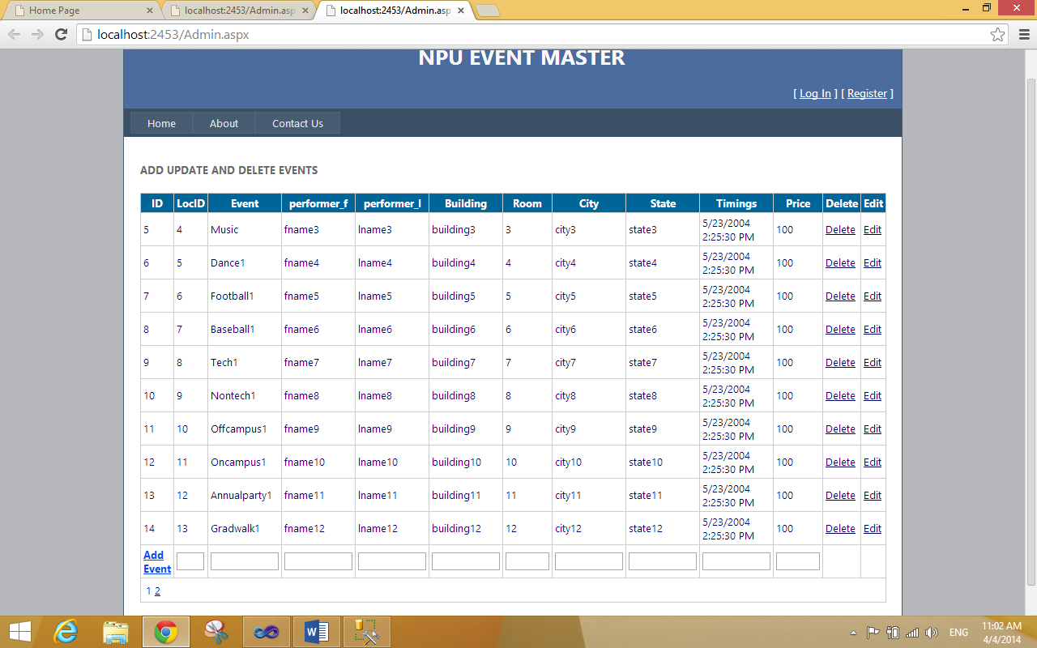
Admin Page

Slide 16
Thank You

