Slide 1
CROP IDENTIFICATION AND WEED DETECTION USING DEEP LEARNING
Team Name: ML Masters A.Srimanth
T.Pratyusha
C.Venkatesh
A.Chandrakiran

Slide 2
Problem Statement
In recent years, weeds have been responsible for most agricultural yield losses.
To deal with this threat, farmers resort to spraying the fields uniformly with herbicides.
This method not only requires huge quantities of herbicides but impacts the environment and human health
It is a tedious process which involves a lot of manual labor.
There is also a huge crop loss for farmers because of their inability to identify this.

Slide 3
Existing System
So far, the systems include automated machines(robotics), which prune the weeds from the soil.
While this is productive in itself, it may not provide important insights in the crop data.
This tool may not useful from a farmer's perspective of using it in real-time, but it is useful for future predictions.

Slide 4
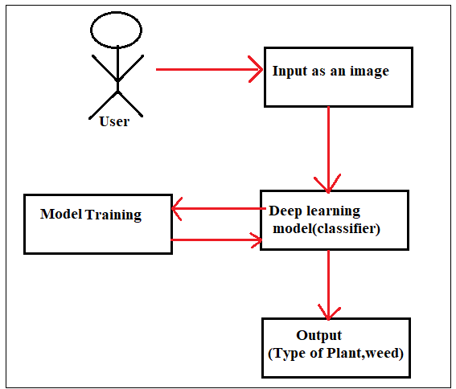
Proposed System
To solve this, we have come up with an idea where we develop a Deep learning model which identifies different types of seedlings.
This system involves the use of Densenet, a type of neural net, implemented using the PyTorch framework in Python.
This model classifies the weeds with a reliable accuracy and thereby helps the farmers get avoid crop loss and wastage of resources.

Slide 5
THANK YOU!!

