Slide 1
Pharma Sector Case Study
-By Pratyush Dubey
Email: pratyushdubeymails@gmail.com

Slide 2
Case Overview:
Client is approaching the launch of their next treatment – the first FDA-approved Epidural Steroidal Injection (ESI) for the treatment of lumbar (lower back) pain. In preparation for the launch, the client is seeking our help in answering the following business questions:
Which doctors should we target for the upcoming launch?
How do we segment these doctors?
How many sales representatives will we need to promote the product successfully?

Slide 3
Dataset:
Its publicly available information on services and procedures provided to Medicare Part B beneficiaries by physicians and other healthcare professionals provided by CMS (Centers for Medicare and Medicaid Services).
URL of the dataset: https://data.cms.gov/provider-summary-by-type-of-service/medicare-physician-other-practitioners/medicarephysician-other-practitioners-by-provider-and-service
Data chosen for the analysis is from 2019.

Slide 4
Understanding the Data:

Slide 5
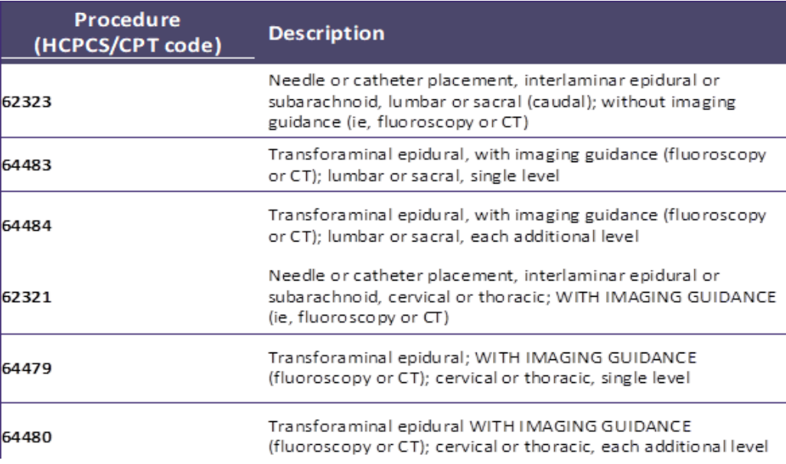
For the ease of data processing, data only with the listed HSPCS codes have been used.
To decipher the field/column names in the table, we referred the data dictionary. URL for the data dictionary: https://data.cms.gov/resources/medicare-physician-other-practitioners-by-provider-and-service-data-dictionary
Figure1

Slide 6
The Analysis:
Part A: Understanding the target physician universe.

Slide 7


Number of Physicians:
Number of Patients they are treating:

Slide 8
Distribution of Physicians by the number of patients:
From this it can be concluded that most physicians are treating 1-4 ESI patients in a year.

Slide 9
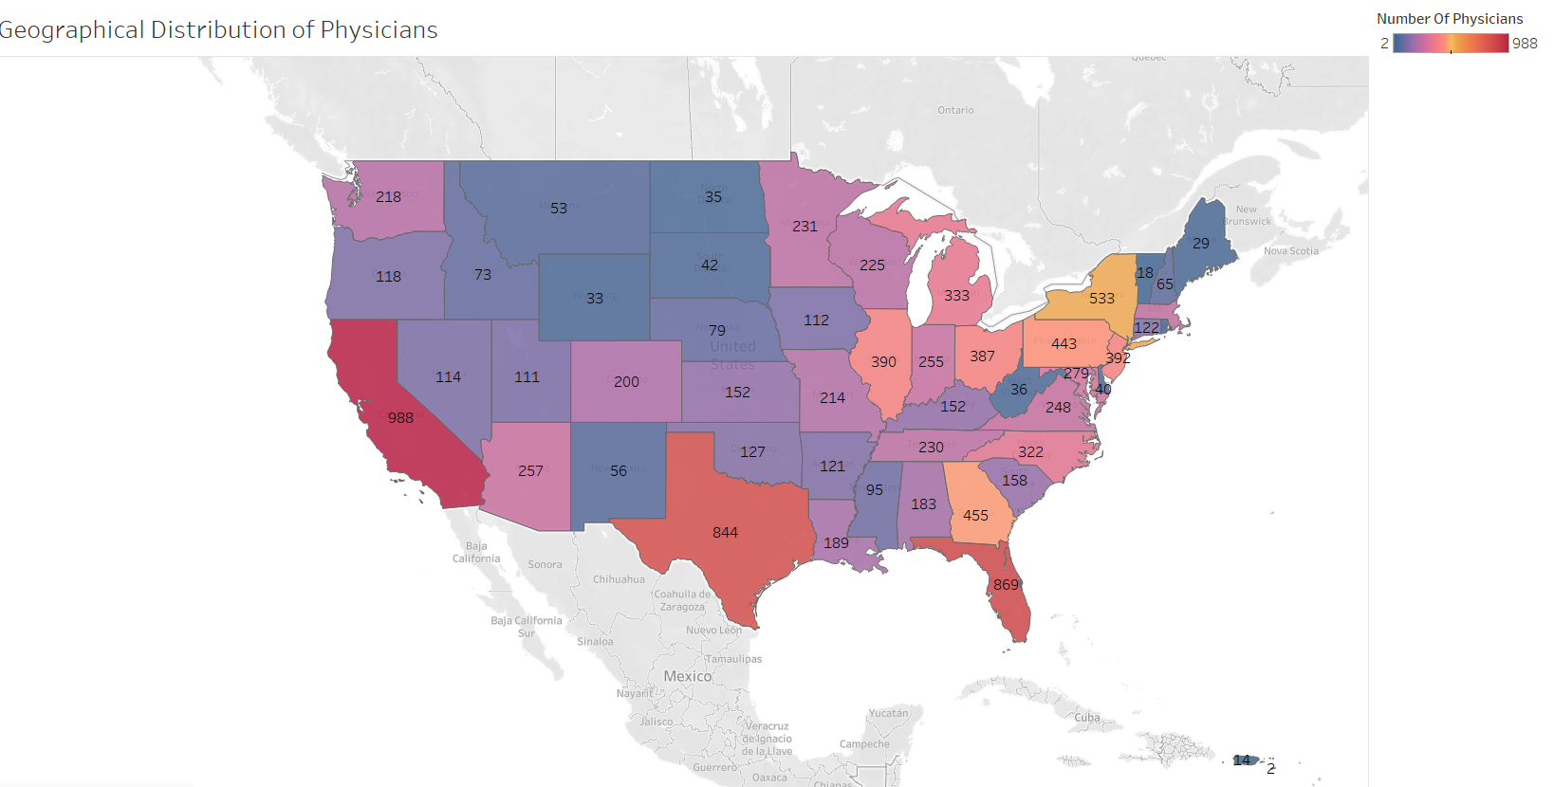
Geographical Distribution of Physicians in mainland USA:

Slide 10
key physician specialties mostly belonging to pain management group:

Slide 11
These specialties can be logically grouped in to:
Pain Management Group:
Ex: Anesthesiology, pain management etc.
Diagnostic and Imaging Group
Ex: Radiology, Nuclear medicine
General Medicine Group
Ex: Family Practice, Internal medicine
Specialized Medical Fields
Ex: Neurology, Psychiatry etc.
Others

Slide 12
Segmentation of physicians as Individual (I) and Organization (O)

Slide 13
Part B: Developing a target list for the salesforce

Slide 14
Segmenting physicians on the basis of ESI patient volume:
Physicians treating 1-4 patients can be labelled as low.
Physicians treating 5-8 patients can be labelled as medium.
Physicians treating more than 9 patients can be labelled as High.

Slide 15
Distribution of physicians on the basis of low-medium-high segmentation:

Slide 16
Segment to be prioritized for the sales force:
Low ESI patient volume i.e. 1-4 patients segment should be prioritized as the target list for salesforce as they constitute 93% of all physicians.

Slide 17
Potential Segmentations:
Demographic segmentation of patients on the basis of age, sex, ethnicity could be also be done if additional data was provided.
The data provided is for Medicare part B patients who are by default over 65 years old. If data had a full representation of the population, segmentation and other estimates would also be more closer to real market conditions.

Slide 18
THANK YOU

