Slide 1

GitHub copilot hackathon
Theme 1: Weather Forecasting Tool (Python)
Team: TechPratyush

Slide 2
Theme 1: Weather Forecasting Tool (Python) Requirements
Create a command-line tool that accepts a city's name and returns the current weather forecast. Leverage OpenWeatherMap API to fetch weather data and parse it using Python. Your solution should demonstrate how GitHub Copilot can help you with API usage, data parsing, and error handling.

Slide 3
Business Challenge / use cases
Users need a command-line tool to retrieve weather forecasts for any given city
The tool should utilize the OpenWeatherMap API to fetch accurate and up-to-date weather data
The weather data should be parsed using Python and presented in a user-friendly format

Slide 4



Tech Requirements
Programming language (Python)
OpenWeatherMap API
API

Slide 5
Proposed solution
Develop a command-line tool using Python that accepts a city's name as input.
Utilize the OpenWeatherMap API to fetch weather data based on the provided city.
Parse the retrieved weather data using Python and extract relevant information.
Handle errors gracefully and provide informative error messages for users.

Slide 6
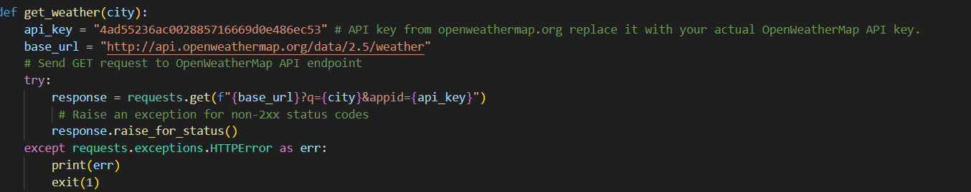
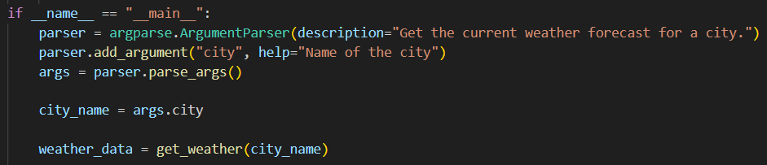
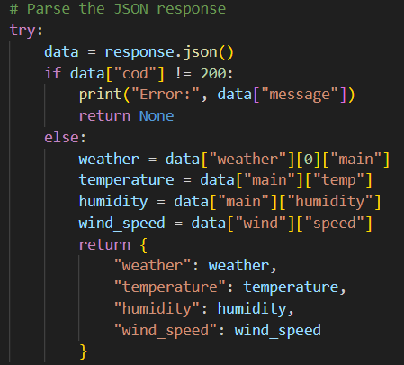
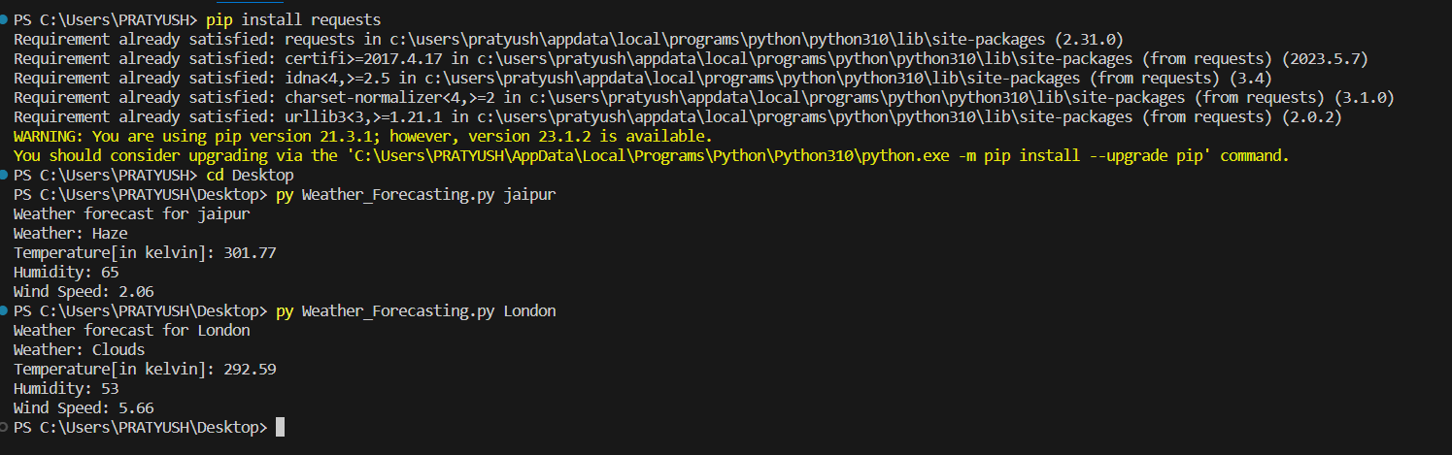

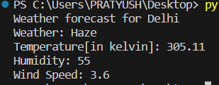
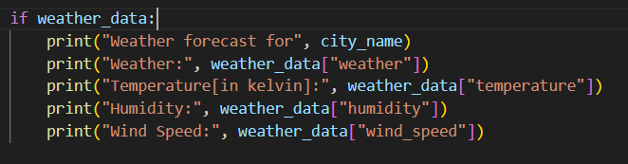

User inputs a city name via the command-line interface.
The tool sends a request to the OpenWeatherMap API, providing the city name.
The OpenWeatherMap API returns the weather forecast data for the specified city.
The Python script parses the weather data and extracts relevant information.
Example of user input:
The parsed data is displayed in a user-friendly format on the command-line interface.
Example of Output for Delhi:
Handle errors gracefully and provide informative error messages for users.

Slide 7
Usage of GitHub Copilot for weather forecast tool
GitHub Copilot helps automate the process of writing code by providing suggestions based on context. It can assist with various aspects of the weather forecast tool, including:
Generating API requests and handling responses from OpenWeatherMap API.
Parsing the retrieved weather data and extracting relevant information.
Implementing error handling mechanisms to handle exceptions and display informative error messages.

Slide 8
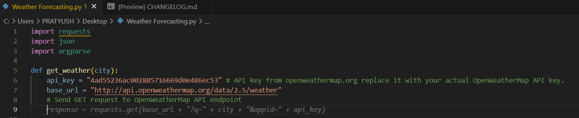
Usage of GitHub Copilot for API Usage
When you write the comment “Send GET request to OpenWeatherMap API endpoint” then GitHub Copilot will give you the suggestion of the code according to your comment requirement.

Slide 9
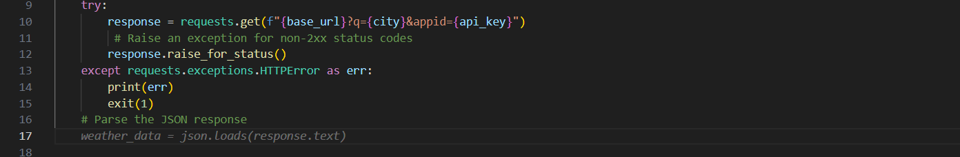
Using GitHub Copilot for data parsing and error handling
When you give the comment “Parse the JSON response” it will give you the suggestion
“weather_data = json.loads(response.text)”
And for error handling it will suggest you:
except (json.JSONDecodeError, KeyError) as e:
print("Error occurred while parsing weather data:", e)
return None

Slide 10
How to Run the code
Open a new terminal.
Install the ‘requests’ library using pip, which is the package installer for Python by using the command:
pip install requests
By using the cd command in the terminal environment change the current working directory
Command: cd [directory]
where [directory] represents the path to the directory you want to navigate to.
To use the tool, save the code in a Python file (e.g., ‘weather_forecast.py’) and run it from the command line, passing the city name as an argument:
python weather_forecast.py London
OR
py weather_forecast.py London

Slide 11
How to Run the code

Slide 12
How to Run the Webpage Code
Open a new terminal.
Install the ‘requests’ library using pip, which is the package installer for Python by using the command:
pip install requests
By using the cd command in the terminal environment change the current working directory
Command: cd [directory]
where [directory] represents the path to the directory you want to navigate to.
To use the tool, save the code in a Python file (e.g., ‘weather_forecast.py’) and run it from the command line, passing the city name as an argument:
python app.py
OR
Py app.py

Slide 13
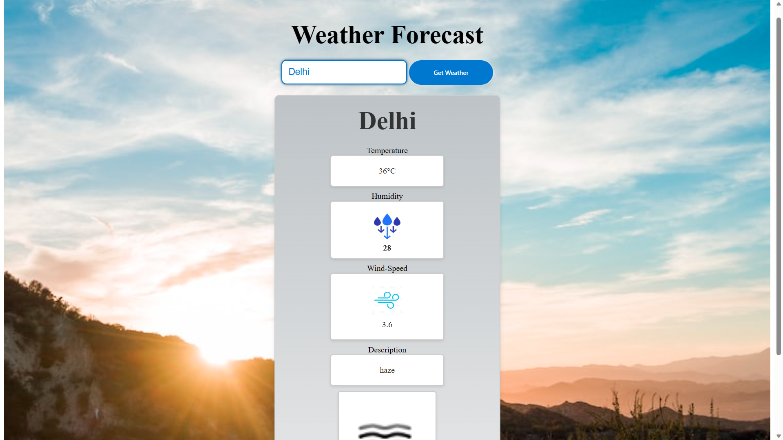
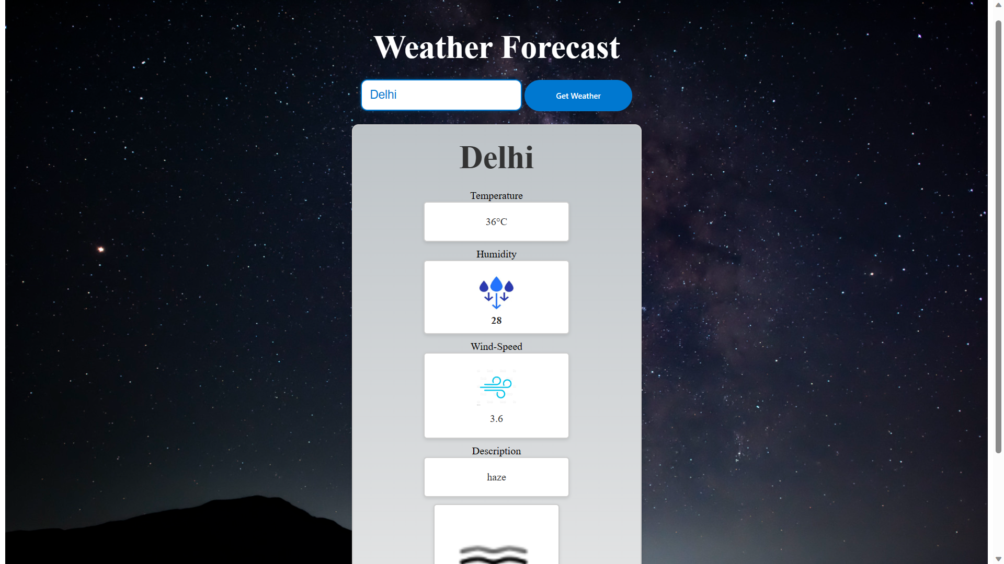
Day Time Result
Night Time Result

Slide 14

Digital Communications
OpenWeatherMap API
JSON Parsing
GitHub Copilot Assistance
HTTP Requests
Error Handling

Slide 15
CODE Link
https://github.com/Pratyushk2003/Weather-Forecast-Tool-Website
https://github.com/Pratyushk2003/Weather-Forecasting-Tool

Slide 16

Thank You
TEAM name: TechPratyush
Member: Pratyush Khare (Leader)
nevergiveup24.786@gmail.com
Mobile: +91 - 9660784378

