Slide 1


Maven Movies: Rental Trends & Film Popularity Analysis

Slide 2


Project analysis slide 3
Project Objectives
Objective
To analyze rental trends, identify popular films, and assess store performance.
Tasks: 1. Rental Trends:
Analyze the monthly rental trends over the available data period.
Determine the peak rental hours in a day based on rental transactions.
2. Film Popularity:
Identify the top 10 most rented films.
Determine which film categories have the highest number of rentals.
3. Store Performance:
Identify which store generates the highest rental revenue.
Determine the distribution of rentals by staff members to assess performance.

Slide 3
Project analysis slide 5
Monthly Rental Trends
Data Summary:
The number of rentals increased steadily from May to
July 2005, peaking in July before slightly
decreasing in August.
May 2005: 1156 rentals
June 2005: 2311 rentals
July 2005: 6709 rentals
August 2005: 5686 rentals
Insights:
Growth Trend: There was a significant increase in rentals from May to July, indicating a possible seasonal demand or effective marketing strategies during these months.
Peak Month: July had the highest number of rentals, suggesting it could be the most profitable month. The slight drop in August still shows strong performance.
Recommendations:
Focus Marketing in Quarter2 - Quarter3: Increase promotional activities and inventory in Q2 and Q3, particularly from May to August, to capitalize on peak rental periods.
Analyse July for Special Events: Investigate if specific promotions, releases, or external factors contributed to the July spike and replicate successful strategies.

Slide 4

Project analysis slide 6
Peak Rental Hours
Insights:
Afternoon Peak: 3:00 PM appears to be the most popular rental time, possibly due to customers renting after work or college.
Evening and Late Night: Rentals are also high during late-night hours (12:00 AM, 3:00 AM) and evening times (6:00 PM, 7:00 PM).
Data Summary:
The top rental times are dispersed throughout the day, with the highest number of rentals occurring at 3:00 PM (887 rentals).
Top 5 Peak Times:
3:00 PM: 887 rentals
8:00 AM: 696 rentals
12:00 AM: 694 rentals
6:00 PM: 688 rentals
3:00 AM: 684 rentals
Recommendations:
Optimize Staffing: Ensure adequate staffing during peak rental hours, especially in the late afternoon and evening.
Promotions During Peak Times: Run promotions or special offers during busy times of the day to boost the number of rentals.
Late-Night Specials: Consider offering late-night specials or extending store hours to capitalize on the high demand during these times.

Slide 5

Project analysis slide 7
Popular Films & Category
Insights:
Diverse Interests: Customers have diverse tastes, with strong interest in Sports, Animation, and Action genres.
High Performers: Films like "BUCKET BROTHERHOOD" and "ROCKETEER MOTHER" should be prominently featured due to their high rental counts.
Recommendations:
Stock Popular Genres: Ensure that inventory is well-stocked with titles from popular genres, particularly Sports and Animation.
Feature High-Rentals: Promote top-rented films in-store and online to attract more customers.

Slide 6
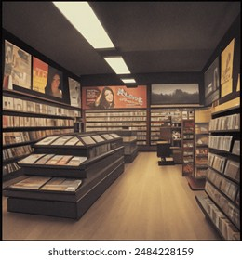
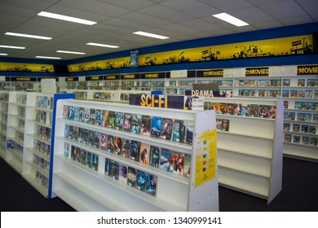
Project analysis slide 8
Store and Staff Performance
Data Summary:
Store 2 generated a total revenue of $33,881.94.
Top Performing Staff:
Mike Hillyer: 8,040 rentals
Jon Stephens: 8,004 rentals
Insights:
Strong Store Performance: Store 2 is performing well, with considerable revenue.
Efficient Staff: Both Mike Hillyer and Jon Stephens have high rental counts, indicating strong performance and customer engagement.
Recommendations:
Incentivize Top Performers: Consider offering bonuses or other incentives to top-performing staff like Mike and Jon.
Replicate Best Practices: Analyze what makes Store 2 successful and replicate those strategies in other locations.

Slide 7

Project analysis slide 11
Overall Recommendations
Seasonal Promotions: Focus on Q2-Q3 for promotions, leveraging the peak rental periods.
Staff Optimization: Adjust staffing based on peak hours and reward top performers.
Inventory Management: Prioritize stocking and promoting popular genres and films to maximize rentals.
Tech Stack Used:
SQL: Used for data extraction and manipulation to generate the necessary datasets.
Pivot Tables: Employed to reorganize and summarize data for detailed analysis.
Excel: Utilized for data visualization, pivot table creation, and presentation formatting.

Slide 8



MavenMovies: Rental Trends & Film Popularity Analysis

Slide 9


Thank You
Thank you for your time and attention. I appreciate the opportunity to share my project insights

