Slide 1

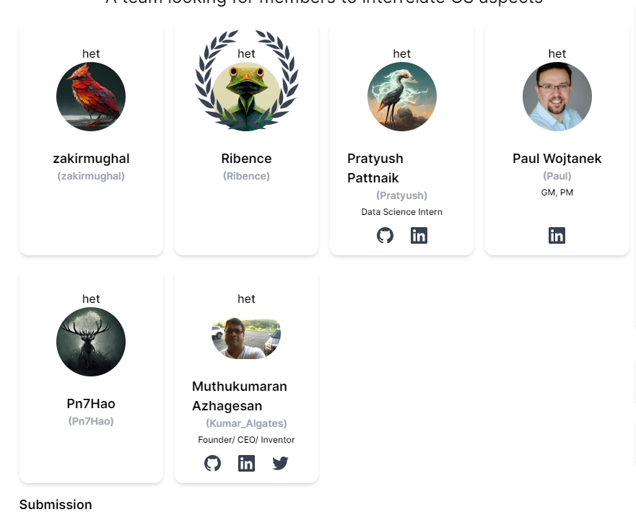
Assistant to Inventors & Scientists
A cool go-to app for Inventors & Scientists using co:here conversant API
Team: AI Meets Cybersecurity
@aimeetscybersecurity in

Slide 2


Design & Input flow
UI made of flutter
Python uses co:here conversant to validate and process input
User input
Datasets, other data, Global Internet Data
Mobile App flutter
(android/ iOS Swift)
Validation, & Business Layers
Backend Processing (python, co:here)

Slide 3
Outcome
User input
Datasets, other data, Global Internet Data
Mobile App flutter
(android/ iOS Swift)
Validation, & Business Layers
Backend Processing (python, co:here)

Slide 4
Future state
A production ready python app, in cloud(Google CP/Docker) that will leverage co:here conversant
Flutter Mobile app will be the UI (for android & iOS devices)
The mobile app will ask user(scientist/inventor) input, & search thru datasets
Exploration in progress: to facilitate researchers to extract/get a useful summary QUICKLY
Datasets could be limitless as wide as the internet
Leveraging: utilizing, fine-tuning NER model
Example:
input: “possibility of water available in planet mars”
Output(co:here conversant’s job): planet mars will become a livable planet because recent discovery by rover and satellite pictures have found that solid ice is likely underneath the surface of mars, hence melting that ice will result in water, hence livable for human beings and other species.
End product : this will become and indispensable app/tool for inventors/scientists who’ll rely on our app.

Slide 5
Thank you! @aimeetscybersecurity in lablabai AI Meets Cybersecurity Team

