Slide 1
Assistant to Scientists
A cool go-to app for Scientists using co:here conversant API
Team: AI Meets Cybersecurity

Slide 2


Design & Input flow
UI made of flutter
Python uses co:here conversant to validate and process input
User input
Datasets, other data, Global Internet Data
Mobile App flutter
(android/ iOS Swift)
Validation, & Business Layers
Backend Processing (python, co:here)

Slide 3
Outcome
User input
Datasets, other data, Global Internet Data
Mobile App flutter
(android/ iOS Swift)
Validation, & Business Layers
Backend Processing (python, co:here)

Slide 4
FUTURE SCOPES
We will soon be fine-tuning the model and fully utilising the capabilities of NER.
We intend to deploy this application using Google Cloud Platform and Docker containers.
We've also explored summarising, and we have plans to integrate the two approaches to make it easier for aspiring researchers to extract or understand the main ideas of a research report while also saving them time.
We also intend to leverage the research paper's urls in order to use our app to gather and extract as much data as we can.

Slide 5
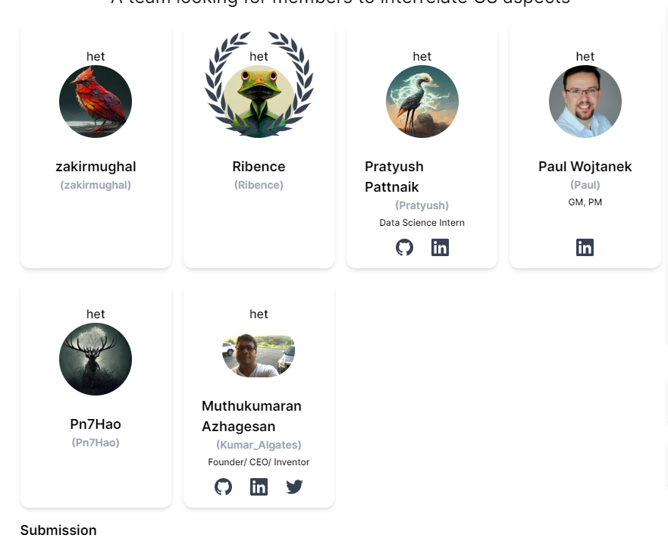
Thank you! AI Meets Cybersecurity Team

