Slide 1
Univ.AI
Project1:
Orange Data Analysis
Dikshant Agarwal, Rampunit Kumar, Yash Surange, Pratyush Pattnaik

Slide 2

Project1: Orange Data Analysis
Dikshant Agarwal, Rampunit Kumar, Yash Surange, Pratyush Pattnaik source: https://www.google.com/url?sa=i&url=https%3A%2F%2Fwww.commbox.io%2Fhow-data-analysis-and-reports-can-improve-customer-service%2F&psig=AOvVaw1ZPsrHV0MGCqowruG2ujIA&ust=1645289534742000&source=images&cd=vfe&ved=0CA0Q3YkBahcKEwjwmNKl24n2AhUAAAAAHQAAAAAQAw
Univ.AI

Slide 3
Content of the presentation
Motivation
About the project
Raw Data
Models
Result & Outcomes
Conclusion
Future Work
References

Slide 4
Motivation
Customer Relationship Management (CRM) is a vital part of the new marketing and growing world. The French telecom company Orange, works in the field of telecommunication and internet service providers. We are visualizing the customer base of Orange, whereby we need to analyze the customers switching the service provider from Orange to another service provider on the consortium. Herein we are applying the machine learning models to the data after cleaning. Which is basically taken from a database of the KDD Cup 2009. What is the time limit in which the customer, left the company service, and thereby what are the numbers and rate of losses of the customer by Orange in the given time period? What are the reasons and resources which are responsible for this? And making Insights that how do we get back those customers. Also, we may visualize what is the tendency of their churned customers to buy a new product or to avail of new service human-to-human how and in what way we (data scientists) may add-ons propose to them to make the sales profitable and fast.

Slide 5
About the Project
The project is to predict the sales technique whereby a salesman attempts to have the customer purchase more expensive items, upgrades, or other add-ons in an attempt to make a more profitable sale. Up-selling usually involves marketing more profitable services or products, but up-selling can also be simply exposing the customer to other options he or she may not have considered previously. For which the outline of the project is as: Pre-processing and Cleaning of the data which involves everything, from handling missing values to transformations. Exploratory Data Analysis. Base modeling, where we have to compare the rest of your model's results. Ensemble Models, up-sample or down-sample. F1 score and ROC_AUC Interpretation. Post modeling, we need interpretation of our results. Finally, draw conclusions on the company’s upselling.

Slide 6
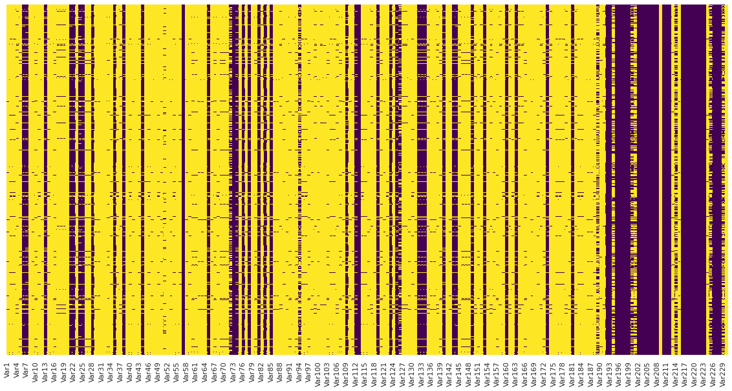
Raw Data

Slide 7
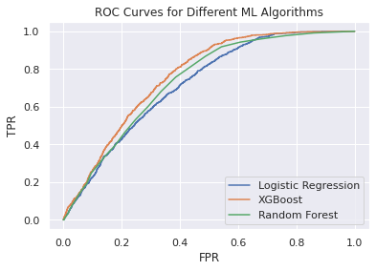
Models

Slide 8
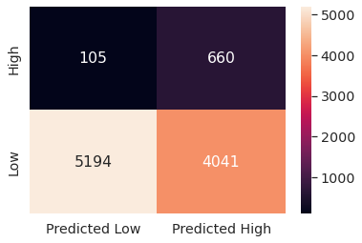
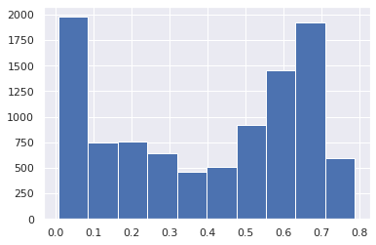
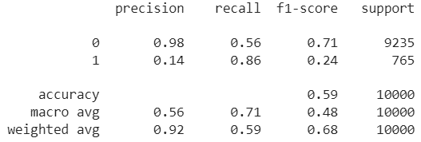
Confusion matrix and classification report for the best model

Slide 9
Result and analysis
.

Slide 10
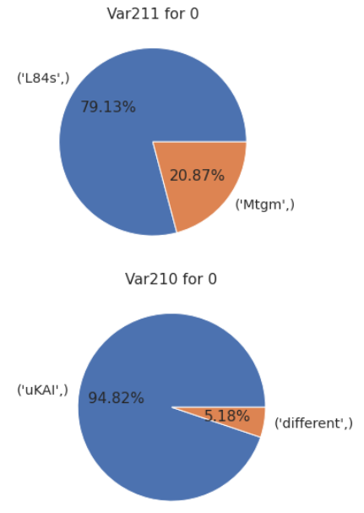
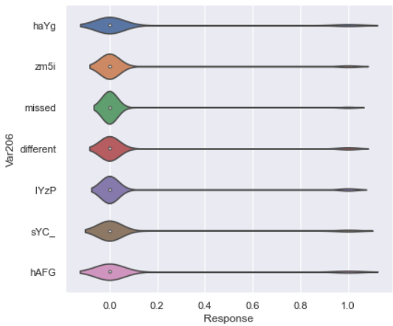
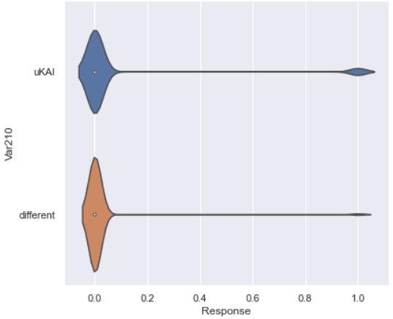
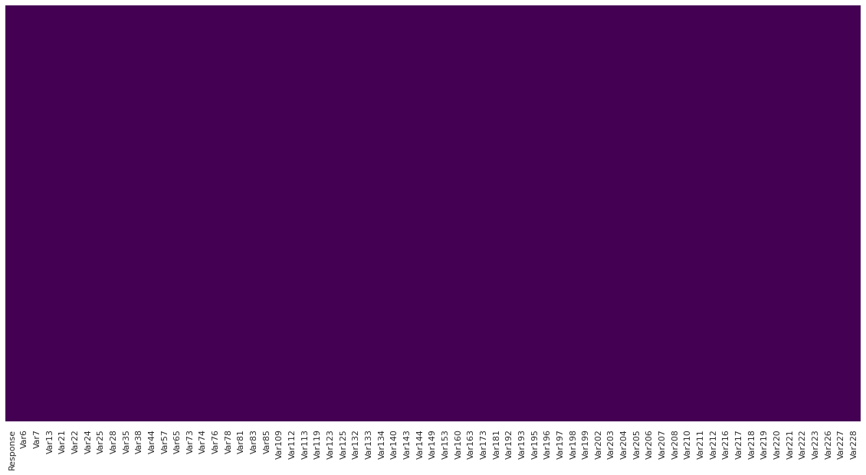
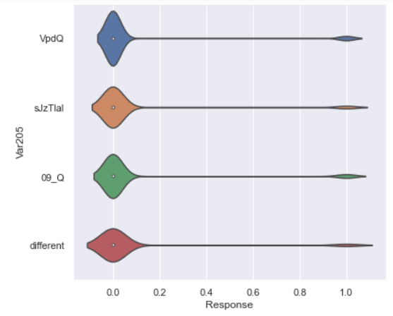
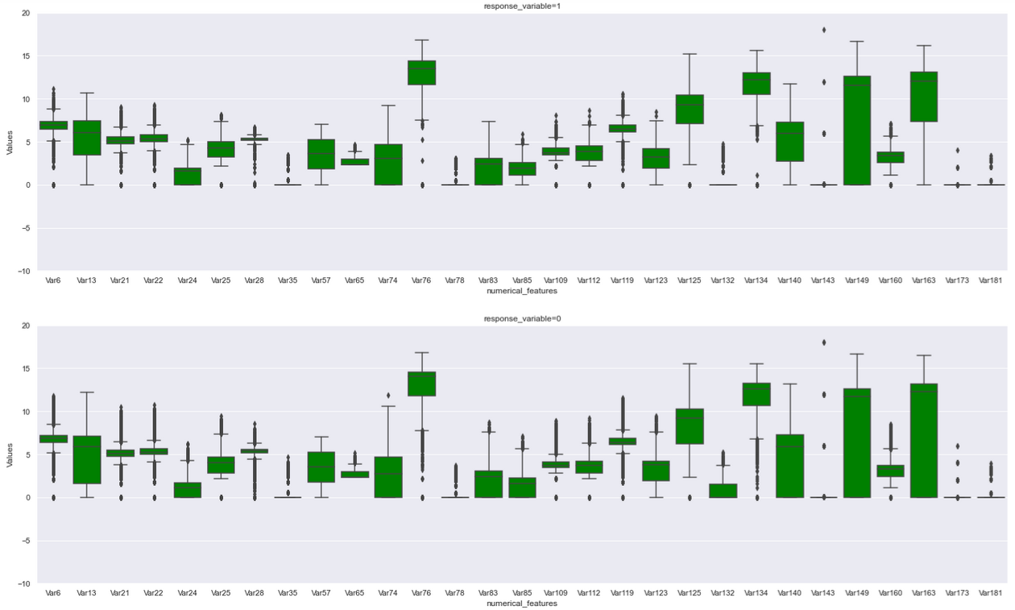
EDA and data cleaning results:

Slide 11
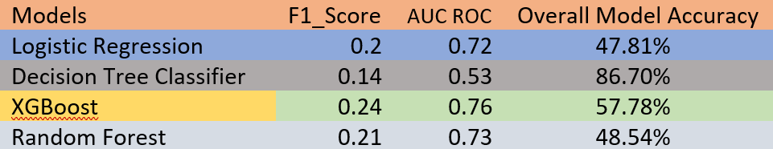
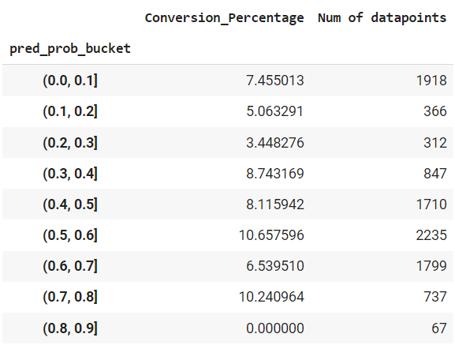
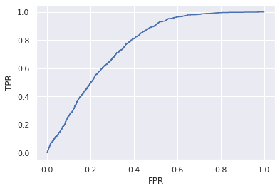
Model results

Slide 12
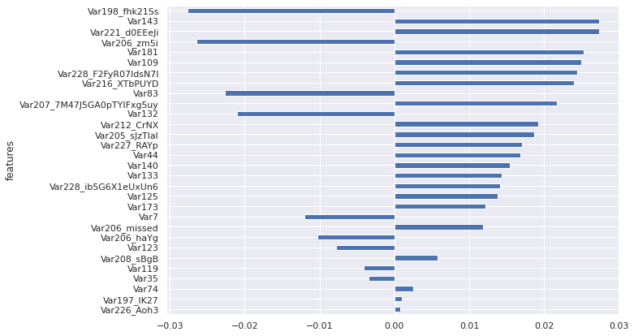
Best parameter results: from logistic regression

Slide 13
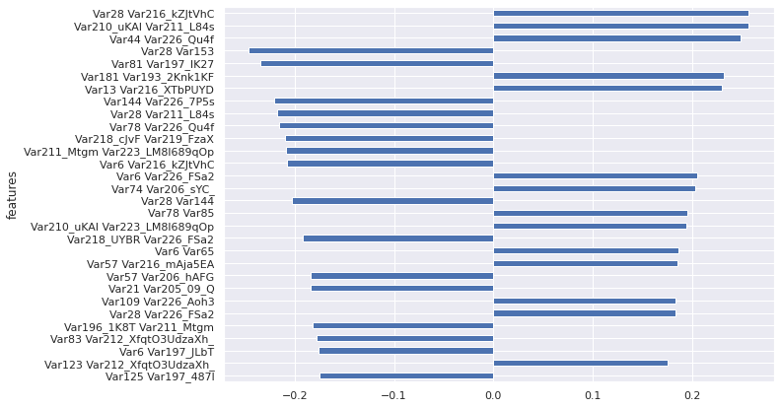
Best parameter results: from polynomial regression

Slide 14
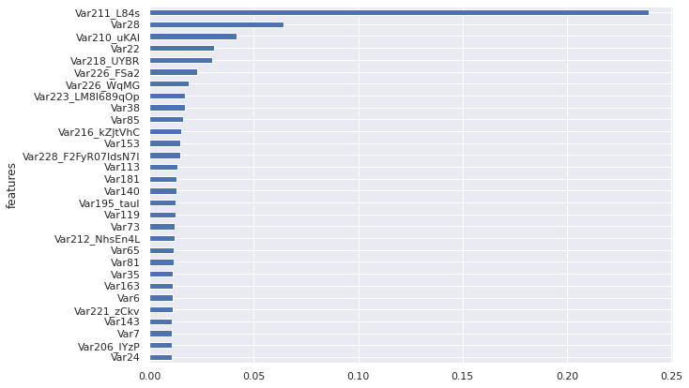
Best parameter results: from XG-Boost

Slide 15
Conclusion:
If we used traditional approach of random calling the customers in test set, we would’ve obtained avg conversion percentage of 7.6%. In comparison, the final model obtained by this project can help us strategize the promotions better than this traditional approach. We can divide these customers in different buckets and run differential promotions to target these customers better. Also, the probability scores obtained using final XGBoost model can help us prioritize our calling efforts.
Future Work:
We can further improve upon this model through following ways:
By improving on the pre-processing done on numerical and categorical variables, since it had a huge impact on the performance during our limited trials. We can do more context appropriate imputation for missing values.
Since it’s an highly imbalanced class problem, we can try variety of sampling methods to improve target variable proportion prior to modelling.

Slide 16
References
1. https://medium.com/@pathakvishnudutt123/customer-relationship-prediction-kdd-cup-2009-2248d83e9d32
2 https://github.com/yulguseva/orange_churn/blob/master/Submission.ipynb
3https://www.upgrad.com/blog/data-preprocessing-in-machine-learning/
4. http://www.mtome.com/Publications/CiML/CiML-v3-book.pdf?ref=https://githubhelp.com
5. https://github.com/Wangsherpa/Customer-Relationship-Prediction/blob/main/KDD_2009_data_preprocessing.ipynb?ref=https://githubhelp.com
https://githubhelp.com/rovinapinto/Customer-Relationship-Prediction
https://github.com/ChicagoBoothML/MachineLearning_Fall2015/blob/master/Programming%20Scripts/KDD%20Cup%202009%20Orange%20Customer%20Relationships/Python/KDDCup2009_OrangeCustRel_Churn.ipynb
https://www.kaggle.com/yasmino/kdd-cup-2009-data-analysis/notebook
https://www.kaggle.com/razoli/pre-processing-data

Slide 17

Thank you all for listening to……..

