Slide 1
CUSTOM PROJECT-01: CHEST X-RAY PNEUMONIA DETECTION
PREETPAL SINGH

Slide 2
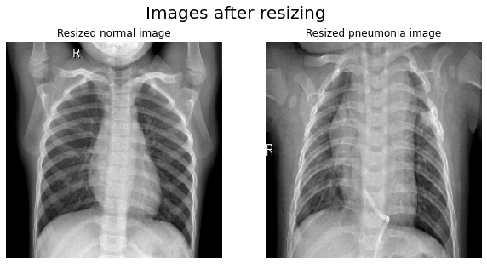
CUSTOM PROJECT-01: CHEST X-RAY PNEUMONIA DETECTION
PREETPAL SINGH, RAMPUNIT KUMAR, YASH SURANGE, PRATYUSH PATTNAIK
UNIV.AI

Slide 3
CONTENT OF THE PRESENTATION
Motivation
Image Data
Models
Result & Conclusion
Future Work
References

Slide 4
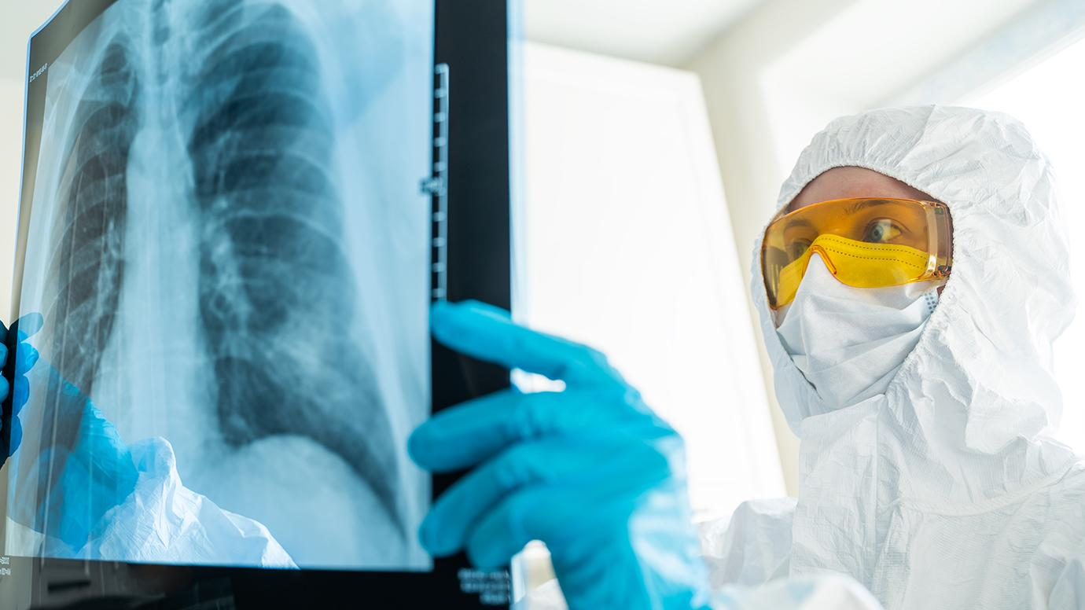
MOTIVATION
AS THE SAME WITH CHEST X-RAY (CXR) WHICH IS A GENERAL WAY OF DETECTING THE PATIENT SUFFERING FROM THE DISEASE PNEUMONIA OR NOT. IT IS NOT ALWAYS EASY FOR THE DOCTOR TO DETECT PNEUMONIA. SEEING THE ABOVE-CITED PROBLEM, WE CAN FIND THE ALTERNATIVE FOR THE DOCTORS, TO CURE THE SAME WITH DEEP LEARNING MODELS. WHICH IS FASTER MORE EFFICIENT, RELIABLE IN MOST CASES, AND HELPS THE RADIOLOGIST TO DECIDE ON THE TREATMENT ON TIME.
KEEPING THE ABOVE FACTORS IN MIND, RADIOLOGISTS WOULD WANT A SECOND OPINION WHICH IS FASTER, MORE

Slide 5
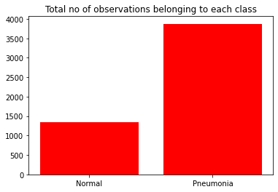
IMAGE DATA
WE HAVE TAKEN THE DATA FROM KAGGLE (IMBED MARDANA ISSUE HTTPS://WWW.KAGGLE.COM/C/RSNA-PNEUMONIA-DETECTION-CHALLENGE). NORMAL CONTAINS 1341 FILES AND PNEUMONIA CONTAINS 3875 FILES. WE RESIZED THE IMAGE THROGH IMAGE DATA GENERATOR

Slide 6
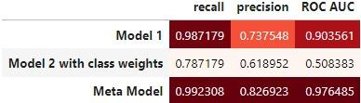
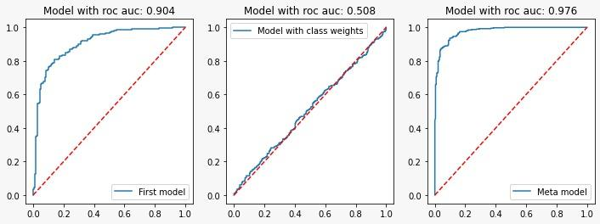
MODELS
THE BELOW STRUCTURE OF THE META-MODEL IS CLEARLY SHOWN IN THE FLOW CHART. WHICH IS PERFORMING WAY BETTER THAN THE CNN MODEL USED. IT IS HAVING BETTER ROC-AUC, PRECISION, RECALL, AND OTHER METRICS THAN OTHER MODELS. WE FOUND OUT THAT THE META-MODEL WAS PERFORMING THE BEST WITH A ROC AUC OF 0.97, THE ATTENTION IMAGES SHOWED THAT THE MODEL WAS FOCUSING MORE ON THE POSITION OF THE RIBS MOSTLY IN BOTH THE CASES.

Slide 7
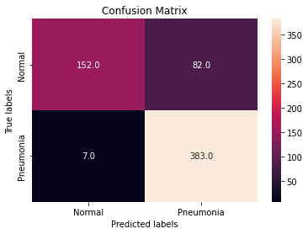
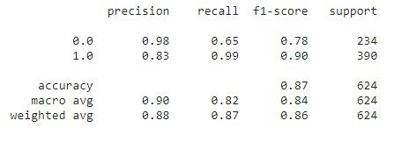
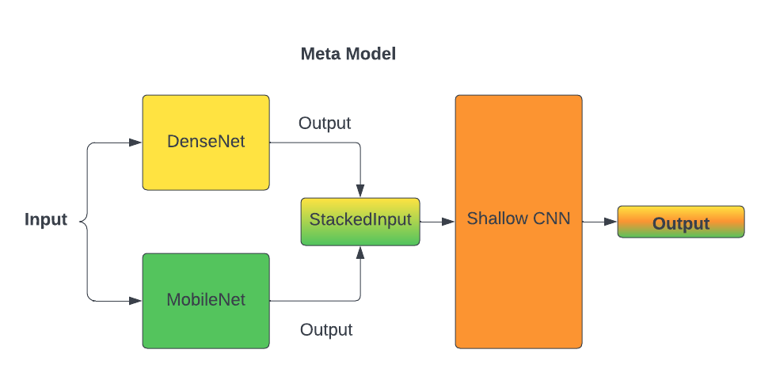
FLOW CHART CONFUSION MATRIX AND CLASSIFICATION REPORT FOR THE BEST MODEL

Slide 8
RESULTS & CONCLUSION
.

Slide 9
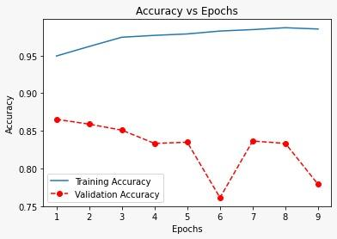
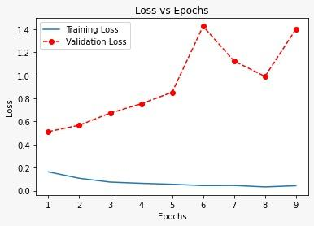
META MODEL REPORTS

Slide 10
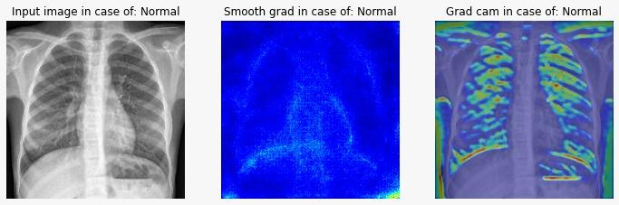
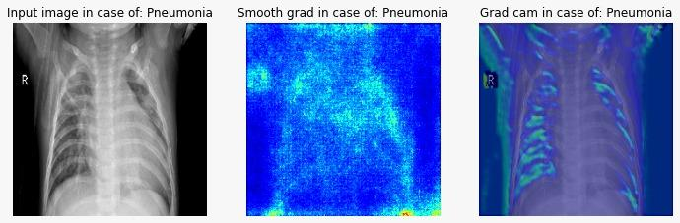
NORMAL & PNEUMONIA PATIENT CHEST X-RAY (CXR), A DEPICTION WITH SMOOTH GRAD CAM AND GRAD CAM.

Slide 11
CONCLUSION
We tried various models the first model was the CNN model with parameters around 51 million parameters.
Which gave us the ROC_AUC ≈0.90. Then we tried with the same architecture but with the previous model
class weight, but it was not performing well. At last, we tried transfer learning, stacked DenseNet and MobileNet,
and passed it to another shallow neural network as input. Hence creating a meta-model, which was giving us
a ROC-AUC of ≈0.97, a precision of ≈0.83, and a recall of ≈0.99. Hence, we concluded that transfer learning
(meta-model), performs best. And its attention maps show that the position of ribs was a major factor in
predicting a person with and without pneumonia.

Slide 12
FUTURE WORK
We can further improve upon this model in the following ways:
We could try UNet architecture, which has been seen to perform better on x-ray images. Therefore, we can use UNet as our base model too.
We haven’t done much data augmentation, as this project domain was new to us, as doing wrong augmentation may add noise to the trained data, which may degrade the learning of the model. So through, right augmentation, we can improve our model.

Slide 13
REFERENCES
https://www.frontiersin.org/articles/10.3389/fmed.2021.629134/full,
https://towardsdatascience.com/deep-learning-in-healthcare-x-ray-imaging-part-5-data-augmentation-and-image-normalization-1ead1c02cfe3
https://journals.plos.org/plosone/article?id=10.1371/journal.pone.0256630
https://www.tandfonline.com/doi/full/10.1080/00051144.2021.1973297

Slide 14
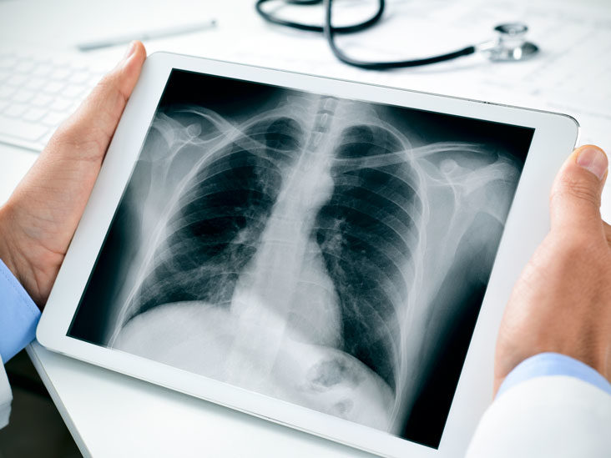
THANK YOU ALL FOR LISTENING TO……..

